Slide 1
Sap-1 Presented by: Aimal kHan(21pwcse1996) Hamza(21pwcse1990) Sarwat(21pwcse2014)

Slide 2
Agenda
Introduction
SAP-1 components
Block Diagram
Instruction set of SAP-1
Instruction execution cycle
Output
Conclusion

Slide 3

Introduction to SAP-1​
Sap-1 stands for simple-as-possible.
It was developed by Albert Paul Malvino in the late 1960s.
A simple computer that can compute the basic arithmetic operations.
The Sap-1 computer is a good example of how a computer works.

Slide 4
Sap-1 Components
Program Counter (PC):
Accumulator (AC):
Memory Address Register (MAR):
Random access memory
Instruction Register (IR):
Controller sequencer
Accumulator (AC):
Adder/subtractor
B-register
Output register
Binary display

Slide 5
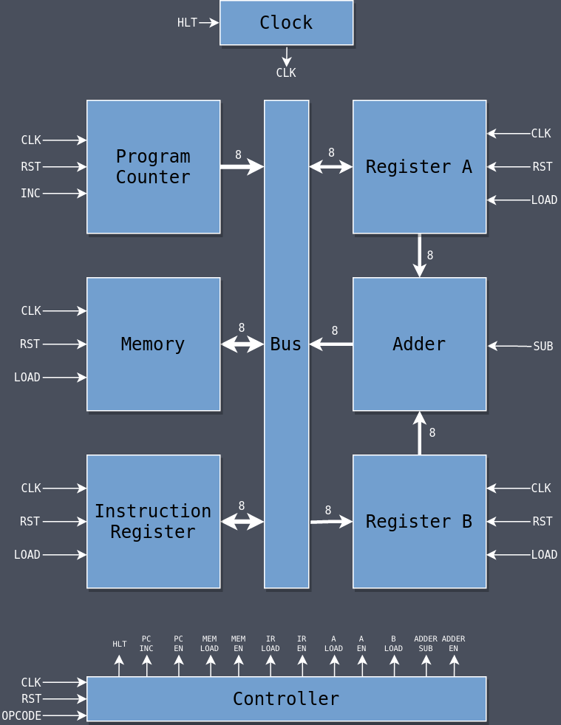
Block diagram

Slide 6
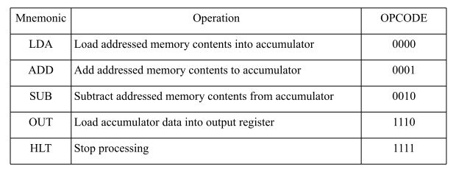
Instruction set of SAP-1

Slide 7
Instruction Execution cycle
1. Fetch
The PC value is sent to MAR which then feeds to the RAM to load the instruction from RAM. The instruction is then forwarded to IR.
Decode:
The IR is nibbled into two parts.one part is send to control sequencer and the other part send to MAR.
Execute:
During the execution ,the specific instruction is carried out. e.g the ADD instruction performs addition on a specified registers.

Slide 8
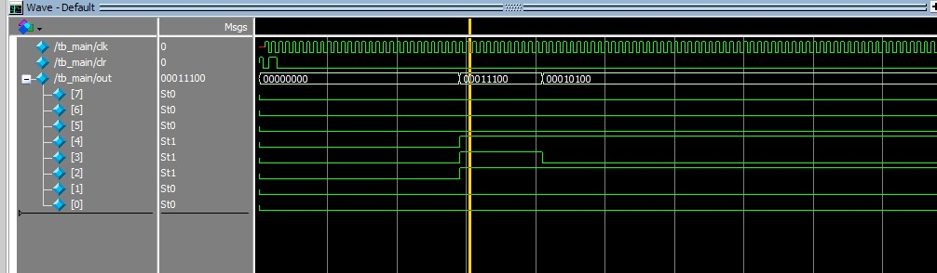
Output:

Slide 9
Conclusion:
In conclusion, Sap-1 stands as a foundational model in the realm of computer architecture ,offering a simplified and effective framework for grasping fundamental concepts.

Slide 10
Thank you

