Slide 1
Literatura

Slide 2
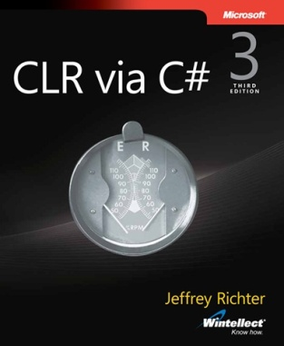
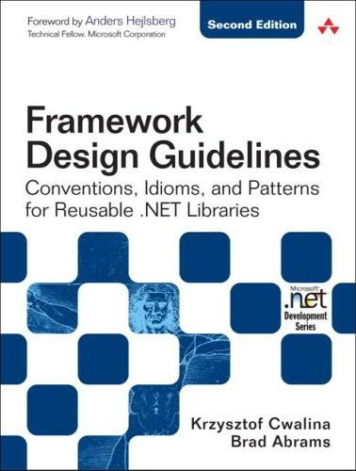
O tym CO robimy
Jeffrey Richter
CLR via C# (3rd edition)
Microsoft Press, 2010
Krzysztof Cwalina, Brad Adams
Framework Design Guidelines Conventions, Idioms, and Patterns for Reusable .NET Libraries (2nd edition)
Addison-Wesley Professiona, 2005

Slide 3
O tym CO robimy
Composite Application Guidance
Microsoft
http://compositewpf.codeplex.com/
OSGi Service Platform Specifications
OSGi Alliance
http://www.osgi.org/

Slide 4
O tym JAK to robimy
Succeeding with Agile: Software Development Using Scrum Mike Cohn, Addison-Wesley Professional, 2009
Refactoring to Patterns Joshua Kerievsky, Addison-Wesley Professional, 2004
Implementation Patterns Kent Beck, Addison-Wesley Professional, 2007
Continuous Integration: Improving Software Quality and Reducing Risk Paul M. Duvall, Steve Matyas, Andrew Glover, Addison-Wesley Professional 2007

Slide 5
O tym JAK to robimy
Refactoring: Improving the Design of Existing Code Martin Fowler, et al., Addison-Wesley Professional, 1999
Test Driven Development: By Example Kent Beck, Addison-Wesley Professional, 2002
Head First Design Patterns Elisabeth Freeman, et al., O'Reilly Media, 2004
Growing Object-Oriented Software, Guided by Tests Steve Freeman, Nat Pryce, Addison-Wesley Professional, 2009

