Slide 1
Bkash
Group 14
Section:B1
Student ID:1705084
1705088
Project Supervisor: T. M. Tariq Adnan

Slide 2
Project Overview:
This is an E-Wallet
The Purpose of this project is to make different kinds of money transaction easier for user.
To avail this system,at first a person has to Register to the system by giving his details. Then an user has to Log In everytime to enter the sytem
A person can register to the system as a customer or an agent
A customer can cash in,cash out through an agent
A customer can also send money to other users by using his own account or through an agent
A customer can also pay different types of utility bills using this system
Mobile recharge of differet operators is also possible for users.
Different shops can also give offers to their customers for paying bills for their product through this E-wallet

Slide 3
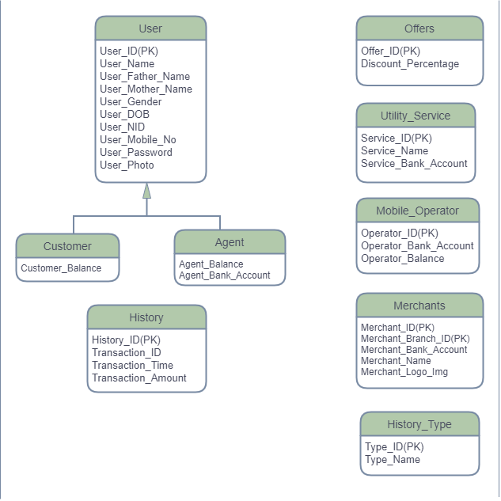
Contents of ERD:
There are mainly 7 entities in the Entity Relationship Diagram
1.User( Customer, Agent)
2.History
3. History_Type
4.Mobile_Operator
5.Utility_Service
6.Merchants
7.Offers
There are 5 different modules:
1.Cash_In,Cash_Out
2.Send_Money
3.Mobile Recharge
4.Merchant Payment
5.Utility Service

Slide 4
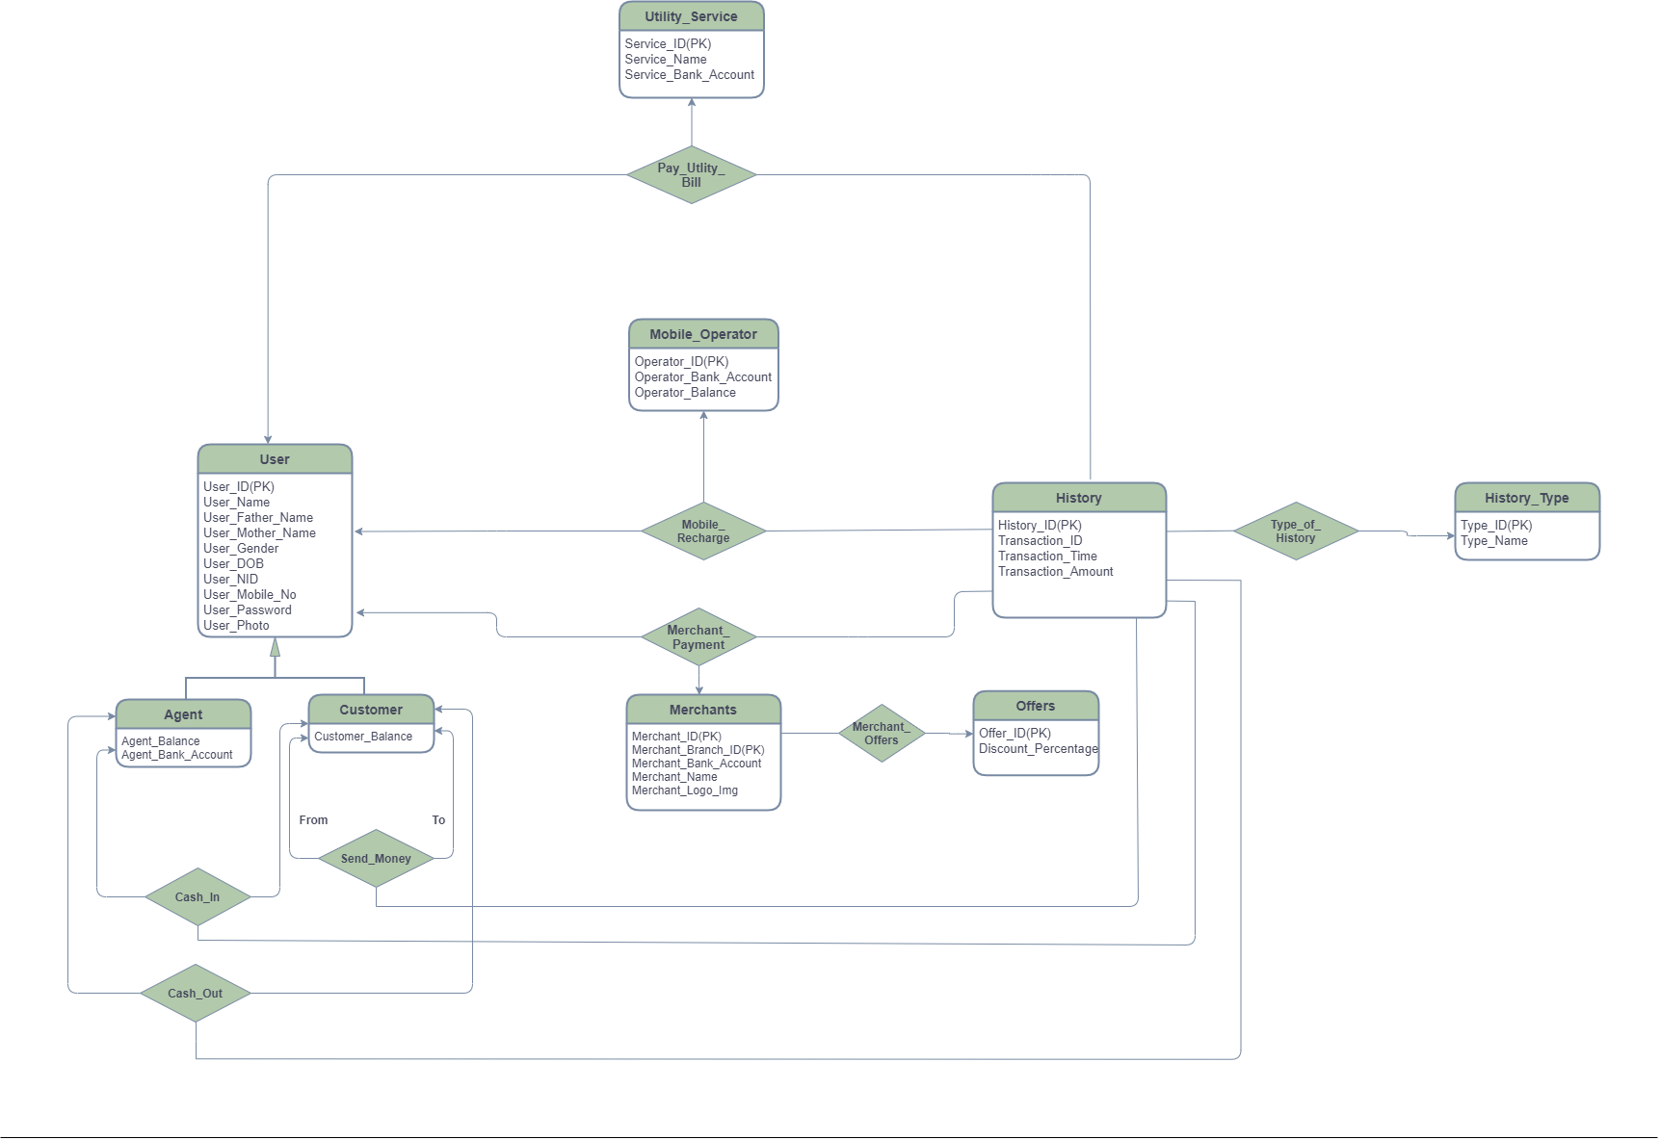
ERD:

Slide 5
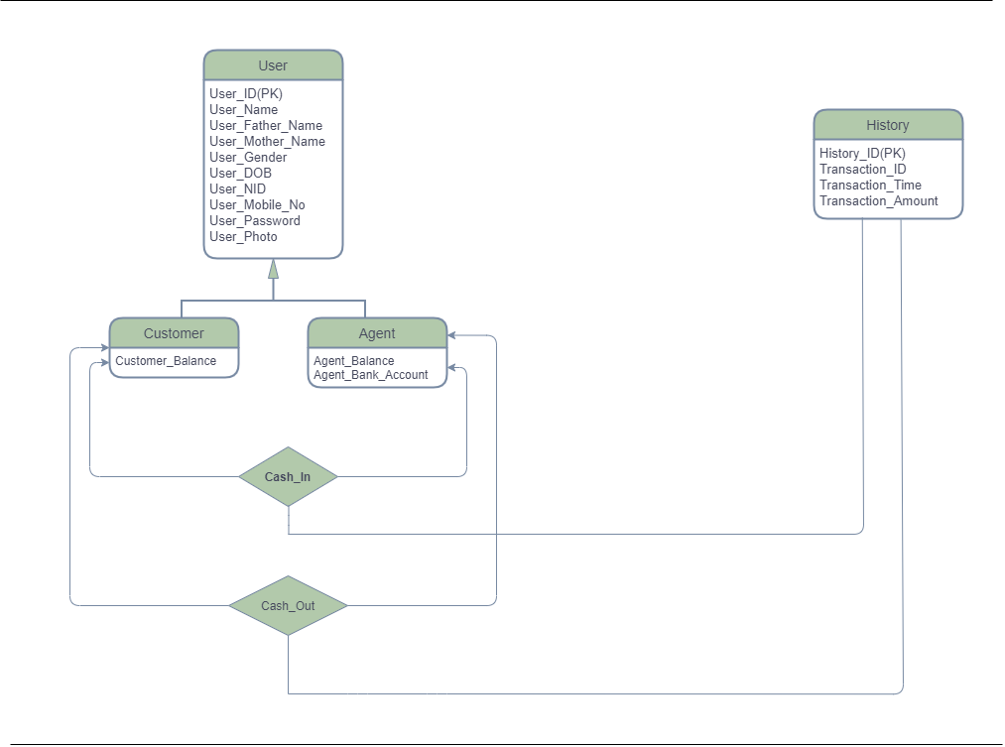
Cash_In,Cash_Out Module:

Slide 6
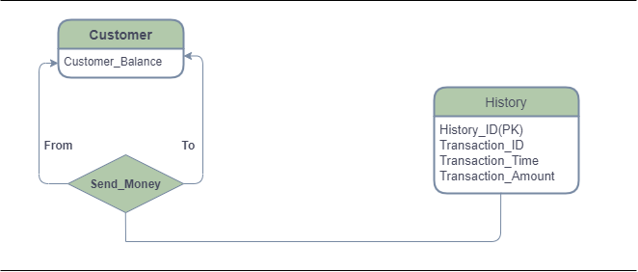
Send_Money Module:

Slide 7
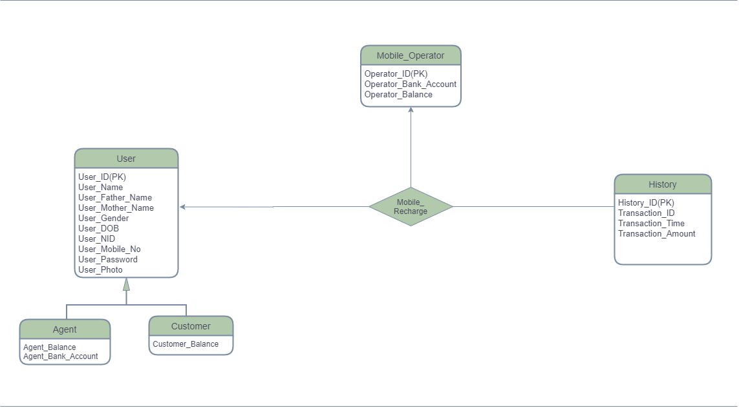
Mobile Recharge Module:

Slide 8
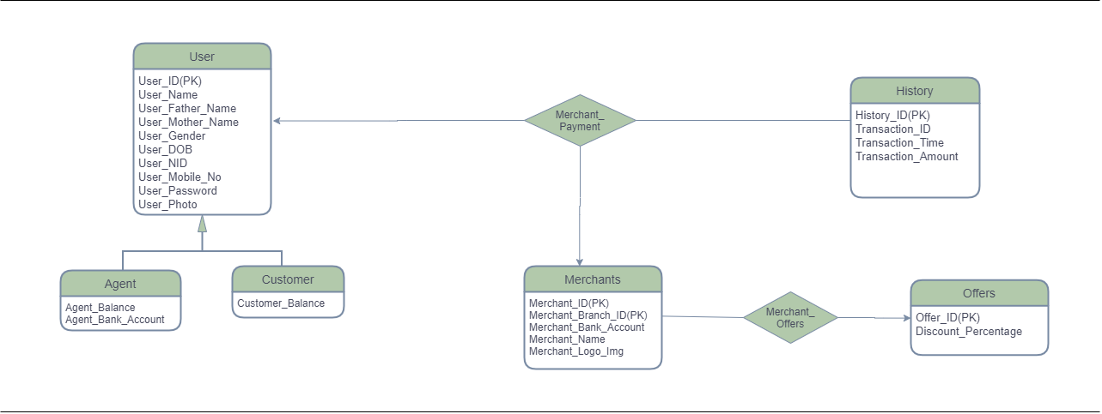
Merchant Payment Module:

Slide 9
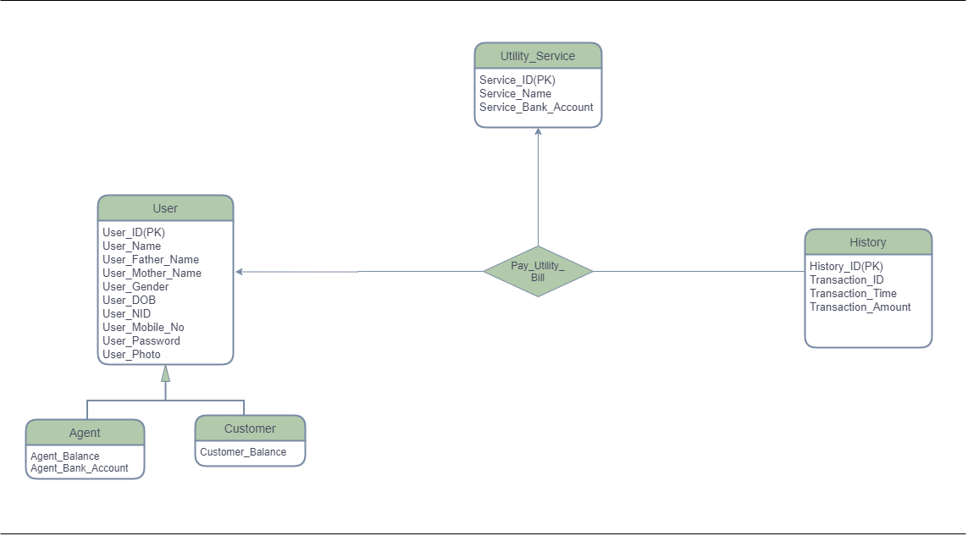
Utility_Service Module:

Slide 10
Thanks for listening .
Please give your suggestion to improve the ERD.

