Slide 1

ERD
Fahmid Al Rifat
Student ID : 1705087

Slide 3
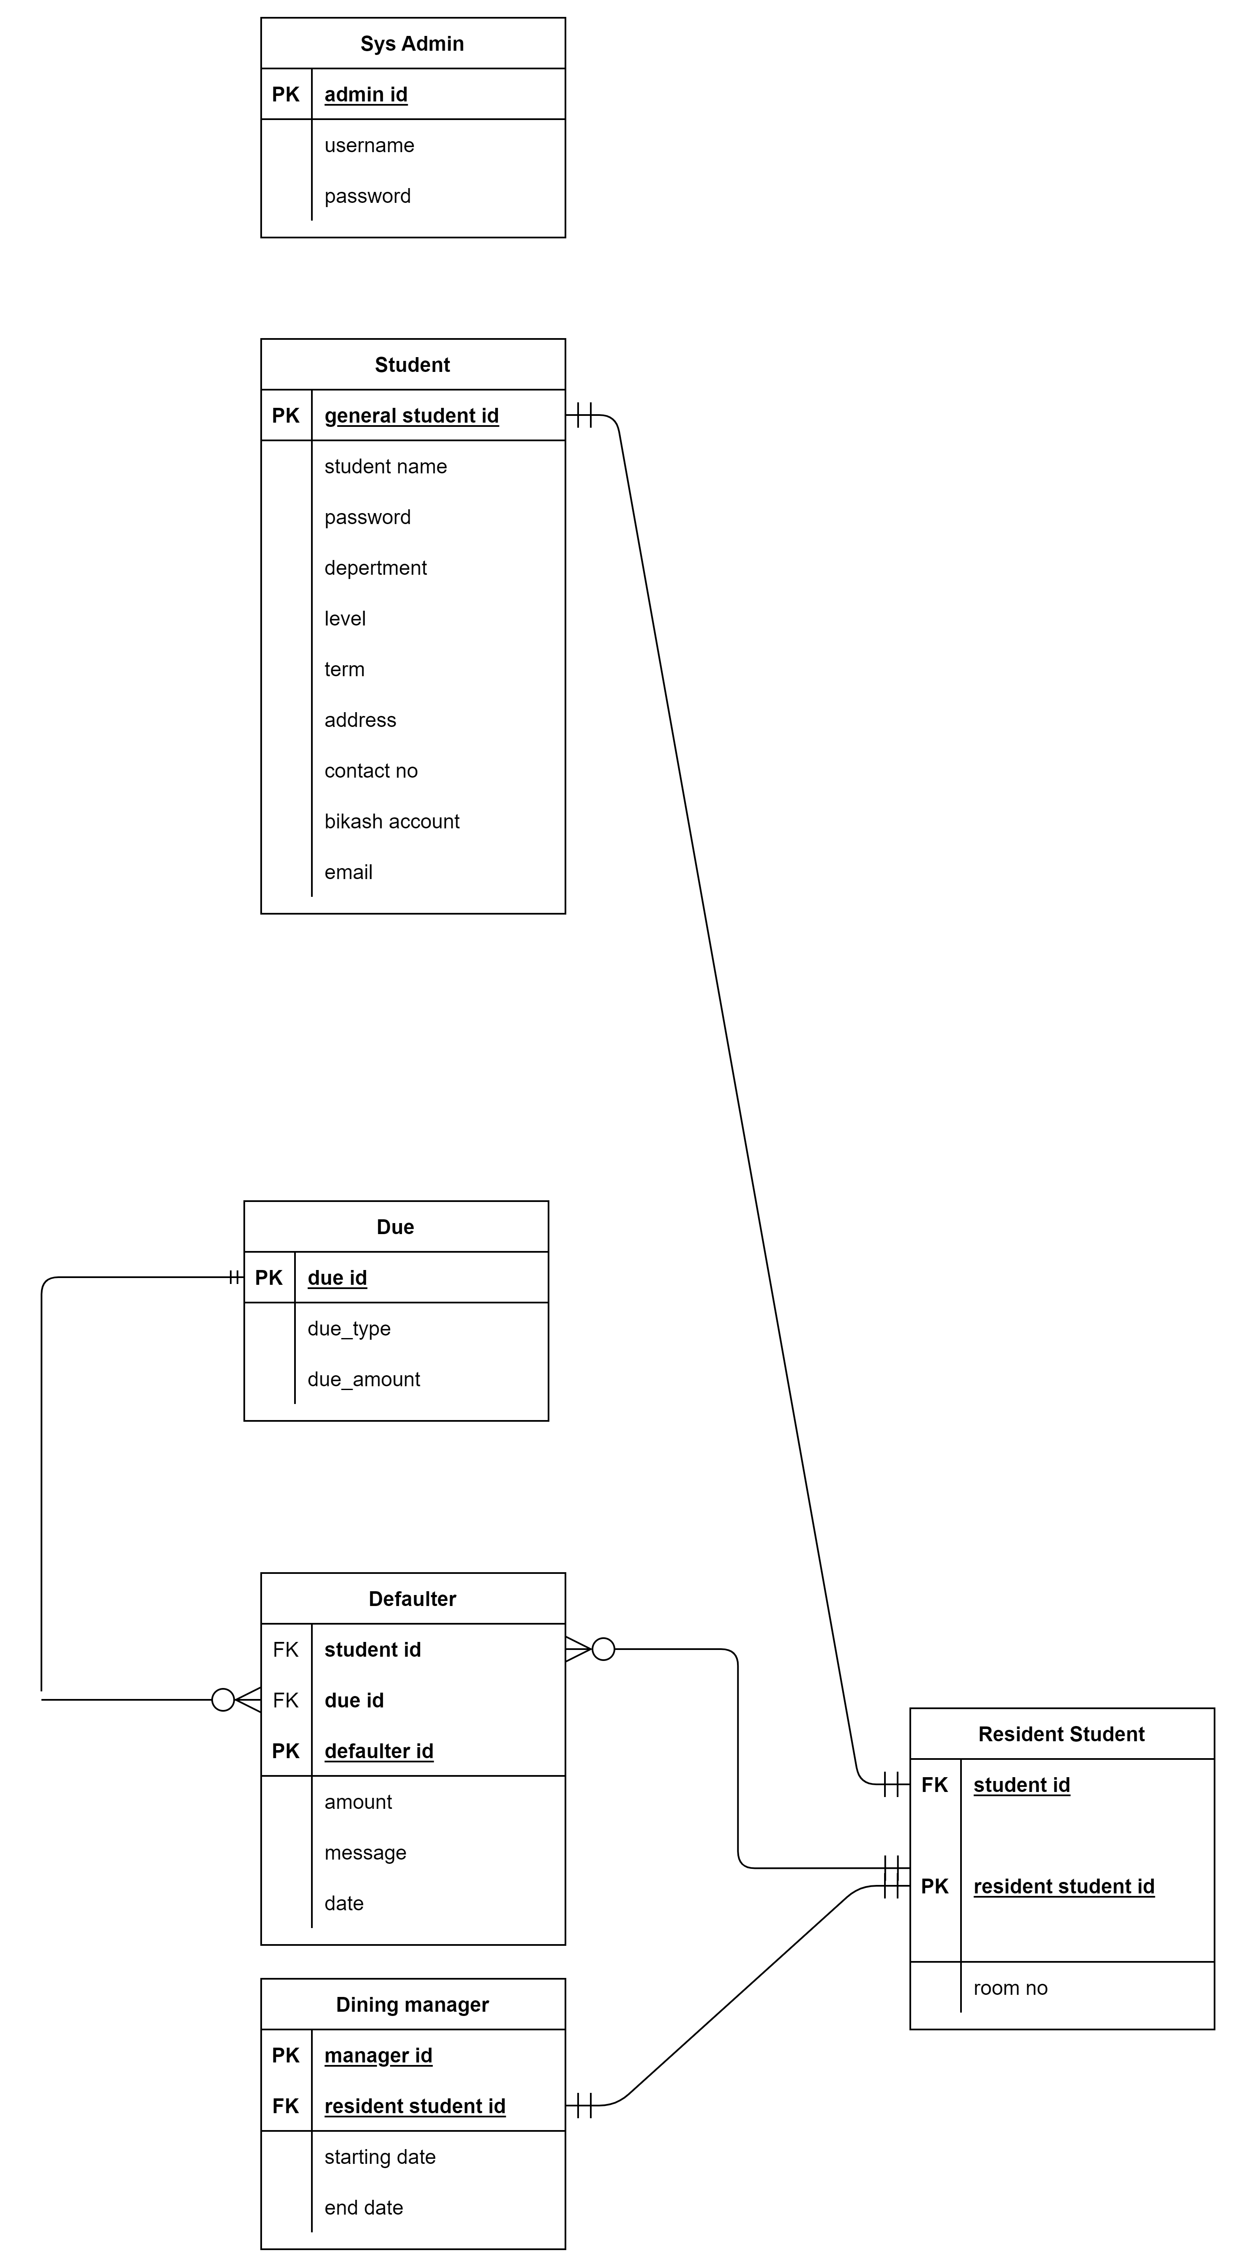
Student Side

Slide 4
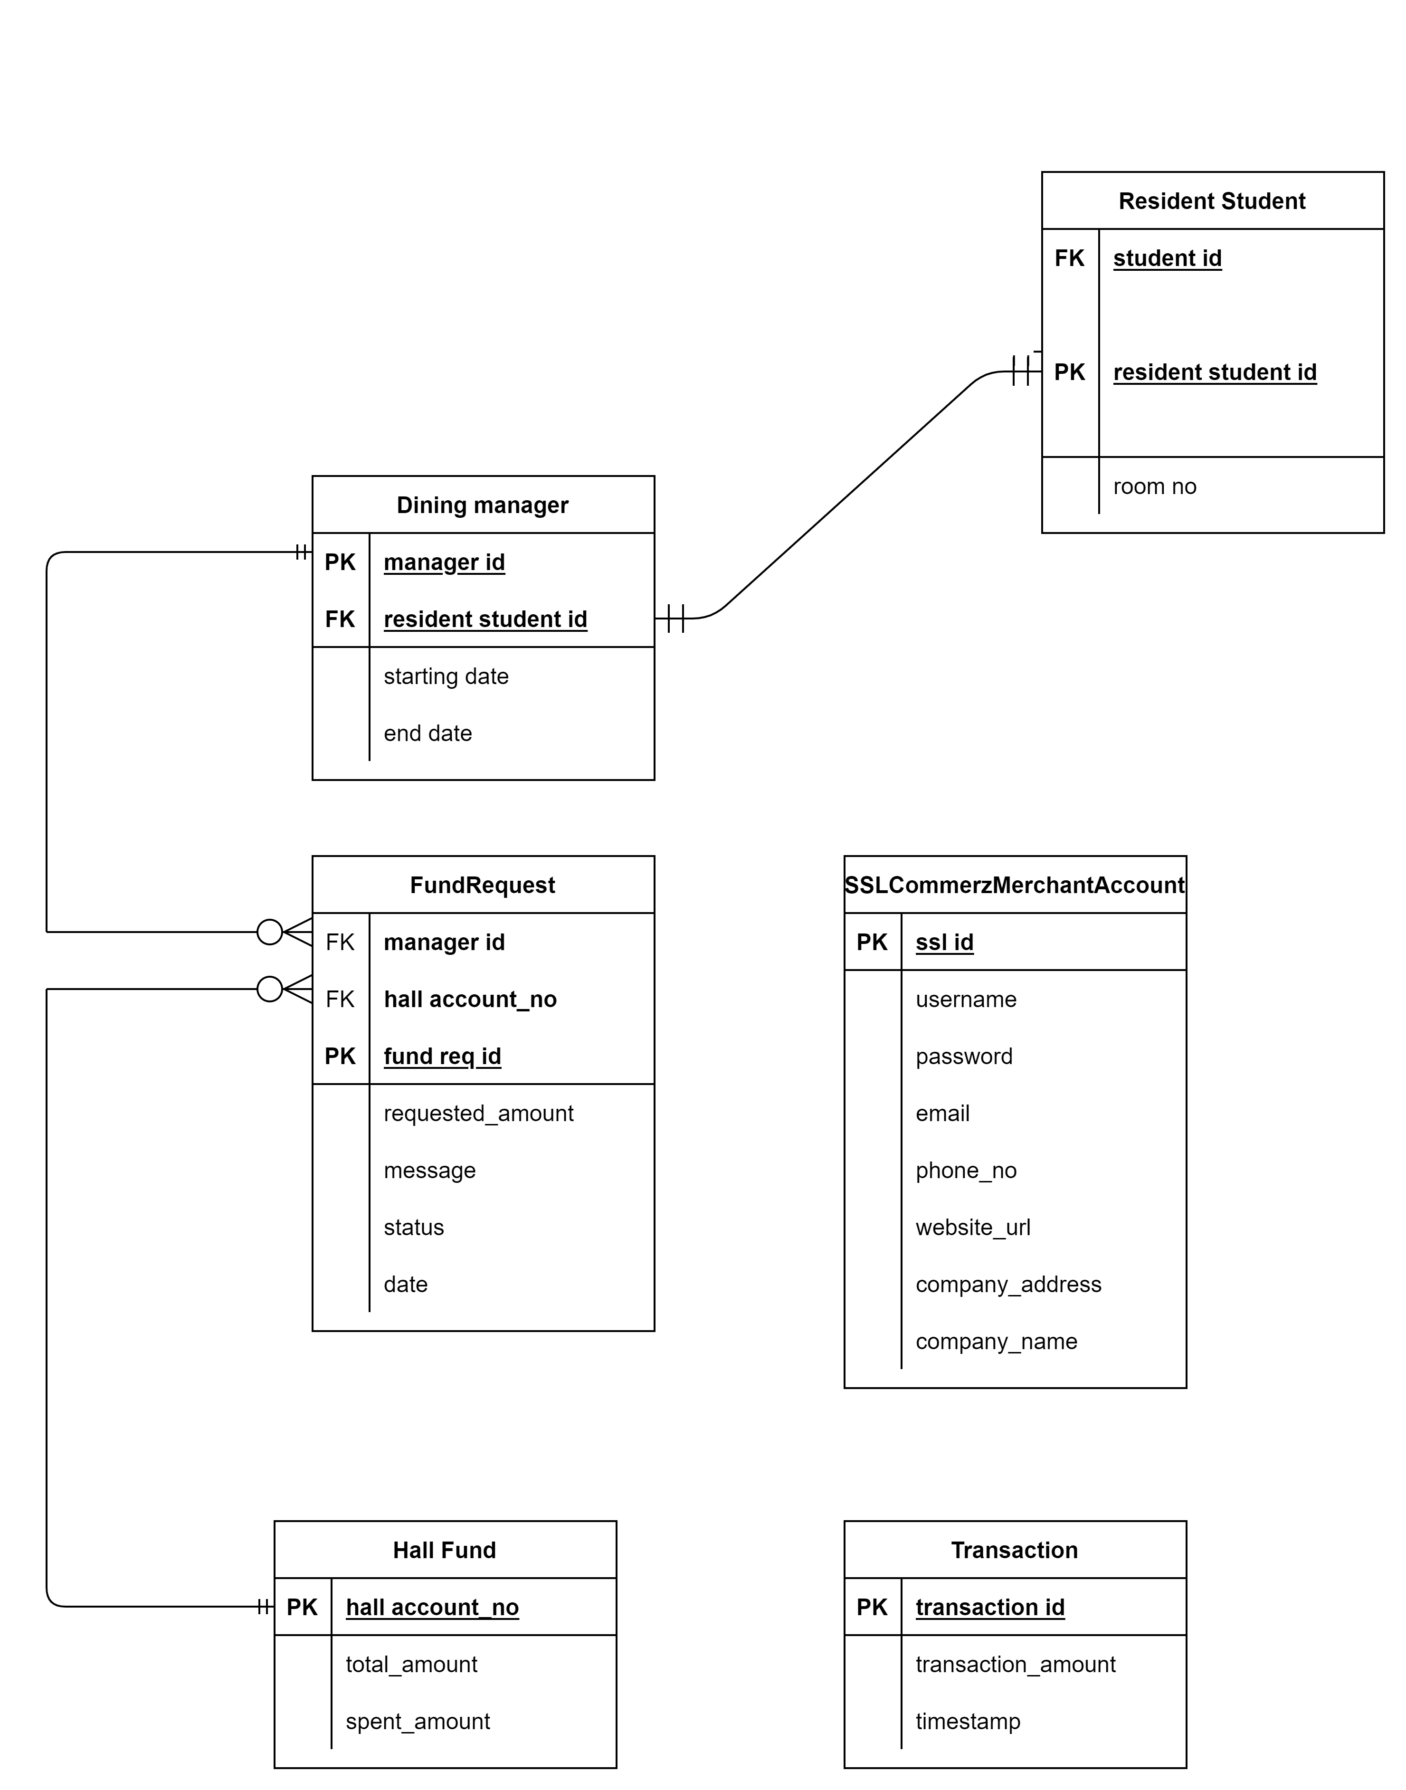
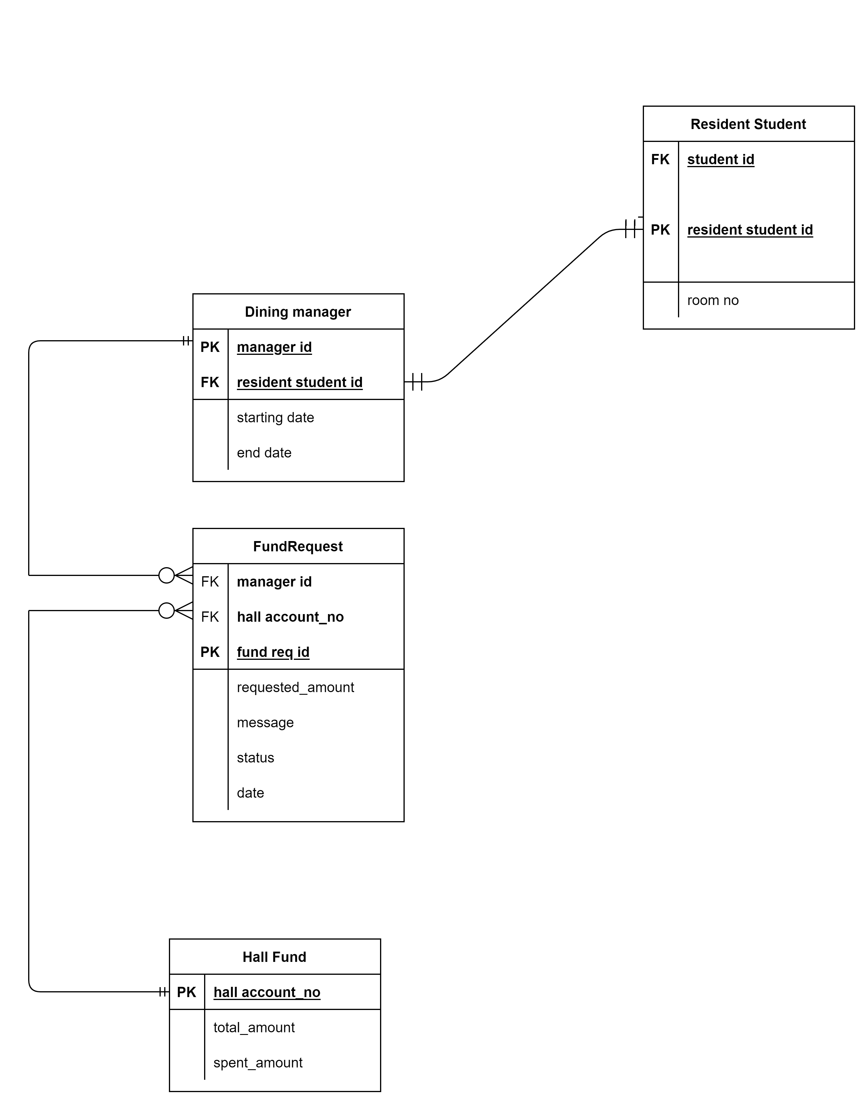
Dining

Slide 5
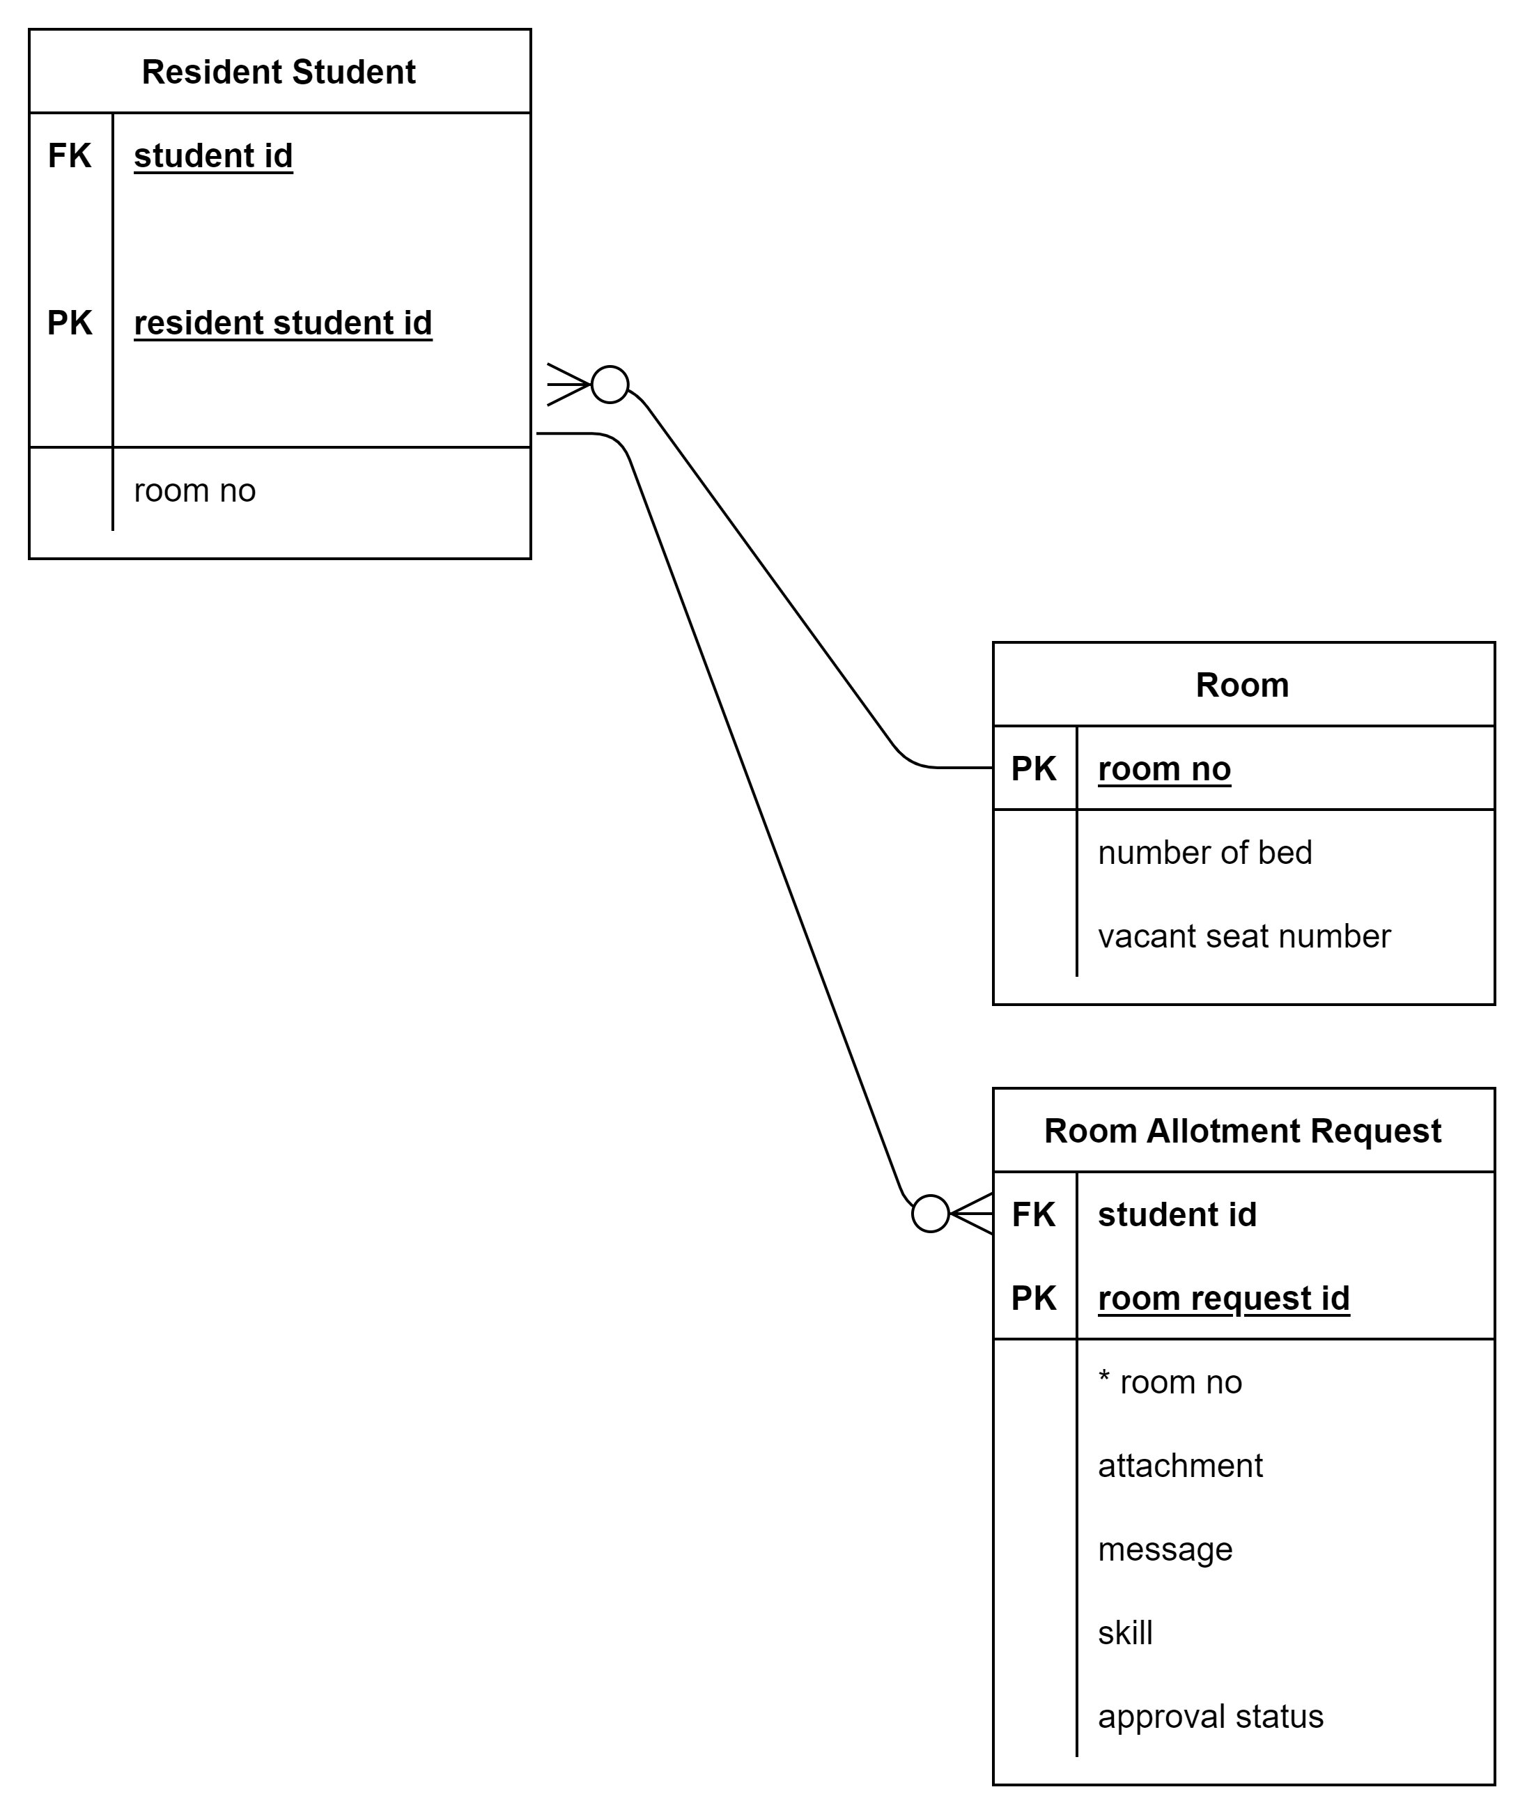
Room Allotment

Slide 6
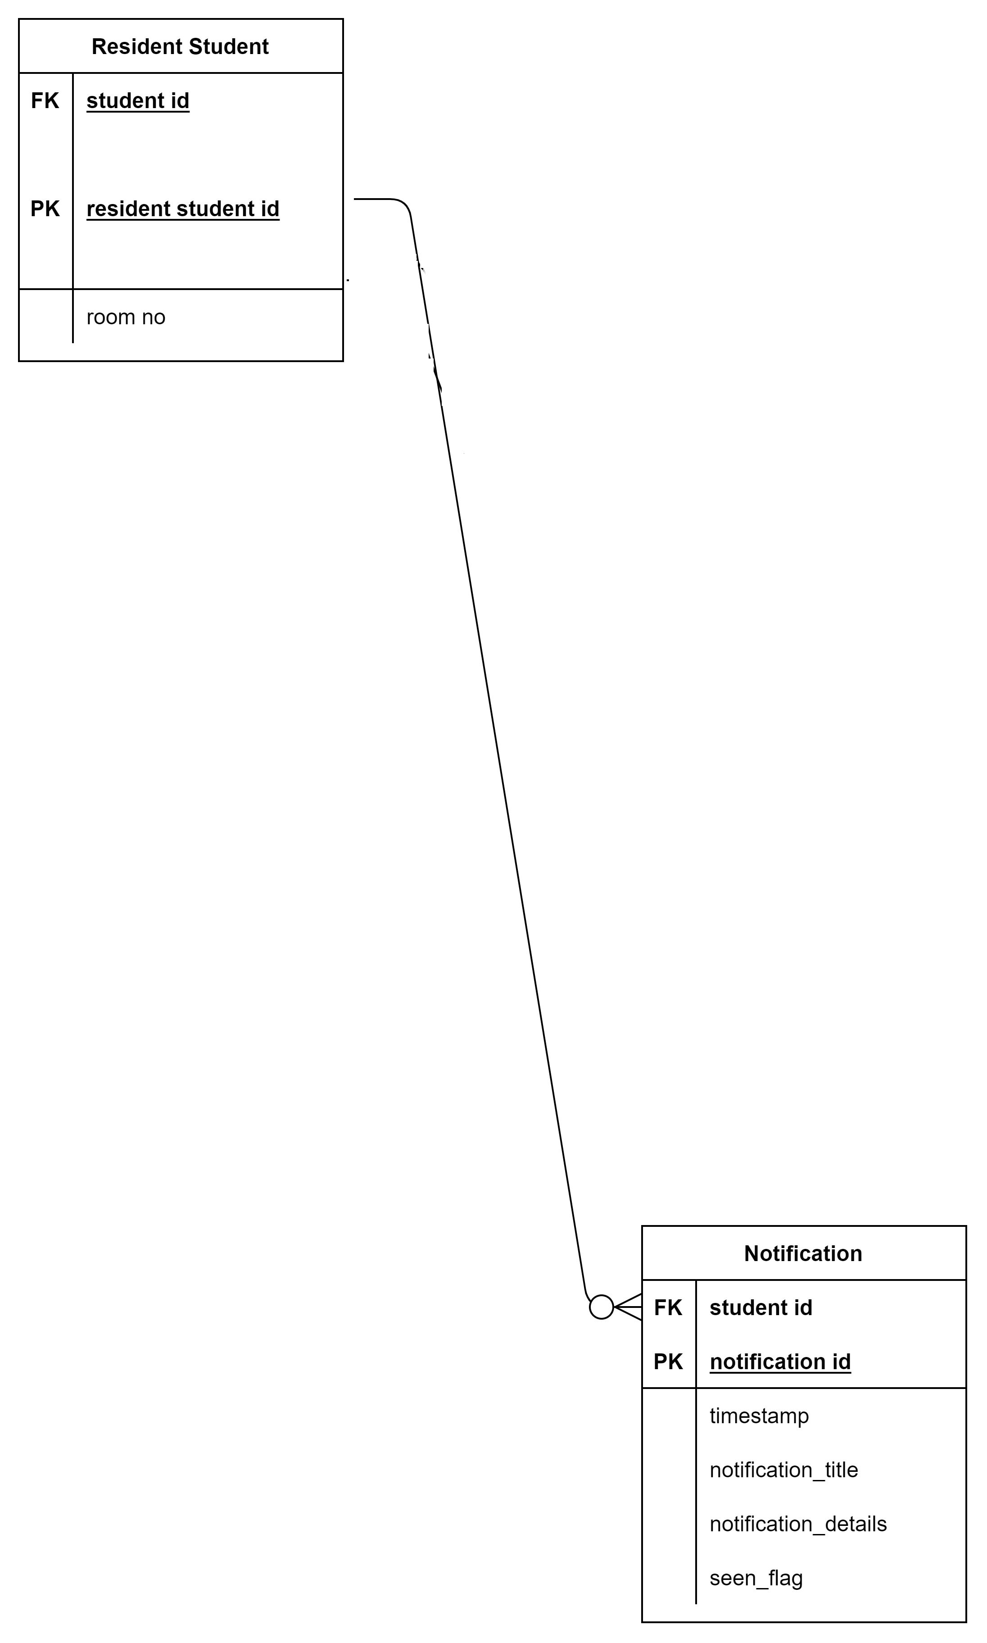
Notification

Slide 7

Meal

Slide 8
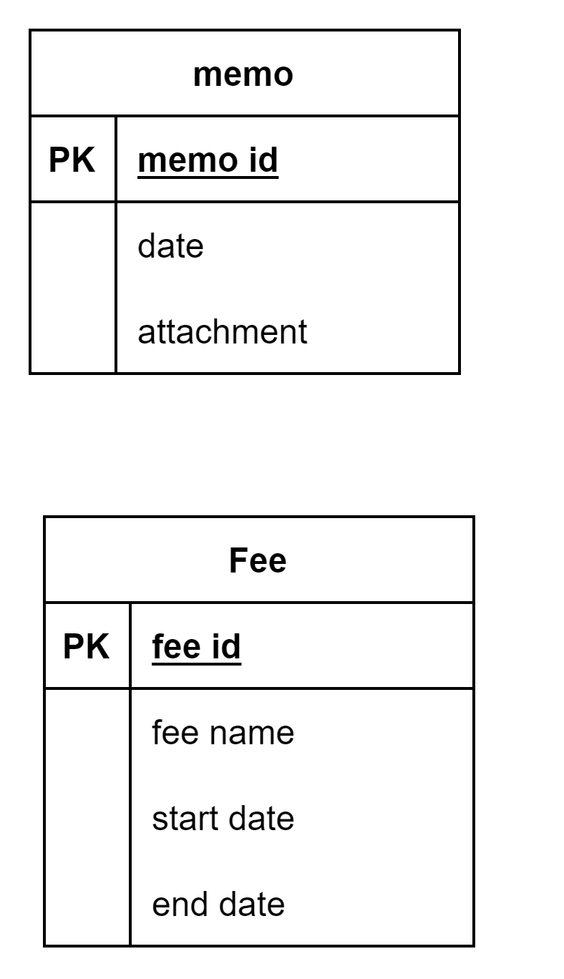
Memo and Fees

Slide 9
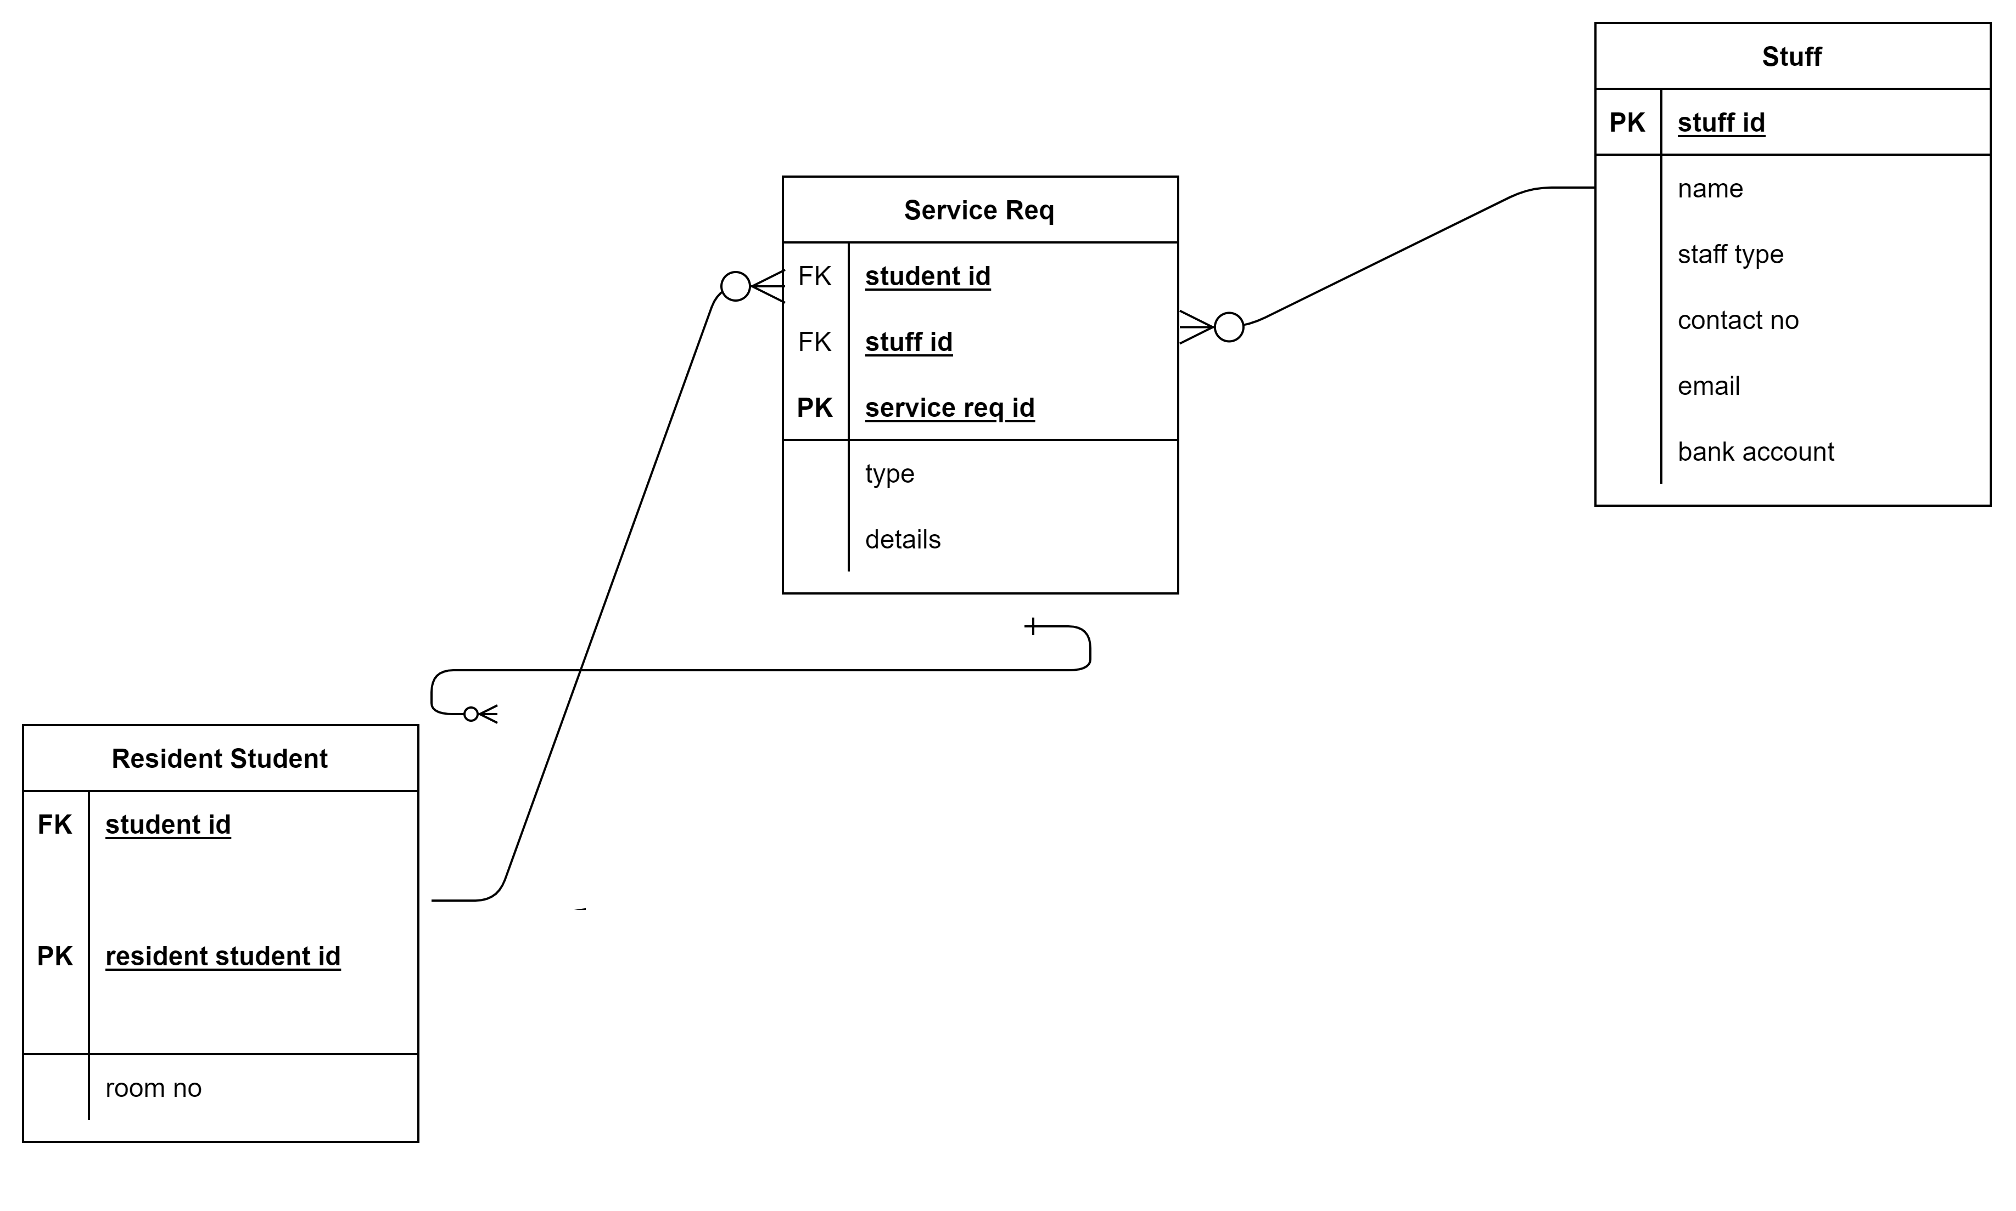
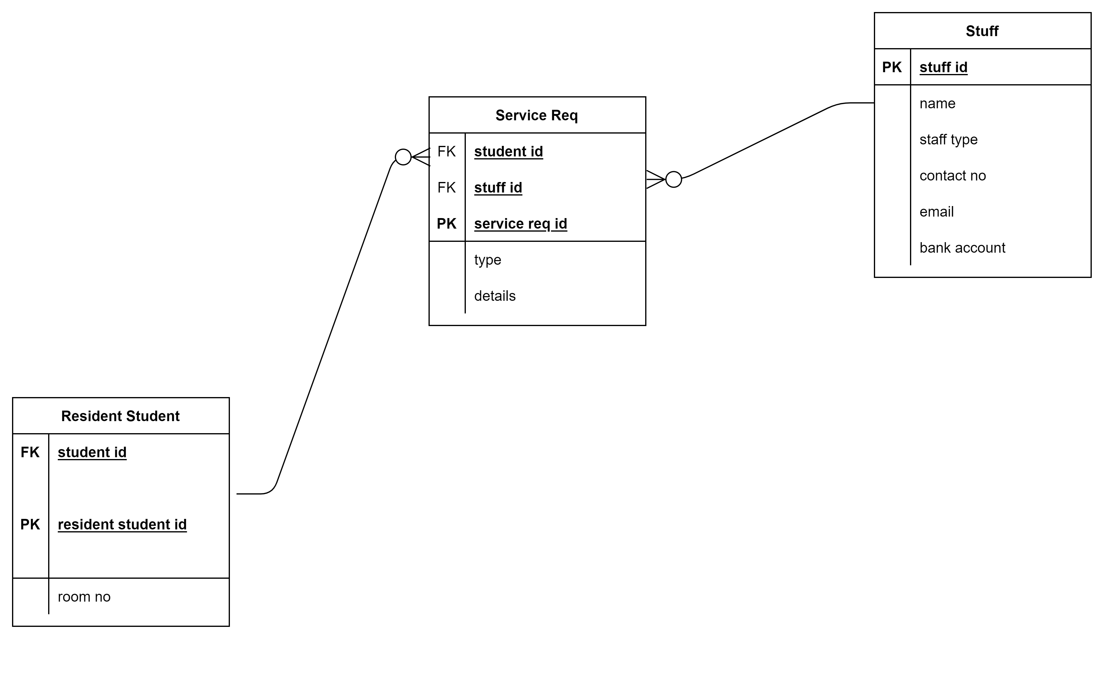
Service

Slide 10
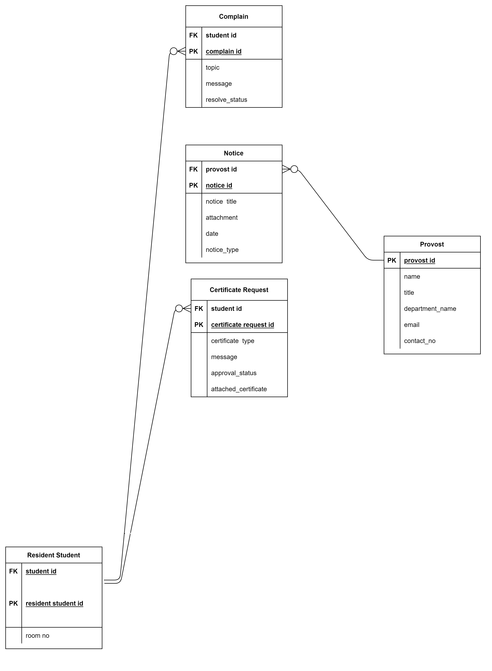
Notice, Complaint, Certificate

Slide 11
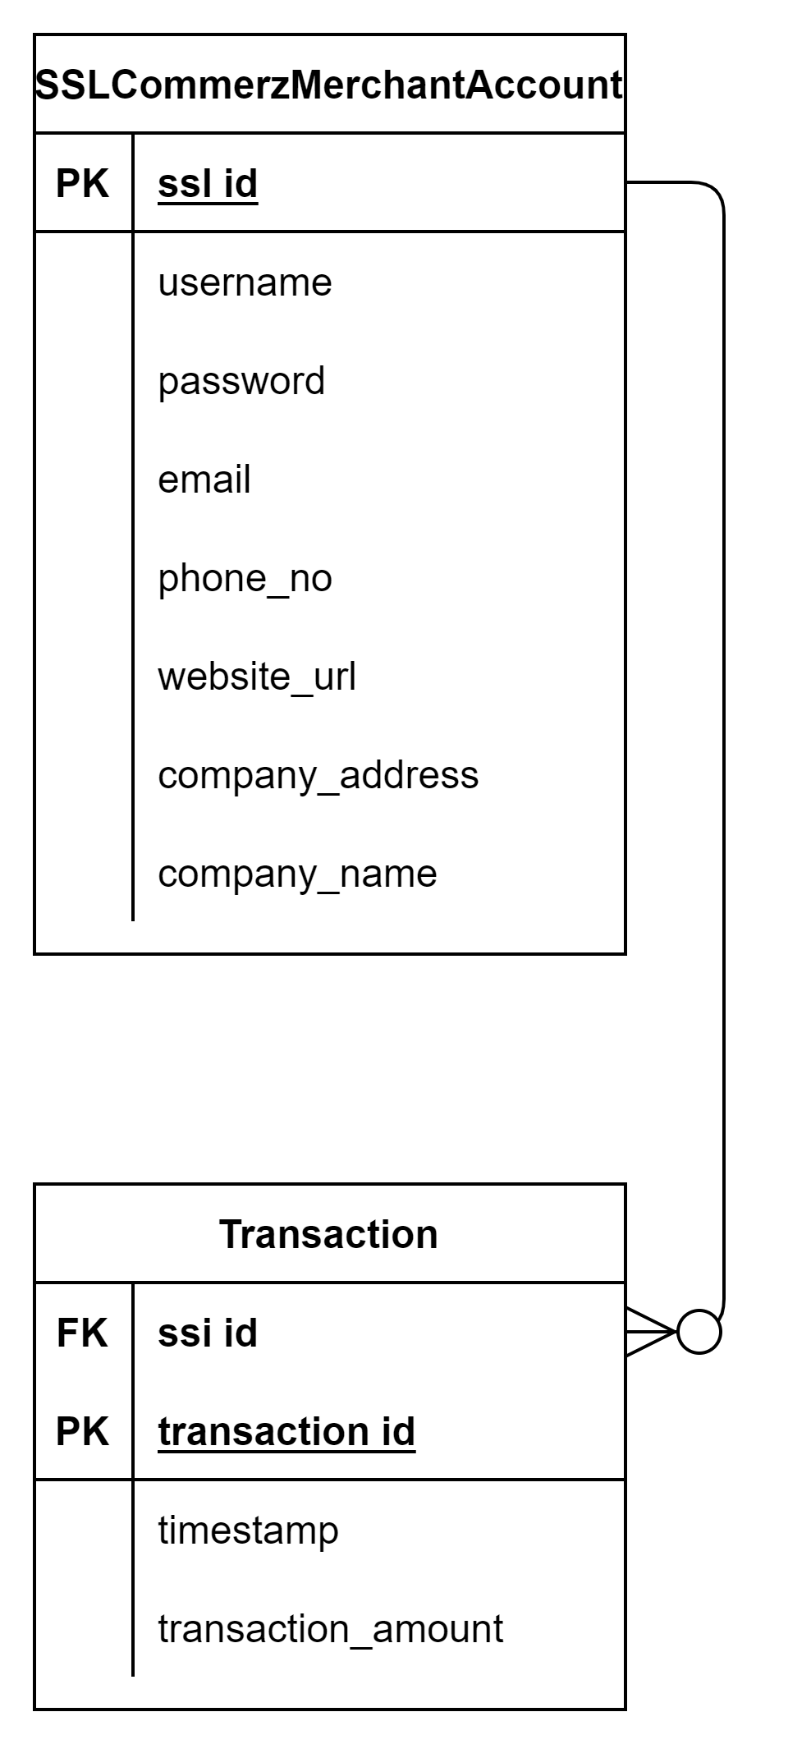
Transaction

Slide 12
THANK YOU

