Slide 1

HALL AUTOMATION SYSTEM
BPMN Diagram Presented BY : Abdullah Al Noman (1705088)

Slide 2
Pools Of the Business Process model
Hall Management Pool
Provost
Office Staff
Servicing & Maintenance Stuff
Dining Staff
Student Pool
Attached Student
Resident Student

Slide 3

5 Major Features of the system
Room Allotment
Dining Management
Request For A Service
Fees Management For Students
Handles A Complaint

Slide 4
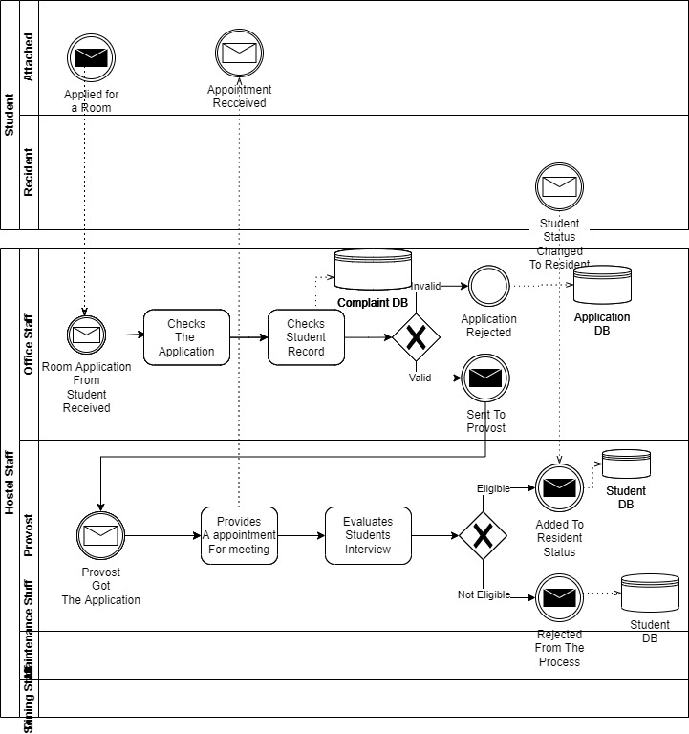
Room Allotment

Slide 5
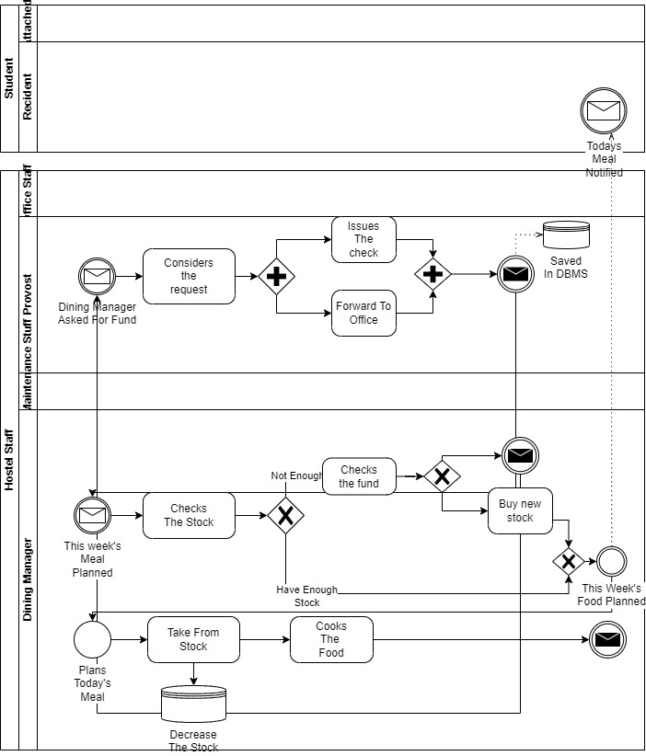
Dining Management

Slide 6
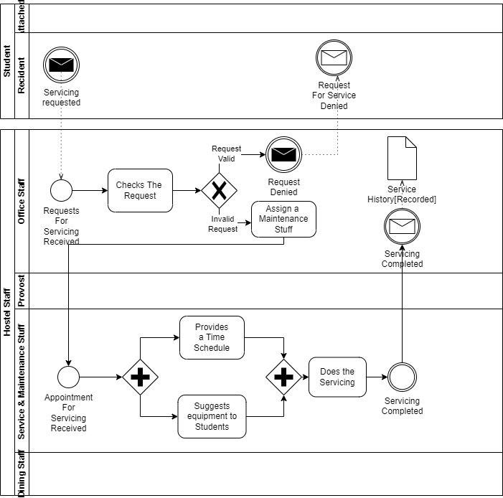
Request For Service

Slide 7
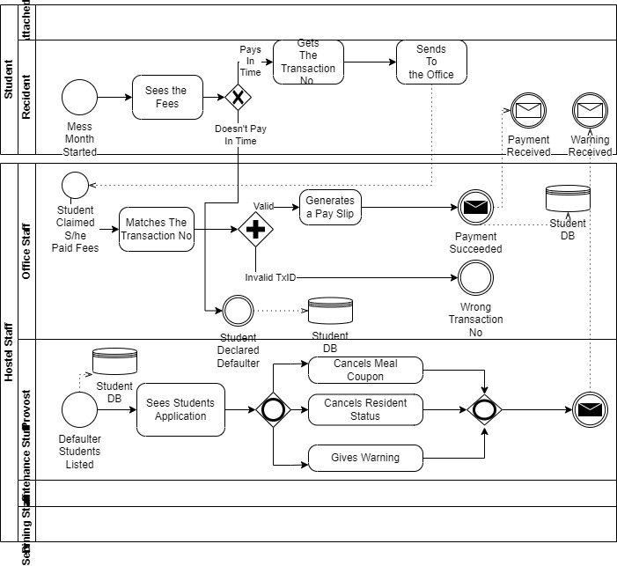
Fees Management

Slide 8
Handles A Complaint

Slide 9
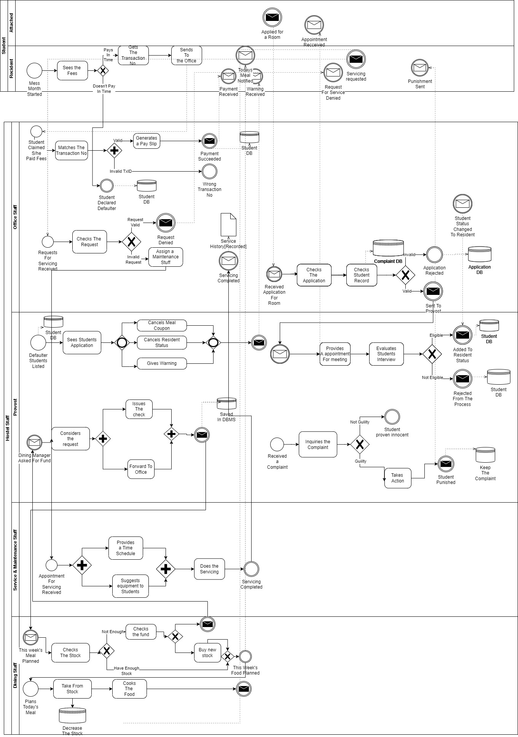
Total System

Slide 10
Thanks A Lot

