Slide 1
Hall Management System Sequence Diagram
Presented by
Md Sabbir Rahman
1705076, Group 4
1

Slide 2
Major Use Cases
1. Login and Account Creation 2. Student Dining 3. Mess Manager Meal Plan 4. Mess Manager Fund Request 5. Student Due Payment | 6. Provost Defaulter Actions 7. Room Allotment 8. Certificate Request 9. Service Request 10. Fee Updates by Provost
2

Slide 3
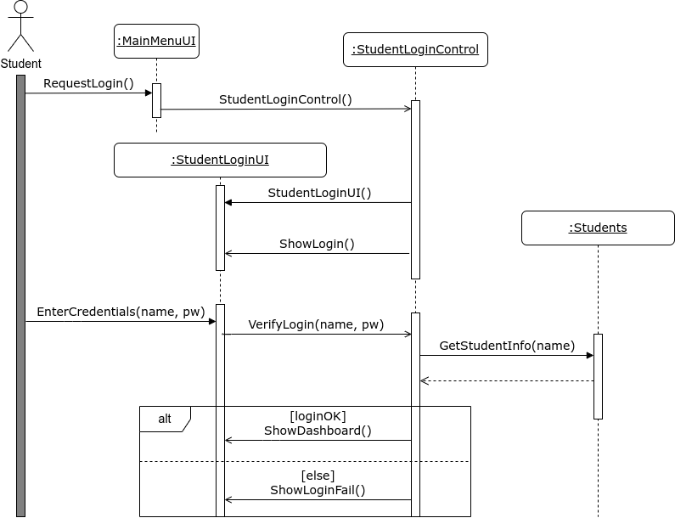
1. Login And Account Creation
3

Slide 4
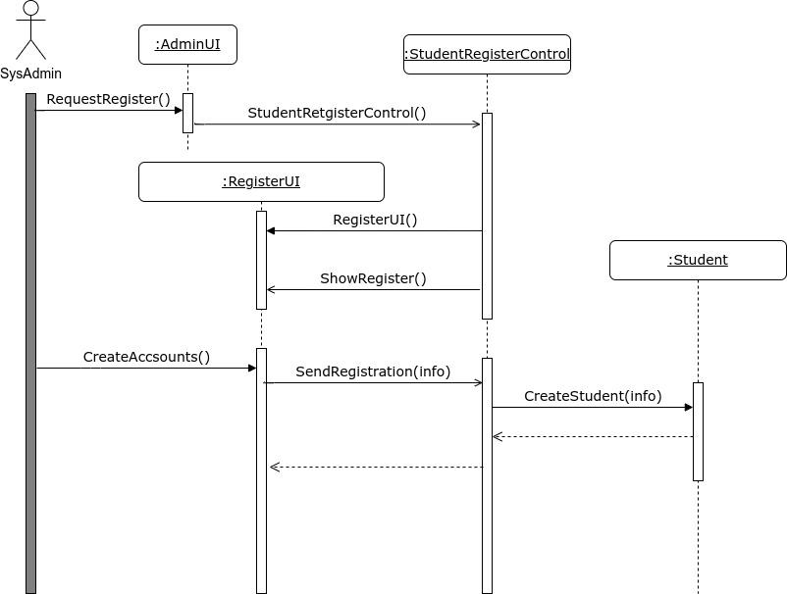
1. Login And Account Creation
4

Slide 5
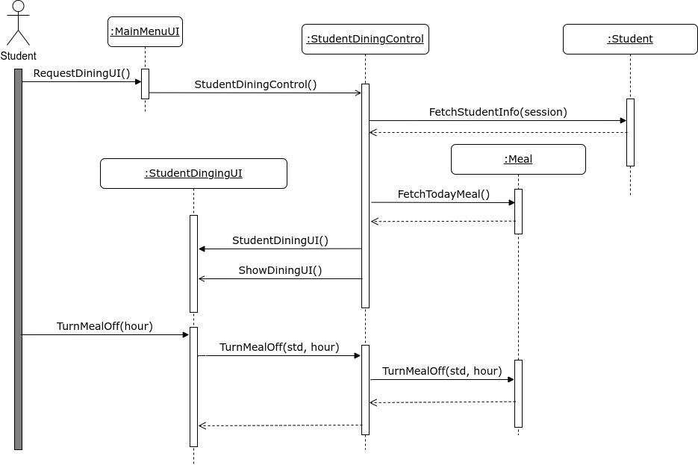
2. Student Dining
5

Slide 6
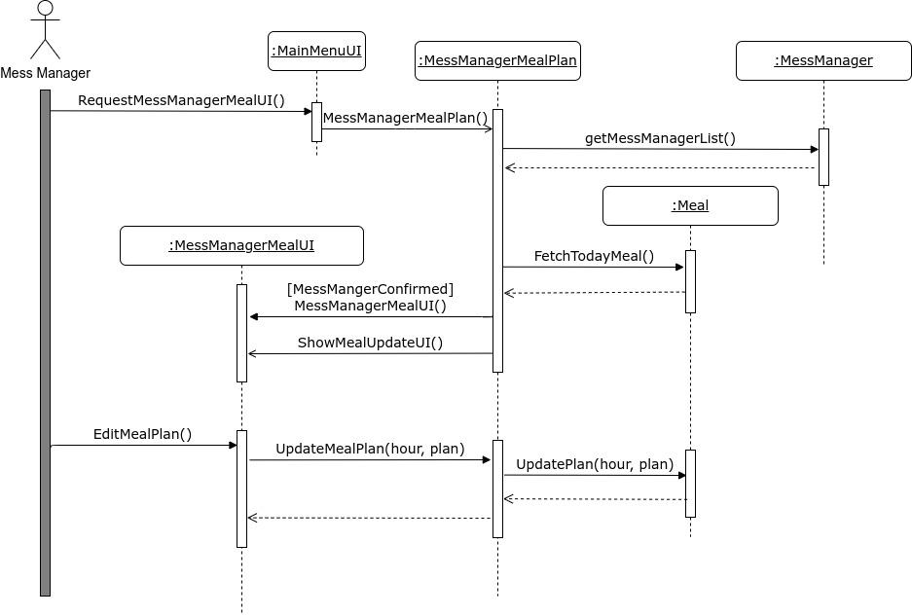
3. Mess Manager Meal Plan
6

Slide 7
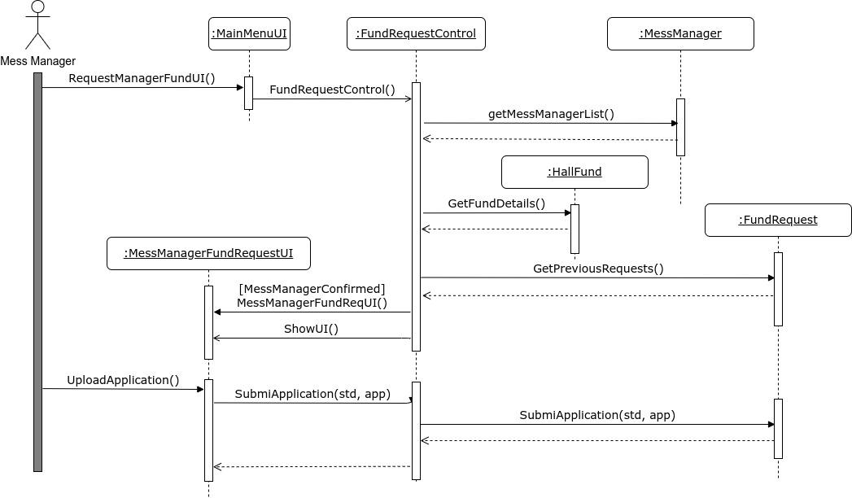
4. Mess Manager Fund Request
7

Slide 8
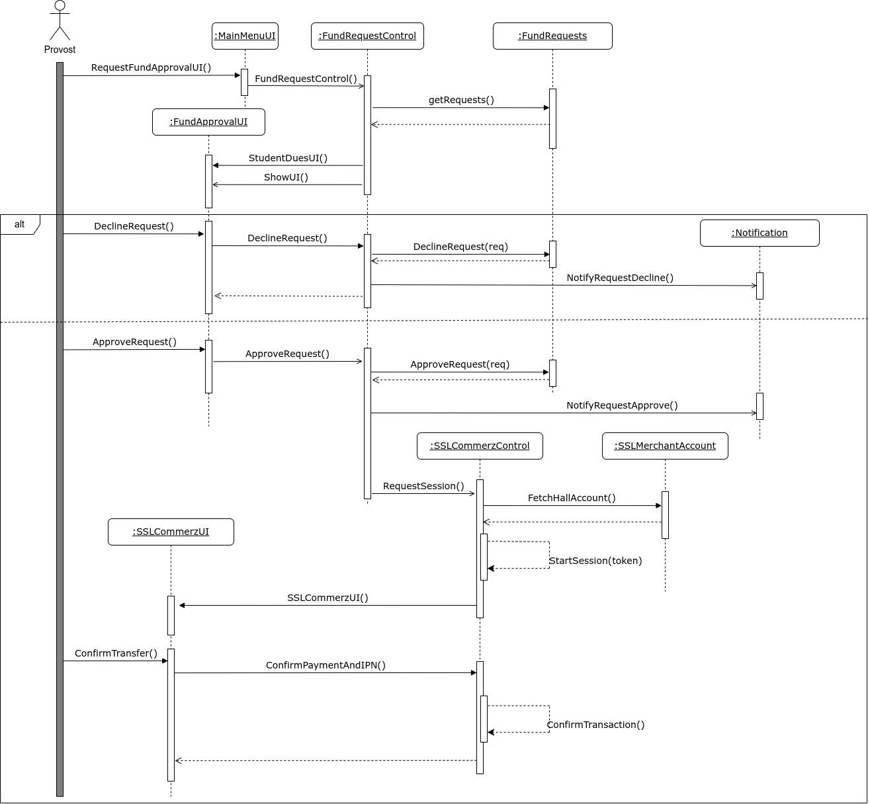
4. Mess Manager Fund Request
8

Slide 9
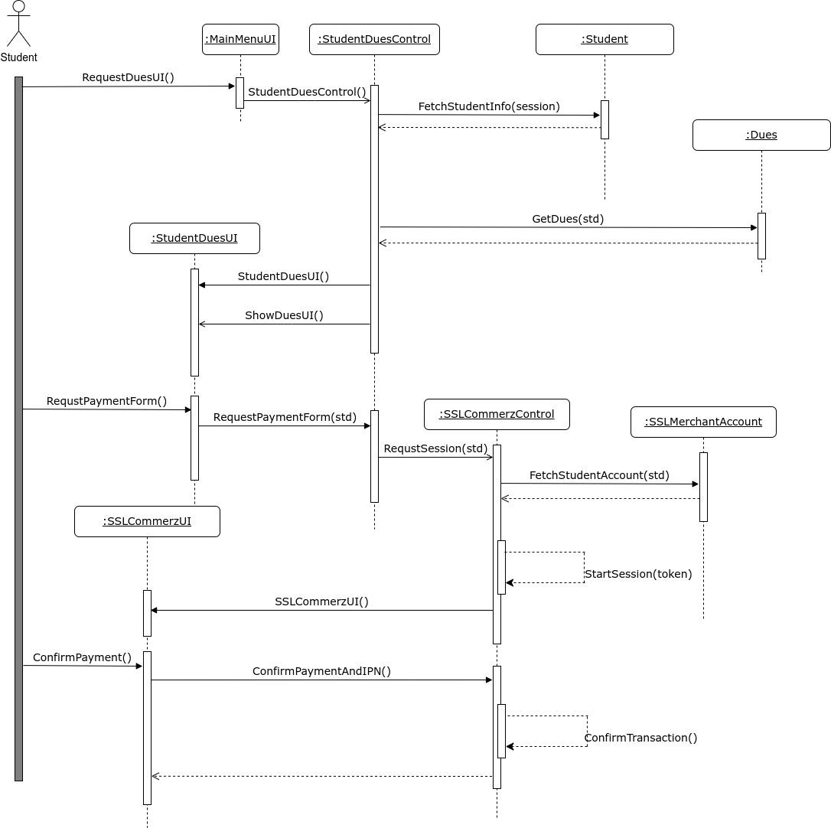
5. Student Due Payment
9

Slide 10
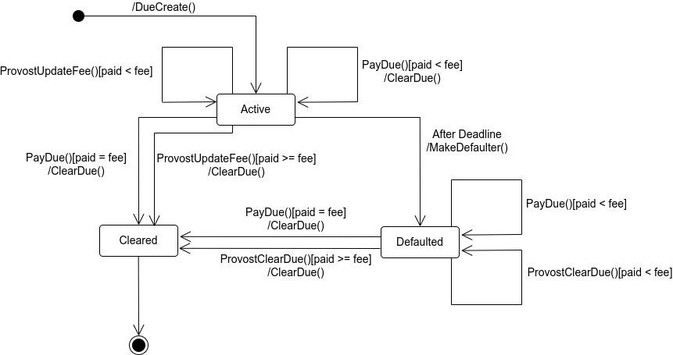
5. Student Due Payment : State Chart for Due
10

Slide 11
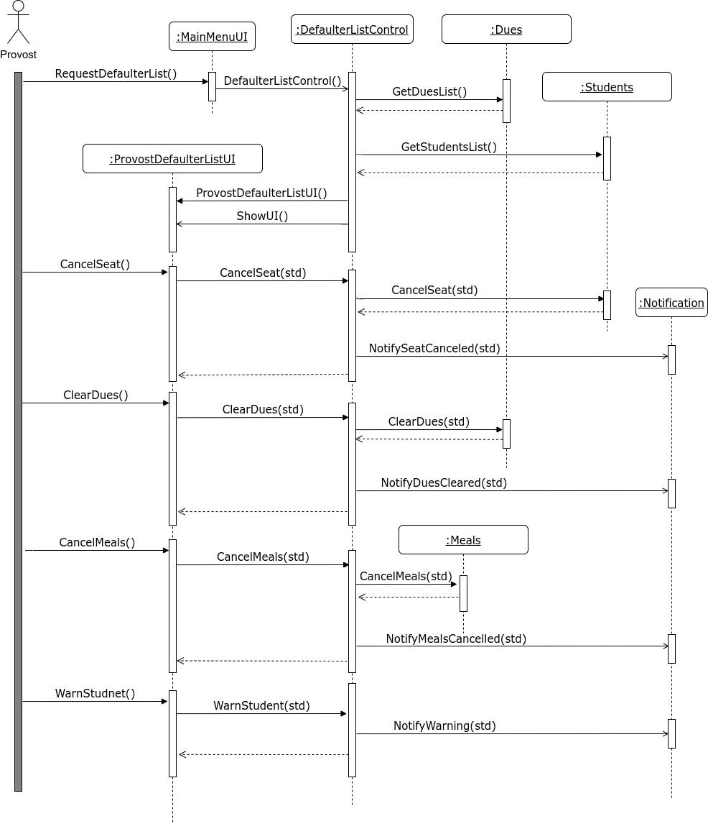
6. Provost Defaulter Actions
11

Slide 12
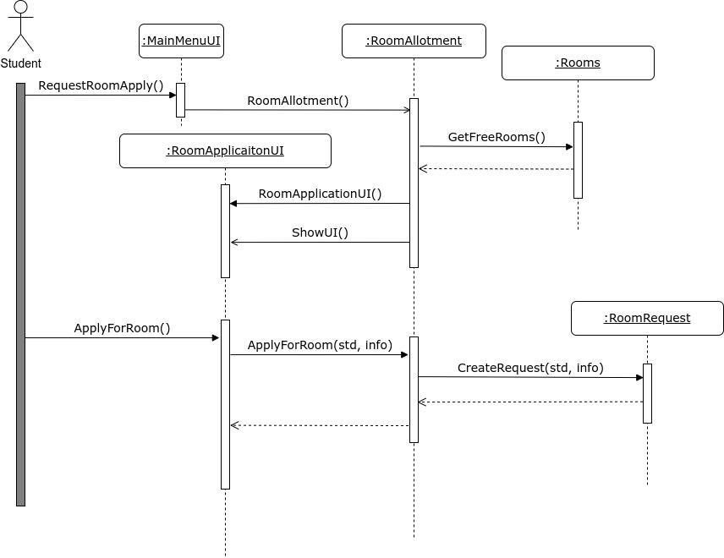
7. Room Allotment
12

Slide 13
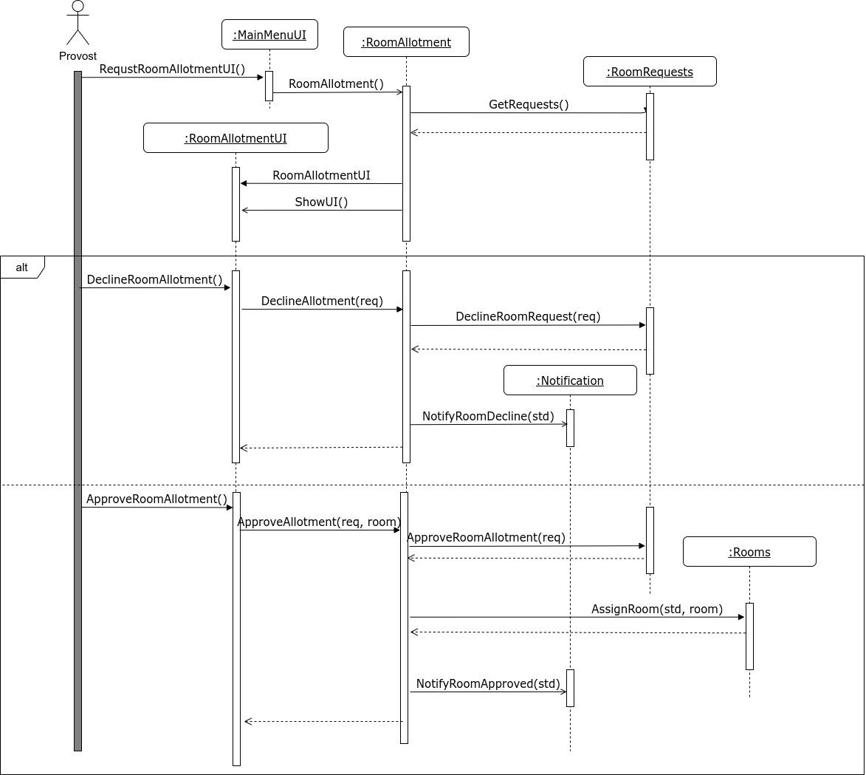
7. Room Allotment
13

Slide 14
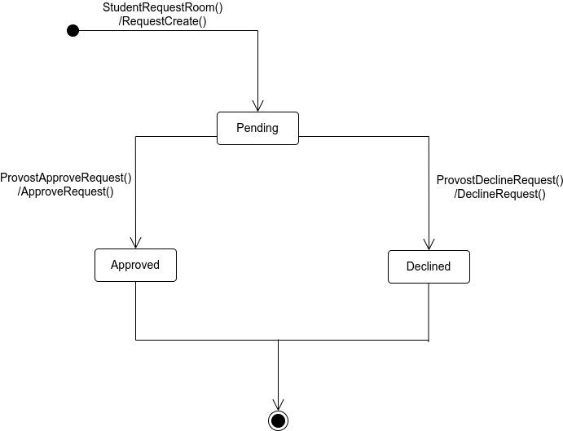
7. Room Allotment : State Chart for Room Request
14

Slide 15
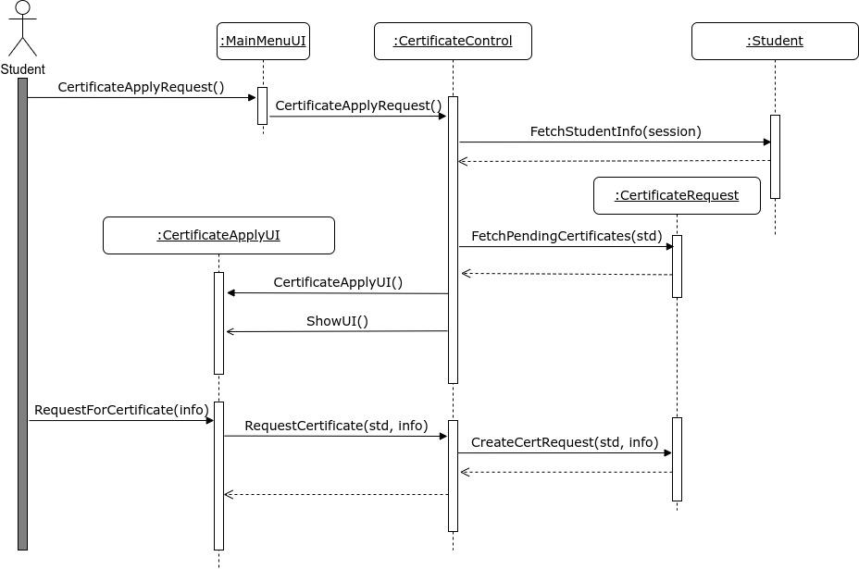
8. Certificate Request
15

Slide 16
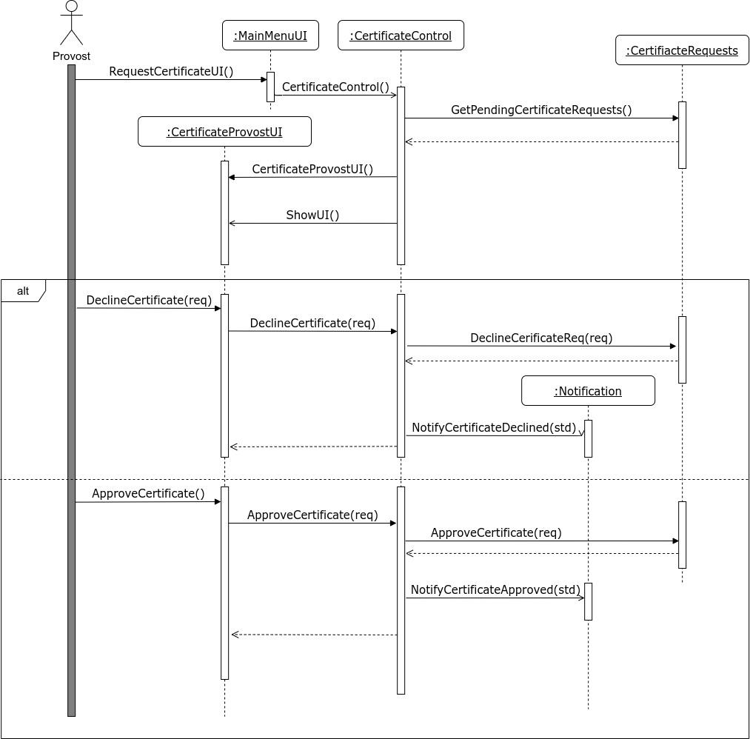
8. Certificate Request
16

Slide 17
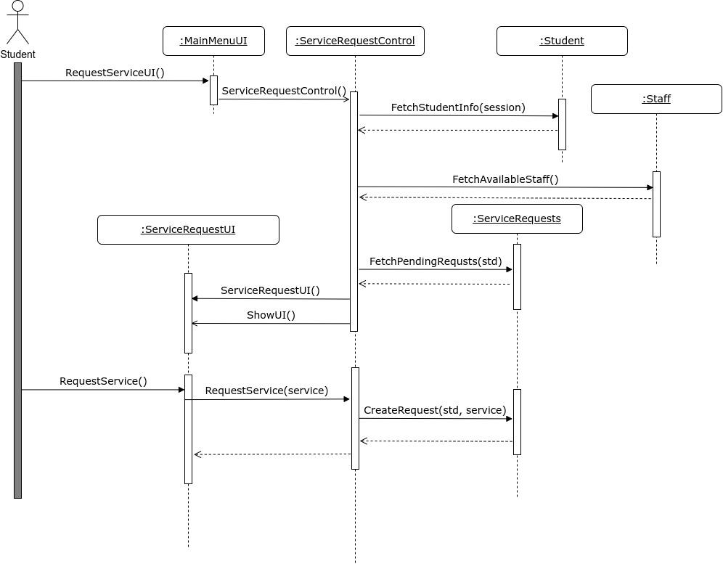
9. Service Request
17

Slide 18
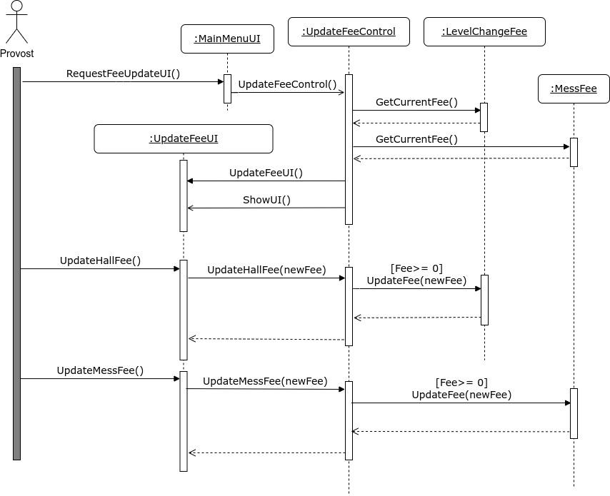
10. Fee Updates by Provost
18

Slide 19
Thank You!
19

