Slide 1
HALL MANAGEMENT SYSTEM Collaboration Diagram
Presented by
1705077
Fahim Faysal
B1, Group 4

Slide 2
Use cases:
1. Login and Account Creation
2. Student Dining
3. Mess Manager Meal Plan
4. Mess Manager Fund Request
5. Student Pay Dues
6. Provost Defaulter Actions
7. Room Allotment
8. Certificate Request
9. Service Request
10. Provost Update Fee

Slide 3
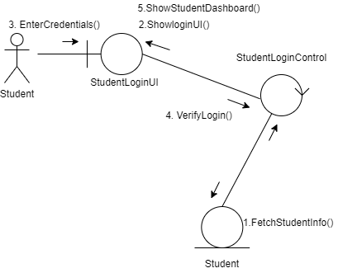
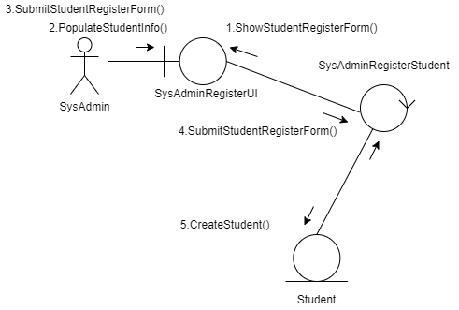
1. Login and Account Creation

Slide 4
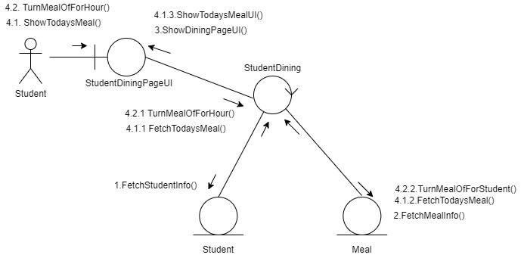
2. Student Dining

Slide 5
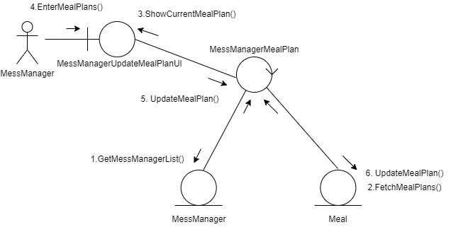
3. MessManager Meal Plan

Slide 6
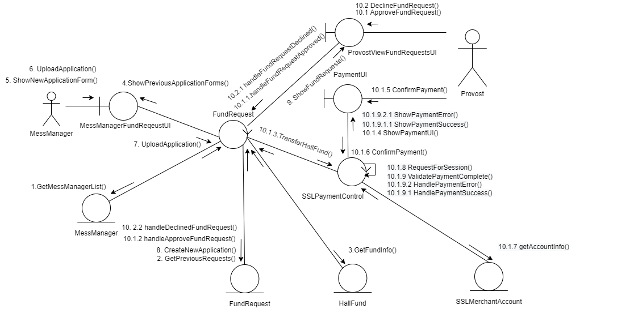
4. MessManager Fund Request && Provost update Fund request

Slide 7
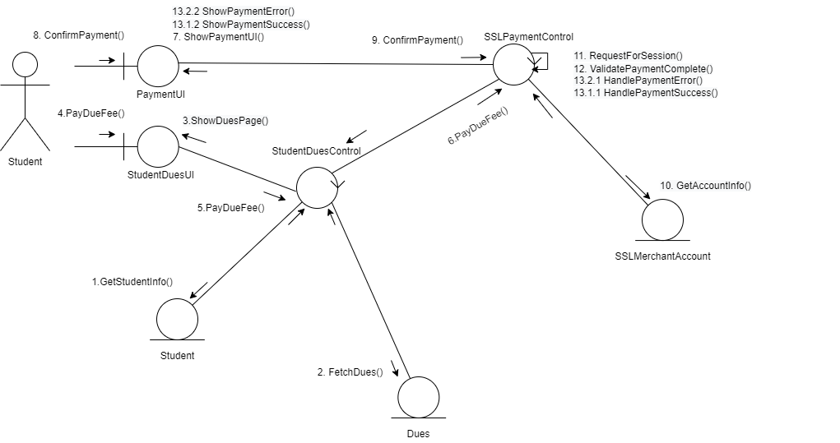
5. Student Pay Dues

Slide 8
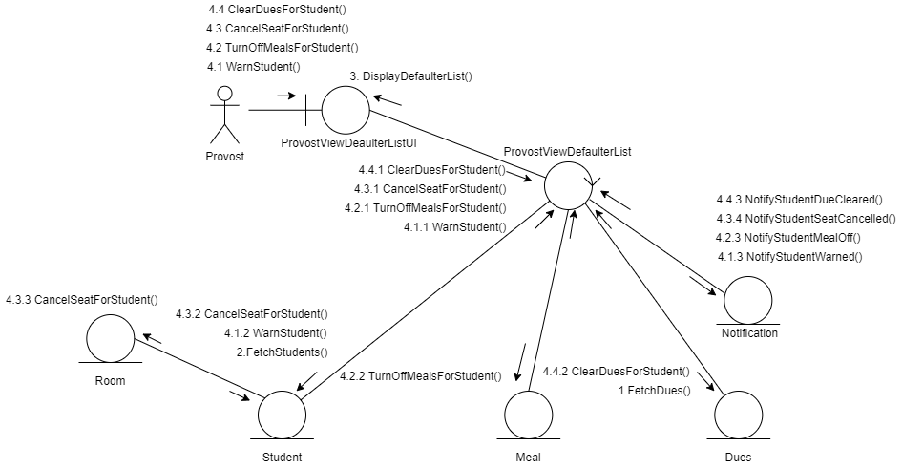
6. Provost Defaulter Action

Slide 9
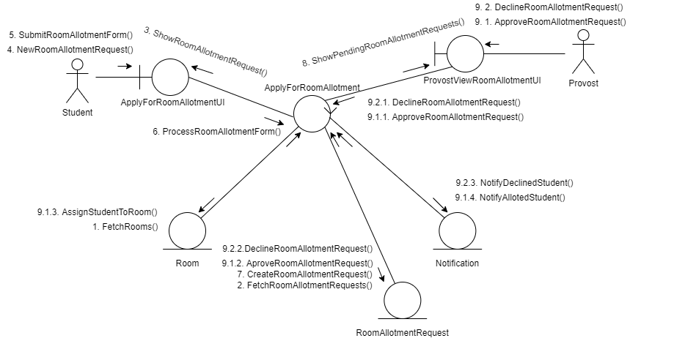
7. Student Room Allotment Request/ Provost Update Request

Slide 10
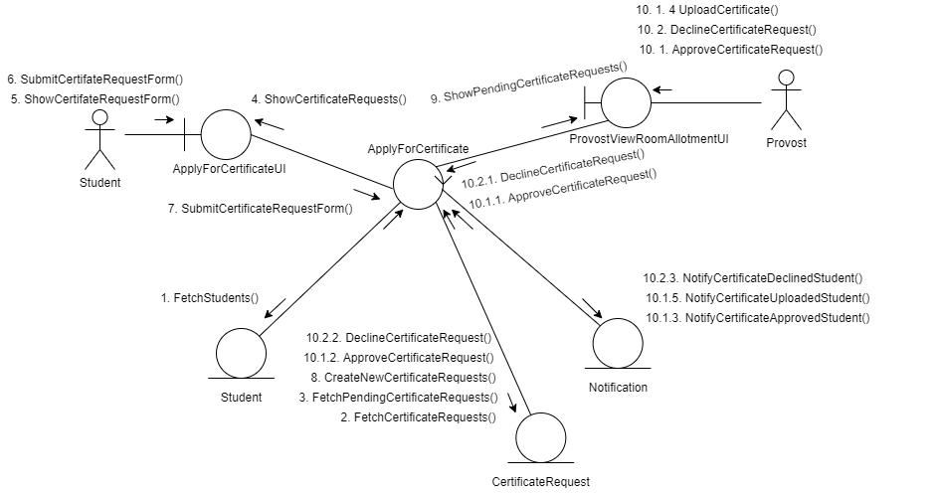
8. Student Certificate Request/Provost Update Certificate Request

Slide 11
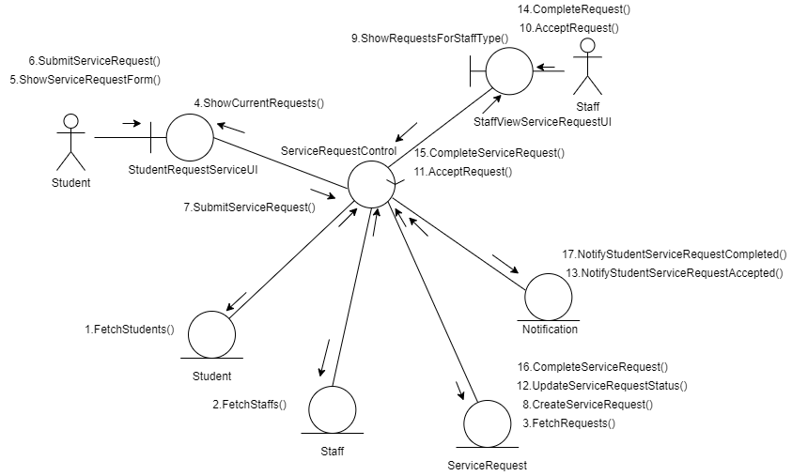
9. Service Request

Slide 12
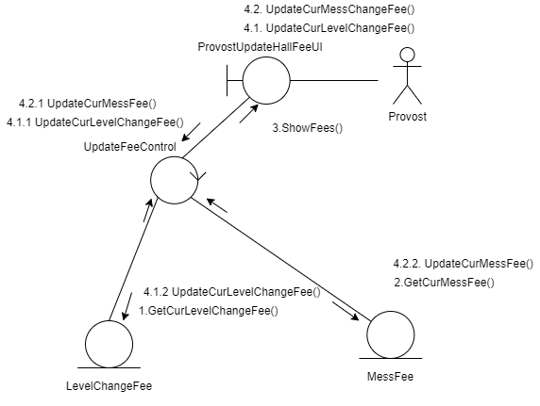
10. Provost Update Fees

Slide 13
Thank you for listening.

