Slide 1
ARTIFICIAL INTELLIGENCE
Informed Search, Heuristics
and A* Search
Using Problem Knowledge to Search More Intelligently
Lecture 4
BS Computer Science — Artificial Intelligence
Dr. Ghulam Ali
Duration: approximately 1.5 – 2 hours
AI — Lecture 4 | Introduction
1 / 40
Notes:
Welcome students back. State the lecture's position in the course arc: Lecture 3 built the vocabulary of search (states, actions, transition model, path cost) and studied blind strategies. Lecture 4 asks a pointed question: those blind strategies never look at WHERE the goal is — could we do better if the algorithm were allowed to use problem-specific knowledge? Emphasize this is a conceptual pivot, not just 'another algorithm' — it is the beginning of every practical AI search system used in industry (routing, robotics, games). Mention duration and that today has heavy worked examples — students should keep pen and paper ready to trace through the A* example with you.

Slide 2
BRIDGING LECTURE 3 → LECTURE 4
From Blind Search to Informed Search
Lecture 3 — Uninformed Search
States, actions, transition model, path cost
BFS / DFS / UCS use only the problem's structure
None of them know where the goal actually is
Lecture 4 — Informed Search
Adds a heuristic h(n): an estimate of distance to the goal
That estimate reshapes the ORDER of node expansion
Result: far fewer nodes explored, when h is good
AI — Lecture 4 | 1. Transition
2 / 40
Notes:
This is the conceptual hinge of the whole lecture — spend real time here. Ask the class: 'BFS and UCS both eventually find the goal — so why would we ever need anything else?' Draw out the answer: efficiency. On a large state space (road network with millions of intersections, a puzzle with billions of states), exploring blindly is computationally infeasible even though it is theoretically correct. Uninformed search treats every unexplored node as equally promising; informed search does not. Conceptual distinction to state explicitly: 'uninformed' does not mean 'bad' — it means the algorithm has no access to problem-specific estimates of remaining distance. Transition line into next slide: 'Today we formalize exactly what that extra knowledge looks like, and build one of the most important algorithms in all of AI on top of it — A*.'

Slide 3
ROADMAP
Learning Objectives for Today
1
Define informed search and h(n); contrast with uninformed search.
2
Formalize f(n) and its three cases: UCS, Greedy, A*.
3
Trace Greedy and A* by hand, with a full expansion table.
4
Apply admissibility and consistency to A*'s optimality.
5
Compare weak vs. strong heuristics and heuristic dominance.
6
Introduce Hill Climbing and its local maxima / plateaus / ridges.
AI — Lecture 4 | 1. Transition
3 / 40
Notes:
Read through objectives briskly — this slide sets expectations, not depth. Flag explicitly what we will NOT cover in detail today, to manage scope: IDA*, RBFS, SMA*, Beam Search, minimax/alpha-beta, constraint satisfaction algorithms, genetic algorithms and simulated annealing. These may be mentioned only in passing as 'future extensions' of the ideas we build today — none of them will be tested on today's material. Also flag that machine learning, neural networks, and reinforcement learning are entirely out of scope — heuristic search here is a classical, symbolic AI technique, conceptually different from learning-based methods covered later in the course.

Slide 4
2. INFORMED SEARCH
What Is Informed Search?
Concept
Uses problem-specific knowledge to choose which node to expand.
Formal definition
f(n) incorporates an estimate of cost from n to the nearest goal.
Consequence
Typically expands far fewer nodes than an uninformed strategy.
Real-world instances
GPS · Robotics · Game AI · Warehousing · Logistics · Routing · Puzzles · Scheduling
AI — Lecture 4 | 2. Informed Search
4 / 40
Notes:
Emphasize the word 'estimate' — informed search does not know the true remaining cost (if it did, search would be trivial); it only has an ESTIMATE. That imperfection is precisely why later slides on admissibility and consistency matter — an estimate can be good or bad, and the algorithm's guarantees depend on which. Classroom question to pose here: 'If you were driving to campus using only distance-so-far as your guide, with no idea which direction campus was in, how would that feel? Now imagine you also have a compass pointing roughly toward campus — that compass is your heuristic.' This analogy will be reused implicitly all lecture. Conceptual distinction to name explicitly: uninformed vs informed is about the INFORMATION available to the evaluation function, not about which specific algorithm is used. Also mention, verbally, the remaining real-world instances that didn't fit the tile grid: autonomous drone navigation and delivery-fleet logistics are covered by the same 'GPS routing' and 'logistics planning' tiles shown.

Slide 5
2. INFORMED SEARCH
The Heuristic Function h(n)
Formal definition
h(n) estimates the cheapest cost from n to a goal. h(goal) = 0.
Worked example — Arifwala to Lahore
Straight-line distance Arifwala → Lahore ≈ 185 km (illustrative estimate).
Actual road distance ≈ 215 km — roads bend around terrain.
So: h(n)=185 ≤ h*(n)≈215 — the estimate never overestimates.
AI — Lecture 4 | 2. Informed Search
5 / 40
Notes:
State clearly that the 185 km / 215 km figures are illustrative approximations chosen to teach the concept, not a surveyed measurement — the pedagogical point is the relationship h(n) ≤ h*(n), not the exact kilometre count. This is the same technique AIMA's Romania map example uses with straight-line distances to Bucharest. Ask a classroom question here: 'Can you think of a situation where straight-line distance would be a BAD heuristic?' (Answer: a large lake, mountain range, or river directly between two cities with no direct crossing — straight-line distance would drastically underestimate the real driving distance, making the heuristic weak, though it would still be admissible.) This foreshadows the 'weak vs strong heuristic' discussion in Section 5. Also cover verbally why straight-line distance works as a heuristic at all: it is cheap to compute from coordinates alone with no search required, it can never exceed the true road distance since roads never shortcut through open country, and it correlates with true cost — these three properties (cheap, non-overestimating, informative) are exactly what a good heuristic needs.

Slide 6
2. INFORMED SEARCH
Formal Notation: g, h, and f
g(n)
h(n)
h*(n)
f(n)
Cost so far
Cost to go
True cost to go
Total estimate
Actual cost from start to n — already known.
ESTIMATE of cost from n to the goal.
The TRUE cost — unknown; used only for proofs.
Combines g(n) and h(n); rule depends on algorithm.
Key distinction: h(n) is what the algorithm computes; h*(n) is the unknown ground truth used only in proofs.
AI — Lecture 4 | 2. Informed Search
6 / 40
Notes:
This slide is a notation anchor students will refer back to for the rest of the lecture — go slowly. The g(n) vs h(n) distinction is conceptual distinction #1 for today: g(n) is BACKWARD-looking (what we already paid), h(n) is FORWARD-looking (what we still expect to pay). Also flag the h(n) vs h*(n) distinction explicitly: h*(n) is a purely theoretical quantity used to define and prove properties like admissibility — no algorithm ever computes h*(n) directly (if it could, it wouldn't need to search at all). Common student confusion: they think h*(n) is 'the better heuristic' — clarify it is not a heuristic at all, it is the ground truth used to judge heuristics.

Slide 7
What is a Heuristic?
Current State
a node n in the search
h(n)
Heuristic Function
Estimated Cost to Goal
a number, h(n) ≥ 0
Heuristic
Heuristic function h(n)
A rule of thumb that uses knowledge of the problem to judge which choice looks most promising.
h(n) = estimated cost from node n to the goal
h(n) ≥ 0 for every node n, and h(goal) = 0
Low h(n): n looks close to the goal
High h(n): n looks far from the goal
Cheap to compute, but not always exactly right
Guides search toward the goal instead of exploring blindly
Notes:
A heuristic is a rule of thumb. The heuristic function h(n) maps a state to a number: our estimate of the remaining cost to reach the goal. h(goal)=0 and h(n) is never negative.

Slide 8
Costs Compared and Algorithms That Use h(n)
Actual cost
Estimated cost
Heuristic cost
True cost of a path.
g(n): start → n (known)
h*(n): n → goal, the true optimum (unknown until solved)
A prediction of the remaining cost, made before it is known.
May be too low, too high, or exact.
h(n): the estimate computed by our heuristic function.
Uses only the state n; no search needed.
Why heuristics help
Algorithms that use heuristics
Blind search expands a huge number of nodes
h(n) ranks nodes, so promising ones are expanded first
Fewer nodes expanded → less time and memory
Greedy Best-First
expands the lowest h(n)
A*
expands the lowest
f(n) = g(n) + h(n)
Hill Climbing
moves to the neighbour with the best h(n)
Beam Search
keeps only the k best nodes by h(n)
Notes:
Distinguish actual cost (real, g(n) and h*(n)), estimated cost (any prediction) and heuristic cost (the specific number h(n) our function returns). Then list the four algorithms that rely on a heuristic.

Slide 9
How Do We Evaluate a Heuristic?
Property | 1 · Admissibility | 2 · Consistency (Monotonicity) | 3 · Efficiency (Computational Cost)
Condition | h(n) ≤ h*(n) h never overestimates the true minimum cost from n to the goal. | h(n) ≤ c(n,n′) + h(n′) Triangle inequality: the estimate at n is at most one step cost plus the estimate at the next node n′. | Cost of computing h(n) Evaluating h(n) must be much cheaper than the search effort it saves.
Simple example | Straight-line distance 5 km ≤ road distance 7 km ✓. An estimate of 9 km would overestimate ✗. | h(n) = 5, c(n,n′) = 2, h(n′) = 4: 5 ≤ 2 + 4 = 6 ✓ | Manhattan distance: cheap and informative. Exact h*(n): perfect, but costs as much as solving the puzzle.
Why it matters | Guarantees optimal solutions with A* tree search. Not required for every heuristic (e.g. greedy search, game evaluation). | With A* graph search, no node is re-opened and f(n) never decreases along a path. Consistent → admissible. | Trade-off: accuracy vs. cost. Total effort ≈ nodes expanded × cost per node.
Notes:
Three different questions: (1) Is it ever too optimistic by overestimating? (2) Is it coherent from one node to the next? (3) Is it cheap enough to compute? Not every heuristic must be admissible; it matters when optimality is required, e.g. A*.

Slide 10
Heuristic Functions: g(n), h(n) and f(n)
g(n)
actual cost from start to n
h(n)
estimated cost from n to goal
f(n) = g(n) + h(n)
estimated total cost through n
A* always expands the open node with the lowest f(n). Setup: c(S,A) = 2, c(S,B) = 3; true remaining costs h*(A) = 7 and h*(B) = 3, so the optimal path S → B → goal costs 6.
Uninformative: h(n) = 0
Informative: h(A) = 6, h(B) = 3
S
S
2
3
2
3
A
B
A
B
g = 2, h = 0
f = 2 (lowest)
g = 3, h = 0
f = 3
g = 2, h = 6
f = 8
g = 3, h = 3
f = 6 (lowest)
A* is lured into the detour: lowest f is A (2 < 3).
A* heads straight to the optimal path: lowest f is B (6 < 8).
Notes:
g(n) is already paid, h(n) is a guess about the future, f(n) adds them. Both heuristics shown are admissible, but the informative one lets A* select node B immediately.

Slide 11
Good, Poor, Overestimating and Informed Heuristics
Good
Close to h*(n) but never above it, and cheap to compute.
The overestimation trap
S
2
3
Poor
Far below h*(n), e.g. h(n) = 0: little guidance, so the search is almost blind.
A
B
g = 2, h = 6
f = 8 (lowest)
g = 3, h = 8 ✗
f = 11
Over-estimating
h(n) > h*(n): can hide the best path, so A* may return a non-optimal solution.
h*(B) = 3, but h(B) = 8 overestimates.
A* expands A (8 < 11), reaches the goal with cost 9 and never tries B.
The optimal cost is 6: the best path was missed.
More informed
h₂ is more informed than h₁ if h₁(n) ≤ h₂(n) ≤ h*(n) for all n: fewer nodes expanded.
Notes:
Overestimation breaks the optimality guarantee of A*. A more informed heuristic dominates: it is at least as large everywhere yet still below h*.

Slide 12
8-Puzzle: Two Heuristic Functions
Problem: slide tiles into the blank until the board matches the goal. Every move costs 1.
1 · Misplaced Tiles
h₁(n) = number of misplaced tiles
Start state n
Goal state
Counts tiles 1–8 that are not on their goal square (blank excluded).
2
8
3
1
2
3
Start state: tiles 2, 8, 1, 6 → h₁ = 4
Lower = fewer tiles to fix; h₁ = 0 only at the goal.
1
6
4
8
4
2 · Manhattan Distance
7
5
7
6
5
h₂(n) = Σᵢ ( |xᵢ − xᵢ*| + |yᵢ − yᵢ*| )
Orange = tile not in its goal position (2, 8, 1, 6)
Σ over the 8 numbered tiles i. (xᵢ, yᵢ) = current column and row; (xᵢ*, yᵢ*) = goal column and row.
The blank is never counted as a tile.
Each term = moves tile i needs if nothing blocked it. Lower = closer to goal.
Notes:
Introduce the puzzle, then both heuristics. Misplaced tiles only counts; Manhattan distance measures how far each tile must travel. Worked numbers on the next slide.

Slide 13
8-Puzzle: Worked Calculation and Comparison
Tile i | Current (x, y) | Goal (x, y) | |Δx| + |Δy|
1 | (1, 2) | (1, 1) | 0 + 1 = 1
2 | (1, 1) | (2, 1) | 1 + 0 = 1
3 | (3, 1) | (3, 1) | 0
4 | (3, 2) | (3, 2) | 0
5 | (3, 3) | (3, 3) | 0
6 | (2, 2) | (2, 3) | 0 + 1 = 1
7 | (1, 3) | (1, 3) | 0
8 | (2, 1) | (1, 2) | 1 + 1 = 2
Total |  |  | h₂ = 5
h₁(n) = 4
h₂(n) = 5
h₁(n) ≤ h₂(n) ≤ h*(n) = 5
h* = 5: the optimal solution needs 5 moves.
Which is more informed?
Each misplaced tile adds at least 1 to h₂, so h₂(n) ≥ h₁(n).
Both are admissible: one move shifts one tile by one square.
h₂ is more informed: it sees how far tiles are, so A* expands fewer nodes.
(x, y) = (column, row), counted from 1 at the top-left. Orange rows are misplaced tiles.
Notes:
Walk through the table tile by tile. h1 = 4, h2 = 5, and the true optimal cost is 5. Manhattan distance dominates misplaced tiles while both stay admissible.

Slide 14
8-Queens: Counting Attacking Pairs
Place 8 queens, one per column, so that none attack each other.
h(n) = number of attacking pairs of queens
Q
Queens i and j form an attacking pair if they share a row or a diagonal. Qᵢ = the queen in column i.
Q
Q
Attacking pairs on this board: h(n) = 5
Q
Q2 – Q8: same diagonal
Q3 – Q5: same row
Q5 – Q6: same diagonal
Q5 – Q7: same diagonal
Q6 – Q8: same row
Q
Q
Q
Q
h(n) = 0 → a solution (no pair attacks). Lower is better; the worst case is C(8,2) = 28 pairs.
1
2
3
4
5
6
7
8
Notes:
Orange queens are involved in at least one attack; orange lines connect attacking pairs. A goal state has h = 0.

Slide 15
Tic-Tac-Toe: A Game Evaluation Function
H(s) = 100(X₃ − O₃) + 10(X₂ − O₂) + 1(X₁ − O₁)
Xₖ (Oₖ) = number of the 8 lines holding exactly k marks of X (O) and none of the opponent’s. X = AI, O = opponent.
State s (X to move)
Line | Cells | Counts as
Row 1 | X _ O | dead
Row 2 | _ X _ | X₁
Row 3 | _ _ O | O₁
Column 1 | X _ _ | X₁
Column 2 | _ X _ | X₁
Column 3 | O _ O | O₂
Diagonal ↘ | X X O | dead
Diagonal ↙ | O X _ | dead
X₁ = 3 X₂ = 0 X₃ = 0
O₁ = 1 O₂ = 1 O₃ = 0
H = 100(0 − 0)
+ 10(0 − 1)
+ 1(3 − 1)
= −8
X must block cell 6; then H = +11.
O’s two-in-a-row is blocked, and X gains its own two-in-a-row in row 2.
X
O
X
O
O threatens column 3
H > 0 favors the AI · H < 0 favors the opponent · H = 0 ≈ balanced position
Notes:
Count only lines that are still open for a player (no opponent mark). Weights 100/10/1 reflect how close each line is to winning. The state is bad for X because O has two in column 3 and X is to move.

Slide 16
More Heuristic Examples
Route Finding
Grid Pathfinding
Chess / Games
h(n) = √((x₁ − x₂)² + (y₁ − y₂)²)
Manhattan (4-way moves)
|x₁ − x₂| + |y₁ − y₂| = 7
Chebyshev (8-way moves)
max(|x₁ − x₂|, |y₁ − y₂|) = 4
Euclidean (any direction)
√(Δx² + Δy²) = 5
E(s) = w₁·Material + w₂·Position + w₃·Mobility
Straight-line (Euclidean) distance from node n (x₁, y₁) to the destination (x₂, y₂).
Estimates how good a position is for White; it is a score, not a cost to the goal.
h = 5 (straight line)
G
P 1
N 3
B 3
R 5
Q 9
S
Up a knight (+3), position +1, mobility +4, with w = (1, 0.5, 0.1):
n
E = 3 + 0.5 + 0.4 = 3.9
Real road = 7: h never overestimates.
G
E > 0 favors White, E < 0 favors Black.
Robot moving from S (0, 0) to G (4, 3)
Notes:
Route finding: straight-line distance is admissible. Grid: choose the distance that matches the allowed moves. Chess: a weighted evaluation function, like tic-tac-toe, estimates who is ahead.

Slide 17
Comparing Heuristics
Problem | Heuristic | Formula | Interpretation
8-Puzzle | Misplaced Tiles | h₁(n) = number of misplaced tiles | Simpler estimate
8-Puzzle | Manhattan Distance | h₂(n) = Σᵢ (|xᵢ − xᵢ*| + |yᵢ − yᵢ*|) | More informed
8-Queens | Conflict Count | h(n) = number of attacking pairs | Lower is better; 0 = solution
Tic-Tac-Toe | Evaluation Function | H(s) = 100(X₃ − O₃) + 10(X₂ − O₂) + (X₁ − O₁) | Positive = favorable to AI
Route Finding | Straight-Line Distance | h(n) = √((x₁ − x₂)² + (y₁ − y₂)²) | Estimated remaining distance
A good heuristic should ideally be:
Informative
Admissible (if optimal)
Consistent
Computationally efficient
Notes:
Summarise the table, then the four desirable properties. Admissibility matters when optimality is required.

Slide 18
Key Takeaways
What is a heuristic?
A rule of thumb that uses problem knowledge to guess which option looks most promising.
1
What does h(n) represent?
The estimated cost from node n to the goal, with h(goal) = 0. It is not g(n), the cost already paid.
2
Three evaluation parameters
Admissibility h(n) ≤ h*(n); consistency h(n) ≤ c(n,n′) + h(n′); computational efficiency.
3
Examples of heuristic functions
8-puzzle: misplaced tiles, Manhattan distance · 8-queens: attacking pairs · Tic-Tac-Toe: weighted line counts · routes: straight-line distance
4
Why a good heuristic matters
It ranks nodes so the search expands far fewer of them: the same answer with much less time and memory.
5
Notes:
Close by revisiting: heuristic, h(n), the three parameters, example functions, and the search-effort savings.

Slide 19
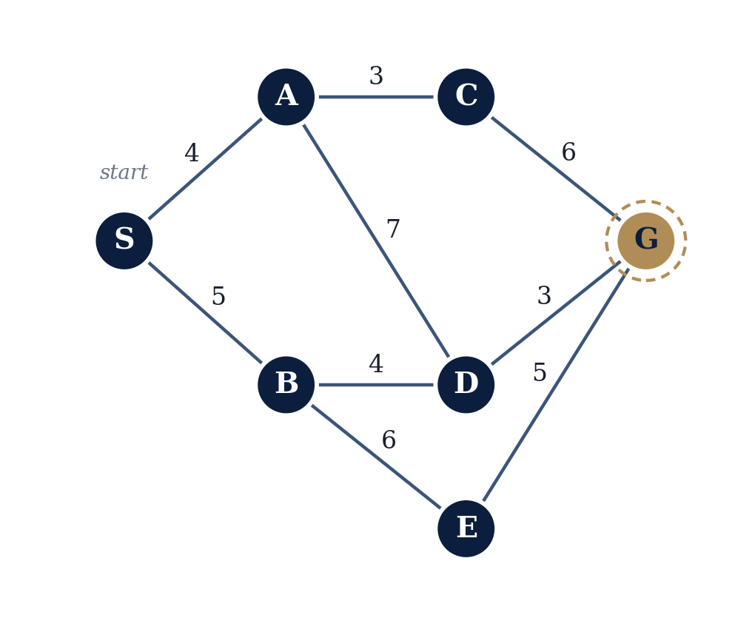
2. INFORMED SEARCH
Our Running Example — A Delivery Network
One small weighted graph, reused all lecture: a delivery robot navigating hubs S (start) to G (goal).
Numerical calculation
True shortest cost to G (h*):
h*(D)=3, h*(C)=6, h*(E)=5, h*(B)=7, h*(A)=9, h*(S)=12
Optimal path: S → B → D → G (cost 12)
A heuristic must never exceed these h* values. Two candidates, h₁, h₂ appear throughout.
AI — Lecture 4 | 2. Informed Search
7 / 40
Notes:
This is a set-up slide, not yet the algorithm trace — the point is to show students HOW h*(n) values are derived (by brute-force enumeration of paths), so the later admissibility check (h ≤ h*) is not a black box. Walk through at least one h* computation live on the board, e.g. h*(B): paths from B to G are B-D-G (4+3=7) and B-E-G (6+5=11); the cheaper is 7, so h*(B)=7. Classroom question: 'Why don't we just always use h*(n) itself as our heuristic, since it's clearly admissible (h=h* satisfies h≤h*)?' Answer: computing h*(n) requires already knowing the optimal path — which is precisely what search is trying to find. Using h* as h would mean the problem is already solved; heuristics must be cheap to compute WITHOUT search.

Slide 20
2. INFORMED SEARCH
From Heuristic Value to Search Behavior
Every strategy here is a GENERIC BEST-FIRST SEARCH with a different f(n).
Changing f(n) only changes the ORDER the frontier is explored in.
Uniform-Cost Search
f(n)=g(n)
Ignores h — purely cost-so-far.
Greedy Best-First
f(n)=h(n)
Ignores g — purely estimated remaining cost.
A* Search
f(n)=g(n)+h(n)
Balances both.
AI — Lecture 4 | 2. Informed Search
8 / 40
Notes:
This slide is the conceptual skeleton for the entire rest of the lecture — students should leave this slide knowing that everything from here forward is 'the same algorithm, different priority rule.' This directly sets up and helps correct misconception #7 later: UCS is NOT some unrelated algorithm from Lecture 3 living in a separate universe — it is A* with h(n)=0 everywhere. Do not over-explain that connection yet (it is formally revisited in Section 8, slide 32) — just plant the seed here. Classroom question: 'If f(n)=g(n) is UCS and f(n)=h(n) is Greedy, what algorithm do you think f(n)=g(n)+h(n) gives us, and why might combining them be smarter than either alone?' Let students guess before the next section names it: A*.

Slide 21
3. GREEDY BEST-FIRST SEARCH
Greedy Best-First Search
Concept — Always expand the node that LOOKS closest to the goal right now.
Formal definition — f(n) = h(n). Frontier is a priority queue ordered by h(n).
Consequence — No safeguard against a path that only LOOKS good early on.
f(n) = h(n)
Classroom question
Two frontier nodes tie on h(n) — what tie-break rule would you propose?
Priority queue key: h(n) only
AI — Lecture 4 | 3. Greedy Best-First Search
9 / 40
Notes:
Name the algorithm plainly: this is the first NAMED informed algorithm of the lecture. Stress the word 'Greedy' is a formal algorithmic term here, not a casual insult — greedy algorithms make the locally best choice at each step without reconsidering it. Pose the classroom question live and collect 2-3 student proposals (common answers: alphabetical order, insertion order (FIFO among ties), prefer larger g(n) so far). Reveal that different tie-breaking rules can change WHICH optimal-looking-but-suboptimal path greedy falls into, though it does not change greedy's fundamental lack of an optimality guarantee. We will fix our own tie-break rule (prefer smaller h, else insertion order) for consistency in today's worked examples.

Slide 22
3. GREEDY BEST-FIRST SEARCH
Greedy Best-First — Algorithm
function GREEDY-BEST-FIRST(problem, h):
frontier <- queue ordered by h(n); start in frontier
explored <- {}
loop: if frontier empty: return FAILURE
node <- pop lowest h(n)
if node is GOAL: return SOLUTION(node)
add node to explored
for child of node: if unseen, add to frontier
Notes
Same skeleton as UCS and A* — only the priority key differs
No mechanism ever reconsiders a choice — root of Greedy's weakness
AI — Lecture 4 | 3. Greedy Best-First Search
10 / 40
Notes:
Walk through the pseudocode line by line, but do not dwell too long — the real teaching moment is the worked trace on the next slides. Make the structural point explicit: this is line-for-line the same skeleton as UCS from Lecture 3 and as A* which we meet shortly; ONLY the priority key changes. This is worth writing on the board as three lines with blanks: 'frontier ordered by ___' and having students fill in g(n), h(n), g(n)+h(n) respectively before moving on. Also mention: a repeated-state check (the explored set) is what keeps this efficient on graphs with cycles.

Slide 23
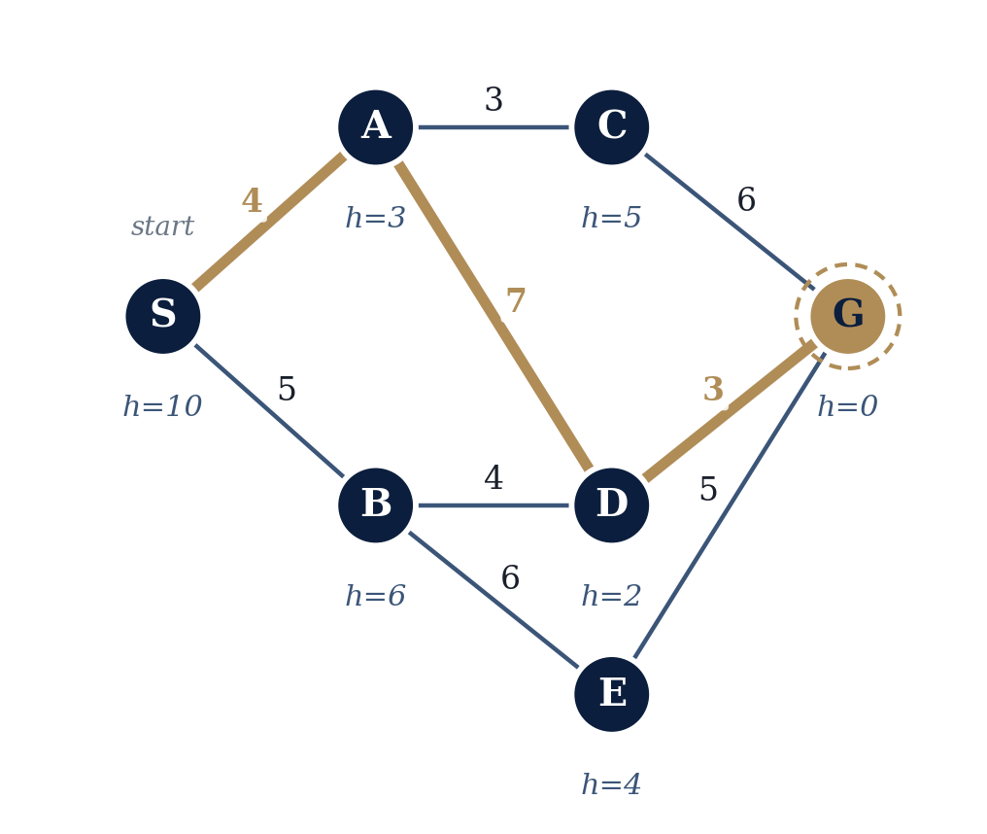
3. GREEDY BEST-FIRST SEARCH
Worked Example — Greedy Trace
Step | Expand | g(n) | h(n) | f(n)
1 | S | 0 | 10 | 10
2 | A | 4 | 3 | 3
3 | D | 11 | 2 | 2
4 | G (goal) | 14 | 0 | 0
Result
h₁ shown at each node — admissible but misleading at A
Greedy picks A (h=3 looks best) and never revisits that choice.Path: S→A→D→G, cost = 14. True optimum is 12 — Greedy is complete here but not optimal.
AI — Lecture 4 | 3. Greedy Best-First Search
11 / 40
Notes:
Trace this table live, node by node, asking students to predict the next expansion before you reveal it. Key moment: at Step 2, remind students that B was also on the frontier with h₁(B)=6 — Greedy strictly prefers A (h=3) without ever looking at the fact that reaching A cost 4 and the edge onward to D costs a further 7. This is exactly the misconception to correct here: 'Greedy chooses the node that is cheapest overall' is WRONG — correct statement: 'Greedy chooses the node that LOOKS closest to the goal, regardless of how expensive it was to get there.' Flag this now for direct contrast against A*'s trace in Section 4, which will find the cost-12 path on the SAME graph.

Slide 24
3. GREEDY BEST-FIRST SEARCH
Greedy — Strengths and Limitations
Strengths
Often expands far fewer nodes when h is reliable
Low overhead — no accumulated cost to track
Simple to implement and reason about
Limitations
Not optimal in general — as our trace just showed
Not complete in general without a repeated-state check
A misleading h(n) can make it worse than blind search
AI — Lecture 4 | 3. Greedy Best-First Search
12 / 40
Notes:
Correct misconception here explicitly: some students assume 'Greedy is always fast and A* is always slow because A* does more work' — push back gently: A* does not always expand more nodes than Greedy; it expands more than or equal to the minimum needed for optimality, while Greedy's node count is unpredictable — it can be very low OR very high depending entirely on how well the heuristic happens to align with the true costs on that specific problem. State the completeness caveat precisely: Greedy Best-First IS complete on a finite state space when a repeated-state (explored-set) check is used, as in our pseudocode; the classic incompleteness failure mode arises mainly on infinite or very large implicit search spaces without such a check. Bridge line to next slide: 'So can we keep Greedy's speed but recover the optimality guarantee? That question has a clean answer, and it's the single most important algorithm in this course.'

Slide 25
3. GREEDY BEST-FIRST SEARCH
Two Extremes: UCS vs. Greedy
Uniform-Cost Search — f(n) = g(n)
Blind to the goal's location — explores outward like ripples
Guaranteed optimal, but can explore many irrelevant nodes
Greedy Best-First Search — f(n) = h(n)
Blind to cost already paid — can be lured by early appearances
Often fast, but not guaranteed optimal
The natural question: what if f(n) used BOTH terms at once?
AI — Lecture 4 | 3. Greedy Best-First Search
13 / 40
Notes:
This slide is a deliberate rhetorical pause before naming A*. Let the question at the bottom hang for a moment — ask the class directly 'What would you call an algorithm that adds g(n) and h(n) together?' before advancing. Conceptual distinction to reinforce: Greedy vs UCS vs A* is not three unrelated algorithms to memorize separately; it is one idea (best-first search) explored at three different points along a single spectrum from 'ignore h' to 'ignore g' to 'use both.' This framing will make the A* definition on the next slide feel inevitable rather than arbitrary.

Slide 26
4. A* SEARCH
A* Search: Motivation
A* was designed to combine UCS's optimality with Greedy's goal-directed efficiency.
Hart, Nilsson, Raphael (1968)
First published at Stanford Research Institute for robotics planning.
Still the default today
GPS navigation, game pathfinding, robotics, logistics.
One elegant idea
Never discard cost paid — combine it with the estimate remaining.
AI — Lecture 4 | 4. A* Search
14 / 40
Notes:
Brief historical grounding, then move quickly — the payoff of this lecture is the mechanics, not the history. Emphasize the phrase 'never discard the cost already paid': this is the single sentence that separates A* from Greedy. Real-world application callout: mention that when players in modern video games watch an NPC or unit navigate around obstacles intelligently, that pathfinding is very often A* or a close variant running many times per second. Transition line: 'Let's write down exactly what expression A* uses, and then prove to ourselves why combining g and h is not just intuitive but mathematically well-motivated.'

Slide 27
4. A* SEARCH
The A* Evaluation Function
f(n) = g(n) + h(n)
Concept — A*'s best guess of total path cost through node n.
Formal definition — g(n): exact cost so far. h(n): estimated cost remaining.
At the goal — h(goal)=0, so f(goal)=g(goal) — the estimate becomes exact.
AI — Lecture 4 | 4. A* Search
15 / 40
Notes:
This is the formula slide students will photograph — write it on the board too, slowly. Correct misconception #1 directly and explicitly here (it recurs constantly in student work): 'A* always chooses the node with the smallest h(n)' is FALSE. A* chooses the node with the smallest f(n) = g(n)+h(n). A node can have a very small h(n) (looks close to the goal) yet a large g(n) (was very expensive to reach), giving it a large f(n) that A* correctly deprioritizes. Ask a classroom question: 'Node X has g=20, h=1. Node Y has g=2, h=15. Which does A* expand first?' Recompute together on the board: f(X)=21, f(Y)=17, so A* expands Y first. Use this as a live gotcha to make the point concrete.

Slide 28
4. A* SEARCH
Why Combining g and h Works
f(n) splits the journey into a KNOWN half (g) and an ESTIMATED half (h)
Low f(n) means cheap so far AND likely cheap to finish
A* neither wanders blindly (like UCS) nor is fooled by first looks (like Greedy)
Classroom question
If h(n)=0 everywhere, what algorithm results? If h(n)=h*(n) exactly, what happens?
Answers: h≡0 reduces f(n) to g(n) — exactly UCS. h=h*(n) exactly gives zero wasted expansions — the theoretical ideal, never available in practice.
AI — Lecture 4 | 4. A* Search
16 / 40
Notes:
Give the class real time on the classroom question before revealing the printed answer — this single question, worked out by students themselves, cements the g/h/f relationship better than any amount of additional lecture. This also plants the formal bridge that UCS is literally the special case of A* with h ≡ 0, which will be stated explicitly again in Section 8. Conceptual distinction to name here: the difference between a heuristic that is merely admissible (never overestimates) versus one that is perfectly accurate (h=h*) — perfect heuristics are a useful thought experiment but essentially never available for hard problems, since computing h*(n) requires already having solved the search problem.

Slide 29
4. A* SEARCH
A* Search — Algorithm
function A-STAR(problem, h):
g[start] <- 0; frontier <- queue by f(n)=g(n)+h(n)
explored <- {}
loop: if frontier empty: return FAILURE
node <- pop lowest f(n)
if node is GOAL: return SOLUTION(node) // safe here
add node to explored
for child via action a:
g_new <- g(node)+COST(node,a,child)
if unseen or g_new < g(child): update g,f; requeue
Why test the goal on pop, not on generation
A goal found via an expensive path could have a high g(n); testing only when POPPED guarantees optimality.
AI — Lecture 4 | 4. A* Search
17 / 40
Notes:
Spend a moment on the update rule 'if unseen or g_new < g(child)' — this is the mechanism that lets A* correct itself when a cheaper path to an already-seen node is discovered, something Greedy's pseudocode never does. This relates directly to why an admissible-but-inconsistent heuristic can force A* to reopen nodes pulled from the explored set (a wrinkle we will only mention briefly in Section 7, not implement here — out of scope for this lecture's pseudocode, which assumes we do not need to reopen explored nodes because we will only use it with a consistent heuristic in our worked example). Emphasize the goal-test-on-pop point strongly — it is a frequent source of subtle bugs when students implement A* in assignments.

Slide 30
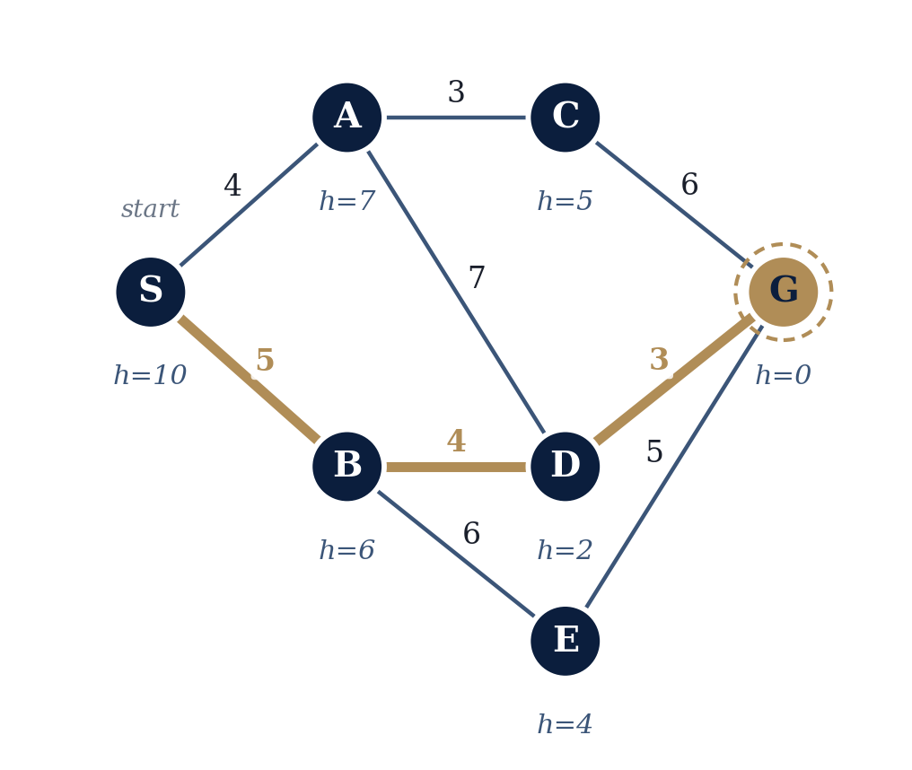
4. A* SEARCH
Worked Example — Setting Up A*
Same graph, now with h₂ — identical to h₁ except h₂(A)=7 instead of 3.
Why change h(A) from 3 to 7?
h₁(A)=3 was admissible but badly underestimated h*(A)=9
h₂(A)=7 is closer to truth, still admissible — stronger heuristic
h₂ is also consistent; h₁ is not (verified in Section 7)
A* reaches the OPTIMAL path with either — quality affects efficiency, not correctness
AI — Lecture 4 | 4. A* Search
18 / 40
Notes:
This is an important framing slide before the trace begins — make sure students register that we deliberately changed ONE heuristic value between the Greedy example and this one, and why. Foreshadow Section 5 and Section 7 explicitly: this same h₁-vs-h₂ pair will return as our worked example for heuristic dominance (Section 5) and for the admissible-vs-consistent distinction (Section 7). Reassure students that A* with h₁ (the weaker heuristic) would STILL find the optimal path here — admissibility alone guarantees A* eventually finds the optimum — but might expand more nodes doing so; we are using h₂ for this particular trace simply because it also lets us demonstrate consistency cleanly.

Slide 31
4. A* SEARCH
A* Step-by-Step Trace (Part 1 of 2)
Step | Node | g(n) | h(n) | f(n) | Status
1 | S | 0 | 10 | 10 | Expanded (start)
2 | B | 5 | 6 | 11 | Beats A: tie on f=11, lower h wins
3 | D | 9 | 2 | 11 | Beats A: tie on f=11, lower h wins
Frontier evolution
After S: A(f=11), B(f=11)
After B: A(f=11), D(f=11), E(f=15)
After D: A(f=11), G(f=12), E(f=15)
AI — Lecture 4 | 4. A* Search
19 / 40
Notes:
Trace this on the board in real time alongside the slide — draw the frontier as a literal sorted list after each step. Critical instructor point at Step 2 and Step 3: both times, node A (f=11, from Step 1) is sitting in the frontier the whole time but loses the f=11 tie to a node with smaller h(n) — this is exactly the tie-breaking rule from slide 9's classroom question, now put to concrete use. Ask: 'Why didn't we expand A at Step 2, even though it's been waiting since Step 1?' Answer: it is tied on f(n) with B and D respectively, and our tie-break rule (smaller h wins) consistently favors the other node; A's turn will come at Step 4, shown next slide. State plainly, since it is no longer spelled out on the slide: the tie-break rule in use throughout is 'among equal f(n), prefer the smaller h(n).'

Slide 32
4. A* SEARCH
A* Step-by-Step Trace (Part 2 of 2)
Step | Node | g(n) | h(n) | f(n) | Status
4 | A | 4 | 7 | 11 | Its turn — no longer tied
5 | G | 12 | 0 | 12 | GOAL selected — terminate
Why stopping here is safe
Final result
C (f=12) also ties with G — G wins (h=0 < 5)
h₂ consistent ⇒ f(n) never decreases
So no undiscovered node can beat G
Path: S → B → D → G
Cost: 5+4+3 = 12
5 expansions vs. Greedy's 14 — same optimum.
AI — Lecture 4 | 4. A* Search
20 / 40
Notes:
This slide carries the single most important punchline of the entire lecture — do not rush it. Make students verbally confirm the arithmetic: 5+4+3=12, matching the h* computation from slide 7 exactly (h*(S) was defined as 12). Restate the safe-termination argument slowly: it depends on CONSISTENCY, not merely admissibility — flag that Section 7 will make this precise, and that an admissible-but-inconsistent heuristic (like h₁) can still find the optimum eventually but may require reopening nodes pulled from explored, which is a more advanced implementation detail we are only mentioning, not implementing, today (explicitly out of scope, akin to IDA*/RBFS variants).

Slide 33
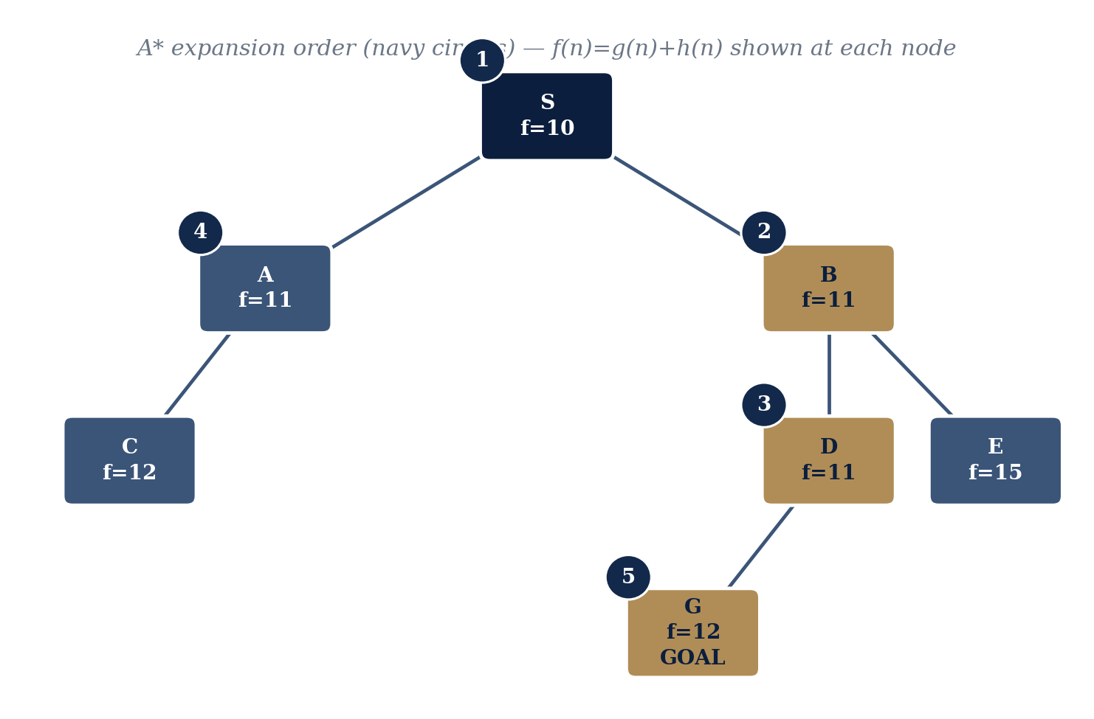
4. A* SEARCH
Visualizing the A* Search Tree
Reading the tree
Each box shows f(n) at the moment of expansion
Numbered circles show expansion ORDER (1–5), by increasing f(n)
C and E were generated but never needed expanding
AI — Lecture 4 | 4. A* Search
21 / 40
Notes:
Use this slide to consolidate the trace into a single visual artifact students can study later. Ask a classroom question: 'C and E were both generated but never expanded — does that mean the algorithm wasted work generating them?' Answer: no — generating a node (computing its g, h, f and placing it on the frontier) is inexpensive compared to expanding it (exploring its children); A*'s efficiency comes from minimizing EXPANSIONS of unpromising nodes, not from avoiding ever looking at them. This distinguishes 'generated' from 'expanded,' a distinction worth making explicit since students often conflate the two when reasoning about search complexity.

Slide 34
4. A* SEARCH
Section Recap: Same Graph, Three Outcomes
Algorithm | f(n) | Path | Cost | Outcome
Uniform-Cost Search | f(n)=g(n) | S→B→D→G | 12 | Optimal, broader search
Greedy Best-First | f(n)=h(n) | S→A→D→G | 14 | Fast, misled by h₁(A) — not optimal
A* Search | f(n)=g(n)+h(n) | S→B→D→G | 12 | Optimal AND goal-directed
Misconception check: “UCS is unrelated to A*” is FALSE — UCS is A* with h(n)=0 everywhere.
AI — Lecture 4 | 4. A* Search
22 / 40
Notes:
This is a deliberate section-closer that puts all three results side by side for direct visual comparison — give students a moment to just look at it before talking. Reinforce that UCS and A* found the SAME path here (S-B-D-G, cost 12); that is not a coincidence of this particular example but a guaranteed property whenever the heuristic is admissible — what differs between UCS and A* is not correctness but EFFICIENCY (A* typically reaches this conclusion after exploring far fewer nodes on larger problems, though on our tiny 7-node example the difference is not dramatic). Transition to next section: 'We've seen a weak heuristic mislead Greedy and a stronger one guide A* perfectly — let's now formalize exactly what makes one heuristic ‘better’ than another.'

Slide 35
5. HEURISTIC QUALITY
What Makes a Heuristic “Good”?
Concept — “Good” is a matter of DEGREE among admissible heuristics, not yes/no.
Formal criterion — Larger values (closer to h*, never exceeding it) prune more search.
The trade-off to remember
A more informative heuristic can be more expensive to COMPUTE
Balance: how much it narrows search vs. its per-node cost
Engineers often accept a weaker, cheaper h evaluated millions of times/sec
AI — Lecture 4 | 5. Heuristic Quality
23 / 40
Notes:
Ground this abstractly-stated trade-off with a concrete instance: computing Euclidean distance is a few arithmetic operations; computing a heuristic derived from a relaxed version of a large planning problem (a 'pattern database' heuristic, mentioned only by name, not detail) might take far longer per node despite being much more accurate. This slide sets up both the h₁/h₂ comparison on the next slide and the Manhattan/Euclidean comparison two slides later. Classroom question: 'Would you ever prefer a WEAKER heuristic on purpose?' Let students reason towards the computation-cost trade-off themselves before you state it explicitly.

Slide 36
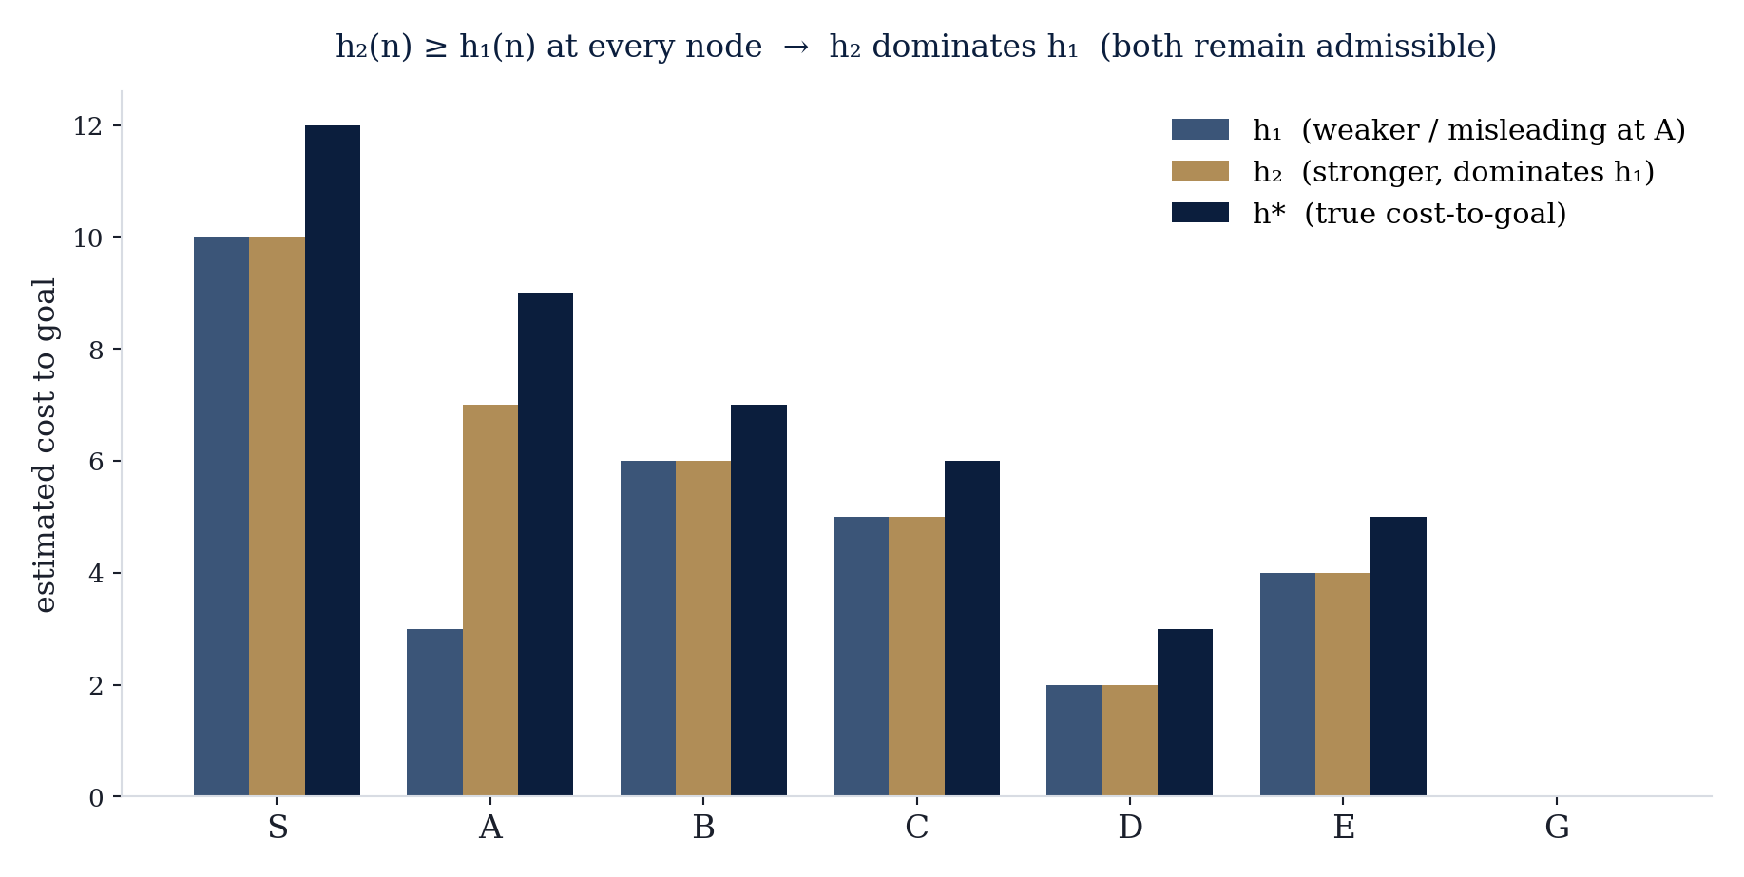
5. HEURISTIC QUALITY
Weak vs. Strong Heuristics — h₁ and h₂
Reading this chart
h₁ and h₂ agree everywhere except at A
h₂(A)=7 sits much closer to h*(A)=9 than h₁(A)=3
Both stay admissible — neither bar exceeds h*
A* handled either correctly — quality affects EFFICIENCY, not correctness
AI — Lecture 4 | 5. Heuristic Quality
24 / 40
Notes:
This slide is the visual payoff of the running example — students have now seen h₁ and h₂ in a graph diagram, a numeric trace, and now this direct bar-chart comparison. Reinforce the definition of 'weak' and 'strong' precisely: both terms are always relative to a shared upper bound (h*) and only meaningful when comparing heuristics that are both admissible. A heuristic that occasionally overestimates is not 'strong' — it is simply inadmissible, a different and more serious problem covered on the admissibility slides.

Slide 37
5. HEURISTIC QUALITY
Heuristic Dominance
Definition: If h₂(n) ≥ h₁(n) everywhere and both are admissible, h₂ dominates h₁ — A* with h₂ never expands more nodes.
Expansion order | 1st | 2nd | 3rd | 4th | 5th | Total
A* using h₁ (dominated) | S | A | B | D | G | 5
A* using h₂ (dominant) | S | B | D | A | G | 5
Honest reading
Both need 5 expansions — dominance means never MORE, not always fewer. h₂ deprioritizes A (4th); h₁ wastes a slot on it early (2nd).
AI — Lecture 4 | 5. Heuristic Quality
25 / 40
Notes:
This slide directly corrects misconception #5: 'a more informative (dominant) heuristic always strictly reduces the number of expansions' is an overstatement students often walk away with from a quick treatment of this topic — the precise guarantee is 'never more, possibly equal, generally fewer on larger or more branching problems.' Use the honest-reading box to model good scientific reasoning: we are not hiding the fact that our tiny example doesn't show a raw count improvement, we are explaining exactly why the small size of the example limits what it can demonstrate, while the ORDER of expansion still clearly favors h₂. This is a good moment to remind students that toy examples in lectures are chosen for clarity of mechanism, not for showcasing every real-world benefit at scale.

Slide 38
5. HEURISTIC QUALITY
A Second Example: Manhattan vs. Euclidean
Grid robot, 4-directional unit moves. Robot at (0,0), goal at (3,4).
Euclidean distance
Manhattan distance
√(3²+4²) = 5
|3|+|4| = 7
5 ≤ 7 — admissible but LOOSE (assumes diagonal shortcuts)
7 = h* — admissible AND exact for this movement model
The lesson: the best heuristic depends on the ACTION MODEL — allow diagonal moves and Manhattan could even become inadmissible.
AI — Lecture 4 | 5. Heuristic Quality
26 / 40
Notes:
This is a classic and important example — sketch the (0,0) to (3,4) grid on the board with the Euclidean straight line versus the Manhattan staircase path visibly overlaid. This example generalizes beautifully to the sliding-tile puzzles (8-puzzle, 15-puzzle) mentioned as a real-world application earlier: Manhattan distance summed over all misplaced tiles is the standard heuristic taught in every AI course for that exact reason — tile moves are grid-restricted, so Manhattan distance is tight. Flag the final point about the action model as a genuinely subtle, university-level insight: heuristic design is not a fixed recipe, it must respect what moves the problem actually allows.

Slide 39
6. ADMISSIBILITY
Admissibility
h(n) ≤ h*(n) for every node n
Formal definition — Never overestimates the true cost to the nearest goal.
Theorem — Admissible h ⇒ A* with TREE SEARCH is guaranteed optimal.
Why it works — h never overpromises, so A* never dismisses a path too early.
AI — Lecture 4 | 6. Admissibility
27 / 40
Notes:
Correct misconception #2 head-on, in these words: 'admissible' does NOT mean 'accurate' or 'good.' It is a one-sided, minimal requirement — h(n)=0 for every node is trivially admissible (0 never overestimates anything), and we already know that particular admissible heuristic is exactly UCS. Emphasize the asymmetry: overestimating is dangerous (can cause A* to miss the optimal path), underestimating is only ever a matter of efficiency, never correctness (for tree search). Classroom question: 'Is h(n) = h*(n) - 1000 (for every node with h*(n) ≥ 1000) admissible? Would it be a GOOD heuristic?' Answer: yes it is technically admissible (never overestimates by construction) but computationally it is nearly worthless / degenerates search efficiency close to UCS-like behavior for those nodes, and is not realistic since h*(n) is generally unknown anyway.

Slide 40
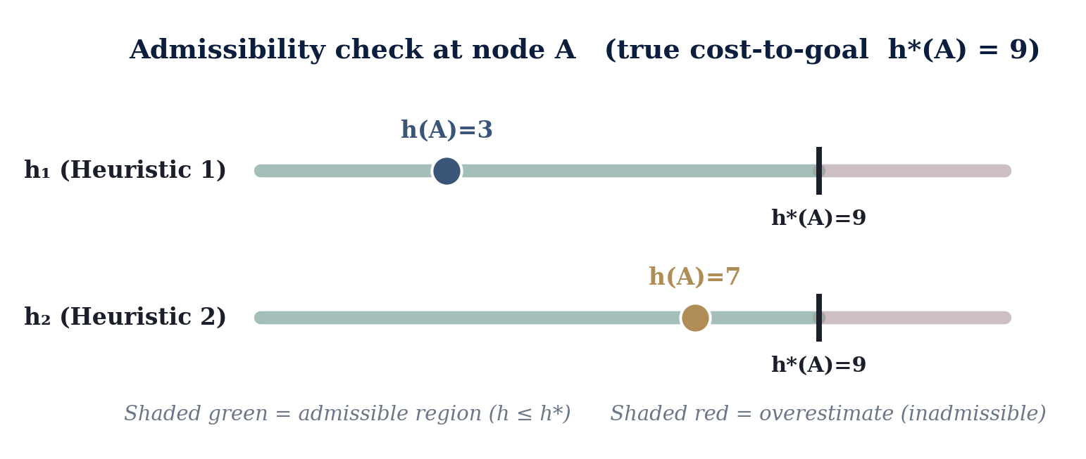
6. ADMISSIBILITY
Admissibility — Numerical Example
Both heuristics pass
h₁(A)=3 ≤ 9 and h₂(A)=7 ≤ 9. Both admissible — they differ only in tightness, not correctness.
AI — Lecture 4 | 6. Admissibility
28 / 40
Notes:
Walk through the number line visually: the green shaded region is the entire admissible range for h(A), from 0 up to and including h*(A)=9; both our candidate heuristics land safely inside it, at very different points. Ask a classroom question: 'Where on this number line would a heuristic sit if it were both admissible AND perfectly informative?' (Answer: exactly at the boundary, h(A)=9=h*(A) — as close to the red zone as possible without crossing it. This is the theoretical ideal that real heuristics only approximate.) Reiterate that crossing into the red zone even slightly — say h(A)=9.01 — breaks the admissibility guarantee and can cause A* (tree search) to return a suboptimal answer, even though intuitively 9.01 seems like an almost-perfect estimate.

Slide 41
7. CONSISTENCY (MONOTONICITY)
Consistency
h(n) ≤ c(n,n′) + h(n′) for every edge n → n′
Formal definition — The triangle inequality above, for every edge (also called monotonicity).
Intuition — h can never drop by more than the cost of the edge just crossed.
Consequence — f(n) is NON-DECREASING along every path A* explores.
AI — Lecture 4 | 7. Consistency (Monotonicity)
29 / 40
Notes:
Derive the non-decreasing-f claim on the board from the inequality directly, since it is a short one-line algebra step and is exactly the kind of derivation a university-level treatment should include: f(n') = g(n') + h(n') = g(n) + c(n,n') + h(n') ≥ g(n) + h(n) = f(n), using consistency in the middle step. Point out this derivation is precisely why we introduced g(n), h(n), f(n) notation so carefully in Section 2 — it now pays off in a real proof. Do not let students conflate 'monotonicity' as a totally different concept from 'consistency' — explicitly state these are two names for the exact same property, both appear interchangeably in AI textbooks and exam questions.

Slide 42
7. CONSISTENCY (MONOTONICITY)
Admissibility vs. Consistency
Consistent ⟶ always admissible (the reverse is NOT guaranteed)
Consistency is STRICTER: every consistent h is admissible, not the reverse
h₂ is admissible AND consistent; h₁ is admissible but NOT consistent (fails on edge S–A)
Practical stake: an inconsistent h may force graph-search A* to reopen an explored node when a cheaper path turns up later
AI — Lecture 4 | 7. Consistency (Monotonicity)
30 / 40
Notes:
This slide corrects misconception #3 directly: 'admissible and consistent are the same requirement' is false, and the direction of implication matters (consistent ⇒ admissible, not the other way). Give students the one-line proof sketch for why consistency implies admissibility: chain the triangle inequality along the entire path from n to the goal, edge by edge; the telescoping sum gives h(n) ≤ (sum of edge costs along the path) + h(goal) = cost of that path, and since this holds for the OPTIMAL path in particular, h(n) ≤ h*(n). This is a satisfying short proof worth putting on the board. On the reopening point: mention explicitly that implementing reopening logic is an important but more advanced detail we are flagging conceptually, not implementing today — consistent with our scope control for this lecture. Also state plainly, since the slide leaves it implicit: with a consistent heuristic this reopening never happens, because the first time a node is popped its g-value is already optimal.

Slide 43
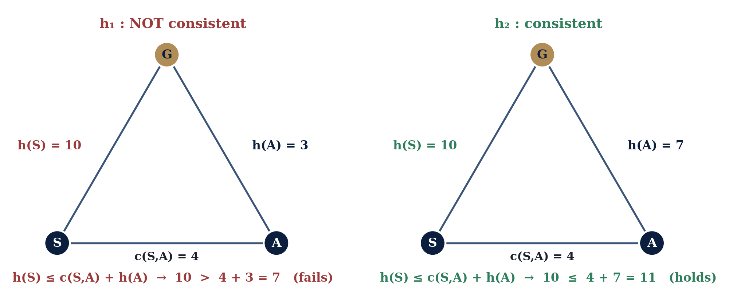
7. CONSISTENCY (MONOTONICITY)
Consistency — Numerical Example
Classroom question
h₁ is admissible yet fails consistency on edge S–A. Do the other eight edges violate it too? (No — S–A is the only one.)
AI — Lecture 4 | 7. Consistency (Monotonicity)
31 / 40
Notes:
Have students actually check one or two of the other edges live as a quick group exercise — e.g., edge B-D under h₁: h₁(B)=6 ≤ c(B,D)+h₁(D) = 4+2 = 6 — holds with EQUALITY, which is still consistent (the inequality is non-strict). This is worth pointing out: consistency allows equality, it only forbids h(n) exceeding c(n,n')+h(n'). Use this slide to reassure students that a single local violation does not necessarily wreck an entire A* run in every case — but stress this was a lucky feature of this specific small example, not a general guarantee; in general graphs, inconsistency CAN force reopening and extra work, which is precisely why consistency is the property algorithm designers actively aim for when hand-crafting a heuristic. This is also why A* still reached the optimal answer with h₁ earlier without needing to reopen any node in that particular run.

Slide 44
8. A* PROPERTIES
When Is A* Guaranteed Optimal?
Tree search (no explored set)
Admissible h is sufficient. Nodes may be revisited via different paths; can be wasteful on graphs with repeated states.
Graph search (with explored set)
Consistent h is sufficient (standard in practice) — a node's g-value is already optimal the first time it is popped.
Special case: UCS is exactly A* with h(n)=0 — trivially consistent, so UCS is always optimal.
AI — Lecture 4 | 8. A* Properties
32 / 40
Notes:
This slide formalizes the tree-vs-graph-search conceptual distinction promised back in Section 4, and closes the loop on misconception #7 (UCS vs A*) with an actual short proof rather than just an assertion: h≡0 satisfies the consistency inequality trivially (0 ≤ c(n,n′)+0 always holds for non-negative costs), so all of A*'s consistency-based guarantees apply automatically to UCS. Ask a classroom question: 'Does Greedy Best-First Search fit anywhere in this admissible/consistent framework?' Answer: no — Greedy's optimality is not governed by these properties at all, because its evaluation function f(n)=h(n) does not incorporate g(n); admissibility and consistency are properties that specifically interact with the g+h STRUCTURE of A*'s evaluation function, which Greedy lacks entirely. This is worth stating explicitly since students sometimes assume admissibility 'fixes' Greedy too — it does not.

Slide 45
8. A* PROPERTIES
Comparing All Five Search Strategies
Algo | Complete? | Optimal? | f(n) | Structure | Strength | Weakness
BFS | Yes* | Yes* | depth(n) | FIFO queue | Simple, shallowest | Exponential memory
DFS | Conditional* | No | — | LIFO stack | Very low memory | Long dead-end paths
UCS | Yes* | Yes | g(n) | P-queue by g | Optimal, weighted | Blind to goal
Greedy | Conditional* | No | h(n) | P-queue by h | Often fast | Can be misled
A* | Yes* | Yes* | g(n)+h(n) | P-queue by f | Optimal + efficient | Frontier memory grows
* BFS: equal step costs. UCS: costs ≥ ε. A*: admissible/consistent h. DFS & Greedy: complete only with a repeated-state / finite-space check.
AI — Lecture 4 | 8. A* Properties
33 / 40
Notes:
This is the reference table students will use most when reviewing for exams — spend real time here, and read the caveats aloud rather than letting students assume the Yes/No columns are unconditional absolutes. Highlight specifically: BFS is optimal only under the equal-step-cost assumption (a frequent exam trick question is to ask about BFS optimality on a WEIGHTED graph, where the answer is no); DFS's completeness depends entirely on whether the space is finite or cycle-checking is used; Greedy's completeness is conditional on a repeated-state check, spelled out in the footnote. Emphasize the A* row last as the section's takeaway: it is the only algorithm in the table that is simultaneously guaranteed optimal AND actively goal-directed, which is exactly why it dominates practical use in the applications listed earlier (GPS routing, robotics, games, logistics).

Slide 46
9. LOCAL SEARCH
Introducing Local Search
Motivation
Some problems only care about the FINAL state, not the path (e.g., n-queens); some state spaces are too large to store a frontier at all.
Definition
Keeps ONE current state, moves to a neighbor, and retains no memory of the path taken.
Systematic search vs. Local search
Systematic (BFS…A*): explicit frontier + explored set; can backtrack; completeness/optimality guarantees
Local (Hill Climbing): only the current state; O(1) memory; NO general guarantee
AI — Lecture 4 | 9. Local Search
34 / 40
Notes:
This is conceptual distinction #7 (systematic vs local search) stated formally — make the memory argument concrete: systematic search on a state space with branching factor b and depth d can need frontier memory on the order of b^d; local search needs to remember exactly one state, a constant amount of memory, regardless of d. That is the entire appeal of local search, and also the source of its weaknesses covered in the next few slides. Classroom question: 'Why would path cost be irrelevant for something like arranging furniture in a room to maximize space, or assigning exam time slots to avoid conflicts?' Answer: we only care about the quality of the FINAL arrangement, not which sequence of moves produced it. Mention real-world uses verbally: circuit layout, task/resource scheduling, VLSI design, and any large-scale optimization problem where path-based search would be infeasible.

Slide 47
9. LOCAL SEARCH
Hill Climbing — Definition and Algorithm
function HILL-CLIMBING(problem):
current <- problem.INITIAL-STATE
loop:
neighbor <- highest-valued successor of current
if VALUE(neighbor) <= VALUE(current): return current
current <- neighbor
Reading this algorithm
“Steepest-ascent”: among all neighbors, always take the single BEST one
Maximization framing (VALUE, higher = better) — mirrors minimizing h(n)
AI — Lecture 4 | 9. Local Search
35 / 40
Notes:
Note explicitly that this pseudocode has NO frontier, no explored set, and no way to undo a move — contrast this visually and verbally against the A* pseudocode from slide 17, which had all three. Point out the sign-flip framing: our whole lecture has used h(n) where SMALLER is better (closer to goal); Hill Climbing is conventionally taught with VALUE where LARGER is better, since it is often framed on optimization problems (maximize board quality, maximize schedule efficiency) rather than minimize distance-to-goal — the underlying idea is identical, just mirrored. Also state plainly, since the slide compresses it: the algorithm halts the moment no neighbor improves on the current state, since it never looks further ahead than one step. Set up the next three slides: 'This greedy, one-step-lookahead design is exactly why Hill Climbing runs into some very characteristic failure modes.'

Slide 48
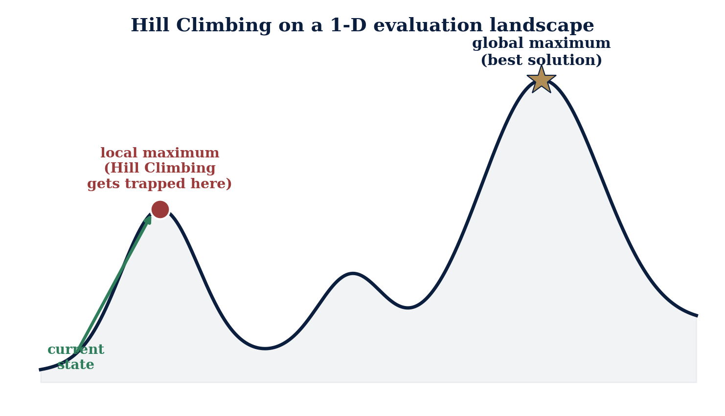
9. LOCAL SEARCH
Local Maxima — Getting Trapped
Global vs. Local
Local max: better than neighbors, not the whole landscape
Global max: the true best point anywhere
Hill Climbing can't tell the difference from where it stands
AI — Lecture 4 | 9. Local Search
36 / 40
Notes:
This slide corrects misconception #6 directly and forcefully: 'Hill Climbing is an informed method, so surely it eventually finds the best solution' is false — informed does not imply globally aware. The algorithm's entire field of view is its immediate neighbors; it is structurally incapable of distinguishing a local maximum from the global one without additional machinery. Classroom question: 'From the trapped position shown, what would the algorithm have to do to escape, and why can't steepest-ascent Hill Climbing do that on its own?' Answer: it would need to accept a temporarily WORSE move to get over the dip — something the pseudocode on the previous slide explicitly forbids, since it only ever accepts strictly improving moves. Mention, only as a name-drop for a future lecture and not to be elaborated on: random-restart hill climbing and simulated annealing are two classic fixes for exactly this failure mode.

Slide 49
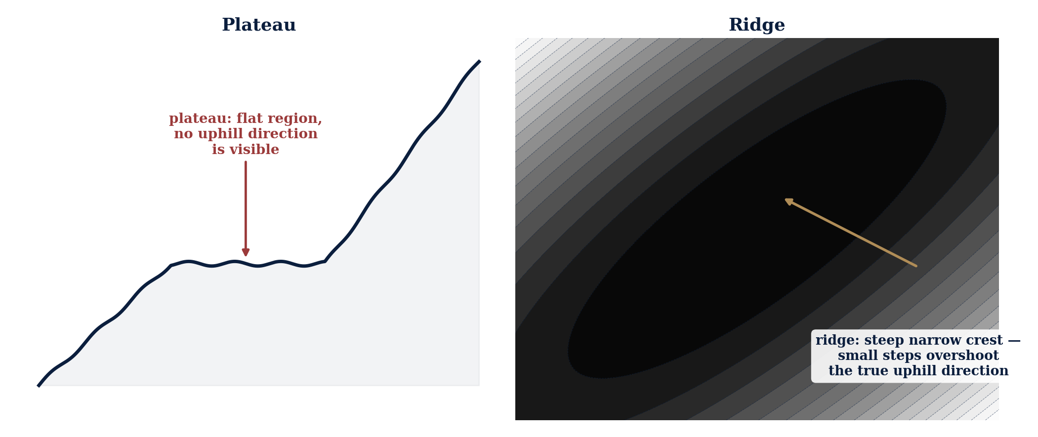
9. LOCAL SEARCH
Plateaus and Ridges
Plateau: flat region, no signal — may wander or halt early.
Ridge: crest misaligned with moves — steps overshoot, zig-zag.
AI — Lecture 4 | 9. Local Search
37 / 40
Notes:
This slide completes conceptual distinction #13: local maximum vs. plateau vs. ridge are three DIFFERENT structural failure modes, often incorrectly treated as synonyms by students. A local maximum is a point failure (nowhere better nearby in any direction); a plateau is a flat failure (no direction is distinguishable at all); a ridge is a directional-mismatch failure (there IS a clear uphill direction in principle, but it does not line up with the algorithm's discrete move options, so each individual step looks unpromising even though a short sequence of them would make progress). Classroom question: 'For a ridge, would allowing diagonal moves (if the problem structure permits them) help, and why?' Answer: often yes — more move directions available per step increases the chance that one of them aligns closely with the true ridge direction.

Slide 50
9. LOCAL SEARCH
Hill Climbing — Strengths, Limitations, Fixes
Strengths
Limitations
Constant memory, any state-space size
Simple to implement, often fast
Vulnerable to maxima, plateaus, ridges
Fixes for later: restarts, annealing
 | Systematic (BFS…A*) | Local (Hill Climbing)
Memory | Grows with frontier | Constant
Path returned? | Yes, full path | No, final state only
Guarantees | Under stated conditions | None, in general
AI — Lecture 4 | 9. Local Search
38 / 40
Notes:
Be explicit and firm about scope control on this slide: random-restart Hill Climbing and simulated annealing are named ONLY so students recognize the terms later — do not derive or trace either one; they belong to a future lecture. If a student asks for detail, it is appropriate to say 'great question, we will cover that when we get to stochastic local search methods.' Use the closing comparison table to summarize the systematic-vs-local distinction one final time before moving to the lecture's closing integration section. Classroom question: 'Given everything today, when would you choose local search over A* even though local search offers weaker guarantees?' Answer: when the state space is too large or continuous for a frontier-based method to be feasible at all, or when only the final configuration matters and path cost is irrelevant.

Slide 51
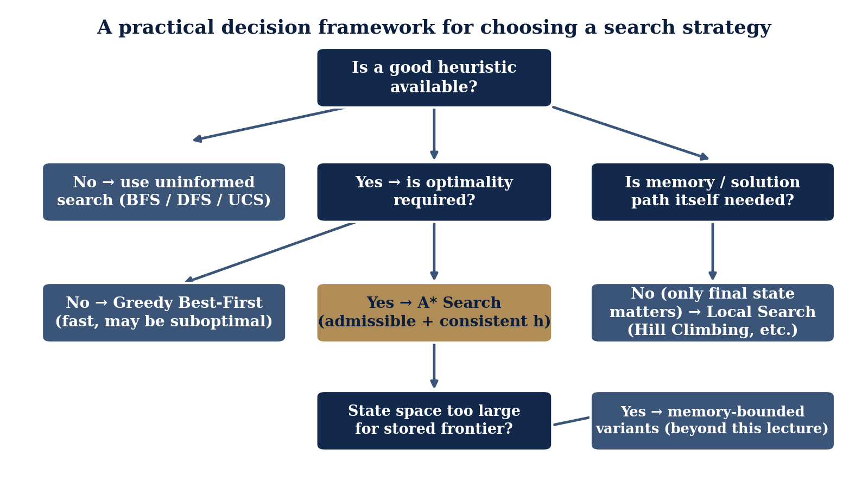
10. INTEGRATION
Choosing the Right Search Strategy
In Industry Today
GPS routing — A*
Robot/drone nav. — A* variants
Game NPC pathfinding — A*
Warehouse & logistics — A* / Greedy
Network routing — UCS / A*-style
Puzzle solving — A* + Manhattan h
Scheduling & layout — local search
AI — Lecture 4 | 10. Integration
39 / 40
Notes:
Walk through the flowchart as a decision students could genuinely apply to a homework or capstone project: start at the top ('is a good heuristic available?'), and follow branches down. This slide is also the natural place to circle back to every real-world application named on slide 4 and connect each one concretely to a specific algorithm from today, closing the loop the lecture opened with. Classroom question (good discussion starter, not a quick-answer one): 'A ride-sharing app needs to compute a driver's route in under 50 milliseconds on a road network with millions of intersections — which of today's ideas would you reach for first, and what would you need to know about the heuristic before trusting it in production?' Let a few students answer before moving to the closing slide.

Slide 52
10. INTEGRATION
Summary and Final Challenge
Key takeaways
Final challenge question
h(n) guides expansion toward the goal
f=g is UCS; f=h is Greedy; f=g+h is A*
A* is optimal when h is admissible (tree) or consistent (graph)
Consistency ⇒ admissibility, not the reverse
A dominant heuristic never expands more nodes
Local search trades guarantees for constant memory
h(n) ≤ h*(n) everywhere, but fails consistency on one edge. With graph-search A*, is the result still optimal? What must the code handle?
Bring your answer to Lecture 5 — we open with it.
AI — Lecture 4 | 10. Integration
40 / 40
Notes:
Read the final challenge question aloud slowly and resist the urge to answer it yourself today — it is intentionally left open as a bridge into Lecture 5. The expected reasoning (for your own reference, not necessarily to reveal): yes, optimality is still guaranteed EVENTUALLY because admissibility alone is enough for correctness, but the implementation must allow REOPENING a node that is already in the explored set if a cheaper path to it is discovered later (updating its g-value and re-inserting it into the frontier) — without that provision, a naive graph-search A* that never revisits explored nodes could return a suboptimal answer when the heuristic is admissible but not consistent. Close the lecture by briefly previewing that Lecture 5 will build on today's admissible/consistent framework. Thank the class and open the floor for any remaining questions.

