Slide 1

Android Mobile Development
Lecture No. 01

Slide 2
Android
Android tutorial or android development tutorial covers basic and advanced concepts of android technology. Our android tutorial is developed for beginners and professionals.
Android is a complete set of software for mobile devices such as tablet computers, notebooks, smartphones, electronic book readers, set-top boxes etc.
It contains a Linux-based Operating System, middleware and key mobile applications.
It can be thought of as a mobile operating system. But it is not limited to mobile only. It is currently used in various devices such as mobiles, tablets, televisions etc.

Slide 3
What is Android ?
Before learning all topics of android, it is required to know what is android.
Android is a software package and Linux based operating system for mobile devices such as tablet computers and smartphones.
It is developed by Google and later the OHA (Open Handset Alliance). Java language is mainly used to write the android code even though other languages can be used.
The goal of android project is to create a successful real-world product that improves the mobile experience for end users.
There are many code names of android such as Lollipop, Kitkat, Jelly Bean, Ice cream Sandwich, Froyo, Ecliar, Donut etc which is covered in next page.

Slide 4
What is Open Handset Alliance (OHA)
It's a consortium of 84 companies such as google, Samsung, AKM, Synaptics, KDDI, Garmin, Teleca, ebay, Intel etc.
It was established on 5th November, 2007, led by Google. It is committed to advance open standards, provide services and deploy handsets using the Android Platform.

Slide 5
Features of Android
After learning what is android, let's see the features of android. The important features of android are given below:
It is open-source.
Anyone can customize the Android Platform.
There are a lot of mobile applications that can be chosen by the consumer.
It provides many interesting features like weather details, opening screen, live RSS (Really Simple Syndication) feeds etc.
It provides support for messaging services(SMS and MMS), web browser, storage (SQLite), connectivity (GSM, CDMA, Blue Tooth, Wi-Fi etc.), media, handset layout etc.

Slide 6
Categories of Android applications
There are many android applications in the market. The top categories are:
Entertainment
Tools
Communication
Productivity
Personalization
Music and Audio
Social
Media and Video
Travel and Local etc.

Slide 7
History of Android
The history and versions of android are interesting to know. The code names of android ranges from A to J currently, such as Aestro, Blender, Cupcake, Donut, Eclair, Froyo, Gingerbread, Honeycomb, Ice Cream Sandwitch, Jelly Bean, KitKat and Lollipop. Let's understand the android history in a sequence.
Initially, Andy Rubin founded Android Incorporation in Palo Alto, California, United States in October, 2003.
In 17th August 2005, Google acquired android Incorporation. Since then, it is in the subsidiary of Google Incorporation.
The key employees of Android Incorporation are Andy Rubin, Rich Miner, Chris White and Nick Sears.
Originally intended for camera but shifted to smart phones later because of low market for camera only.
Android is the nick name of Andy Rubin given by coworkers because of his love to robots.
In 2007, Google announces the development of android OS.
In 2008, HTC launched the first android mobile.

Slide 8
Android Versions, Codename and API
Let's see the android versions, codenames and API Level provided by Google. Visit android website (Developer).
Code name | Version numbers | API level | Release date
No codename | 1.0 | 1 | September 23, 2008
No codename | 1.1 | 2 | February 9, 2009
Cupcake | 1.5 | 3 | April 27, 2009
Donut | 1.6 | 4 | September 15, 2009
Eclair | 2.0 - 2.1 | 5 - 7 | October 26, 2009
Froyo | 2.2 - 2.2.3 | 8 | May 20, 2010
Gingerbread | 2.3 - 2.3.7 | 9 - 10 | December 6, 2010
Honeycomb | 3.0 - 3.2.6 | 11 - 13 | February 22, 2011
Ice Cream Sandwich | 4.0 - 4.0.4 | 14 - 15 | October 18, 2011
Jelly Bean | 4.1 - 4.3.1 | 16 - 18 | July 9, 2012

Slide 9
Android Versions, Codename and API
Let's see the android versions, codenames and API Level provided by Google. Visit android website (Developer).
Code name | Version numbers | API level | Release date
KitKat | 4.4 - 4.4.4 | 19 - 20 | October 31, 2013
Lollipop | 5.0 - 5.1.1 | 21- 22 | November 12, 2014
Marshmallow | 6.0 - 6.0.1 | 23 | October 5, 2015
Nougat | 7.0 | 24 | August 22, 2016
Nougat | 7.1.0 - 7.1.2 | 25 | October 4, 2016
Oreo | 8.0 | 26 | August 21, 2017
Oreo | 8.1 | 27 | December 5, 2017
Pie | 9.0 | 28 | August 6, 2018
Android 10 | 10.0 | 29 | September 3, 2019
Android 11 | 11 | 30 | September 8, 2020

Slide 10
Android Architecture
Android Architecture or Android Software Stack is categorized into five parts:
Linux kernel
Native libraries (middleware),
Android Runtime
Application Framework
Applications
Let's see the android architecture first. (on Lecture 01)

Slide 11
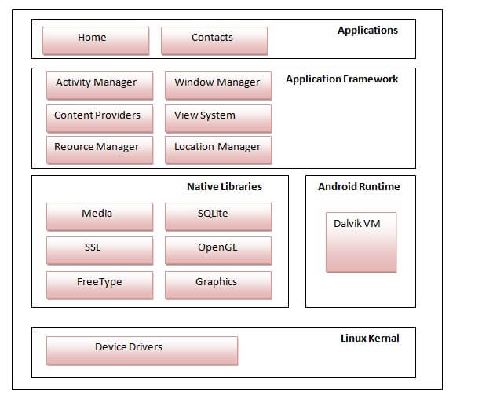
Android Architecture

Slide 12
Android Architecture
1) Linux Kernel
It is the heart of android architecture that exists at the root of android architecture. Linux kernel is responsible for device drivers, power management, memory management, device management and resource access.
2) Native Libraries
On the top of linux kernel, their are Native libraries such as WebKit, OpenGL, FreeType, SQLite, Media, C runtime library (libc) etc. The WebKit library is responsible for browser support, SQLite is for database, FreeType for font support, Media for playing and recording audio and video formats.
3) Android Runtime
In android runtime, there are core libraries and DVM (Dalvik Virtual Machine) which is responsible to run android application. DVM is like JVM but it is optimized for mobile devices. It consumes less memory and provides fast performance.

Slide 13
Android Architecture
4) Android Framework
On the top of Native libraries and android runtime, there is android framework. Android framework includes Android API's such as UI (User Interface), telephony, resources, locations, Content Providers (data) and package managers. It provides a lot of classes and interfaces for android application development.
5) Applications
On the top of android framework, there are applications. All applications such as home, contact, settings, games, browsers are using android framework that uses android runtime and libraries. Android runtime and native libraries are using Linux Kernal.

Slide 14
Android Core Building Blocks
An android component is simply a piece of code that has a well defined life cycle
e.g. Activity, Receiver, Service etc.
The core building blocks or fundamental components of android are activities, views, intents, services, content providers, fragments and AndroidManifest.xml.
Activity
An activity is a class that represents a single screen. It is like a Frame in AWT.
View
A view is the UI element such as button, label, text field etc. Anything that you see is a view.

Slide 15
Android Core Building Blocks
Intent
Intent is used to invoke components. It is mainly used to:
Start the service
Launch an activity
Display a web page
Display a list of contacts
Broadcast a message
Dial a phone call etc.
For example, you may write the following code to view the webpage.
Intent intent = new Intent (Intent.ACTION_VIEW) ;
intent.setData( Uri.parse( "http://www.ahksoft.com" ) ) ;
startActivity( intent ) ;

Slide 16
Android Core Building Blocks
Service
Service is a background process that can run for a long time.
There are two types of services local and remote. Local service is accessed from within the application whereas remote service is accessed remotely from other applications running on the same device.
Content Provider
Content Providers are used to share data between the applications.
Fragment
Fragments are like parts of activity. An activity can display one or more fragments on the screen at the same time.

Slide 17
Android Core Building Blocks
AndroidManifest.xml
It contains information about activities, content providers, permissions etc.
It is like the web.xml file in Java EE.
Android Virtual Device (AVD)
It is used to test the android application without the need for mobile or tablet etc.
It can be created in different configurations to emulate different types of real devices.

Slide 18



Compiled by Abdul Hafeez
Sources:
This presentation is for informational and educational purpose only.
Third party pictures for education purpose, using google search engine.
Wikipedia and third party websites for data contents also with own words.
Contact me:
https://www.facebook.com/sirabdulhafeez/
ahtozee@yahoo.com

Slide 19


Thank you for your Attention

