Slide 1


Android Mobile Development
Lecture No. 05

Slide 2
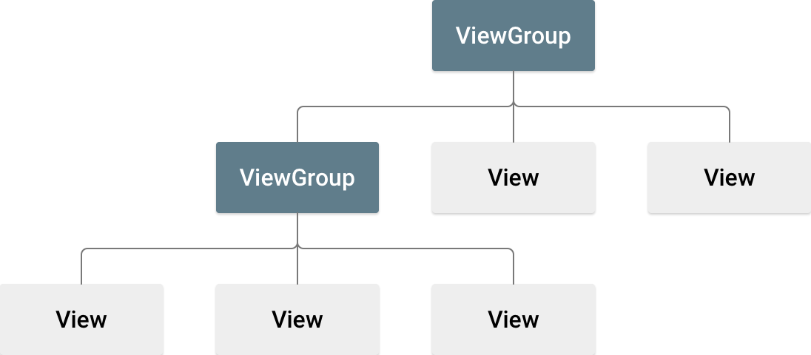
Android Layout
A layout defines the structure for a user interface in your app, such as in an activity. All elements in the layout are built using a hierarchy of View and ViewGroup objects. A View usually draws something the user can see and interact with. Whereas a ViewGroup is an invisible container that defines the layout structure for View and other ViewGroup objects, as shown in figure.

Slide 3
Android Layout
The View objects are usually called "widgets" and can be one of many subclasses, such as Button or TextView. The ViewGroup objects are usually called "layouts" can be one of many types that provide a different layout structure, such as LinearLayout or ConstraintLayout .
You can declare a layout in two ways:
Declare UI elements in XML. Android provides a straightforward XML vocabulary that corresponds to the View classes and subclasses, such as those for widgets and layouts. You can also use Android Studio's Layout Editor to build your XML layout using a drag-and-drop interface.
Instantiate layout elements at runtime. Your app can create View and ViewGroup objects (and manipulate their properties) programmatically.

Slide 4
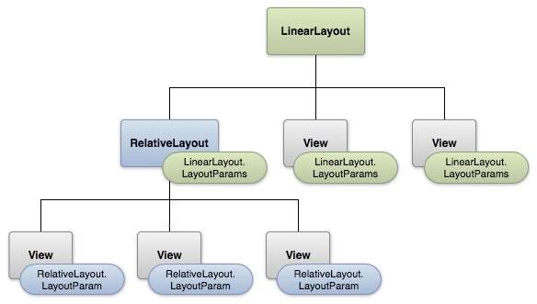
Android Layout

Slide 5
Android Layout Types
There are number of Layouts provided by Android which you will use in almost all the Android applications to provide different view, look and feel.
# | Layout & Description
1 | LinearLayout is a view group that aligns all children in a single direction, vertically or horizontally.
2 | RelativeLayout is a view group that displays child views in relative positions.
3 | TableLayout is a view that groups views into rows and columns.
4 | AbsoluteLayout enables you to specify the exact location of its children.
5 | FrameLayout is a placeholder on screen that you can use to display a single view.
6 | ListView is a view group that displays a list of scrollable items.
7 | GridView is a ViewGroup that displays items in a two-dimensional, scrollable grid.

Slide 6
Android Layout Types
There are number of Layouts provided by Android which you will use in almost all the Android applications to provide different view, look and feel.
# | Layout & Description
1 | LinearLayout is a view group that aligns all children in a single direction, vertically or horizontally.
2 | RelativeLayout is a view group that displays child views in relative positions.
3 | TableLayout is a view that groups views into rows and columns.
4 | AbsoluteLayout enables you to specify the exact location of its children.
5 | FrameLayout is a placeholder on screen that you can use to display a single view.
6 | ListView is a view group that displays a list of scrollable items.
7 | GridView is a ViewGroup that displays items in a two-dimensional, scrollable grid.

Slide 7
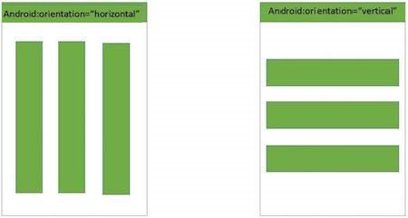
LinearLayout
Android LinearLayout is a view group that aligns all children in either vertically or horizontally.

Slide 8
LinearLayout Attributes
Following are the important attributes specific to LinearLayout −
# | Attribute & Description
1 | android:id This is the ID which uniquely identifies the layout.
2 | android:baselineAligned This must be a boolean value, either "true" or "false" and prevents the layout from aligning its children's baselines.
3 | android:baselineAlignedChildIndex When a linear layout is part of another layout that is baseline aligned, it can specify which of its children to baseline align.
4 | android:divider This is drawable to use as a vertical divider between buttons. You use a color value, in the form of "#rgb", "#argb", "#rrggbb", or "#aarrggbb".

Slide 9
LinearLayout Attributes
Following are the important attributes specific to LinearLayout −
# | Attribute & Description
5 | android:gravity This specifies how an object should position its content, on both the X and Y axes. Possible values are top, bottom, left, right, center, center_vertical, center_horizontal etc.
6 | android:orientation This specifies the direction of arrangement and you will use "horizontal" for a row, "vertical" for a column. The default is horizontal.
7 | android:weightSum Sum up of child weight

Slide 10
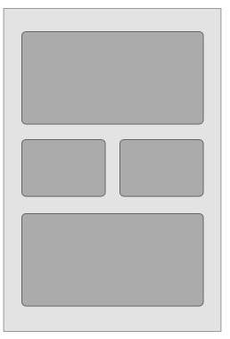

RelativeLayout
Android RelativeLayout enables you to specify how child views are positioned relative to each other. The position of each view can be specified as relative to sibling elements or relative to the parent.

Slide 11
Relative Layout Attributes
Following are the important attributes specific to RelativeLayout −
# | Attribute & Description
 | android:id This is the ID which uniquely identifies the layout.
2 | android:gravity This specifies how an object should position its content, on both the X and Y axes. Possible values are top, bottom, left, right, center, center_vertical, center_horizontal etc.
3 | android:ignoreGravity This indicates what view should not be affected by gravity.
 | android:id This is the ID which uniquely identifies the layout.

Slide 12
Relative Layout Attributes
RelativeLayout.LayoutParams
# | Attribute & Description
 | android:layout_above Positions the bottom edge of this view above the given anchor view ID and must be a reference to another resource, in the form "@[+][package:]type:name"
2 | android:layout_alignBottom Makes the bottom edge of this view match the bottom edge of the given anchor view ID and must be a reference to another resource, in the form "@[+][package:]type:name".
3 | android:layout_alignLeft Makes the left edge of this view match the left edge of the given anchor view ID and must be a reference to another resource, in the form "@[+][package:]type:name".
4 | android:layout_alignParentBottom If true, makes the bottom edge of this view match the bottom edge of the parent. Must be a boolean value, either "true" or "false".

Slide 13
Relative Layout Attributes
RelativeLayout.LayoutParams
# | Attribute & Description
 | android:layout_alignParentEnd If true, makes the end edge of this view match the end edge of the parent. Must be a boolean value, either "true" or "false".
6 | android:layout_alignParentLeft If true, makes the left edge of this view match the left edge of the parent. Must be a boolean value, either "true" or "false".
7 | android:layout_alignParentRight If true, makes the right edge of this view match the right edge of the parent. Must be a boolean value, either "true" or "false".
8 | android:layout_alignParentStart If true, makes the start edge of this view match the start edge of the parent. Must be a boolean value, either "true" or "false".

Slide 14
Relative Layout Attributes
RelativeLayout.LayoutParams
# | Attribute & Description
 | android:layout_alignParentTop If true, makes the top edge of this view match the top edge of the parent. Must be a boolean value, either "true" or "false".
10 | android:layout_alignRight Makes the right edge of this view match the right edge of the given anchor view ID and must be a reference to another resource, in the form "@[+][package:]type:name".
11 | android:layout_alignStart Makes the start edge of this view match the start edge of the given anchor view ID and must be a reference to another resource, in the form "@[+][package:]type:name".
12 | android:layout_alignTop Makes the top edge of this view match the top edge of the given anchor view ID and must be a reference to another resource, in the form "@[+][package:]type:name".

Slide 15
Relative Layout Attributes
RelativeLayout.LayoutParams
# | Attribute & Description
 | android:layout_below Positions the top edge of this view below the given anchor view ID and must be a reference to another resource, in the form "@[+][package:]type:name".
14 | android:layout_centerHorizontal If true, centers this child horizontally within its parent. Must be a boolean value, either "true" or "false".
15 | android:layout_centerInParent If true, centers this child horizontally and vertically within its parent. Must be a boolean value, either "true" or "false".
16 | android:layout_centerVertical If true, centers this child vertically within its parent. Must be a boolean value, either "true" or "false".

Slide 16
RelativeLayout Attributes
RelativeLayout.LayoutParams
# | Attribute & Description
 | android:layout_toEndOf Positions the start edge of this view to the end of the given anchor view ID and must be a reference to another resource, in the form "@[+][package:]type:name".
18 | android:layout_toLeftOf Positions the right edge of this view to the left of the given anchor view ID and must be a reference to another resource, in the form "@[+][package:]type:name".
19 | android:layout_toRightOf Positions the left edge of this view to the right of the given anchor view ID and must be a reference to another resource, in the form "@[+][package:]type:name".
20 | android:layout_toStartOf Positions the end edge of this view to the start of the given anchor view ID and must be a reference to another resource, in the form "@[+][package:]type:name".

Slide 17
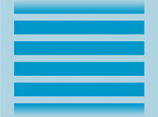

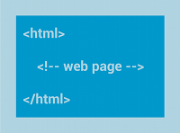
Layouts
ListView
GridView
WebView
Displays a scrolling single column list.
Displays a scrolling grid of columns and rows.
Displays web pages.

Slide 18
Android Layout Sample code
<LinearLayout xmlns:android="http://schemas.android.com/apk/res/android"
android:layout_width="match_parent" android:layout_height="wrap_content"
android:background="@color/colorAccent" android:orientation="vertical"
>
<Button
android:layout_width="100dp" android:layout_height="50dp"
android:text="Submit" android:padding="10dp" android:layout_weight="70"
/>
<Button
android:layout_width="100dp" android:layout_height="50dp"
android:text="cancel" android:layout_weight="30"
/>

Slide 19
Android Layout Sample Code
<RelativeLayout xmlns:android="http://schemas.android.com/apk/res/android"
android:layout_width="match_parent" android:layout_height="match_parent">
<Button
android:id="@+id/button" android:text="Button"
android:layout_alignParentBottom="true"
android:layout_alignParentLeft="true"
android:layout_alignParentRight="true"
android:layout_centerHorizontal="true"
android:layout_centerVertical="true"
android:layout_centerInParent="true"
android:layout_alignTop="@+id/btn1"
android:layout_toRightOf="@+id/btn1"
/>

Slide 20
Android Layout Sample Code
<activity android:name=".MainActivity" android:screenOrientation="landscape">

Slide 21



Compiled by Abdul Hafeez
Sources:
This presentation is for informational and educational purpose only.
Third party pictures for education purpose, using google search engine.
Wikipedia and third party websites for data contents also with own words.
Contact me:
https://www.facebook.com/sirabdulhafeez/
ahtozee@yahoo.com

Slide 22


Thank you for your Attention

