Slide 1

Android Mobile Development
Lecture No. 10

Slide 2
Dalvik Virtual Machine | DVM
As we know the modern JVM is high performance and provides excellent memory management. But it needs to be optimized for low-powered handheld devices as well.
The Dalvik Virtual Machine (DVM) is an android virtual machine optimized for mobile devices. It optimizes the virtual machine for memory, battery life and performance.
Dalvik is a name of a town in Iceland. The Dalvik VM was written by Dan Bornstein.
The .dex compiler converts the class files into the .dex file that run on the Dalvik VM. Multiple class files are converted into one .dex file.

Slide 3
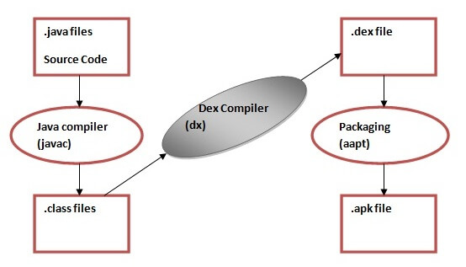
Dalvik Virtual Machine | DVM
Let's see the compiling and packaging process from the source file:

Slide 4
Dalvik Virtual Machine
Let's see the compiling and packaging process from the source file:
The javac tool compiles the java source file into the class file.
The dx tool takes all the class files of your application and generates a single .dex file. It is a platform-specific tool.
The Android Assets Packaging Tool (.aapt) handles the packaging process.

Slide 5



Compiled by
Abdul Hafeez
Sources:
This presentation is for informational and educational purpose only.
Third party pictures for education purpose, using google search engine.
Wikipedia and third party websites for data contents also with own words.
Contact me:
https://www.facebook.com/sirabdulhafeez/
ahtozee@yahoo.com

Slide 6



Thank you for your Attention

