Slide 1
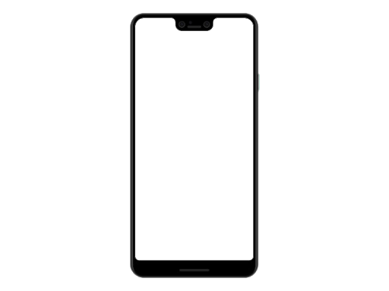
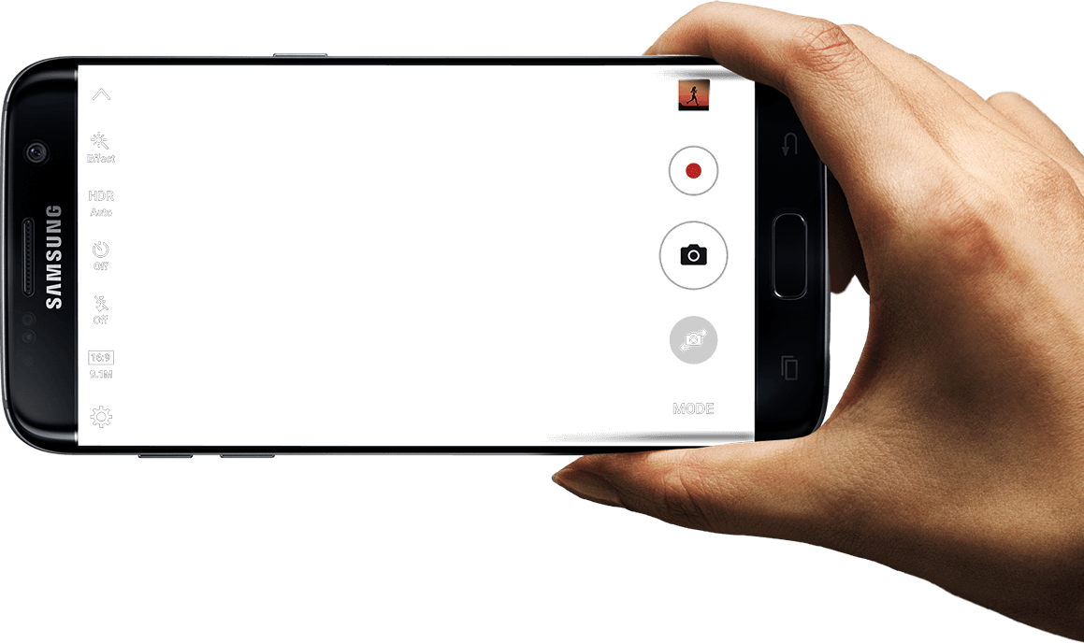

Android Mobile Development
Lecture No. 11

Slide 2
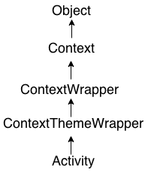
Android Activity Lifecycle
Android Activity Lifecycle is controlled by 7 methods of android.app.Activity class. The android Activity is the subclass of ContextThemeWrapper class.
An activity is the single screen in android. It is like window or frame of Java.
By the help of activity, you can place all your UI components or widgets in a single screen.
The 7 lifecycle method of Activity describes how activity will behave at different states.

Slide 3
Android Activity Lifecycle methods
Let's see the 7 lifecycle methods of android activity.
Method | Description
onCreate ( ) | called when activity is first created.
OnStart ( ) | called when activity is becoming visible to the user.
onResume ( ) | called when activity will start interacting with the user.
onPause ( ) | called when activity is not visible to the user.
onStop ( ) | called when activity is no longer visible to the user.
onRestart ( ) | called after your activity is stopped, prior to start.
onDestroy ( ) | called before the activity is destroyed.
The onCreate() and onDestroy() methods are called only once throughout the activity lifecycle.

Slide 4
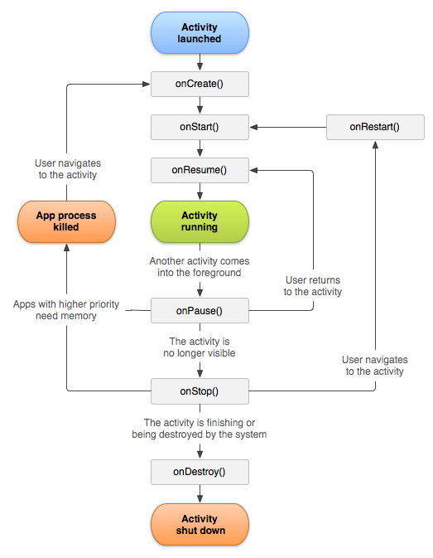
Android Activity Lifecycle

Slide 5
Sample Code
@Override
protected void onCreate(Bundle savedInstanceState) {
super.onCreate(savedInstanceState);
setContentView(R.layout.activity_main);
Log.d("lifecycle","onCreate invoked");
}
@Override
protected void onStart() {
super.onStart();
Log.d("lifecycle","onStart invoked");
}
@Override
protected void onResume() {
super.onResume();
Log.d("lifecycle","onResume invoked");
}
Sample Code Page 1 of 3

Slide 6
Sample Code
@Override
protected void onPause() {
super.onPause();
Log.d("lifecycle","onPause invoked");
}
@Override
protected void onStop() {
super.onStop();
Log.d("lifecycle","onStop invoked");
}
@Override
protected void onRestart() {
super.onRestart();
Log.d("lifecycle","onRestart invoked");
}
Sample Code Page 2 of 3

Slide 7
Sample Code
@Override
protected void onDestroy() {
super.onDestroy();
Log.d("lifecycle","onDestroy invoked");
}
Sample Code Page 3 of 3

Slide 8



Compiled by Abdul Hafeez
Sources:
This presentation is for informational and educational purpose only.
Third party pictures for education purpose, using google search engine.
Wikipedia and third party websites for data contents also with own words.
Contact me:
https://www.facebook.com/sirabdulhafeez/
ahtozee@yahoo.com

Slide 9


Thank you for your Attention

