Slide 1
Android Screen Orientation Example
The screenOrientation is the attribute of activity element. The orientation of android activity can be portrait, landscape, sensor, unspecified etc. You need to define it in the AndroidManifest.xml file.
Syntax:
<activity android:name="package_name.my_Activitynam“ android:screenOrientation="orirntation_type">
</activity>
Example:
<activity android:name=" example.ahksoft.com.screenorientation.MainActivity" android:screenOrientation="portrait“ >
</activity>
<activity android:name=".SecondActivity" android:screenOrientation="landscape"> </activity>
Example:

Slide 2
Android Screen Orientation Example
The common values for screenOrientation attribute are as follows:
Value | Description
unspecified | It is the default value. In such case, system chooses the orientation.
portrait | taller not wider
landscape | wider not taller
sensor | orientation is determined by the device orientation sensor.

Slide 3
Android Screen Orientation Example
activity_main.xml
<android.support.constraint.ConstraintLayout
xmlns:android="http://schemas.android.com/apk/res/android"
…………………………
tools:context="example.ahksoft.com.screenorientation.MainActivity“
>
activity_second.xml
<android.support.constraint.ConstraintLayout
xmlns:android="http://schemas.android.com/apk/res/android"
…………………………
tools:context="example.ahksoft.com.screenorientation.SecondActivity“
>

Slide 4
Android Screen Orientation Example
AndroidManifest.xml
In AndroidManifest.xml file add the screenOrientation attribute in activity and provides its orientation. In this example, we provide "portrait" orientation for MainActivity and "landscape" for SecondActivity.
<manifest xmlns:android="http://schemas.android.com/apk/res/android" ….. >
<application ………….. android:theme="@style/AppTheme">
<activity
android:name="exampleahksoft.com.screenorientation.MainActivity"
android:screenOrientation="portrait“ >
<intent-filter> …….. </intent-filter>
</activity>
<activity android:name=".SecondActivity"
android:screenOrientation="landscape">
</activity>
</application>
</manifest>

Slide 5
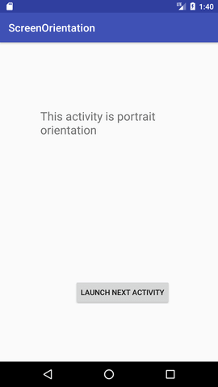
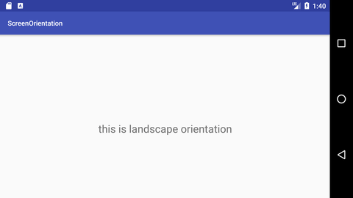
Android Screen Orientation Example

