Slide 1
Android Widgets

Slide 2
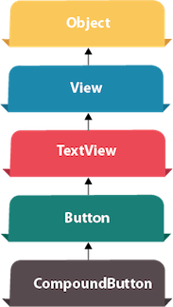
Android Button Example
Android Button represents a push-button. The android.widget.Button is subclass of TextView class and CompoundButton is the subclass of Button class.
There are different types of buttons in android such as RadioButton, ToggleButton, CompoundButton etc.
Android Button Example with Listener
Here, we are going to create two textfields and one button for sum of two numbers. If user clicks button, sum of two input values is displayed on the Toast.
We can perform action on button using different types such as calling listener on button or adding onClick property of button in activity's xml file.

Slide 3
Android Button Example
Android Button Example with Listener
button.setOnClickListener(new View.OnClickListener() {
@Override
public void onClick(View view) {
//Your code here, and execute after clicking.
}
});
<Button
android:onClick"methodName"
/>

Slide 4
Android Button Example
File: activity_main.xml
<?xml version="1.0" encoding="utf-8"?>
<RelativeLayout xmlns:android="http://schemas.android.com/apk/res/android"
xmlns:app="http://schemas.android.com/apk/res-auto" xmlns:tools="http://schemas.android.com/tools"
android:layout_width="match_parent“ android:layout_height="match_parent"
tools:context="example.javatpoint.com.sumoftwonumber.MainActivity">
<EditText
android:id="@+id/editText1"
android:layout_width="wrap_content“ android:layout_height="wrap_content"
android:layout_alignParentTop="true“ android:layout_centerHorizontal="true"
android:layout_marginTop="61dp“ android:ems="10"
android:inputType="number“ tools:layout_editor_absoluteX="84dp"
tools:layout_editor_absoluteY="53dp" />
++++++++ Part A code here +++++
</RelativeLayout>

Slide 5
Android Button Example
File: activity_main.xml
++++++++ Part A code here +++++
<EditText
android:id="@+id/editText2" android:layout_width="wrap_content"
android:layout_height="wrap_content“ android:layout_below="@+id/editText1"
android:layout_centerHorizontal="true“ android:layout_marginTop="32dp"
android:ems="10“ android:inputType="number"
tools:layout_editor_absoluteX="84dp“ tools:layout_editor_absoluteY="127dp" />
<Button
android:id="@+id/button“ android:layout_width="wrap_content"
android:layout_height="wrap_content“ android:layout_below="@+id/editText2"
android:layout_centerHorizontal="true“ android:layout_marginTop="109dp"
android:text="ADD“ tools:layout_editor_absoluteX="148dp"
tools:layout_editor_absoluteY="266dp" />

Slide 6
Android Button Example
File: MainActivity.java
import android.support.v7.app.AppCompatActivity; import android.os.Bundle;
import android.view.View; import android.widget.Button;
import android.widget.EditText; import android.widget.Toast;
public class MainActivity extends AppCompatActivity {
private EditText edittext1, edittext2; private Button buttonSum;
@Override
protected void onCreate(Bundle savedInstanceState) {
super.onCreate(savedInstanceState);
setContentView(R.layout.activity_main);
addListenerOnButton();
}
+++++++++ Part A code here ++++++++++++++++
}

Slide 7
Android Button Example
File: MainActivity.java
+++++++++ Part A code ++++++++++++++++
public void addListenerOnButton() {
edittext1 = (EditText) findViewById(R.id.editText1);
edittext2 = (EditText) findViewById(R.id.editText2);
buttonSum = (Button) findViewById(R.id.button);
buttonSum.setOnClickListener(new View.OnClickListener() {
@Override
public void onClick(View view) {
String value1=edittext1.getText().toString();
String value2=edittext2.getText().toString();
int a=Integer.parseInt(value1);
int b=Integer.parseInt(value2);
int sum=a+b;
Toast.makeText(getApplicationContext(),String.valueOf(sum), Toast.LENGTH_LONG).show();
}
});
}

Slide 8
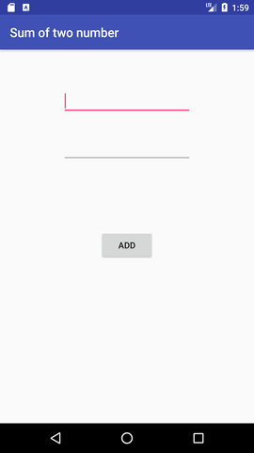
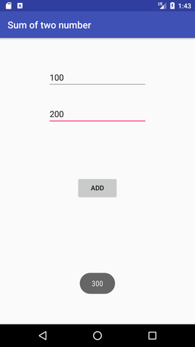
Android Button Example

