Slide 1
Android Widgets

Slide 2
Android ToggleButton Example
Android Toggle Button can be used to display checked/unchecked (On/Off) state on the button.
It is beneficial if user have to change the setting between two states. It can be used to On/Off Sound, Wifi, Bluetooth etc.
Since Android 4.0, there is another type of toggle button called switch that provides slider control.
Android ToggleButton and Switch both are the subclasses of CompoundButton class.
Android ToggleButton class
ToggleButton class provides the facility of creating the toggle button.
XML Attributes of ToggleButton class
The 3 XML attributes of ToggleButton class.
XML Attribute | Description
android:disabledAlpha | The alpha to apply to the indicator when disabled.
android:textOff | The text for the button when it is not checked.
android:textOn | The text for the button when it is checked.

Slide 3
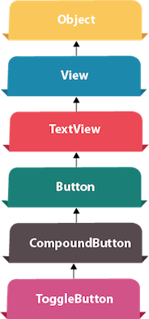
Android ToggleButton Example
Methods of ToggleButton class
The widely used methods of ToggleButton class are given below.
Method | Description
CharSequence getTextOff() | Returns the text when button is not in the checked state.
CharSequence getTextOn() | Returns the text for when button is in the checked state.
void setChecked(boolean checked) | Changes the checked state of this button.

Slide 4
Android ToggleButton Example
activity_main.xml
<?xml version="1.0" encoding="utf-8"?>
<android.support.constraint.ConstraintLayout xmlns:android="http://schemas.android.com/apk/res/android"
xmlns:app="http://schemas.android.com/apk/res-auto" xmlns:tools="http://schemas.android.com/tools"
android:layout_width="match_parent“ android:layout_height="match_parent"
tools:context="example.javatpoint.com.togglebutton.MainActivity">
<ToggleButton
android:id="@+id/toggleButton“ android:text="ToggleButton"
android:layout_width="wrap_content" android:layout_height="wrap_content"
android:layout_marginLeft="8dp“ android:layout_marginTop="80dp"
android:textOff="Off“ android:textOn="On"
app:layout_constraintEnd_toStartOf="@+id/toggleButton2" app:layout_constraintStart_toStartOf="parent"
app:layout_constraintTop_toTopOf="parent" />
++++++++++++++ Part A Code here ++++++++++++++++
</android.support.constraint.ConstraintLayout>

Slide 5
Android ToggleButton Example
activity_main.xml
++++++++++++++ Part A Code ++++++++++++++++
<ToggleButton
android:id="@+id/toggleButton2“
android:layout_width="wrap_content“ android:layout_height="wrap_content"
android:layout_marginRight="60dp“ android:layout_marginTop="80dp"
android:text="ToggleButton“ android:textOff="Off“ android:textOn="On"
app:layout_constraintEnd_toEndOf="parent" app:layout_constraintTop_toTopOf="parent" />
<Button
android:id="@+id/button“ android:text="Submit"
android:layout_width="wrap_content" android:layout_height="wrap_content“
android:layout_marginBottom="144dp" android:layout_marginLeft="148dp“
app:layout_constraintBottom_toBottomOf="parent“
app:layout_constraintStart_toStartOf="parent" />

Slide 6
Android ToggleButton Example
File: MainActivity.java
Let's write the code to check which toggle button is ON/OFF.
import android.support.v7.app.AppCompatActivity; import android.os.Bundle; import android.view.View;
import android.widget.Button; import android.widget.Toast; import android.widget.ToggleButton;
public class MainActivity extends AppCompatActivity {
private ToggleButton toggleButton1, toggleButton2;
private Button buttonSubmit;
@Override
protected void onCreate(Bundle savedInstanceState) {
super.onCreate(savedInstanceState);
setContentView(R.layout.activity_main);
addListenerOnButtonClick();
}
+++++ Code Part A Here ++++
}

Slide 7
Android ToggleButton Example
File: MainActivity.java
Let's write the code to check which toggle button is ON/OFF.
+++++ Code Part A ++++
public void addListenerOnButtonClick(){
//Getting the ToggleButton and Button instance from the layout xml file
toggleButton1=(ToggleButton)findViewById(R.id.toggleButton);
toggleButton2=(ToggleButton)findViewById(R.id.toggleButton2);
buttonSubmit=(Button)findViewById(R.id.button);
//Performing action on button click
buttonSubmit.setOnClickListener(new View.OnClickListener(){
@Override
public void onClick(View view) {
StringBuilder result = new StringBuilder();
result.append("ToggleButton1 : ").append(toggleButton1.getText());
result.append("\nToggleButton2 : ").append(toggleButton2.getText());
//Displaying the message in toast
Toast.makeText(getApplicationContext(), result.toString(),Toast.LENGTH_LONG).show();
}
});
}

Slide 8
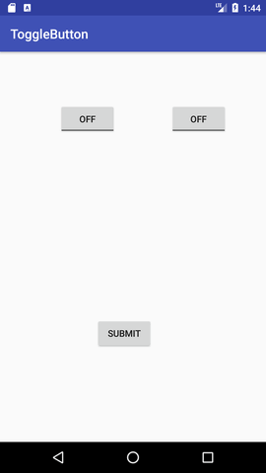
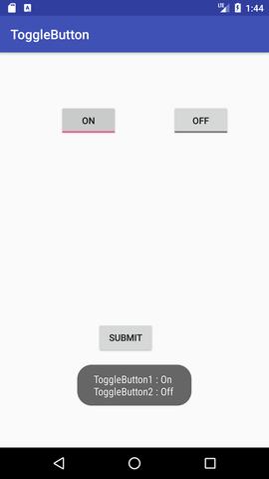
Android ToggleButton Example

