Slide 1
Android Widgets

Slide 2
Android CheckBox Example
Android CheckBox is a type of two state button either checked or unchecked.
There can be a lot of usage of checkboxes. For example, it can be used to know the hobby of the user, activate/deactivate the specific action etc.
Android CheckBox class is the subclass of CompoundButton class.
Android CheckBox class
The android.widget.CheckBox class provides the facility of creating the CheckBoxes.
Methods of CheckBox class
There are many inherited methods of View, TextView, and Button classes in the CheckBox class. Some of them are as follows:
Method | Description
public boolean isChecked() | Returns true if it is checked otherwise false.
public void setChecked(boolean status) | Changes the state of the CheckBox.

Slide 3
Android CheckBox Example
activity_main.xml
<?xml version="1.0" encoding="utf-8"?>
<android.support.constraint.ConstraintLayout xmlns:android="http://schemas.android.com/apk/res/android"
xmlns:app="http://schemas.android.com/apk/res-auto" xmlns:tools="http://schemas.android.com/tools"
android:layout_width="match_parent“ android:layout_height="match_parent"
tools:context="example.javatpoint.com.togglebutton.MainActivity">
<CheckBox
android:id="@+id/checkBox“ android:text="Pizza"
android:layout_width="wrap_content“ android:layout_height="wrap_content"
android:layout_marginLeft="144dp” android:layout_marginTop="68dp“ app:layout_constraintStart_toStartOf="parent“
app:layout_constraintTop_toTopOf="parent" />
<CheckBox
android:id="@+id/checkBox2“ android:layout_width="wrap_content"
android:layout_height="wrap_content“ android:layout_marginLeft="144dp"
android:layout_marginTop="28dp“ android:text="Coffee"
app:layout_constraintStart_toStartOf="parent" app:layout_constraintTop_toBottomOf="@+id/checkBox" />
++++++++++++++ Part A Code ++++++++++++++++
</android.support.constraint.ConstraintLayout>

Slide 4
Android CheckBox Example
activity_main.xml
++++++++++++++ Part A Code here ++++++++++++++++
<CheckBox
android:id="@+id/checkBox3“ android:text="Burger"
android:layout_width="wrap_content" android:layout_height="wrap_content"
android:layout_marginLeft="144dp" android:layout_marginTop="28dp"
app:layout_constraintStart_toStartOf="parent"
app:layout_constraintTop_toBottomOf="@+id/checkBox2" />
<Button
android:id="@+id/button“ android:text="Order"
android:layout_width="wrap_content“ android:layout_height="wrap_content"
android:layout_marginLeft="144dp“ android:layout_marginTop="184dp"
app:layout_constraintStart_toStartOf="parent"
app:layout_constraintTop_toBottomOf="@+id/checkBox3" />

Slide 5
Android CheckBox Example
File: MainActivity.java
Let's write the code to check which toggle button is ON/OFF.
import android.support.v7.app.AppCompatActivity; import android.os.Bundle; import android.view.View;
import android.widget.Button; import android.widget.CheckBox; import android.widget.Toast;
public class MainActivity extends AppCompatActivity {
CheckBox pizza,coffe,burger;
Button buttonOrder;
@Override
protected void onCreate(Bundle savedInstanceState) {
super.onCreate(savedInstanceState);
setContentView(R.layout.activity_main);
addListenerOnButtonClick();
}
public void addListenerOnButtonClick(){
//Getting instance of CheckBoxes and Button from the activty_main.xml file
pizza=(CheckBox)findViewById(R.id.checkBox);
coffe=(CheckBox)findViewById(R.id.checkBox2);
burger=(CheckBox)findViewById(R.id.checkBox3);
buttonOrder=(Button)findViewById(R.id.button);
+++++ Code Part A Here ++++
}

Slide 6
Android CheckBox Example
File: MainActivity.java
Let's write the code to check which toggle button is ON/OFF.
+++++ Code Part A Here ++++
//Applying the Listener on the Button click
buttonOrder.setOnClickListener(new View.OnClickListener(){
@Override
public void onClick(View view) {
int totalamount=0;
StringBuilder result=new StringBuilder();
result.append("Selected Items:");
+++++ Code Part B Here ++++
result.append("\nTotal: "+totalamount+"Rs");
//Displaying the message on the toast
Toast.makeText(getApplicationContext(), result.toString(), Toast.LENGTH_LONG).show();
}
});
}
}

Slide 7
Android CheckBox Example
File: MainActivity.java
Let's write the code to check which toggle button is ON/OFF.
+++++ Code Part B Here ++++
if(pizza.isChecked()){
result.append("\nPizza 100Rs");
totalamount+=100;
}
if(coffe.isChecked()){
result.append("\nCoffe 50Rs");
totalamount+=50;
}
if(burger.isChecked()){
result.append("\nBurger 120Rs");
totalamount+=120;
}

Slide 8
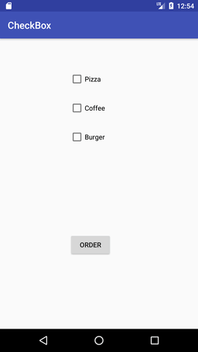
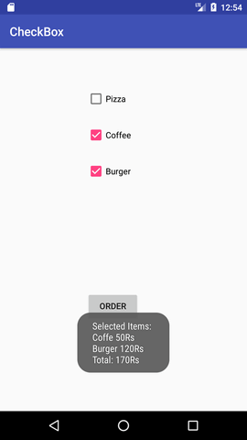
Android CheckBox Example

