Slide 1
Android Widgets

Slide 2
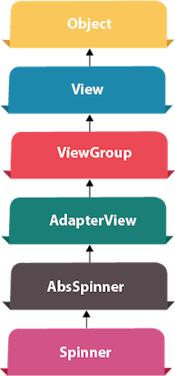
Android Spinner Example
Android Spinner is like the combo box of AWT or Swing. It can be used to display the multiple options to the user in which only one item can be selected by the user.
Android spinner is like the drop down menu with multiple values from which the end user can select only one value.
Android spinner is associated with AdapterView. So you need to use one of the adapter classes with spinner.
Android Spinner class is the subclass of AsbSpinner class.
Android Spinner Example
In this example, we are going to display the country list. You need to use ArrayAdapter class to store the country list.
Let's see the simple example of spinner in android.

Slide 3
Android Spinner Example
activity_main.xml
Drag the Spinner from the pallete, now the activity_main.xml file will like this:
<?xml version="1.0" encoding="utf-8"?>
<android.support.constraint.ConstraintLayout xmlns:android="http://schemas.android.com/apk/res/android"
xmlns:app="http://schemas.android.com/apk/res-auto"
xmlns:tools="http://schemas.android.com/tools"
android:layout_width="match_parent" android:layout_height="match_parent"
tools:context=".MainActivity“ >
<Spinner
android:layout_width="149dp" android:layout_height="40dp"
android:id="@+id/spinner" android:layout_marginBottom="8dp"
android:layout_marginEnd="8dp" android:layout_marginStart="8dp"
android:layout_marginTop="8dp" app:layout_constraintBottom_toBottomOf="parent"
app:layout_constraintEnd_toEndOf="parent" app:layout_constraintHorizontal_bias="0.502"
app:layout_constraintStart_toStartOf="parent" app:layout_constraintTop_toTopOf="parent"
app:layout_constraintVertical_bias="0.498" />
</android.support.constraint.ConstraintLayout>

Slide 4
Android Spinner Example
Activity class
Let's write the code to display item on the spinner and perform event handling.
package example.ah.com.spinner;
import android.support.v7.app.AppCompatActivity;
import android.os.Bundle; import android.view.View;
import android.widget.AdapterView; import android.widget.ArrayAdapter;
import android.widget.Spinner; import android.widget.Toast;
public class MainActivity extends AppCompatActivity implements
AdapterView.OnItemSelectedListener
{
String[] country = { "Pakistan", "England", "Dubai", "Canada", "New Zealand“ } ;
/* Code Part A */
/* Code Part B */
}

Slide 5
Android Spinner Example
Activity class
Let's write the code to display item on the spinner and perform event handling.
/* Code Part A */
@Override
protected void onCreate(Bundle savedInstanceState) {
super.onCreate(savedInstanceState); setContentView(R.layout.activity_main);
//Getting the instance of Spinner and applying OnItemSelectedListener on it
Spinner spin = (Spinner) findViewById(R.id.spinner);
spin.setOnItemSelectedListener(this);
//Creating the ArrayAdapter instance having the country list
ArrayAdapter aa = new ArrayAdapter(this,android.R.layout.simple_spinner_item,country);
aa.setDropDownViewResource(android.R.layout.simple_spinner_dropdown_item);
//Setting the ArrayAdapter data on the Spinner
spin.setAdapter(aa);
}

Slide 6
Android Spinner Example
Activity class
Let's write the code to display item on the spinner and perform event handling.
/* Code Part B */
//Performing action onItemSelected and onNothing selected
@Override
public void onItemSelected(AdapterView<?> arg0, View arg1, int position, long id) {
Toast.makeText(getApplicationContext(),country[position] , Toast.LENGTH_LONG).show();
}
@Override
public void onNothingSelected(AdapterView<?> arg0) {
// TODO Auto-generated method stub
}

Slide 7
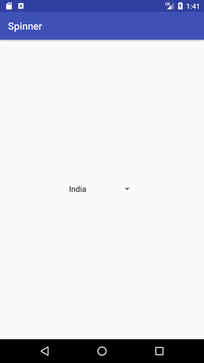
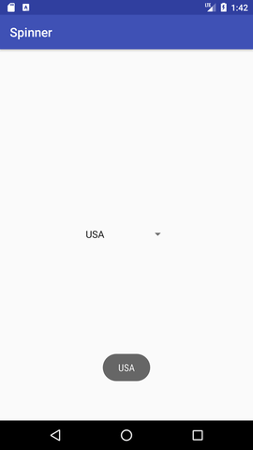
Android Spinner Example

