Slide 1
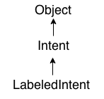
Android Intent Tutorial
Android Intent is the message that is passed between components such as activities, content providers, broadcast receivers, services etc.
It is generally used with startActivity() method to invoke activity, broadcast receivers etc.
The dictionary meaning of intent is intention or purpose. So, it can be described as the intention to do action.
The LabeledIntent is the subclass of android.content.Intent class.
Android intents are mainly used to:
Start the service
Launch an activity
Display a web page
Display a list of contacts
Broadcast a message
Dial a phone call etc.

Slide 2
Types of Android Intents
There are two types of intents in android: implicit and explicit.
1) Implicit Intent
Implicit Intent doesn't specify the component. In such case, intent provides information of available components provided by the system that is to be invoked.
For example, you may write the following code to view the webpage.
Intent intent = new Intent(Intent.ACTION_VIEW) ;
intent.setData(Uri.parse("http://www.ahksoft.com")) ;
startActivity(intent) ;

Slide 3
Types of Android Intents
There are two types of intents in android: implicit and explicit.
2) Explicit Intent
Explicit Intent specifies the component. In such case, intent provides the external class to be invoked.
Intent i = new Intent( getApplicationContext(), ActivityTwo.class ) ;
startActivity( i ) ;
To get the full code of explicit intent, visit the next page.

Slide 4
Android Implicit Intent Example
Let's see the simple example of implicit intent that displays a web page.
activity_main.xml
<?xml version="1.0" encoding="utf-8"?>
<android.support.constraint.ConstraintLayout xmlns:android="http://schemas.android.com/apk/res/android"
xmlns:app="http://schemas.android.com/apk/res-auto"
xmlns:tools="http://schemas.android.com/tools"
android:layout_width="match_parent"
android:layout_height="match_parent"
tools:context="example.ahksoft.com.implicitintent.MainActivity">
++++++ Code part A +++++++++++
++++++ Code part B +++++++++++
</android.support.constraint.ConstraintLayout>

Slide 5
Android Implicit Intent Example
Let's see the simple example of implicit intent that displays a web page.
activity_main.xml
++++++ Code part A +++++++++++
<EditText
android:id="@+id/editText"
android:layout_width="wrap_content"
android:layout_height="wrap_content"
android:layout_marginEnd="8dp"
android:layout_marginStart="8dp"
android:layout_marginTop="60dp"
android:ems="10"
app:layout_constraintEnd_toEndOf="parent"
app:layout_constraintHorizontal_bias="0.575"
app:layout_constraintStart_toStartOf="parent"
app:layout_constraintTop_toTopOf="parent" />

Slide 6
Android Implicit Intent Example
Let's see the simple example of implicit intent that displays a web page.
activity_main.xml
++++++ Code part B +++++++++++
<Button
android:id="@+id/button"
android:layout_width="wrap_content"
android:layout_height="wrap_content"
android:layout_marginRight="8dp"
android:layout_marginLeft="156dp"
android:layout_marginTop="172dp"
android:text="Visit"
app:layout_constraintEnd_toEndOf="parent"
app:layout_constraintHorizontal_bias="0.0"
app:layout_constraintStart_toStartOf="parent"
app:layout_constraintTop_toBottomOf="@+id/editText" />

Slide 7
Android Implicit Intent Example
Activity class
import android.support.v7.app.AppCompatActivity;
import android.content.Intent; import android.net.Uri;
import android.os.Bundle; import android.view.View;
import android.widget.Button; import android.widget.EditText;
public class MainActivity extends AppCompatActivity {
Button button; EditText editText;
@Override
protected void onCreate(Bundle savedInstanceState) {
super.onCreate(savedInstanceState);
setContentView(R.layout.activity_main);
button = findViewById(R.id.button);
editText = findViewById(R.id.editText);
/******** Code Part A *********/
}
}

Slide 8
Android Implicit Intent Example
Activity class
/******** Code Part A *********/
button.setOnClickListener(new View.OnClickListener() {
@Override
public void onClick(View view) {
String url=editText.getText().toString();
Intent intent=new Intent(Intent.ACTION_VIEW, Uri.parse(url));
startActivity(intent);
}
});

Slide 9
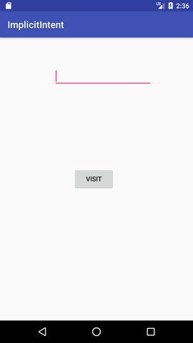
Android Implicit Intent Example

