Slide 1
Android Explicit Intent Example
Android Explicit intent specifies the component to be invoked from activity. In other words, we can call another activity in android by explicit intent.
We can also pass the information from one activity to another using explicit intent.
Here, we are going to see an example to call one activity from another and vice-versa.
Android calling one activity from another activity example
Let's see the simple example of android explicit example that calls one activity from another and vice versa.

Slide 2
Android Explicit Intent Example
Let's see the simple example of android explicit example that calls one activity from another and vice versa.
activity_main.xml
<?xml version="1.0" encoding="utf-8"?>
<android.support.constraint.ConstraintLayout
xmlns:android="http://schemas.android.com/apk/res/android"
xmlns:app="http://schemas.android.com/apk/res-auto"
xmlns:tools="http://schemas.android.com/tools"
android:layout_width="match_parent"
android:layout_height="match_parent"
tools:context="example.ahksoft.com.explicitintent.FirstActivity“ >
++++++ Code part A +++++++++++
++++++ Code part B +++++++++++
</android.support.constraint.ConstraintLayout>

Slide 3
Android Explicit Intent Example
Let's see the simple example of android explicit example that calls one activity from another and vice versa.
activity_main.xml
++++++ Code part A +++++++++++
<TextView
android:layout_width="wrap_content“ android:layout_height="wrap_content"
android:layout_marginEnd="8dp“ android:layout_marginStart="8dp"
android:layout_marginTop="8dp“ android:text="First Activity"
app:layout_constraintBottom_toBottomOf="parent"
app:layout_constraintEnd_toEndOf="parent"
app:layout_constraintHorizontal_bias="0.454"
app:layout_constraintLeft_toLeftOf="parent"
app:layout_constraintRight_toRightOf="parent"
app:layout_constraintStart_toStartOf="parent"
app:layout_constraintTop_toTopOf="parent"
app:layout_constraintVertical_bias="0.06" />

Slide 4
Android Explicit Intent Example
Let's see the simple example of android explicit example that calls one activity from another and vice versa.
activity_main.xml
++++++ Code part B +++++++++++
<Button
android:id="@+id/button"
android:layout_width="wrap_content"
android:layout_height="wrap_content"
android:layout_marginEnd="8dp"
android:layout_marginStart="8dp"
android:layout_marginTop="392dp"
android:onClick="callSecondActivity"
android:text="Call second activity"
app:layout_constraintEnd_toEndOf="parent"
app:layout_constraintStart_toStartOf="parent"
app:layout_constraintTop_toTopOf="parent" />

Slide 5
Android Explicit Intent Example
Let's see the simple example of android explicit example that calls one activity from another and vice versa.
activitytwo_main.xml
<?xml version="1.0" encoding="utf-8"?>
<android.support.constraint.ConstraintLayout
xmlns:android="http://schemas.android.com/apk/res/android"
xmlns:app="http://schemas.android.com/apk/res-auto"
xmlns:tools="http://schemas.android.com/tools"
android:layout_width="match_parent"
android:layout_height="match_parent"
tools:context="example.javatpoint.com.explicitintent.SecondActivity">
++++++ Code part A +++++++++++
++++++ Code part B +++++++++++
</android.support.constraint.ConstraintLayout>

Slide 6
Android Explicit Intent Example
Let's see the simple example of android explicit example that calls one activity from another and vice versa.
activitytwo_main.xml
++++++ Code part A +++++++++++
<TextView
android:layout_width="wrap_content“ android:layout_height="wrap_content"
android:layout_marginEnd="8dp“ android:layout_marginStart="8dp"
android:layout_marginTop="8dp“ android:text="Second Activity"
app:layout_constraintBottom_toBottomOf="parent"
app:layout_constraintEnd_toEndOf="parent"
app:layout_constraintHorizontal_bias="0.454"
app:layout_constraintLeft_toLeftOf="parent"
app:layout_constraintRight_toRightOf="parent"
app:layout_constraintStart_toStartOf="parent"
app:layout_constraintTop_toTopOf="parent"
app:layout_constraintVertical_bias="0.06" />

Slide 7
Android Explicit Intent Example
Let's see the simple example of android explicit example that calls one activity from another and vice versa.
activitytwo_main.xml
++++++ Code part B +++++++++++
<Button
android:id="@+id/button"
android:layout_width="wrap_content"
android:layout_height="wrap_content"
android:layout_marginEnd="8dp"
android:layout_marginStart="8dp"
android:layout_marginTop="392dp"
android:onClick="callFirstActivity"
android:text="Call first activity"
app:layout_constraintEnd_toEndOf="parent"
app:layout_constraintStart_toStartOf="parent"
app:layout_constraintTop_toTopOf="parent" />

Slide 8
Android Explicit Intent Example
ActivityOne class, Filename: MainActivityOne.java
import android.content.Intent;
import android.support.v7.app.AppCompatActivity;
import android.os.Bundle; import android.view.View;
public class FirstActivity extends AppCompatActivity {
@Override
protected void onCreate(Bundle savedInstanceState) {
super.onCreate(savedInstanceState);
setContentView(R.layout.activity_first);
}
public void callSecondActivity(View view){
Intent i = new Intent(getApplicationContext(), SecondActivity.class);
i.putExtra("Value1", "Android By Abdul Hafeez");
i.putExtra("Value2", "Simple Tutorial");
// Set the request code to any code you like, you can identify the callback via this code
startActivity(i);
}
}

Slide 9
Android Explicit Intent Example
ActivityOne class, Filename: MainActivityTwo.java
import android.content.Intent;
import android.support.v7.app.AppCompatActivity;
import android.os.Bundle; import android.view.View; import android.widget.Toast;
public class SecondActivity extends AppCompatActivity {
@Override
protected void onCreate(Bundle savedInstanceState) {
super.onCreate(savedInstanceState);
setContentView(R.layout.activity_second);
Bundle extras = getIntent().getExtras();
String value1 = extras.getString("Value1");
String value2 = extras.getString("Value2");
Toast.makeText(getApplicationContext(),"Values are:\n First value: "+value1+
"\n Second Value: "+value2, Toast.LENGTH_LONG).show();
}
public void callFirstActivity(View view){
Intent i = new Intent(getApplicationContext(), FirstActivity.class);
startActivity(i);
}
}

Slide 10
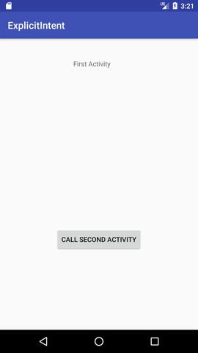
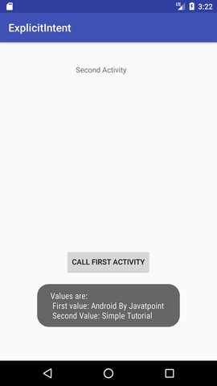
Android Explicit Intent Example

