Slide 1
VPC
VPC
Basics of Virtual Private Cloud (VPC)

Slide 2
VPC Sizing and Structure
VPC (Virtual Private Cloud) is a logically isolated network within the AWS cloud that allows you to define and control your virtual networking environment. Proper sizing and structure of a VPC are critical for ensuring efficient use of resources, scalability, and ease of management.
1--- VPC Sizing
CIDR Block:
When creating a VPC, you must specify an IPv4 CIDR block (e.g., 10.0.0.0/16). This determines the total number of IP addresses available in the VPC.
The smaller the subnet mask (e.g., /16), the more IP addresses are available. A /16 block provides 65,536 IPs, while a /24 provides 256.
Subnet Allocation:
Divide the VPC CIDR block into smaller subnet ranges, ensuring sufficient IPs for each subnet. Subnets must be within the VPC's CIDR block and cannot overlap.
Allocate different subnets for different availability zones (AZs) for high availability.
Scalability:
Plan for future growth by choosing a larger CIDR block. However, IPv4 addresses are finite, so consider using IPv6 (unlimited address space) if necessary.

Slide 3
VPC Structure
2. VPC Structure
Subnets:
Subnets divide the VPC into smaller sections.
Public Subnets: Connected to the internet via an Internet Gateway (IGW); used for resources like web servers.
Private Subnets: Isolated from the internet; used for databases and backend services.
Isolated Subnets: No internet access; used for highly secure resources.
Route Tables:
Define how traffic is routed within the VPC and to external networks.
Each subnet must be associated with a route table.
Internet Gateway and NAT Gateway:
Internet Gateway (IGW): Allows public subnets to connect to the internet.
NAT Gateway: Enables private subnets to initiate outbound connections to the internet while remaining inaccessible from the outside.
VPC Peering and Transit Gateway:
VPC Peering: Connects two VPCs directly for communication.
Transit Gateway: Connects multiple VPCs and on-premises networks.
Network ACLs and Security Groups:
Network ACLs: Stateless firewalls for subnets.
Security Groups: Stateful firewalls for individual instances.

Slide 4
Explanation of VPC Sizing
Think of a VPC (Virtual Private Cloud) as your personal space or network within AWS, where you can place your servers, databases, and other resources. Just like a house needs an address, a VPC also needs an address range, which is called a CIDR block.
For example:
If you pick a CIDR block of 10.0.0.0/16, your VPC gets 65,536 possible IP addresses to assign to resources.
If you pick a smaller CIDR block like 10.0.0.0/24, you’ll only have 256 IP addresses.
You must plan carefully when choosing this range because you can’t change it later. If you expect your network to grow, select a larger range.

Slide 5
Explanation of VPC Structure
Inside your VPC, you divide the address range into smaller pieces called subnets. Think of subnets as rooms in your house, each serving a different purpose.
Public Subnets: These are like rooms with windows open to the outside world. Resources here, like web servers, can talk to the internet through an Internet Gateway.
Private Subnets: These are closed rooms. Resources like databases live here because they don’t need to talk to the internet directly.
Isolated Subnets: These are rooms locked completely, used for sensitive tasks.
The Route Table acts like a map that tells traffic in your VPC where to go—for example, whether it should go to the internet or stay within the VPC.
To connect your VPC to the internet or other networks, AWS provides tools like:
Internet Gateway: For public access.
NAT Gateway: Lets private resources access the internet without being exposed.
Transit Gateway: For connecting multiple VPCs or on-premises networks.
For security, you can use:
Security Groups: Like a bouncer for individual resources, controlling who can talk to them.
Network ACLs: Like a fence around the subnet, controlling what traffic gets in and out.

Slide 6
Custom VPC
A Custom VPC is a Virtual Private Cloud that you create manually in AWS, tailored to meet specific requirements for your applications. Unlike the default VPC that AWS provides automatically, a custom VPC gives you greater control over network settings, security, and configuration.
---- Key Features of a Custom VPC
Custom CIDR Range:
You specify the IP address range for your VPC (e.g., 10.0.0.0/16). This allows you to control how many IP addresses are available and ensures no overlap with other networks.
Subnets:
You manually create subnets to divide your VPC into smaller, logical sections. Subnets can be public (internet-accessible) or private (isolated from the internet).
Routing:
You define custom route tables to control how traffic flows between your subnets and the outside world. For example, public subnets have routes to an Internet Gateway, while private subnets may use a NAT Gateway.
Security:
You configure security groups and network ACLs to control inbound and outbound traffic for resources in your VPC. This ensures your applications remain secure.
Optional IPv6:
You can enable IPv6 for your VPC if you need a virtually unlimited number of IP addresses.

Slide 7
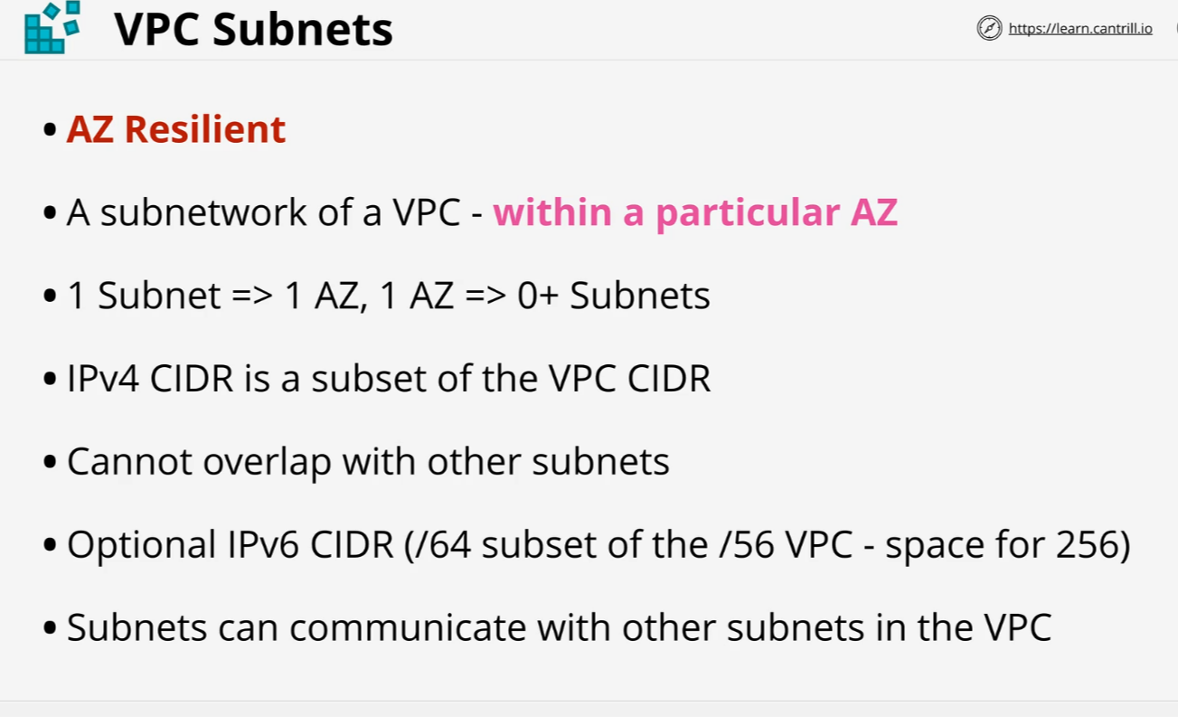
VPC Subnet

Slide 8
VPC Subnet
A subnet in AWS VPC (Virtual Private Cloud) is a smaller network segment within the larger VPC. It divides the VPC's IP address range into smaller, manageable sections and is used to group resources based on their function or accessibility needs. Subnets can be configured as public, private, or isolated, depending on whether they need direct internet access.
---- Key Features of Subnets:
IP Address Allocation:
Each subnet is assigned a portion of the VPC's CIDR block. For example, a VPC with 10.0.0.0/16 can have subnets like 10.0.1.0/24 or 10.0.2.0/24.
Public and Private Subnets:
Public Subnet: Resources, like web servers, that need internet access are placed here. These subnets are connected to an Internet Gateway.
Private Subnet: Resources, like databases, that do not need direct internet access reside here. They can still access the internet via a NAT Gateway.
---- Availability Zones:
Subnets are tied to specific Availability Zones (AZs) within a region, ensuring high availability. You can place subnets in multiple AZs for redundancy.
Route Tables:
Subnets use Route Tables to determine how traffic flows. For instance, public subnets have routes to the internet through the Internet Gateway, while private subnets route outbound traffic via NAT Gateways.
Security:
Subnets are protected using Network ACLs (NACLs), which act as a firewall for the subnet, and Security Groups, which provide instance-level security.

Slide 9
How Subnets Work
Resources (like EC2 instances) are launched in subnets.
Each subnet is associated with a route table to define traffic rules.
Public subnets use Internet Gateways to allow inbound/outbound internet access.
Private subnets use NAT Gateways for outbound internet access without exposing resources to inbound traffic.

Slide 10
VPC Routing
VPC routing controls the flow of traffic within a VPC and between the VPC and external networks. It relies on Route Tables, which act like maps telling packets where to go.
Route Table: Each subnet is associated with a route table that contains rules (routes) defining the destination of traffic and the target resource.
Example: A route might direct traffic destined for the internet (0.0.0.0/0) to an Internet Gateway.
Default Routes: AWS creates default routes for private communication within the VPC, but you must add custom routes for internet access or VPNs.
Types of Routing:
Local Routing: Traffic between resources in the same VPC.
External Routing: Traffic to external networks via gateways or VPNs.

Slide 11
Internet Gateway (IGW)
An Internet Gateway is a component that allows resources in a VPC to access the internet. It serves as a two-way bridge for internet connectivity.
How It Works:
Public subnets connect to the Internet Gateway via a route table.
Resources in these subnets must have public IP addresses or Elastic IPs to communicate with the internet.
Key Features:
It is highly available and scales automatically.
It supports inbound and outbound communication for public subnets.
Use Case: Hosting web servers or applications that require internet access.

Slide 12
Bastion Hosts
A Bastion Host is a secure server used to provide access to resources in private subnets. It acts as a jump server for administrative tasks.
How It Works:
The Bastion Host resides in a public subnet with access to the private subnet.
Administrators connect to the Bastion Host via SSH or RDP, and from there, access private resources.
Key Features:
It reduces the attack surface by allowing controlled access to private resources.
It typically uses strict security rules and multi-factor authentication.
Use Case: Managing resources in private subnets without exposing them to the internet.

Slide 13
Stateless Firewalls
A stateless firewall filters traffic based solely on individual packets without considering the context of the traffic flow. It examines packet headers, such as source and destination IP addresses, port numbers, and protocol types, against a set of predefined rules to determine whether to allow or block the packet. Stateless firewalls do not track the state of network connections, treating each packet in isolation.
Key Characteristics:
Packet-Based Filtering: Decisions are made on a per-packet basis, without awareness of the overall connection state.
Performance: Generally faster and less resource-intensive due to the simplicity of processing.
Simplicity: Easier to configure and manage for straightforward filtering requirements.
Limitations:
Lack of Context Awareness: Cannot distinguish between legitimate packets that are part of an established connection and unsolicited packets, potentially allowing malicious traffic.
Limited Security: Less effective in preventing certain types of attacks, such as spoofing or session hijacking, due to the absence of connection state tracking.

Slide 14
Stateful Firewalls
A stateful firewall monitors the state of active connections and makes filtering decisions based on the context of the traffic flow. It maintains a state table that tracks the state and characteristics of each connection, allowing it to understand and inspect the entire communication session. This enables stateful firewalls to make more informed decisions about allowing or blocking traffic.
Key Characteristics:
Connection Tracking: Keeps track of active connections and their states, allowing for more granular control over traffic.
Enhanced Security: Can detect and block malicious traffic patterns by analyzing the context of the connection.
Dynamic Rule Application: Adjusts filtering rules dynamically based on the state of the connection, providing flexibility in handling complex protocols.
Limitations:
Resource Intensive: Maintaining state information requires more memory and processing power, potentially impacting performance.
Complexity: Configuration and management can be more complex due to the need to define and monitor connection states.

Slide 15
Network Access Control List (NACL)
A Network Access Control List (NACL) in Amazon Web Services (AWS) is a stateless, subnet-level firewall that controls inbound and outbound traffic to and from subnets within a Virtual Private Cloud (VPC). Unlike security groups, which operate at the instance level and are stateful, NACLs provide an additional layer of security by allowing or denying specific traffic at the subnet boundary.
Key Characteristics of NACLs:
Stateless Nature: NACLs are stateless, meaning they do not retain information about previous traffic flows. Each packet is evaluated against the NACL rules independently, without regard to prior packets. This contrasts with security groups, which are stateful and automatically allow return traffic for established connections.
Rule Evaluation: Each NACL contains a numbered list of rules that are evaluated in ascending order, starting with the lowest number. As soon as a rule matches the traffic, it's applied, and no further rules are evaluated. This means that the order of rules is crucial, and it's recommended to leave gaps between rule numbers (e.g., increments of 10 or 100) to allow for future additions.
Separate Inbound and Outbound Rules: NACLs have distinct sets of rules for inbound and outbound traffic, allowing you to control traffic entering and leaving the subnet independently. Each rule specifies the protocol, port range, source or destination CIDR block, and whether to allow or deny the traffic.
Default and Custom NACLs: By default, a VPC comes with a default NACL that allows all inbound and outbound IPv4 and IPv6 traffic. You can create custom NACLs to enforce more granular control over your subnet traffic. Each subnet must be associated with a NACL; if not explicitly associated, a subnet will use the default NACL.
Subnet-Level Security: While security groups operate at the instance level, NACLs provide an additional layer of security at the subnet level. This allows for broader control over traffic entering and exiting your subnets, complementing the more granular controls of security groups.

Slide 16
Considerations When Using NACLs
Rule Limitations: There are limits to the number of NACLs per VPC and the number of rules per NACL. It's important to design your NACLs efficiently to stay within these limits.
Ephemeral Ports: When configuring NACLs, consider the use of ephemeral ports for return traffic. Since NACLs are stateless, you may need to create rules that allow traffic on these ports to ensure proper communication.
Order of Rules: The order of NACL rules is critical. Ensure that more specific rules are placed before general ones to avoid unintended traffic blocking or allowing.

Slide 17
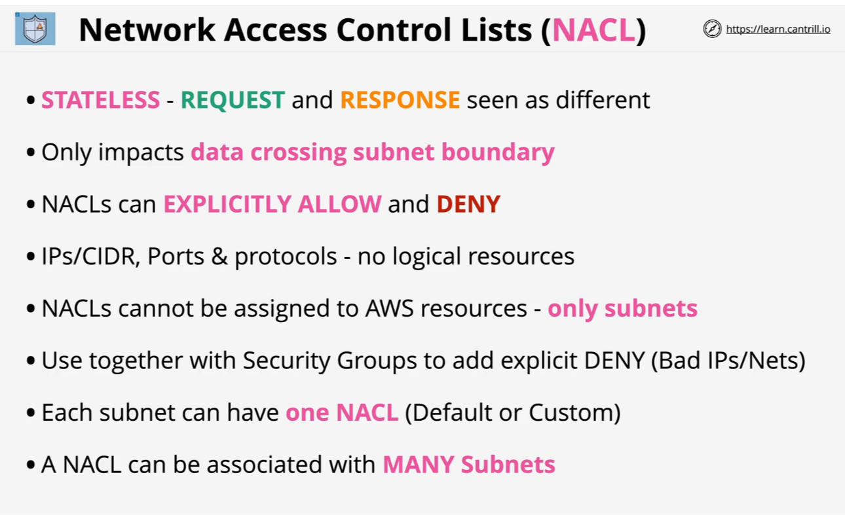
Network Access Control List (NACL)

Slide 18
Security Groups (SG)
In Amazon Web Services (AWS), a Security Group functions as a virtual firewall for your EC2 instances, controlling both inbound and outbound traffic. Unlike Network Access Control Lists (NACLs), which operate at the subnet level, security groups provide instance-level security, allowing you to define fine-grained access controls for your resources.
Key Features of Security Groups:
Stateful Nature: Security groups are stateful, meaning that if you allow an incoming request from a specific IP address and port, the response is automatically allowed, regardless of outbound rules. This simplifies rule management, as you don't need to create corresponding outbound rules for allowed inbound traffic.
Inbound and Outbound Rules: You can define separate sets of rules for inbound and outbound traffic. Inbound rules control the traffic allowed to reach your instance, while outbound rules control the traffic allowed to leave your instance. Each rule specifies protocol, port range, and source or destination IP ranges.
Default Security Group: When you create a VPC, it comes with a default security group that allows all outbound traffic and denies all inbound traffic. You can modify this default group or create custom security groups to meet your specific requirements.
Multiple Associations: An instance can be associated with multiple security groups, allowing for layered security policies. The rules from all associated security groups are aggregated to determine the allowed traffic.

Slide 19
Network Address Translation (NAT) & NAT Gateway
Network Address Translation (NAT) is a networking technique that modifies the source or destination IP addresses of packets as they traverse a router or firewall. This process enables multiple devices on a private network to access external networks, such as the internet, using a single public IP address. NAT conserves public IP addresses and enhances security by masking internal network structures.
In Amazon Web Services (AWS), a NAT Gateway is a managed service that facilitates outbound internet connectivity for instances within private subnets, while preventing unsolicited inbound connections. By deploying a NAT Gateway in a public subnet, instances in private subnets can initiate outbound connections to the internet for tasks such as software updates or data uploads, without exposing themselves to inbound internet traffic.
Key Features of NAT Gateways:
Managed Service: NAT Gateways are fully managed by AWS, ensuring high availability and scalability without the need for user maintenance.
High Availability: Designed to be highly available within a specific Availability Zone, reducing the risk of service interruptions.
Scalability: Automatically scales to accommodate varying levels of traffic, ensuring consistent performance.
Security: Allows outbound connections from private instances while blocking unsolicited inbound traffic, enhancing network security.

Slide 20
Considerations of NAT
Cost: Usage of NAT Gateways incurs charges based on data transfer and hourly usage. For example, in the US East (Ohio) region, the rate is $0.045 per hour, and data processing is charged at $0.045 per GB.
Regional Limitations: NAT Gateways operate within a single Availability Zone; deploying multiple gateways across different zones can enhance fault tolerance.

Slide 21
Exam Question
1. VPC Configuration:
Question: You have created a VPC with a CIDR block of 10.0.0.0/16. You need to create a public subnet that supports up to 200 usable IP addresses. Which CIDR block would you assign to this subnet?
Answer Options:
A. 10.0.0.0/24
B. 10.0.1.0/25
C. 10.0.2.0/26
D. 10.0.3.0/27
2. Internet Connectivity:
Question: Which component is necessary to allow instances in a public subnet to initiate outbound traffic to the internet?
Answer Options:
A. NAT Gateway
B. Internet Gateway
C. Virtual Private Gateway
D. VPC Peering
3. Security Groups vs. NACLs:
Question: Which statement correctly differentiates Security Groups from Network Access Control Lists (NACLs)?
Answer Options:
A. Security Groups are stateless, while NACLs are stateful.
B. Security Groups operate at the subnet level, whereas NACLs operate at the instance level.
C. Security Groups evaluate all rules before deciding, while NACLs process rules in order.
D. Security Groups support deny rules, whereas NACLs do not.

Slide 22
Exam Question
4. NAT Gateway Placement:
Question: To provide internet access for instances in a private subnet, where should you place a NAT Gateway?
Answer Options:
A. In the same private subnet as the instances
B. In a public subnet within the same Availability Zone
C. In a different VPC
D. In any private subnet within the VPC
5. VPC Peering Limitations:
Question: Which of the following is a limitation of VPC Peering?
Answer Options:
A. It supports transitive peering between VPCs.
B. It allows overlapping CIDR blocks between peered VPCs.
C. It enables sharing of security groups across peered VPCs.
D. It does not support edge-to-edge routing through a gateway or private connection.
6. Default VPC Components:
Question: When AWS creates a default VPC in your account, which of the following components are included?
Answer Options:
A. A public subnet in each Availability Zone
B. An Internet Gateway
C. A NAT Gateway
D. Both A and B

Slide 23
Exam Question
7. VPC Endpoint Types:
Question: Which type of VPC endpoint is used to connect to AWS services over a private connection without using an Internet Gateway or NAT device?
Answer Options:
A. Interface Endpoint
B. Gateway Endpoint
C. Transit Gateway
D. VPC Peering
8. Route Table Configuration:
Question: You have a VPC with an Internet Gateway attached and a public subnet. Which route should be added to the route table associated with the public subnet to enable internet access?
Answer Options:
A. Destination: 0.0.0.0/0, Target: Internet Gateway
B. Destination: 0.0.0.0/0, Target: NAT Gateway
C. Destination: ::/0, Target: Internet Gateway
D. Destination: ::/0, Target: NAT Gateway
9. Elastic IP Addresses:
Question: Which statement about Elastic IP addresses in a VPC is correct?
Answer Options:
A. They can be associated with multiple instances simultaneously.
B. They remain associated with an instance after it is stopped and started.
C. They incur charges only when associated with a running instance.
D. They can be assigned to instances in private subnets without a NAT device.

Slide 24
Exam Question
10. VPC Flow Logs:
Question: What is the primary purpose of VPC Flow Logs?
Answer Options:
A. To capture detailed packet data for analysis
B. To monitor and log network traffic to and from network interfaces
C. To enforce security group rules
D. To provide DNS resolution within the VPC
Answers:
A. 10.0.0.0/24
B. Internet Gateway
C. Security Groups evaluate all rules before deciding, while NACLs process rules in order.
B. In a public subnet within the same Availability Zone
D. It does not support edge-to-edge routing through a gateway or private connection.
D. Both A and B
B. Gateway Endpoint
A. Destination: 0.0.0.0/0, Target: Internet Gateway
B. They remain associated with an instance after it is stopped and started.
B. To monitor and log network traffic to and from network interfaces

