Slide 1
S3
All about S3

Slide 2
S3 Security
--- Bucket Policies?
Bucket policies in Amazon S3 are JSON-based access policies applied at the bucket level. They define permissions for actions like reading, writing, or deleting objects in a bucket. These policies allow fine-grained control by specifying who (users, roles, or accounts) can access the bucket, what actions they can perform, and under what conditions. For example, you can use bucket policies to restrict access to trusted IP ranges or specific AWS accounts. Bucket policies are ideal for managing access to shared resources at the bucket level.
--- Resource Policies?
Resource policies are similar to bucket policies but are applied to other AWS resources, not just S3 buckets. In the context of S3, bucket policies are a type of resource policy. These policies define access and permissions for specific AWS resources, allowing you to control actions like data access, storage, and modification. Resource policies provide centralized management for controlling external access to AWS resources securely.
--- Access Control Lists (ACLs)?
Access Control Lists (ACLs) are a legacy feature of Amazon S3 used to control access to buckets and objects. They enable granting permissions to specific AWS accounts, predefined groups (e.g., authenticated users), or public access. ACLs provide simpler, less flexible access control compared to bucket policies, and they operate at both the bucket and object levels. While still supported, AWS recommends using bucket policies or IAM policies for more robust and manageable permissions.

Slide 3
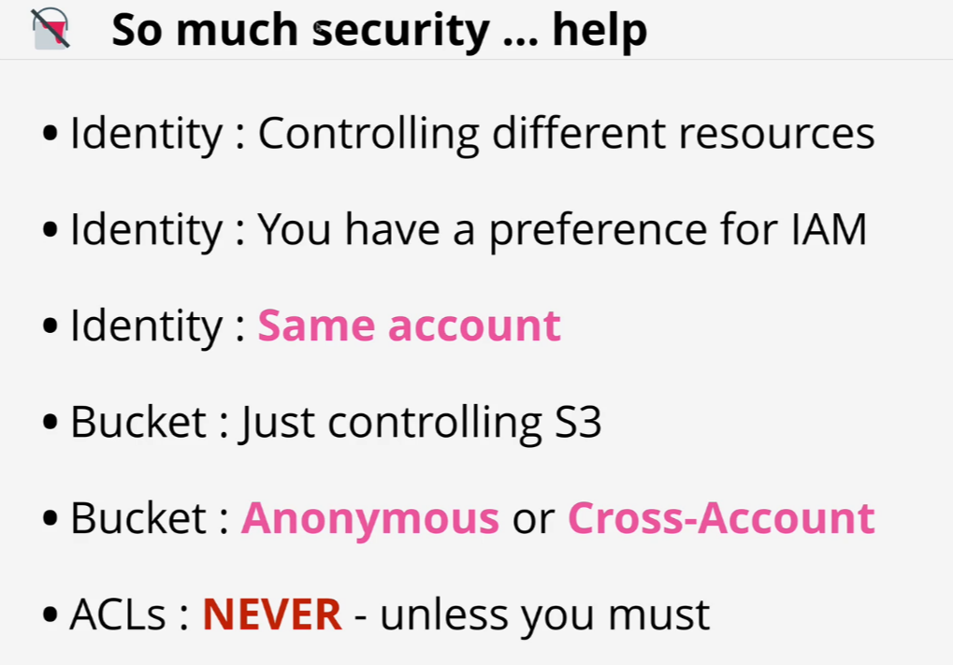
S3 Security (Resource Policies & ACLs)

Slide 4
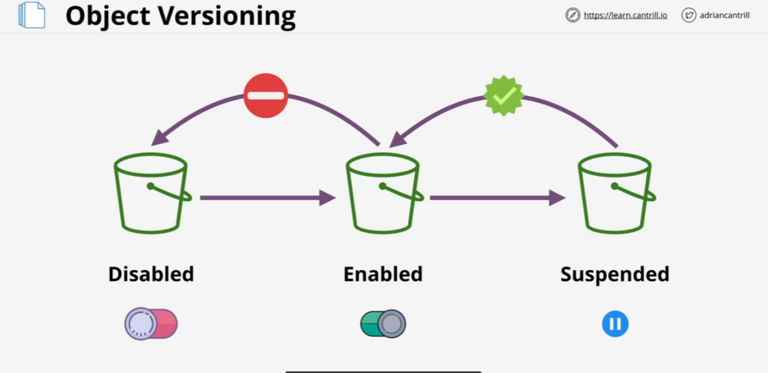
Object Versioning
Object Versioning

Slide 5
Object versioning
Object versioning in Amazon S3 is a feature that maintains multiple versions of an object within a bucket. When versioning is enabled, any changes or deletions to an object result in the creation of a new version rather than overwriting or permanently deleting the existing object. This ensures that previous versions can be recovered if needed, providing protection against accidental overwrites or deletions. Versioning also integrates with lifecycle policies, allowing automated management of older versions.
MFA Delete adds an extra layer of security to S3 buckets by requiring multi-factor authentication (MFA) for certain actions, such as permanently deleting objects or disabling versioning. When MFA Delete is enabled, users must supply an MFA token (from an MFA device) along with their credentials to perform these actions. This feature helps prevent accidental or unauthorized deletions, making it an essential security measure for sensitive or critical data.
Together, object versioning and MFA Delete enhance data protection in S3 by providing recoverability and preventing unintended data loss.

Slide 6
S3 Performance Optimization
Amazon S3 performance optimization involves several strategies to improve data access speed, scalability, and cost efficiency. To handle high request rates, using random or hashed prefixes in object names helps avoid "hot spots" caused by sequential key patterns. Multi-part uploads and parallel GET requests enhance upload and download speeds for large files, while data compression reduces storage costs and transfer times. For long-distance data transfers, enabling S3 Transfer Acceleration leverages Amazon CloudFront’s edge locations for faster performance. Additionally, using CloudFront as a CDN caches frequently accessed data closer to users, reducing latency and load on S3. Implementing lifecycle policies transitions infrequently accessed data to cheaper storage classes, optimizing cost without compromising performance. Network optimization techniques, such as using AWS Direct Connect or VPC endpoints, improve transfer speeds by bypassing public internet traffic. S3 Select and Glacier Select further enhance efficiency by retrieving only necessary portions of data for analytics workloads. Finally, S3 Storage Lens provides insights into storage usage and patterns, helping identify areas for optimization. Together, these strategies ensure S3 delivers high performance for even the most demanding applications.

Slide 7
Key Management Service (KMS)
AWS Key Management Service (KMS) is a managed service that simplifies the creation, management, and control of cryptographic keys used to secure your data. It integrates seamlessly with various AWS services, including Amazon S3, RDS, Lambda, and DynamoDB, to encrypt data at rest and in transit. KMS supports both symmetric and asymmetric keys, offering flexibility for diverse encryption and digital signing use cases.
Types of Keys in AWS KMS:
KMS offers two primary types of keys: customer-managed keys (CMKs) and AWS-managed keys. CMKs give users full control over key permissions and lifecycle, while AWS-managed keys are automatically created and managed for specific services, providing simplicity for users who do not require granular control. Additionally, KMS supports asymmetric keys for public/private key cryptography, suitable for digital signing and verification.
Encryption and Decryption:
AWS KMS simplifies encryption by enabling users to encrypt data directly or generate data keys for client-side encryption. These encrypted data keys can then be securely stored in AWS services like S3 or databases. When decryption is needed, authorized entities can call KMS to decrypt ciphertext or retrieve plaintext data, ensuring secure and controlled access.

Slide 8
S3 Object Encryption CSE/SSE
Amazon S3 supports two encryption methods, each with specific types to suit different security needs: Server-Side Encryption (SSE) and Client-Side Encryption (CSE).
Server-Side Encryption (SSE) has three types:
SSE-S3: Data is encrypted at rest using keys managed entirely by AWS. S3 automatically handles encryption, decryption, and key rotation.
SSE-KMS: This integrates with AWS Key Management Service (KMS), giving you more control over encryption keys and providing detailed auditing via CloudTrail.
SSE-C: You provide your own encryption keys, and S3 uses them for encrypting and decrypting objects, but key management is your responsibility.
Client-Side Encryption (CSE) relies on the client to encrypt data before uploading it to S3. In this case, either the client application or an external library like the AWS SDK handles key management and encryption, ensuring that S3 never has access to plaintext data.
These types allow flexibility based on your requirements for security, control, and compliance.

Slide 9
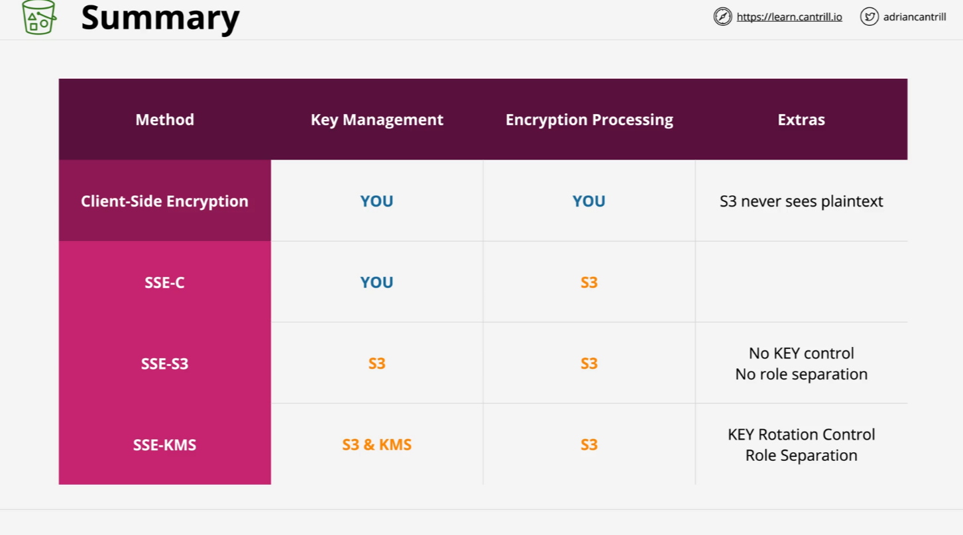
S3 Object Encryption CSE/SSE

Slide 10
S3 Bucket Keys
Amazon S3 Bucket Keys are a feature designed to reduce the cost of using server-side encryption with AWS Key Management Service (SSE-KMS). When enabled, S3 Bucket Keys create a unique, bucket-level key that is reused for encrypting and decrypting objects within the bucket. This reduces the number of requests made to AWS KMS for key operations, significantly lowering costs for workloads with high volumes of data.
The bucket key is generated and managed by S3, and it works in conjunction with the KMS key used for encryption. It ensures that data remains securely encrypted, while reducing the overhead of frequent KMS interactions. S3 Bucket Keys are particularly useful for cost optimization in scenarios like data lakes, analytics workloads, or applications handling large-scale storage.
By using S3 Bucket Keys, you maintain strong encryption standards with AWS KMS while optimizing costs for high-performance storage needs.

Slide 11
S3 Object Storage Classes
S3 Object Storage Classes (Detailed Explanation)
Amazon S3 provides multiple storage classes, each designed to meet different storage and access requirements. These storage classes vary in terms of cost, durability, and performance, allowing you to optimize costs based on how often you access your data.
1--- S3 Standard
Purpose: Ideal for data that is frequently accessed and needs to be immediately available.
Use Cases: Dynamic websites, big data analytics, content distribution, mobile apps, and any data that is regularly accessed.
Key Features:
Low latency and high throughput.
Designed for durability of 99.999999999% (11 9's) and availability of 99.99% over a given year.
This is the default storage class when you upload objects to S3.
2--- S3 Intelligent-Tiering
Purpose: Best for data with unpredictable access patterns, automatically moves between two access tiers based on how frequently data is accessed.
Use Cases: Data that may be frequently accessed at first but later accessed infrequently, like logs or large datasets.
Key Features:
Has two tiers: frequent access and infrequent access.
Automatically moves objects between these two tiers based on access patterns.
Charges a small monitoring and automation fee, but no retrieval fees.
Helps optimize costs without requiring manual intervention.

Slide 12
S3 Object Storage Classes
3--- S3 Standard-IA (Infrequent Access)
Purpose: Designed for data that is infrequently accessed but needs to be quickly retrieved when necessary.
Use Cases: Backup data, long-term storage of images or videos, and disaster recovery.
Key Features:
Lower storage cost than S3 Standard.
Retrieval fee when accessing data.
A durability of 99.999999999% (11 9's), but a higher retrieval cost than S3 Standard.
Ideal for data that is not frequently accessed but still needs to be readily available when needed.
4--- S3 One Zone-IA
Purpose: Similar to Standard-IA, but stores your data in a single availability zone rather than multiple zones, reducing costs.
Use Cases: Data that can be recreated if lost and does not require high availability, like secondary backups or development data.
Key Features:
Lower cost compared to S3 Standard-IA.
Only stores data in one availability zone, so lower durability (99.5%).
Suitable for infrequently accessed data that doesn’t need to be replicated across multiple locations.

Slide 13
S3 Object Storage Classes
5--- S3 Glacier
Purpose: Designed for archival storage of data that is rarely accessed, with retrieval times ranging from minutes to hours.
Use Cases: Long-term archival of infrequently accessed data, such as backups, compliance data, or media archives.
Key Features:
Low storage cost but retrieval can take minutes to hours, depending on the retrieval option selected.
Ideal for data that is not needed on a day-to-day basis but must be stored securely for compliance or disaster recovery.
6--- S3 Glacier Deep Archive
Purpose: The lowest-cost storage class for data that is rarely accessed and is intended for long-term archival storage.
Use Cases: Archiving data that you need to keep for compliance or regulatory purposes, such as legal documents or historical records.
Key Features:
Extremely low storage cost.
Retrieval times can take up to 12 hours.
Ideal for data that might never be retrieved or only retrieved in rare instances.

Slide 14
S3 Object Storage Classes
7--- S3 Outposts
Purpose: Stores your data on on-premises hardware, integrating with AWS Outposts for hybrid environments.
Use Cases: Organizations that need to keep some data locally for compliance or performance reasons while still using AWS for other services.
Key Features:
Data is stored on your own premises in an AWS-managed infrastructure.
Helps create a hybrid cloud environment where some data stays on-premises while still being integrated into AWS services.
Suitable for workloads requiring local processing and storage while seamlessly integrating with the AWS ecosystem.
Exam Tip:
For the AWS Associate exam, focus on knowing the cost trade-offs and use cases for each storage class. Be ready to identify which storage class is best for different scenarios (e.g., backup, archival, high-performance applications). Understand the durability, availability, and retrieval times that distinguish each class, as these are common areas where exam questions may focus.

Slide 15
S3 Lifecycle Configuration
Amazon S3 Lifecycle Configuration is a feature that helps you manage the lifecycle of your objects stored in S3 buckets by automating transitions between storage classes or scheduling deletions. It ensures cost optimization and compliance with data retention policies by managing objects based on their age or other criteria.
A lifecycle configuration consists of rules that define transition actions, which move objects to cheaper storage classes (like S3 Standard-IA or S3 Glacier) after a set period, or expiration actions, which delete objects or older versions after a specified time. These rules can be applied to specific objects using prefixes or tags, providing flexibility and precision in management.
This feature is particularly useful for cost optimization, as it ensures data is stored in the most economical storage class throughout its lifecycle. It also helps enforce data retention policies by automatically deleting objects when they are no longer needed. Lifecycle configurations support both current and non-current object versions, making them ideal for managing versioned buckets.
-- Exam Tip:
For the AWS Associate exam, focus on scenarios where lifecycle configurations are used to save costs, such as transitioning data to S3 Glacier for archiving. Be aware of how to configure rules and the differences between transition and expiration actions.

Slide 16
S3 Replication
Amazon S3 Replication is a powerful feature designed to automatically copy objects between S3 buckets. It operates asynchronously and ensures data redundancy, compliance, and availability. There are two main types of replication: Cross-Region Replication (CRR), which replicates data to a bucket in a different AWS region, and Same-Region Replication (SRR), which replicates data within the same region. These options cater to different needs, such as disaster recovery, regulatory compliance, and reducing latency for users.
Replication requires versioning to be enabled on both source and destination buckets, and it provides granular control by allowing replication of objects based on prefixes or tags. With the Replication Time Control (RTC) option, you can ensure predictable replication times backed by an SLA. Additionally, S3 Replication allows ownership of replicated objects to be transferred to the destination bucket owner, supporting use cases like log aggregation and shared ownership.
This feature is particularly useful for disaster recovery, as it provides reliable backups in different regions. It also supports compliance efforts by ensuring data redundancy and meets regulatory requirements. Furthermore, replication is beneficial for distributing data closer to users, enhancing performance and reducing latency.

Slide 17
S3 Exam PowerUp
Question: What are the two types of S3 Replication, and when should they be used?
A) Same-Region Replication (SRR) for disaster recovery and Cross-Region Replication (CRR) for log aggregation.
B) CRR for reducing latency across regions and SRR for redundancy within the same region.
C) CRR for compliance within the same region and SRR for global data distribution.
D) CRR for storing data in Glacier and SRR for immediate data access.
Correct Answer: B
Question: What is a prerequisite for enabling S3 Replication?
A) Object Lock must be enabled.
B) Versioning must be enabled on both the source and destination buckets.
C) RTC (Replication Time Control) must be enabled.
D) Both buckets must use the same storage class.
Correct Answer: B

Slide 18
Pre-Signed URLs
A Pre-Signed URL in Amazon S3 provides temporary access to an S3 object, allowing users to perform specific actions such as uploading, downloading, or viewing an object. These URLs are generated programmatically using the AWS SDK or CLI and include the signature, expiration time, and permissions for the operation.
Pre-Signed URLs are particularly useful when you want to share private content with specific users or applications without granting them access through an IAM role or policy. Once the URL expires, the object becomes inaccessible via that link.
Key Features:
Temporary Access: Define an expiration time for the URL.
Granular Permissions: Set permissions for upload, download, or other operations.
Secure Sharing: The URL is signed using the AWS credentials of the creator.
Use Cases:
Sharing files securely without making them public.
Allowing users to upload objects directly to your S3 bucket without exposing your access credentials.
Integrating S3 with third-party applications for controlled access.

Slide 19
Pre-Signed URLs Exams
Question: What happens to the pre-signed URL after it expires?
A) The object is deleted.
B) The URL becomes invalid for accessing the object.
C) The object becomes publicly accessible.
D) The permissions for the object are revoked.
Correct Answer: B
Question: What is the primary purpose of a pre-signed URL in S3?
A) To make an object permanently public.
B) To grant temporary and secure access to a private object.
C) To encrypt objects in the bucket.
D) To manage bucket lifecycle policies.
Correct Answer: B
Question: What information is needed to create a pre-signed URL?
A) IAM role, secret key, and bucket policy.
B) Access key, secret key, bucket name, and object key.
C) Bucket lifecycle policy and object name.
D) Bucket versioning and access control list (ACL).
Correct Answer: B

Slide 20
S3 Select and Glacier Select
S3 Select is a feature that allows you to retrieve a subset of data from an object stored in Amazon S3. Instead of downloading the entire object, you can run SQL-like queries on the object, which improves performance and reduces costs by transferring only the data you need. S3 Select is typically used with structured data formats such as CSV, JSON, and Parquet, allowing you to extract specific columns or rows from large datasets.
Glacier Select is similar to S3 Select, but it works with objects stored in Amazon Glacier (a storage service designed for archival). Glacier Select allows you to run queries on data stored in Glacier without having to first restore the entire object. This feature is beneficial for retrieving specific data from archived objects without incurring the cost and time of a full restoration.
Both features use SQL expressions to query the data, reducing the time and cost associated with retrieving specific portions of large objects.

Slide 21
S3 Select and Glacier Select
Question: What is the primary purpose of S3 Select?
A) To restore archived data from Glacier.
B) To extract a subset of data from an S3 object using SQL queries.
C) To store data in the Glacier storage class.
D) To make an S3 object publicly available.
Correct Answer: B
Question: How does Glacier Select differ from S3 Select?
A) Glacier Select works with Glacier storage, while S3 Select works with standard S3 storage.
B) Glacier Select is faster than S3 Select.
C) Glacier Select requires a full object restoration before using queries.
D) Glacier Select can only query non-structured data.
Correct Answer: A
Question: What is the advantage of using Glacier Select over traditional object restoration in Glacier?
A) It allows querying data without restoring the entire object.
B) It is more cost-effective than using S3 Select.
C) It retrieves the entire object faster than standard restoration.
D) It is only available for objects in S3 Standard storage.
Correct Answer: A

Slide 22
S3 Events and Access Logs
S3 Events are notifications triggered by certain actions that occur on objects stored in Amazon S3. These actions can include object creation, deletion, or changes. S3 Events can notify you of these actions, and the notifications can be sent to various destinations such as Amazon Simple Notification Service (SNS), Amazon Simple Queue Service (SQS), or Lambda functions. This feature is useful for automating workflows, such as processing files after they are uploaded, or alerting you when specific object changes occur.
S3 Access Logs are detailed records of requests made to your S3 bucket. These logs provide valuable information about how your S3 resources are being accessed, such as the requester’s IP address, the operation performed (e.g., GET, PUT), and the response from S3. Access logs can help track security-related incidents, optimize performance, and analyze user behavior. The logs are stored in an S3 bucket of your choice, and you can configure them to capture detailed information about every request made to your S3 bucket.

Slide 23
S3 Access Logs Exam
Question: How can you store S3 Access Logs?
A) Logs are stored in CloudWatch automatically.
B) Logs must be stored in a separate S3 bucket that you specify.
C) Logs are sent to your email address by default.
D) Logs are stored in an RDS database.
Correct Answer: B
Question: What information does S3 Access Logs capture?
A) Only the type of storage class used by the object.
B) Information about the requester, operation performed, and response from S3.
C) The content of the objects being uploaded.
D) Billing and cost information for S3 usage.
Correct Answer: B

Slide 24
S3 Events Exam
Question: What is the purpose of S3 Events in Amazon S3?
A) To store logs of access requests.
B) To trigger automated workflows based on object actions.
C) To monitor S3 bucket usage and analyze trends.
D) To control access permissions for S3 objects.
Correct Answer: B
Question: Which of the following can be a destination for S3 Event notifications?
A) Amazon RDS
B) Lambda Functions, SNS, or SQS
C) AWS CloudFormation
D) Amazon EC2 Instances
Correct Answer: B

Slide 25
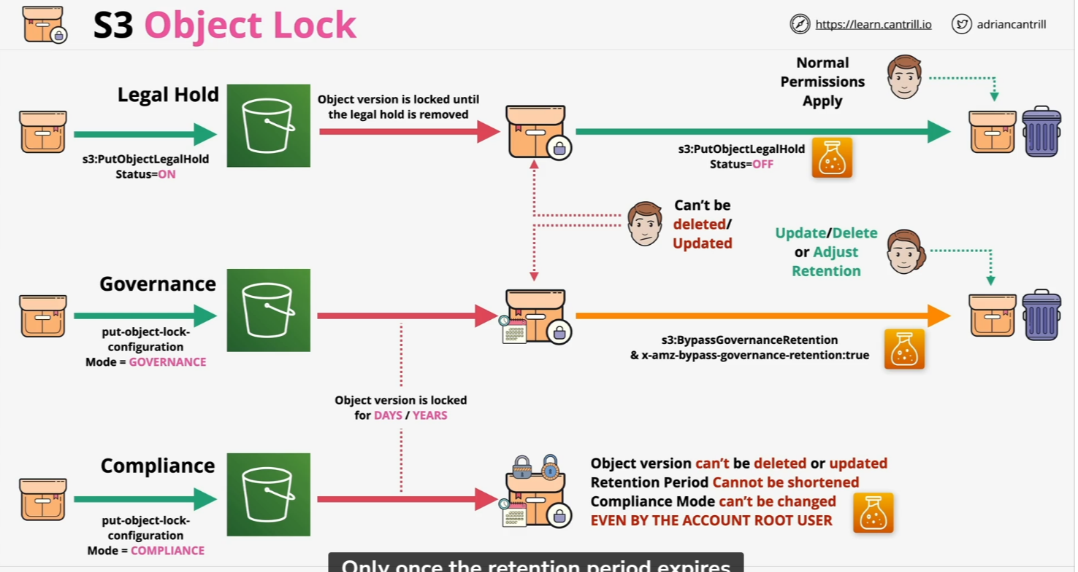
S3 Object Lock

Slide 26
S3 Object Lock
Question: What is the primary purpose of S3 Object Lock?
A) To reduce storage costs for S3 objects.
B) To prevent objects from being deleted or overwritten for a specified retention period.
C) To encrypt S3 objects.
D) To make objects publicly accessible.
Correct Answer: B
Question: What is the difference between Governance Mode and Compliance Mode in S3 Object Lock?
A) Governance Mode allows objects to be deleted by users with special permissions, while Compliance Mode prevents deletions by anyone, including the root user.
B) Governance Mode applies to individual objects, while Compliance Mode applies to entire buckets.
C) Governance Mode encrypts objects, while Compliance Mode does not.
D) Governance Mode is used for temporary retention, and Compliance Mode is for permanent retention.
Correct Answer: A

Slide 27
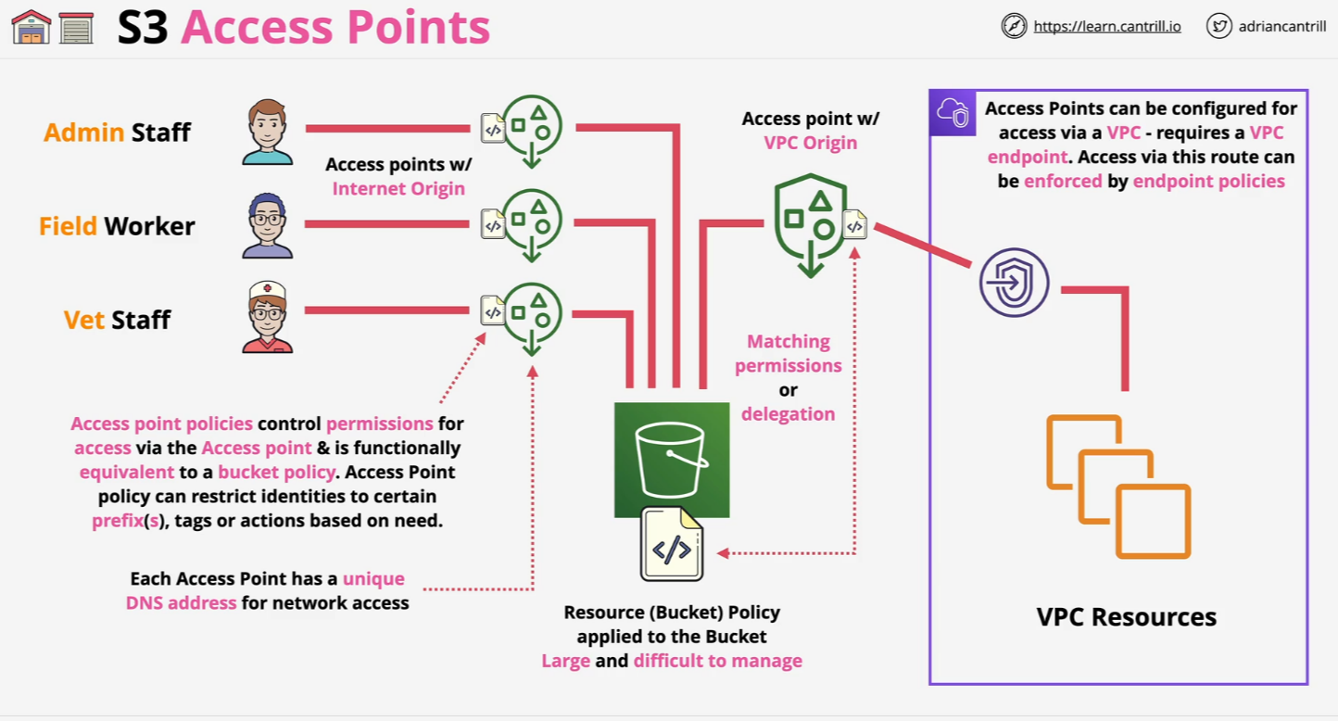
S3 Access Points

Slide 28
S3 Access Points
S3 Access Point is a feature that simplifies managing access to S3 buckets, especially when multiple applications or users require different access permissions. An S3 Access Point acts as a unique access endpoint for a bucket, allowing you to define specific permissions, network settings, and access controls for a particular use case, while the underlying S3 bucket remains unchanged.
Each S3 Access Point has its own DNS name, and it can be configured with a bucket policy that specifies who can access the data. You can also apply VPC restrictions to S3 Access Points, limiting access to specific VPCs (Virtual Private Clouds) for better security. S3 Access Points are especially useful for managing access to shared datasets, reducing the complexity of managing multiple access permissions directly on the S3 bucket.

Slide 29
S3 Access Point Exam
Question: What is the benefit of using S3 Access Points for applications?
A) They allow for direct access to S3 objects without needing IAM roles.
B) They help simplify access management for shared data sets across multiple applications or users.
C) They automatically archive data in Glacier storage.
D) They provide automatic data encryption.
Correct Answer: B
Question: What is the main use case for an S3 Access Point?
A) To increase the storage capacity of an S3 bucket.
B) To simplify managing access to an S3 bucket by creating unique access points for different users or applications.
C) To reduce the cost of storing objects in S3.
D) To enable versioning on S3 objects.
Correct Answer: B

Slide 30
Multi-Region Access Points (MRAP)
Multi-Region Access Points in Amazon S3 are designed to optimize the performance and availability of S3 data by enabling cross-region access to S3 objects. These access points allow you to create a global endpoint that can automatically route traffic to the nearest AWS region where your S3 data is stored, improving access speed for users and applications located in different parts of the world.
When you use Multi-Region Access Points, Amazon S3 automatically replicates the data across multiple regions, ensuring low-latency access and disaster recovery capabilities. This feature is particularly useful for applications that require consistent and fast access to data, regardless of the geographical location of the user.
The key benefit of Multi-Region Access Points is that you don't have to manage multiple access points or worry about manually routing traffic between regions. S3 handles the routing and replication automatically, providing a seamless experience for users and ensuring high availability and fault tolerance.

Slide 31
Multi-Region Access Points Exam
Question: What is the main benefit of using Multi-Region Access Points in Amazon S3?
A) It allows you to store objects in multiple regions.
B) It automatically replicates data across regions for low-latency access.
C) It increases the cost of S3 storage.
D) It provides encryption for all objects in S3.
Correct Answer: B
Question: Which of the following is true about Multi-Region Access Points in S3?
A) They replicate data across multiple regions for disaster recovery purposes.
B) They only work with objects that are stored in the S3 Glacier class.
C) They require users to manually configure routing between regions.
D) They are designed for storing data in a single region only.
Correct Answer: A

