Slide 1

Trusting the Good News
Do you trust good news more than bad news ?
Notes:
What do you think ?

Slide 2
Research Question Details
Do people engage in motivated reasoning just because news is “good” rather than “bad,” when ego, identity, and functional incentives are stripped away?
Good News Is Not a Sufficient Condition for Motivated Reasoning (M. Thaler, 2025)
Notes:
That’s what Michael Thaler asked himself when conducting his study, published in the Paper Good News…. He asked Do people engage… But how did he test it ?

Slide 3
Question
The Department of Peace and Conflict Research estimates that 45.8 thousand people were
killed per year in battles in the fifteen years from 1989-2003.
How many thousands of people were killed per year in battles in the fifteen years from
2004-2018?
Notes:
He asked participants questions like this one and then asked for their median belief (50/50 point)
As motivation they got paid using incentive-compatible scoring system that rewarded right answers
After the question they got a feedback…

Slide 4
Feedback
Bad News – Actually the value is higher as you thought
OR
Good News – Actually the value is lower as you thought
Notes:
The feedback was a news article that was either True or False and was either telling them that in reality the value was lower than or higher than they estimated
Depending on the question this was coded as good or bad news ( in our case Higher would be good news
After the news..

Slide 5
Guessing Probability
How likely is it that the message came from a true news source ?
1
10
Notes:
They had to rate “How likely is it that this message came from the True News source?” on a scale of 1-10
Main Dependent Variable

Slide 6

Experiment Setup Explain
>6,000 observations
~1,900 participant
3 Waves
Notes:
So quite a complicated setup to do what exactly ?
The Goal was to test whether “good news” alone causes motivated reasoning, independent of: self-image, political identity, incentives and functional usefulness of beliefs

Slide 7
Regression Specifications
$$α_{iqr}=α+β∙{1\left(Good News\right)}_{iqr}+γ^{controls}z_{i}+δFE_{r}+ζFE_{r}+ε_{iqr}$$
$$controls=age,gender,years of education$$
Notes:
Participant I
Question topic q
Round r

Slide 8
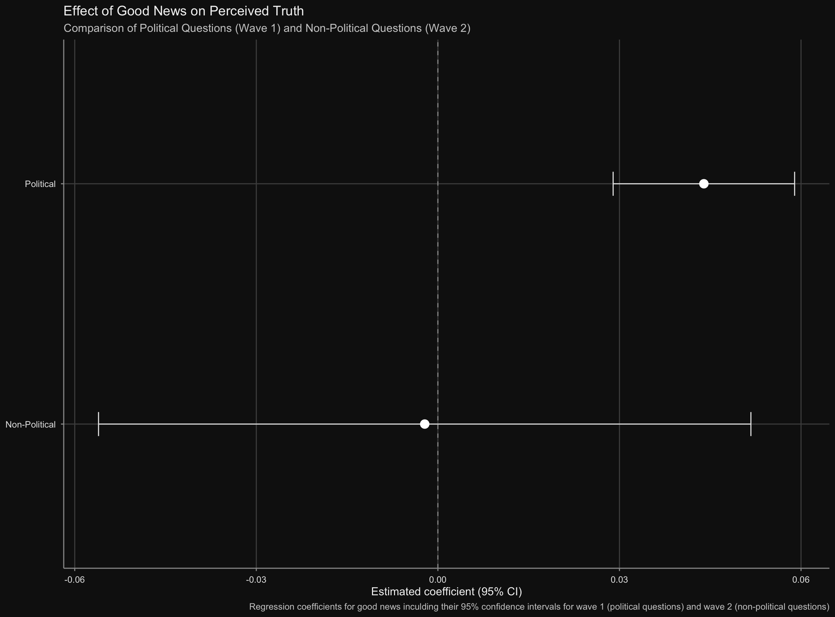
Regression Replication
Notes:
So quite a complicated setup to do what exactly ?
The Goal was to test whether “good news” alone causes motivated reasoning, independent of: self-image, political identity, incentives and functional usefulness of beliefs

Slide 9
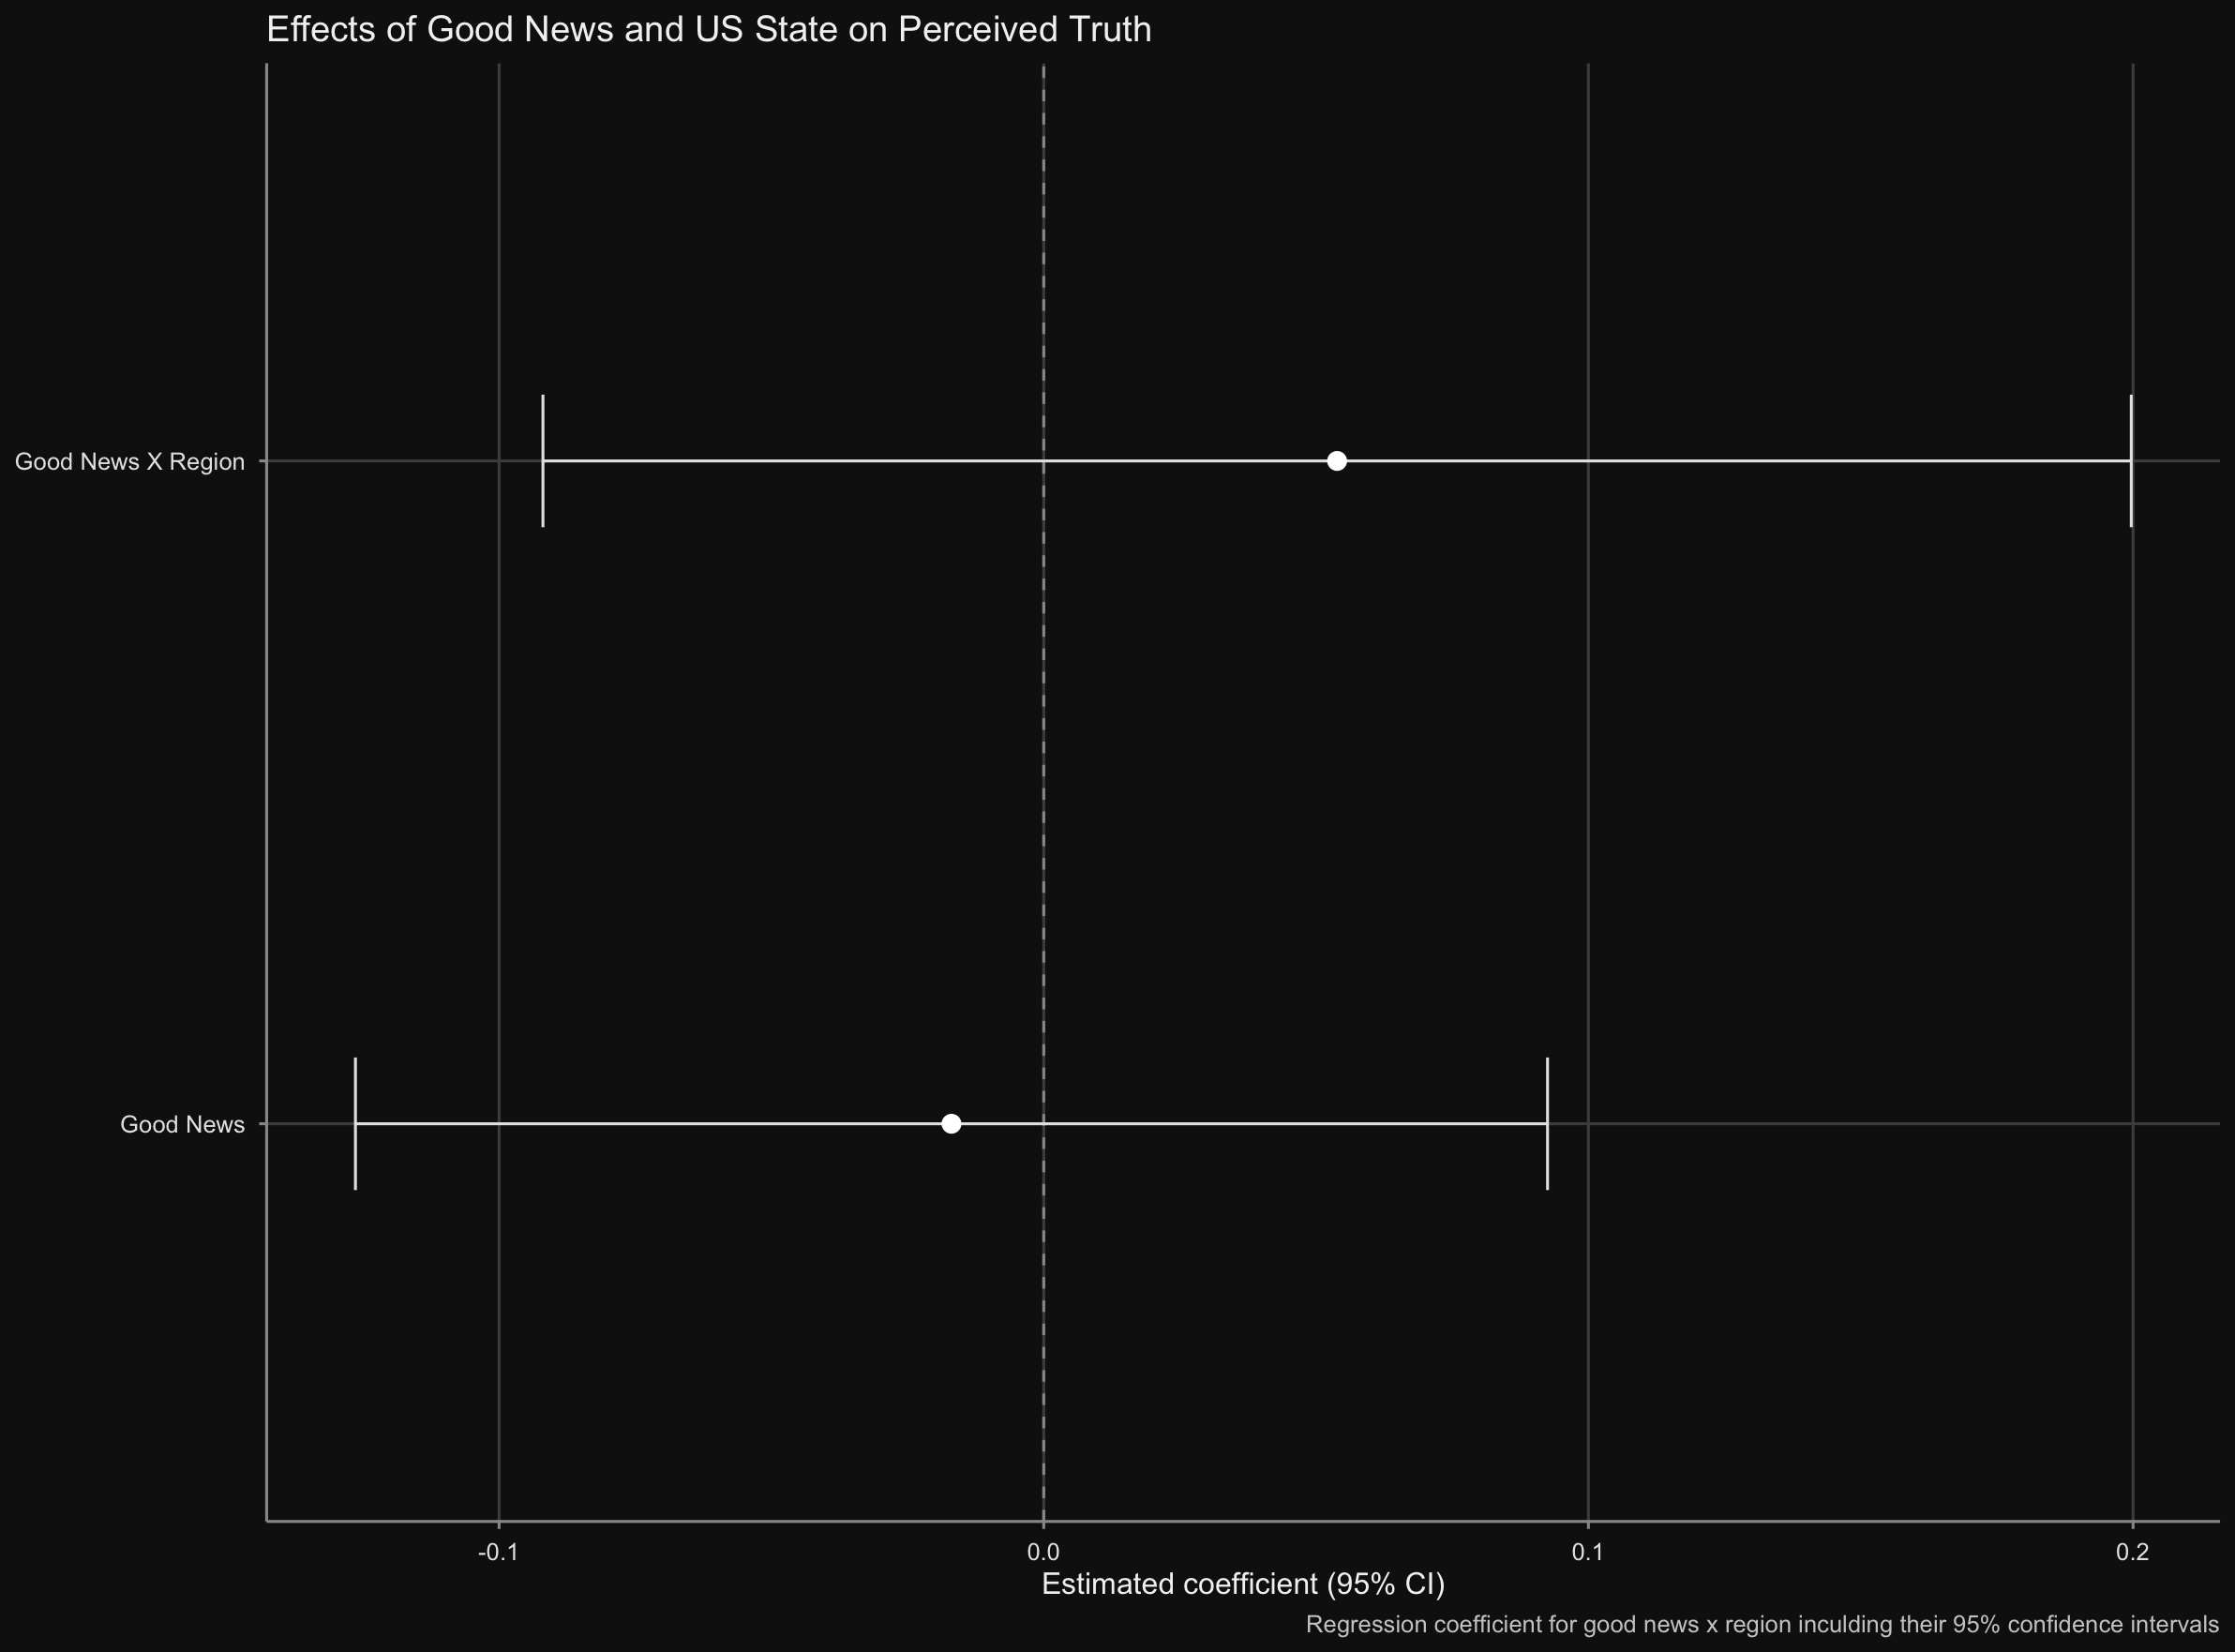
Extension Regression
Notes:
So quite a complicated setup to do what exactly ?
The Goal was to test whether “good news” alone causes motivated reasoning, independent of: self-image, political identity, incentives and functional usefulness of beliefs

Slide 10
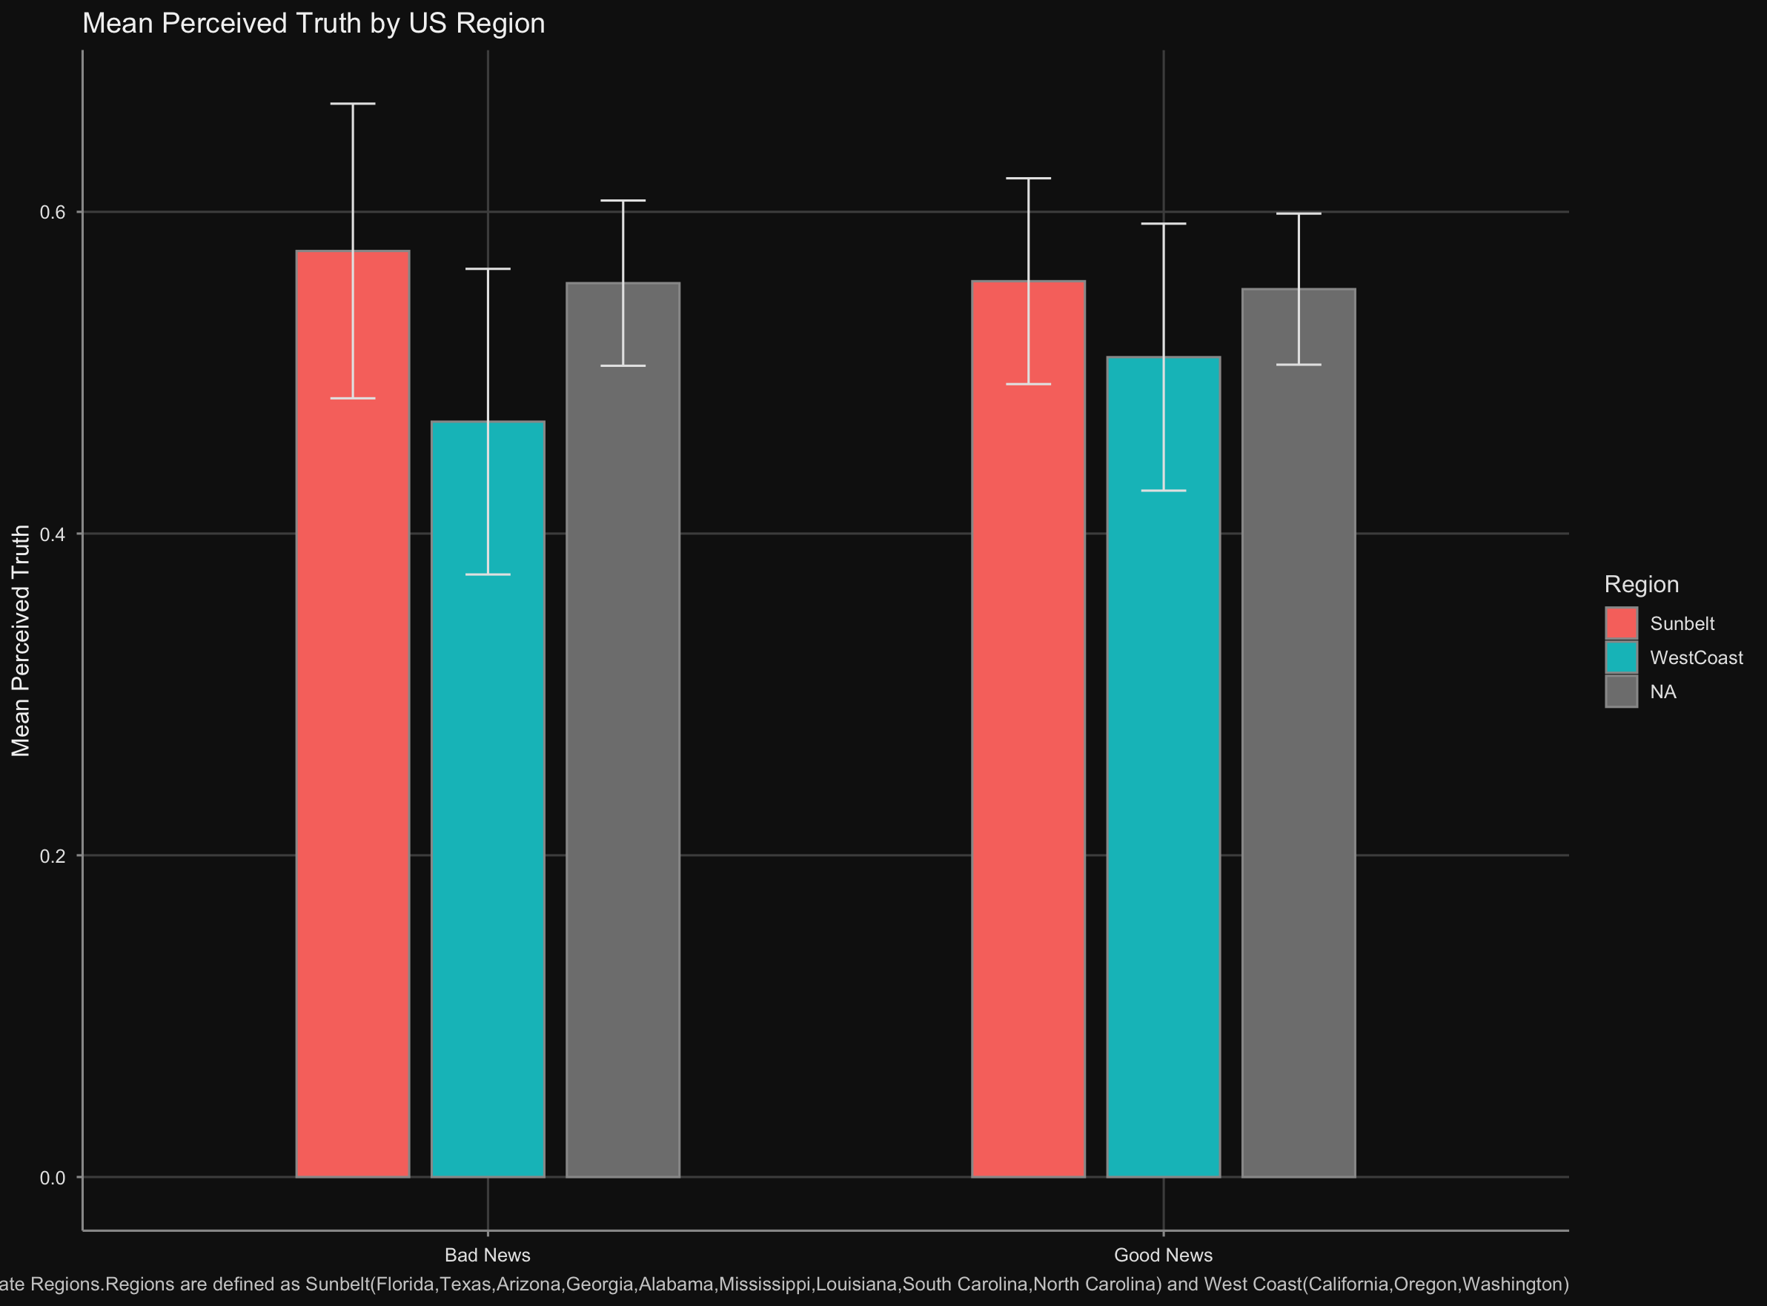
Extension Mean Values
Notes:
So quite a complicated setup to do what exactly ?
The Goal was to test whether “good news” alone causes motivated reasoning, independent of: self-image, political identity, incentives and functional usefulness of beliefs

Slide 11
Fin.

