Slide 1

Git basics

Slide 3
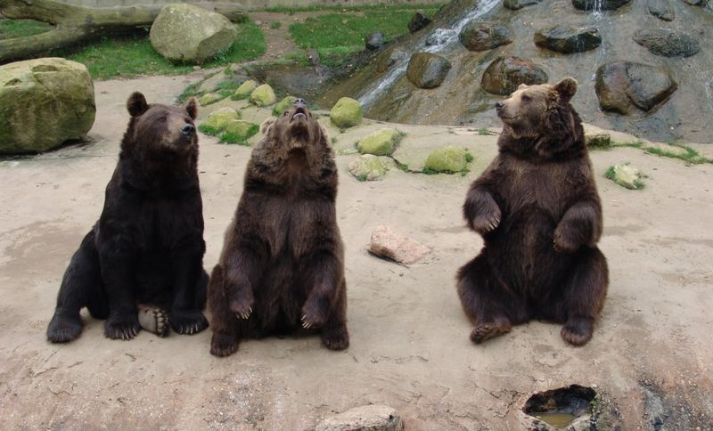
*what have i done
*what ist going on ?
*Gimme food!
Fetch
Pull
Push

Slide 4
Branches

Slide 5
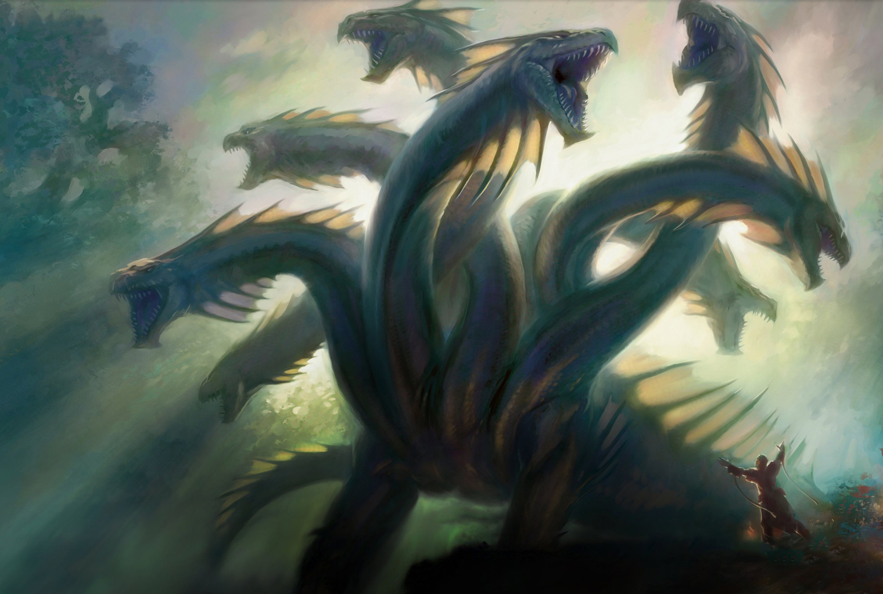
your branch
coworker branch
lets try this feature branch
version from 2 weeks ago
Last working branch
Master
You

Slide 6

Gitignore

