Slide 1
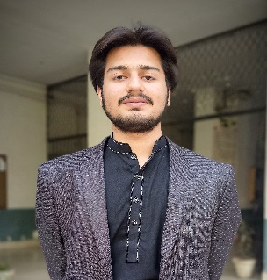




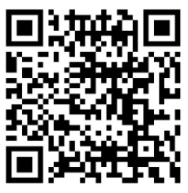
Muhammad Bilal
Mechatronics & Control Engineer
+923314098517
bilalmughal9246@gmail.com
Shahdara,Lahore
EDUCATION
Honors and Certificate
Govt. Islamia College Civil Lines , 2018-2022
Pre-Engineering
– Received academic scholarship with yearly stipend from Higher Education Commission.
– Supervised and Unsupervised Machine Learning from University of Michigan – Coursera.
– IOT- Based on Raspberry Pi from University of Michigan – Coursera.
University of Engineering and Technology Lahore , 2018-2022
Mechatronics and Control Engineering
WORK EXPERIENCE
SKILLS
Pak Elektron Limited (PEL) 2021 – Internship
– Did Internship at PEL in Transformation Engineering in Mechanical Design.
Python|Tkinter|Kivy|Numpy|Pandas
Freelancer – Python
– Doing freelancing in creating customized GUIs using Python Tkinter and Kivy. It has been a perfect student money resource in last years.
Arduini/Raspberry Pi
Teaching, 2019-2020 – Tutor
– Worked as Physics and Chemistry teacher and also provided home teaching services for a year.
OOP
Career Prep Fellowship, 2022 – Skills Development
– Invested 150 hours in order to develop business skills (e.g., communication, leadership, problem solving, teamwork, etc.) that will help me make a deeper impact on the job.
Data Structures
UET Mechatronics Club, 2018-2022 – Technical Team
– Currently part of Mechatronics Clubs’ Technical team and have been part of every technical event since Dec,2018.
Embedded Systems
Deep Learning
Projects
Delta Pick and Place Robot: FYP
– As a final year project we controlled the Industrial Delta Robot using Raspberry Pi. We controlled the motors, deployed Machine Vision using OpenCV and developed GUI on Kivy to operate the Robot.
Intersets
Programming
Blockchain
Word on the Street Game: – Made a real life board game (word on the street) on Python Tkinter.
Space Race
AI
Home Automation: – Made a home automation project using Raspberry Pi . The project was to switch the lights and fan remotely with the help of Raspberry Pi.
Prosthetic Ankle: Simulated the mathematical model of prosthetic ankle on MATLAB and studied its step response in Simulink.
Capactive Touch Sensor: Made a switching circuit using capactive sensing technique.
EquiGo: As a entrepreneurship project, initiated a startup name EQUI, our purpose is to provide trip services to disabled persons.
LinkedIn Profile

