Slide 1
Carding
Noman Siddique
p191664@nu.edu.pk

Slide 2
Carding
Carding is a term describing the trafficking and unauthorized use of credit cards.
If I keep it simple then Carding means to steal someone’s credit card details and use it for personal benefits.

Slide 3
Example
Carding generally involves the purchase of gift cards which are then used to purchase gift cards which can then be spent on relatively difficult to trace goods. Often the goods are then re-sold online or elsewhere.
You can also purchase the game money (such as uc) to buy stuff in game.
Account types like PayPal, Netflix points may be sold alongside card details.
Logins to many sites may also be sold as a back door apparently for major institutions such as banks, universities and even industrial control system.

Slide 4
History
1980s–1999:
Since the 1980s in the days of the dial-up BBSes, the term carding has been used to describe the practices surrounding credit card fraud.
Started in 1989, by 1990 Operation Sundevil was launched by the United States Secret Service to crack down on use of BBS groups involved in credit card fraud and other illegal computer activities, the most highly publicised action by the US federal government against hackers at the time. The severity of the crack down was so much that the Electronic Frontier Foundation was formed in response to the violation of civil liberties.
1999, United States offline and online credit card fraud annual losses were estimated at between $500,000 and $2 million

Slide 5
Stages of Carding
There are basically Four stages of Carding

Slide 6
Stage 1:Hacker
The hacker will extract all the Credit and debit card details using various methods
A huge pool of data is created and sold on the dark web

Slide 7
Ways of Stealing Card Details
Fraudulent Websites:
Fake Confirmation Calls:
ATM Machines:
Websites hack:
Random Guess:

Slide 8
Stage 2:Carder
The Carder will buy will buy this pool of credit and debit cards for hacker
He will purchase all the items from online store and dump the card
Now people will be randomly pitched to buy those products for heavy discount

Slide 9
Who is a Carder?
A carder buys this list of card details and eventually buys a large number of products from online websites like Amazon, Alibaba, etc. Once delivered, they will ask you to buy those products at 10% of the original price.
carders use fake identities for all this online shopping.

Slide 10
Stage 3:Consumer
The consumer makes the payment and he feels that the item will be delivered to him.

Slide 11
Stage 4:Police
If caught it is extremely easy for police to track the buyer and carder
All the people involved can land up in jail

Slide 12
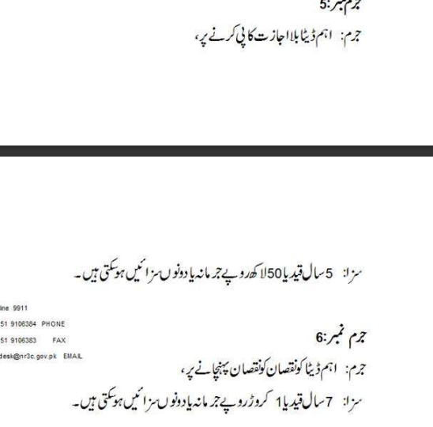
Act for Carding?

Slide 13
90% of the Carders are Fake
Let’s forget about the hacking, carding, or stealing card details for this moment. What if I tell you that the majority of these carders are absolutely fake and they don’t have product or card details?
Firstly, real carder will never come to you and disclose his identity. He will quietly buy the products and resale them in the market.
Secondly, most of the carders pretend to be carders but they merely take your money and flee.
“Sir, I am a carder and I can provide you iPhone 11 for Rs 20k. But you need to send me Rs 500 as processing fees.”
Once you pay this ‘processing fee’, you will never be able to contact that so-called carder again.
Neither you get your iPhone nor you get any carder. It’s just you who lost the amount.
Most of these Telegram and Instagram carders flee away. The only purpose they have is to collect such smaller amounts resulting in a huge sum of money

Slide 14
Conclusion
The carding business is anyway illegal and unsafe irrespective of the role you play – hacker, carder or even buyer.
Secondly, the majority of the carders are fake who never deliver you any product. They just flee away with your money.

