Slide 1
CDBM 280
Normalization

Slide 2
Normalization
Normalization is basically the process of efficiently organizing data in a database.
They are a series of guidelines for ensuring that databases are normalized. These are referred to as normal forms
There are 5 normal forms numbered from one (the lowest form of normalization, referred to as the first normal form or 1NF)
through five (fifth normal form or 5NF).

Slide 3
Characteristics of a relation
A relation is a two-dimensional table that has the characteristics listed below:
  rows contain data about an entity
  columns contain data about attributes of the entity
  cells of the table hold a single value
  all entries in a column are of the same kind
  each column has a unique name
  the order of the columns is unimportant
  the order of the rows is unimportant
  no two rows may be identical

Slide 4
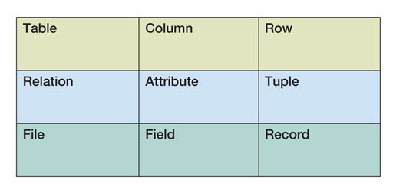
Terms
The terms table and relation are used interchangeably.
Three sets of equivalent terms:

Slide 5
Functional Dependencies
To understand the rules of normalization, it is useful to understand how "functional dependencies" work.
The reason for having relations is to store instances of functional dependencies.
A functional dependency exists when the value of one or more attributes determines the value of other attributes.
The functional dependency holds for the whole relation, not just a particular instance of the relation.
Dependency Diagrams – graphical representation

Slide 6
FD example
Channel # | Name | Language
100 | CNN | English
200 | Cartoon Network | English
255 | Radio Canada | French
138 | Turner Classic Movies | English
Channel# → Name
Channel# → Language
Or may be written as:
Channel# → (Name, Language)

Slide 7
Composite FDs
A composite group can occur on either side of a FD
A grade in a course is determined by both the student and the course
  (StudentID, CourseID) → Grade
If (A, B) → C, then neither A nor B will determine C by itself
If A → (B, C), then it is true that A → B and A → C

Slide 8
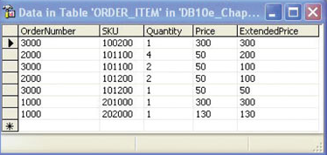
Finding Functional Dependencies

Slide 9
Functional Dependency Ex
studentID | stuName | stuAddress | courseID | courseName | credits | mark
CST201 | Fred | 123 Main St | CDBM190 | SQL | 4 | 86
CST202 | Jane | 6 Last Ave | CDBM190 | SQL | 4 | 76
CST201 | Fred | 123 Main St | COSC285 | Internet Prog | 5 | 75
CST202 | Jane | 6 Last Ave | COSC285 | Internet Prog | 5 | 88

Slide 10
Modification Anomalies
Occur when changing the data creates undesirable consequences.
Three types:
  Deletion anomaly
  Insertion anomaly
  Update anomaly

Slide 11
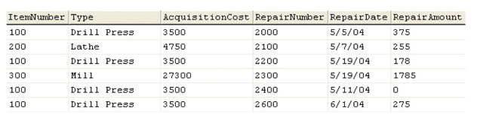
Deletion Anomaly
A deletion anomaly occurs when you delete a tuple and it not only deletes the facts you wanted but also deletes another piece of data.
  EquipmentRepair(ItemNumber, RepairNumber, Type, AcquisitionCost, RepairDate, RepairAmount)
Ex: Delete repair number 2100

Slide 12
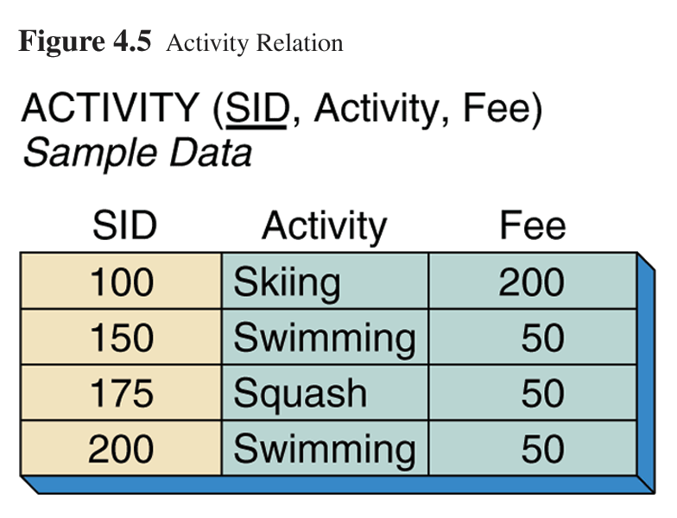
Deletion Anomaly
This relation stores a list of all activities offered (and the activity's associated fee) and students taking those activities.
  SID → Activity
  Activity → Fee

Slide 13
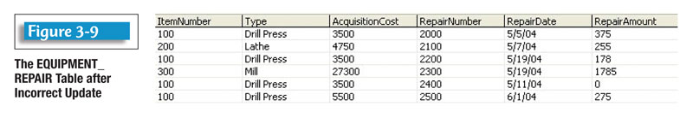
Insertion Anomaly
An insertion anomaly occurs when we cannot insert a fact about one entity until we have an additional fact about another entity.
  EquipmentRepair(ItemNumber, RepairNumber, Type, AcquisitionCost, RepairDate, RepairAmount)
Ex: Add a new item to the table: ItemNumber (400) for a Drill Bit that’s acquisition cost is $67.00.

Slide 14
Insert Anomaly

Slide 15
Update Anomaly
Occurs when the same information can be expressed on multiple rows; therefore updates to the table may result in logical inconsistencies.
Ex: There are two acquisition costs for the Drill Press.

Slide 16
Update Anomaly

Slide 17
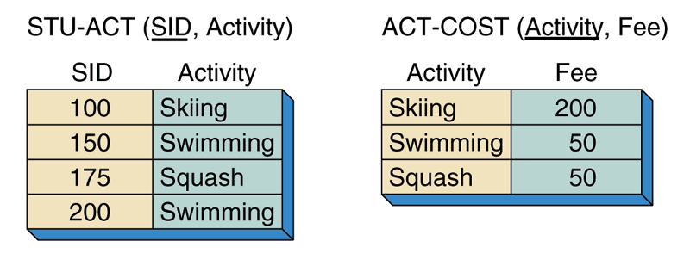
Solve the problem with anomalies
Divide the table into multiple, joining tables

Slide 18
Essence of the normalization process
Every normalized relation should have a single theme.
Any relation having two or more themes should be broken into two or more relations each having a single theme.
When you break up a relation you need to check for and to record any resulting referential integrity constraints.

Slide 19
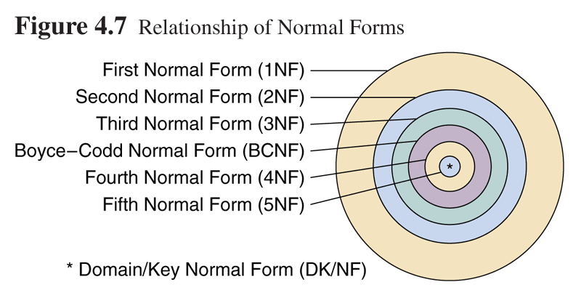
Relationship of Normal Forms

Slide 20
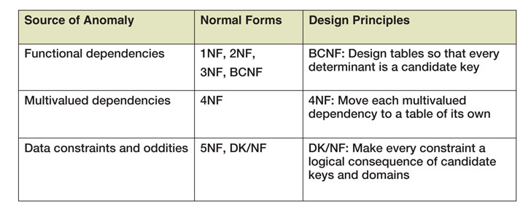
Normalization Categories

Slide 21
Normal Forms
The classes of relations and the techniques for preventing anomalies are called normal forms

Slide 22
1st Normal Form
For a table to be in the First Normal Form, it should follow the following 4 rules:
It should only have single (atomic) valued attributes/columns.
Values stored in a column should be of the same domain.
All the columns in a table should have unique names.
And the order in which data is stored, does not matter.

Slide 23
Unnormalized Table
Character | Animal | Info
Alex | Lion | Born into a life of privilege. Now lives at Central Park Zoo The star in the Greatest city on earth.
Gloria | Hippo | Born and raised in Central Park Zoo. Strikingly beautiful, smart & independent.
Melman | Giraffe | Born in San Diago Zoo & transferred to Central Park Zoo as a young adult. He is a hypochondriac.
Marty | Zebra | Born at the Central Park Zoo. He is a dreamer and an adventurer.

Slide 24
Relation
Character | Animal | PlaceBorn | CurrentResidence | CharacterTraits
Alex | Lion |  | Central Park Zoo | The star in the Greatest city on earth.
Gloria | Hippo | Central Park Zoo | Central Park Zoo | strikingly beautiful
Gloria | Hippo | Central Park Zoo | Central Park Zoo | smart
Gloria | Hippo | Central Park Zoo | Central Park Zoo | independent
Melman | Giraffe | San Diago Zoo | Central Park Zoo | hypochondriac
Marty | Zebra | Central Park Zoo |  | dreamer
Marty | Zebra | Central Park Zoo |  | adventurer

Slide 25
2NF and 3NF
2NF and 3NF deal with the relationship between non-key and key fields.

Slide 26
2nd Normal Form
A relation is in second normal form if it is in 1NF and every non-key attribute is fully dependent on the whole key, not just part of it.
2NF is designed to eliminate dependencies that involve only part of the key.
2NF is violated when a non-key field is determined by only part of the key.
There are no 2NF violations if the key is not composite.

Slide 27
2NF
The relation Relation1(A,B,C,D) where B→C becomes Relation1(A,B,D) and Relation2(B,C)
To place the relation in 2NF:
  remove the functional dependency involving only part of the key and place in a relation of its own. The determinate will become the PK of the new relation and the FK connection to the original relation

Slide 28
3rd Normal Form
For a table to be in 3NF it must be in 2NF and every non-key attribute has no transitive dependencies.
A transitive dependency is when a key attribute determines a non-key attribute and in turn this non-key attribute determines another non-key attribute, A→B→C

Slide 29
To place in 3NF
Move the non-key determinate and its dependant attributes to a new table and form a relationship between the original table and the new table.
The relation – Relation(A, B, C, D) where A→B, C, D and C→D becomes Relation1(A, B, C) and Relation2(C, D)

Slide 30
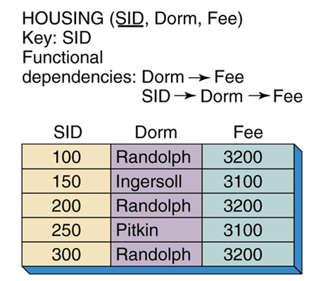
3NF Violation

Slide 31
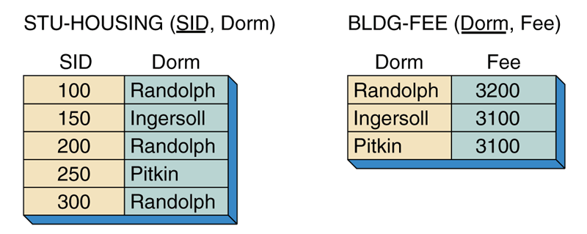
Relations in 3NF
Eliminate transitive dependencies

Slide 32
Boyce-Codd Normal Form
A relation in BCNF must be in 3NF and every determinant is a candidate key.
BCNF is a slightly stronger version of 3NF.
Only in rare cases does a 3NF table not meet the requirements of BCNF. A 3NF table which does not have multiple overlapping candidate keys is guaranteed to be in BCNF.

Slide 33
BCNF
BCNF covers 2 special cases not covered by 3NF
  part of a key determines part of a key
  a non-key attribute determines part of a key
These situations are only possible if there are multiple composite, candidate keys. Tables with multiple, composite candidate keys are not common.

Slide 34
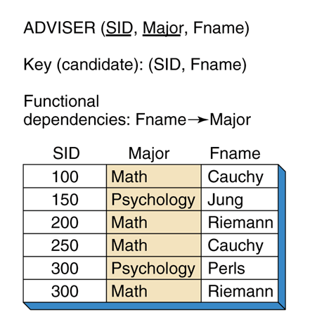
Violates BCNF

Slide 35
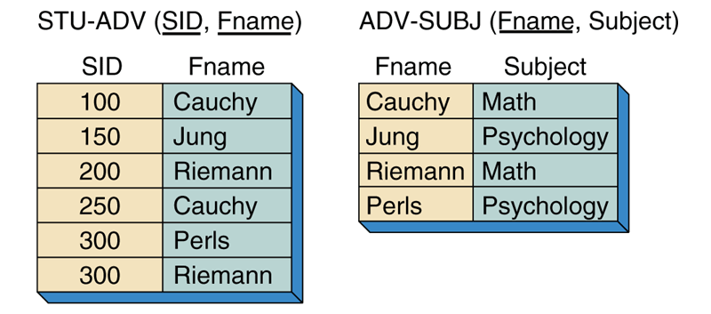
Relation in BCNF

Slide 36
BCNF
Relations in BCNF have no functional dependency anomalies. However there are anomalies that can rise from other situations other than functional dependencies

Slide 37
4thNF and 5thNF
4NF and 5NF deal with multivalued facts.
Multivalue dependency
  A condition in a relation with three or more attributes in which independent attributes appear to have relationships they do not have.

Slide 38
4th Normal Form
A relation is in fourth normal form if it is in BCNF and has no multi-value dependencies (MVD).
A multi-value dependency exists when a relation has at least three attributes, two of them are multi-valued, and their values depend on only the third
4NF is designed to eliminate multiple sets of multi-valued dependencies attribute.

Slide 39
4NF Example
 | Table that is 3NF but not in 4NF
 | Car | Colour | Engine
1 | Mustang | Red | F3.2L
2 | Mustang | Red | F4.5L
3 | Mustang | White | F3.2L
4 | Mustang | White | F4.5L
5 | Mustang | Blue | F3.2L
6 | Mustang | Blue | F4.5L
7 | Cirrus | Red | C2.1L
8 | Cirrus | Red | C3.0L
9 | Cirrus | Green | C2.1L
10 | Cirrus | Green | C3.0L
Each colour for each car is paired with each engine size for each car (and vice versa).
For every car all of its possible colours will be paired with all of its possible engines.

Slide 40
How to detect MVDs
Find any pair of rows that have the same value of [car]. To start, look at rows 1 and 6.
Exchange the values of [colour] in these two rows. Now you have [mustang, blue, F3.2L] and [mustang, red, F4.5L].
Verify that two other rows exist with these values. They do (rows 5 and 2).
Continue this for all other pairs of rows for which the value of [car] is the same.
Since car →→colour then it passes the test (as does car →→ engine). We have verified that this relation does contain MVDs.

Slide 41
Car relation in 4NF
Car Colour relation
Car | Colour
Mustang | Red
Mustang | White
Mustang | Blue
Cirrus | Red
Cirrus | Green
Car Engine relation
Car | Engine
Mustang | F3.2L
Mustang | F4.5L
Cirrus | C2.1L
Cirrus | C3.0L
With this table structure you can still determine, for example, that a red Mustang can have either an F3.2L or F4.5L engine. When you delete one piece of information (i.e., a car colour), you lose only that fact.

Slide 42
5th Normal Form
5NF deals with cases where information can be reconstructed from smaller pieces of information which can be maintained with less redundancy.
Eliminate cyclic dependencies. 5NF is also known as Projection Normal Form (PJNF
2NF, 3NF and 4NF also serve this purpose, but 5NF generalizes to cases not covered by the others.

Slide 43
5NF Example
If agents represent companies, companies make products, and agents sell products, then we might want to keep a record of which agent sells which product for which company. This information could be kept in one record type with three fields.

Slide 44
Although agent Smith sells cars made by Ford and trucks made by GM, he does not sell Ford trucks or GM cars. Thus, we need the combination of all three fields to know which combinations are valid and which are not.
Agent | Company | Product
Smith | Ford | car
Smith | GM | truck

Slide 45
But suppose a certain rule is in effect – if an agent sells a certain product and he represents the company making that product, then he sells that product for that company.
Agent | Company | Product
Smith | Ford | car
Smith | Ford | truck
Smith | GM | car
Smith | GM | truck
Jones | Ford | car

Slide 46
In this case it turns out that we can reconstruct all the true facts from a normalization form consisting of three separate record types, each containing two fields.
Agent | Company
Smith | Ford
Smith | GM
Jones | Ford
Agent | Product
Smith | car
Smith | truck
Jones | car
Company | Product
Ford | car
Ford | truck
GM | car
GM | truck

Slide 47
These 3 record types are in 5NF. The three-field record is not.
5NF does not differ from 4NF unless there exists a symmetric constraint such as the rule about agents, companies and products. In the absence of such a constraint, the record type in 4NF is always in 5NF.

Slide 48
Domain Key Normal Form
Constraint: any rule governing static values of attributes that is precise enough so that we can ascertain whether the rule is true or not.
Key: a unique identifier of a row.
Domain: named set of possible values.
Definition of DK/NF: A relation is in DK/NF if every constraint on the relation is a logical consequence of the definition of keys and domains. Informally, a relation is in DK/NF if enforcing key and domain restrictions causes all of the constraints to be met.

Slide 49
DK/NF
If a relation is in DK/NF there will be no modification anomalies.
DKNF is the ultimate application of normalization and is more a measurement of conceptual state, as opposed to a transformation process in itself

Slide 50
Denormalizing Relations
An overly-normalized database may have many small tables
To combine the information from many tables involves a lot of extra overhead – more disk i/o and processing
There may be circumstances where denormalizing the design is desirable
  The decision to store postal code with the address– SIAST doesn’t split out the postal code, but a mail-order company may find that it is important to have accurate addresses over the decrease in performance.

