Slide 1

20 MUST KNOW
things about Amazon EC2

Slide 2
1

Slide 3
EC2 Service lets you create virtual machines on AWS
Each machine is called an EC2 Instance
EC2 = E C C ( Elastic Compute Cloud)
EC2 instances are elastic, meaning they can instantly grow or shrink to match the requirements of a specific application.
You can pay-as-you-go for ec2 instances and per second.

Slide 4
Features of Amazon EC2
Persistent storage volumes for your data using Amazon Elastic Block Store (Amazon EBS) volumes which are elastic in nature and multiple volumes can be added to an instance.
Multiple physical locations for your resources, such as instances and Amazon EBS volumes, known as regions and Availability Zones
A firewall that enables you to specify the protocols, ports, and source IP ranges that can reach your instances . Also called security groups
Option of having Static IPv4 addresses for dynamic cloud computing, known as Elastic IP addresses
Metadata, known as tags, that you can create and assign to your Amazon EC2 resources
Various sizes and capacity of servers.

Slide 5
2

Slide 6
In order to create an ec2 instance , we have to have an AMI
AMI Stands for Amazon Machine Image
AMI is basically an OS image
An Amazon Machine Image (AMI) provides the information required to launch an instance
An AMI includes the following:
A template for the root volume for the instance (for example, an operating system, an application server, and applications)
Launch permissions that control which AWS accounts can use the AMI to launch instances
A block device mapping that specifies the volumes to attach to the instance when it's launched

Slide 7
Types of AMI:
AWS Provided AMI’s (free)
Community AMI’s (free)
AWS Marketplace AMI (free and paid)
Your custom AMI’s

Slide 8
Amazon Linux AMI (great for beginners!)
Amazon Linux AMI are supported and maintained Linux images provided by AWS. Some of the features of Amazon AMI’s are
A stable, secure, and high-performance execution environment for applications running on Amazon EC2.
Provided at no additional charge to Amazon EC2 users.
Repository access to multiple versions of MySQL, PostgreSQL, Python, Ruby, Tomcat, and many more common packages.
Regular updates of components and packages like yum
Includes packages that enable easy integration with AWS services, such as the AWS CLI, the Boto library for Python etc.

Slide 9
3

Slide 10
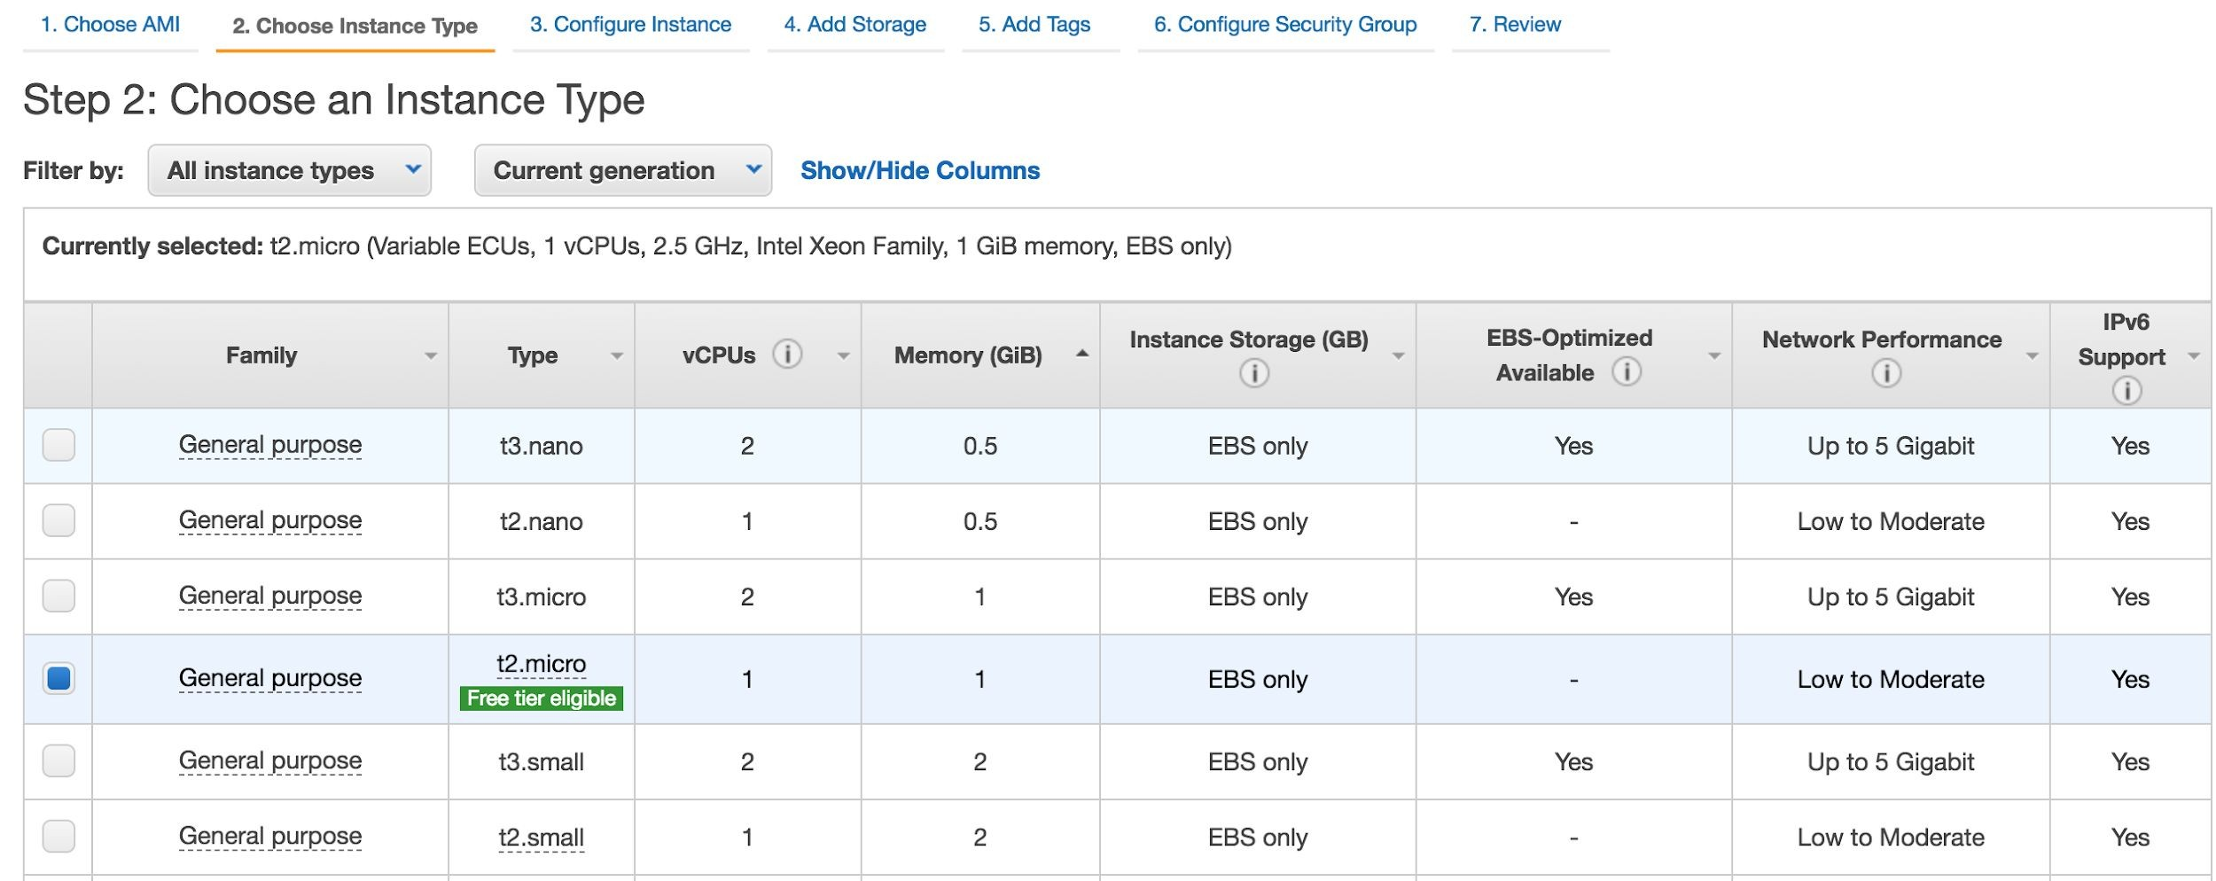
You choose the size of EC2 by selecting a type
There are different types of EC2 instances

Slide 11
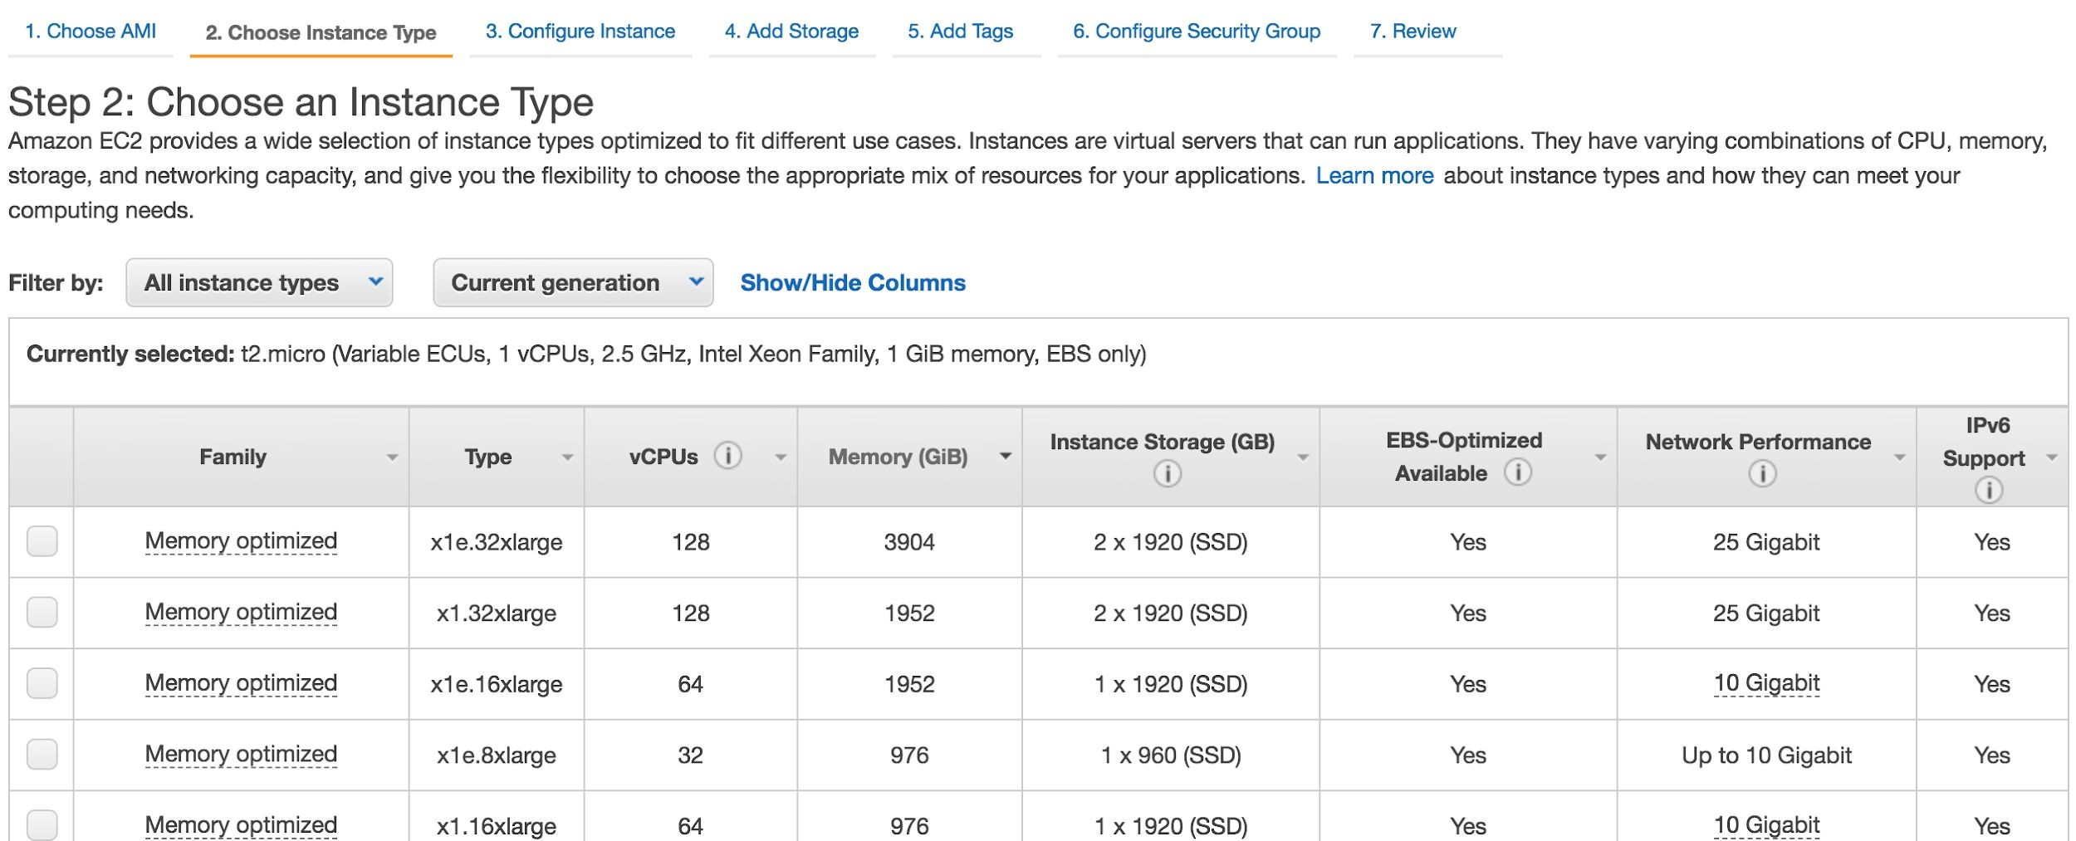
https://aws.amazon.com/ec2/instance-types/

Slide 12
4

Slide 13
You need certain things/components to successfully launch an EC2 and log into it
VPC , Subnet ( there are default subnets)
Security Group
Key Pair
Storage ( usually EBS)
AMI
Instance Type

Slide 14
5

Slide 15
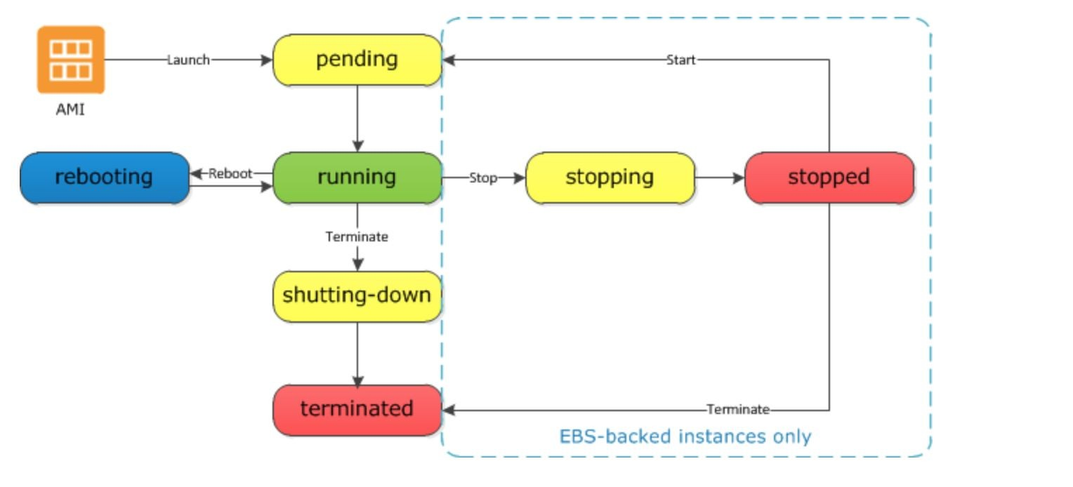
EC2 Lifecycle
You can:
Launch EC2
Reboot/restart
Stop EC2( like shutdown)
Hibernate EC2 instance
Terminate EC2( release forever)
Start EC2( If Stopped)

Slide 16
Differences Between Reboot, Stop, Hibernate, and Terminate
https://docs.aws.amazon.com/AWSEC2/latest/UserGuide/ec2-instance-lifecycle.html

Slide 17
6

Slide 18
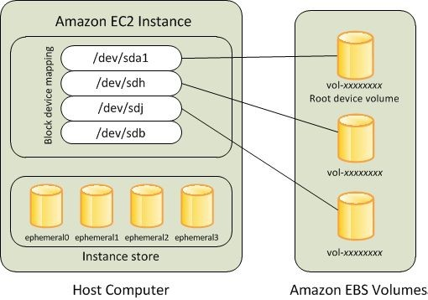
There are 2 kinds of EC2 Storage
Instance Store: Hard disk is in the host machine. You lose data if EC2 instance is shut down.
EBS Storage: EBS stands for Elastic Block Storage. EBS one of the two types of storage on AWS. EBS is basically independent of EC2 and is like a networked drive. You can terminate( release forever) an EC2 and still save EBS volumes and use it later.

Slide 19
7

Slide 20
EC2 Pricing Model
1) On Demand Instances : Rent it for few seconds/hours/days etc . Pay as you go
$$$
2) Reserved Instances : Pay upfront for 1-3 years and save a lot ( up to 75%)
$$
3) Spot Instance: You bid on them IF available. May terminate with 2 minute notice . uptp 90%
cheaper than On Demand Instances
$

Slide 21
8

Slide 22
EC2 Tenancy : Are virtual machines on a shared host or not?
Dedicated ( Needed for compliance and security sensitive needs)
Dedicated Instance ( Your EC2 stays on a host that only is used by you. Host hardware may change)
Dedicated Host( you literally get a physical machine reserved)
Multi-tenant Type ( Cheap and usually secure)

Slide 23
9

Slide 24
When an EC2 instance Is stopped
Private IP remains with the EC2 instance
Public IP may change when you restart a stopped instance The underlying host (physical machine) may change

Slide 25
Differences Between Reboot, Stop, Hibernate, and Terminate
https://docs.aws.amazon.com/AWSEC2/latest/UserGuide/ec2-instance-lifecycle.html

Slide 26
10

Slide 27
EC2 Public IP address and Elastic IP
Elastic IP (EIP) are Static(persistent) IP’s that you can create on demand. They are different than the Public IP you get when you launch an EC2 instance ( if public IP is enabled) . You can attach EIP to an EC2 instance.
Elastic IP’s stay with the instance even when the instance is stopped. This is in contrast to the default Public IP given to instance, which is released after an instance is stopped.
You always pay for EIP if it’s not attached to a running EC2. So if EC2 is stopped and has Elastic IP , you pay for the EIP.

Slide 28
11

Slide 29
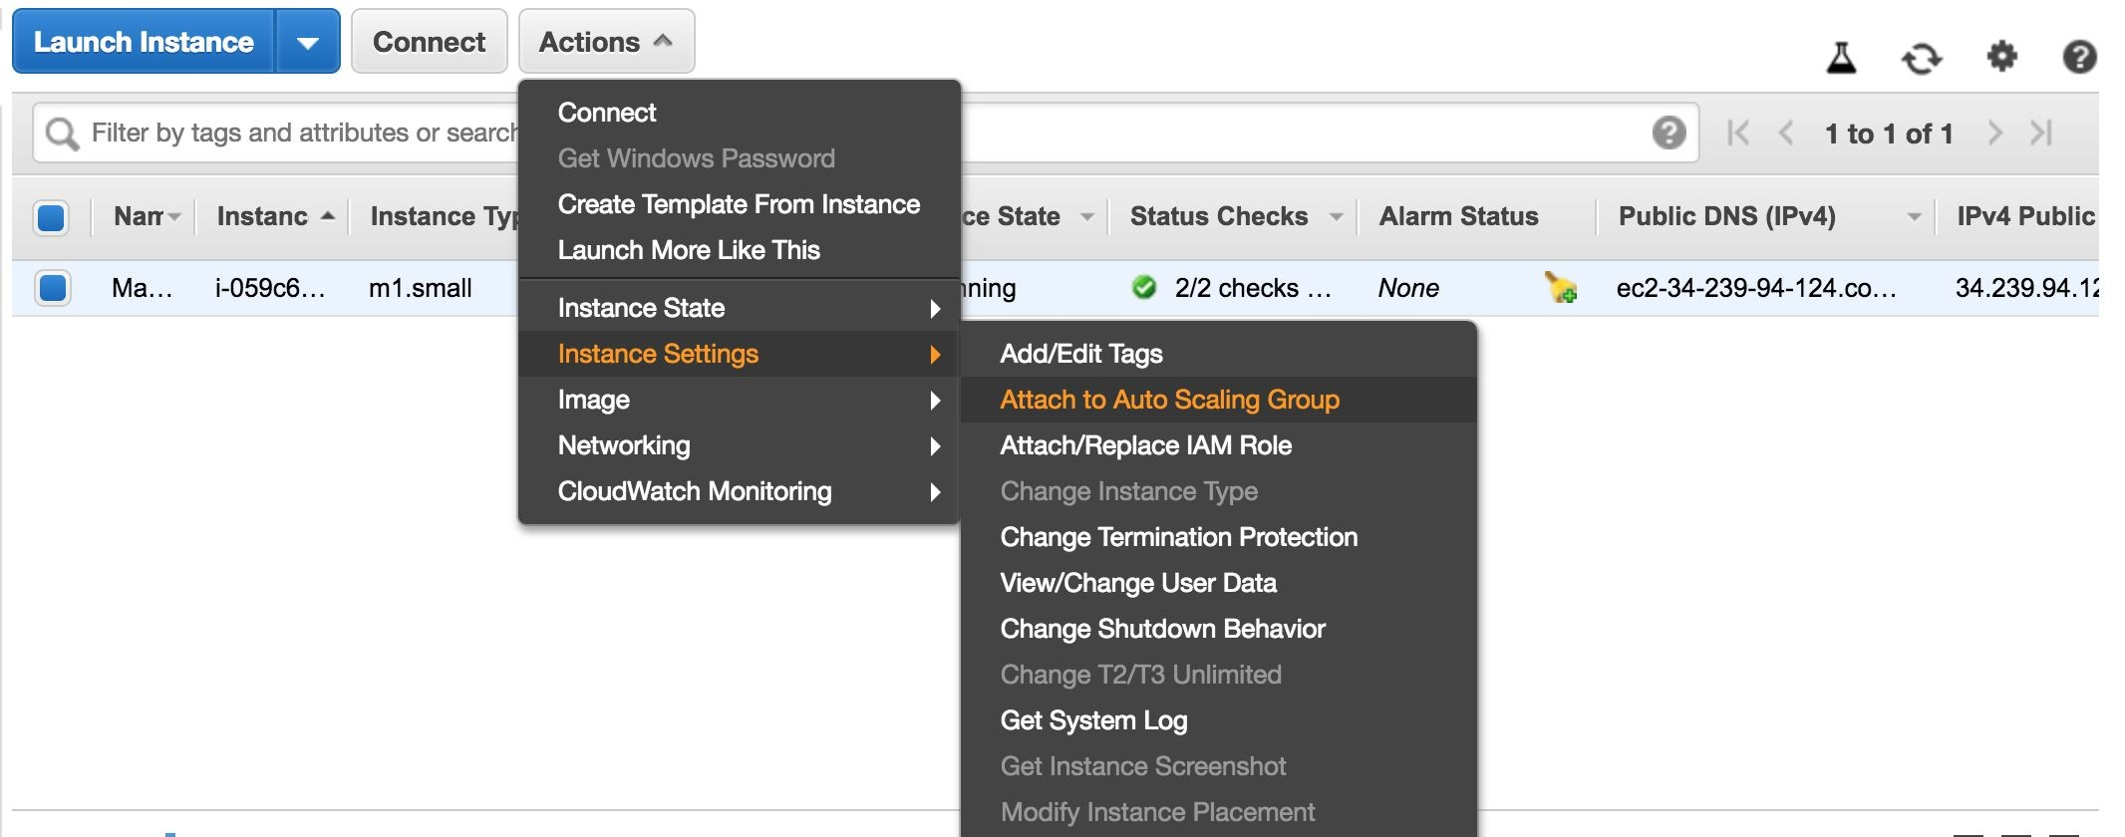
Termination Protection: Easy to launch , easy to destroy
In order to protect accidental deletion, we can set termination protection on an EC2 Instance. This is an added layer of protection for critical EC2 instance.

Slide 30
12

Slide 31
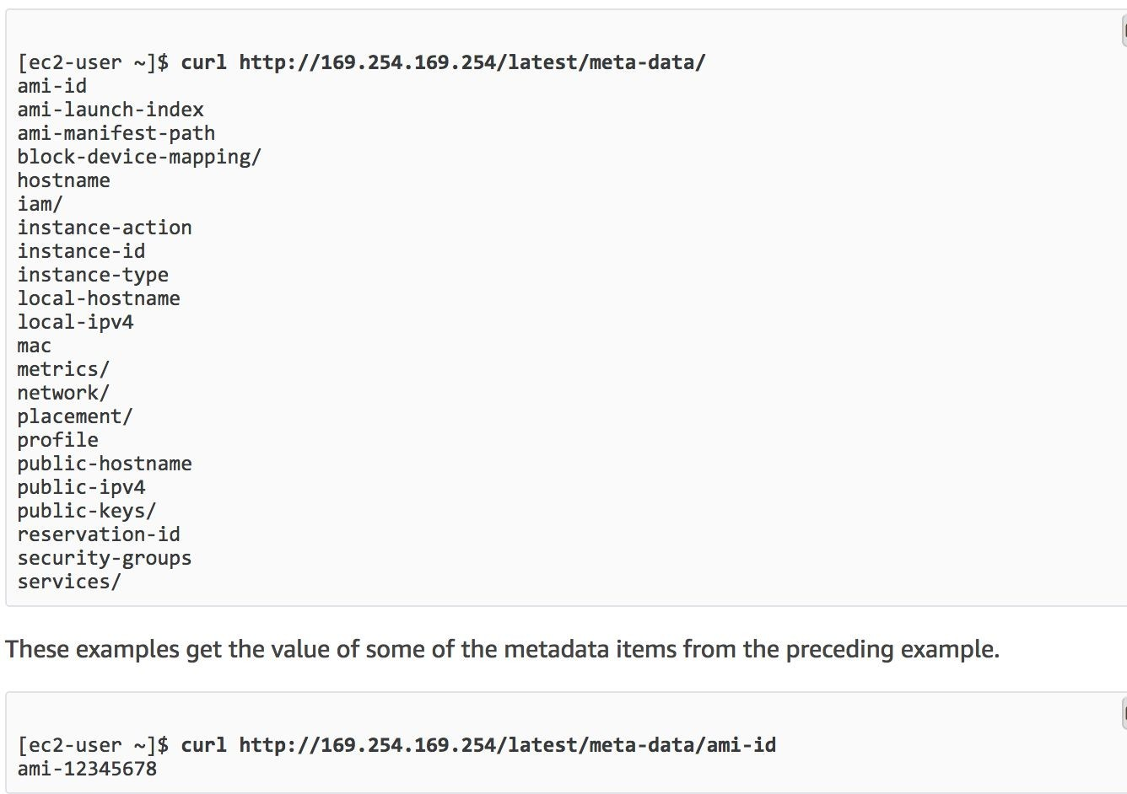
View Instance Metadata
You can access your EC2 instance metadata by accessing the following URL:

Slide 32
13

Slide 33
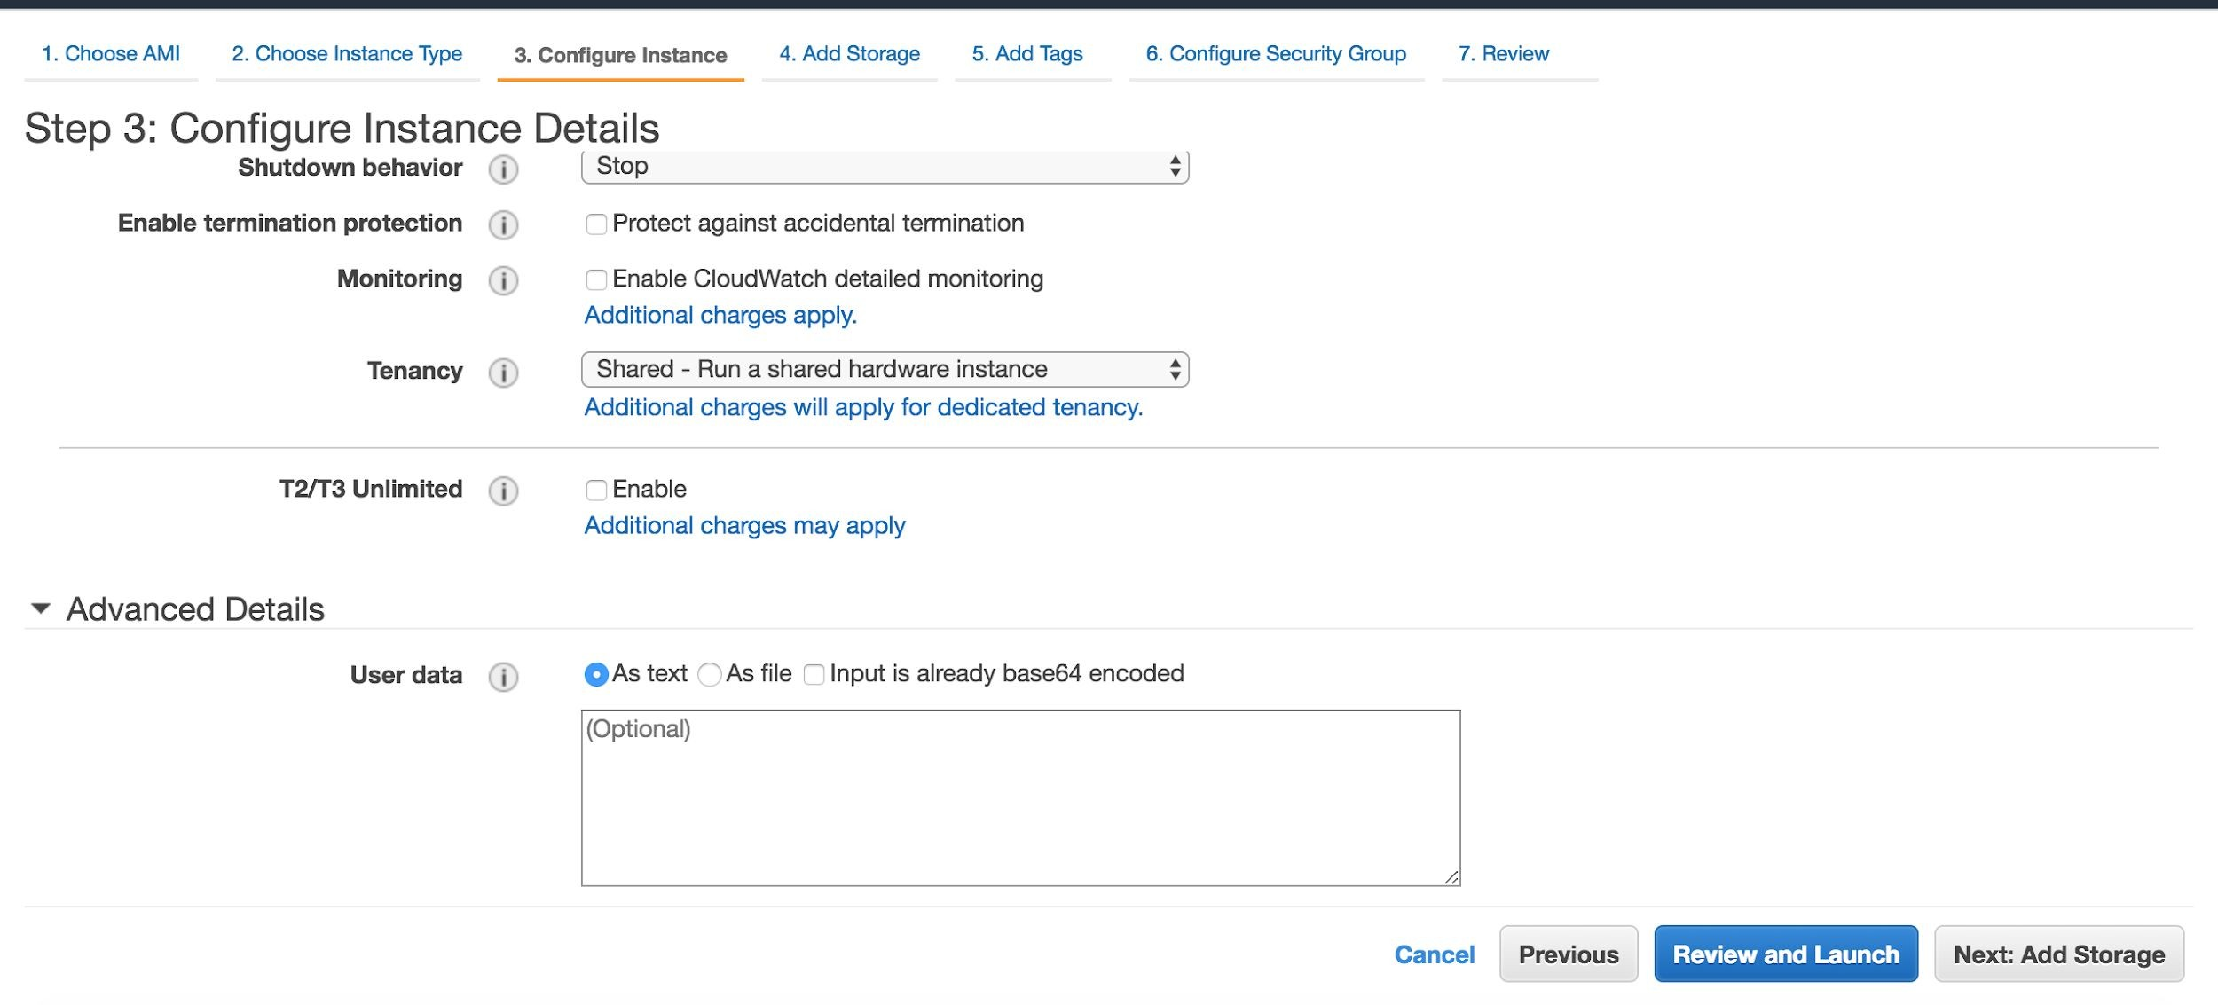
Run Commands on Your EC2 Instance at Launch
You can do this using Userdata section. Just pass a script in the userdata box Tab 3 during the launch process.

Slide 34
14

Slide 35
EC2 Monitoring
Cloudwatch Services provides basic monitoring for various EC2 instance metrics like
CPU Utilization, Network In/ Out Packets In/Out Disk Read/Writes.
But does does not provide metrics like Memory(RAM) Utilization. You can create custom metrics for things like Memory Utilization and disk usage monitoring.

Slide 36
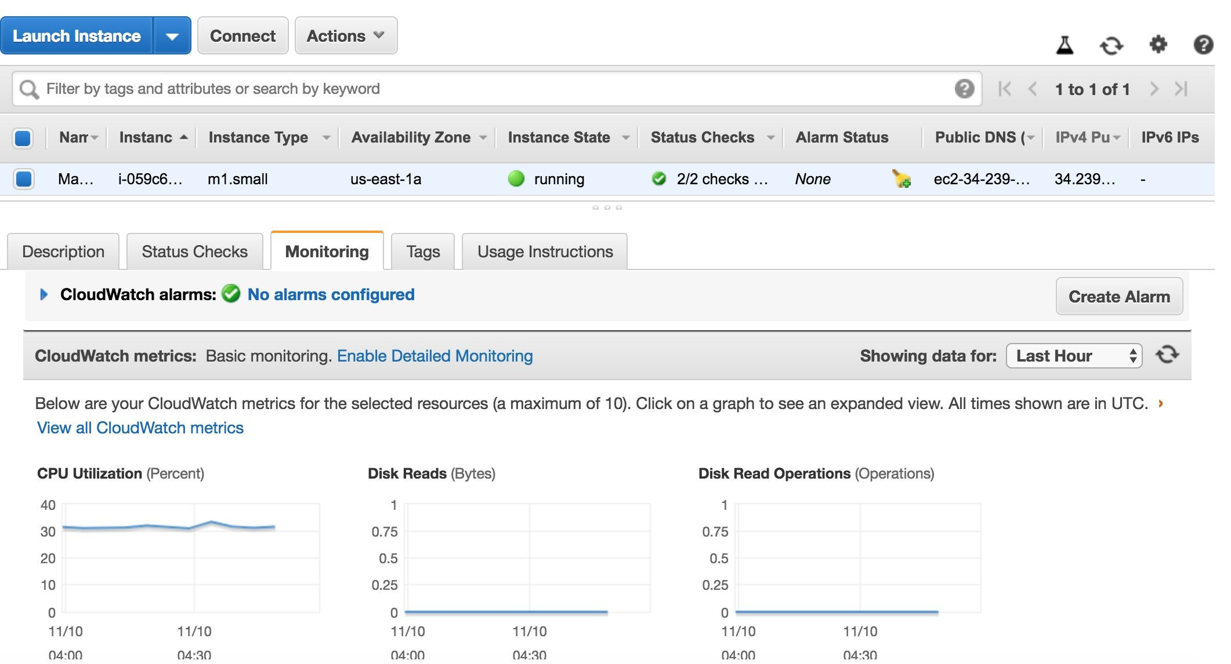
Click 3rd Tab ( default is description) to view cloudwatch metrics

Slide 37
15

Slide 38
Roles: Add permissions to EC2
You can’t access other AWS resources from your EC2 instance by default. You need to either
hard code credentials( access key id and secret access key) somewhere in the code or in a file which is
not recommended.
Attach Roles with proper permissions to EC2 . This way you can access services like S3 , dynamoDB etc from EC2 . This is safer because Roles use temporary credentials.

Slide 39
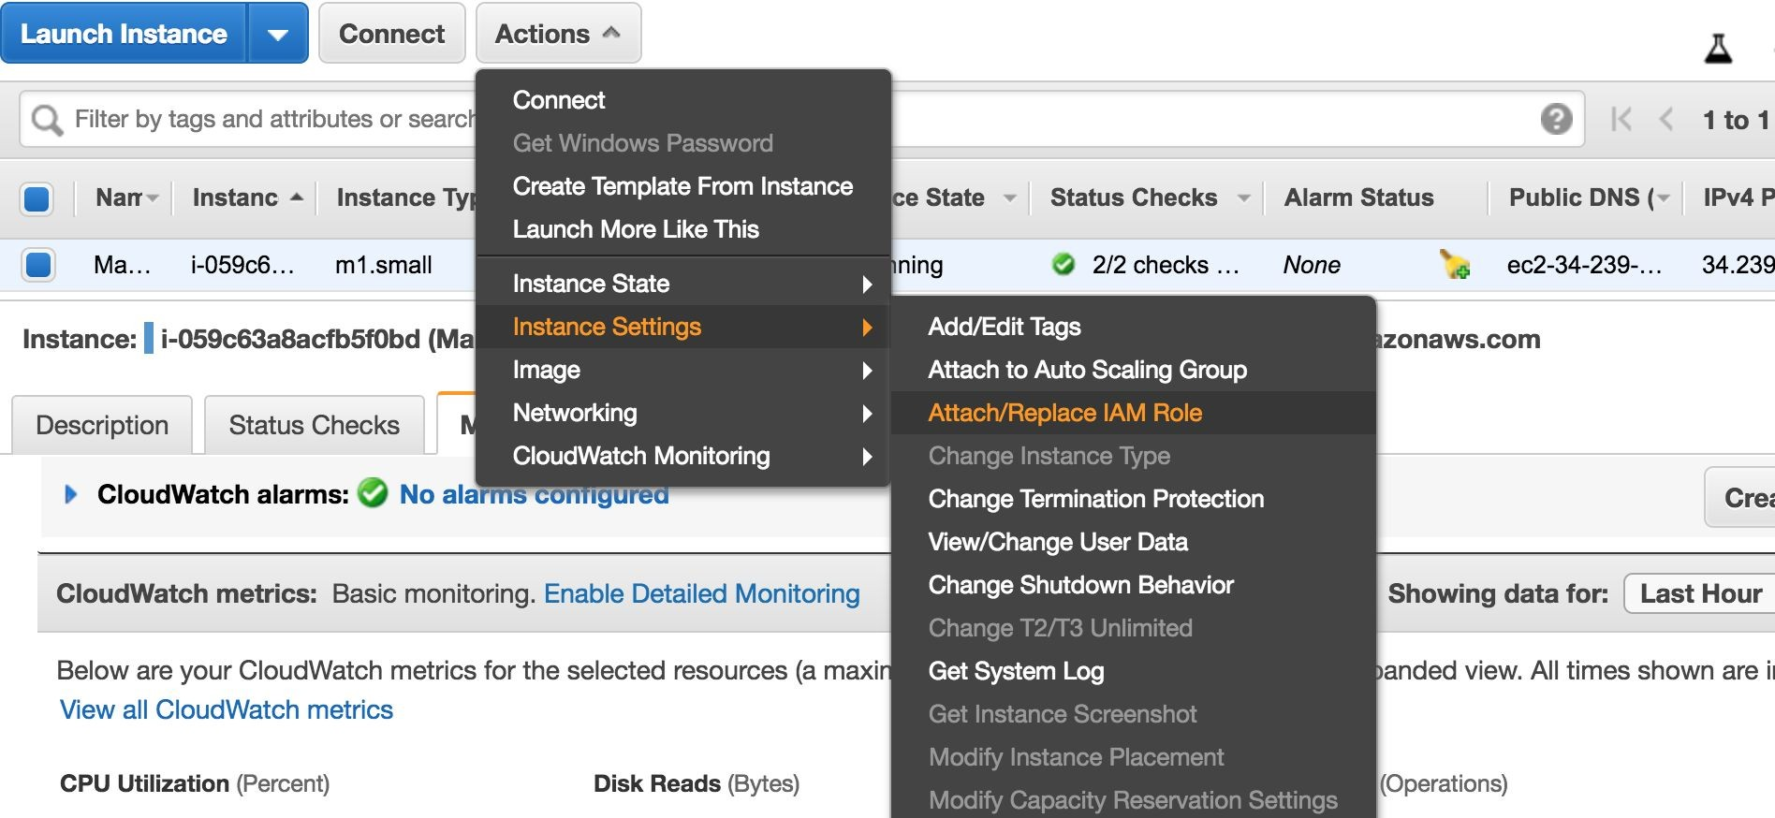

Slide 40
16

Slide 41
Snapshots: Backup Data that lives on EBS Volumes
- You can then create EBS volumes with snapshot
Snapshots of encrypted volumes are encrypted , while volumes created from encrypted snapshots are also encrypted.

Slide 42
Read more about EBS encryption
https://docs.aws.amazon.com/AWSEC2/latest/UserGuide/EBSEncryption.html

Slide 43
17

Slide 44
Custom AMI: You can create a custom AMI( pre-baked)
Install the apps you want and launch it anytime you want.
Makes the configuration Process Quicker
A snapshot is created when you create an AMI
An AMI can be created using a snapshot.

Slide 45
18

Slide 46
Interfaces to ec2
You can interface with EC2 resources using the following mediums:
AWS Management console
AWS CLI
AWS Cloudformation
AWS SDK(boto,node.js, java etc)
AWS REST API

Slide 47
19

Slide 48
EC2 Autoscaling: Increased Performance and Availability
You can also use Amazon EC2 Auto Scaling for dynamic scaling of EC2 instances in order to automatically increase the number of Amazon EC2 instances during demand spikes to maintain performance and decrease capacity during lulls to reduce costs.

Slide 49
20

Slide 50
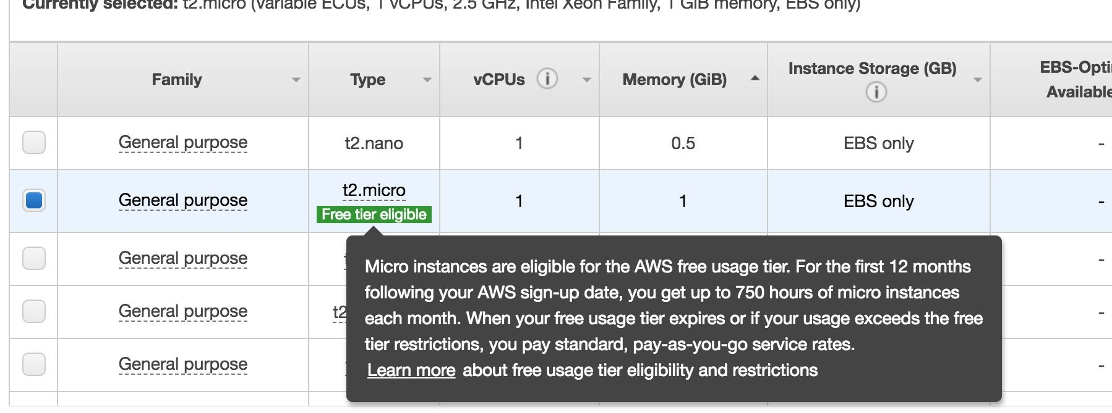
EC2 Free Tier. Go Practice!
You get 750 Hours

Slide 51
References
https://docs.aws.amazon.com/AWSEC2/latest/UserGuide/

Slide 52
LABS

Slide 53
LAB 1: Creating a Basic Linux EC2 (on demand- with option size hard disk sg)

Slide 54
LAB 2: Creating a Windows EC2 instance

Slide 55
LAB 3: Install and configure Web server and Create an Golden Image (ami), launch instance from golden image

Slide 56
LAB 4:Demonstration of command line interface to work with ec2
*Use Amazon linux AMI

Slide 57
LAB 4: EC2 Permissions with Access keys and with Roles

Slide 58
LAB 5:
AWS EC2 Command Line Interface commands

Slide 59
LAB6: Creating an ec2 with instance store as root volume

Slide 60
LAB7: EC2 Userdata and SSH Auth with username and password

Slide 61
LAB 8: Install Cloudwatch Unified Agent

Slide 62
LAB 9: Collect Apache logs in Cloudwatch using cloudwatch agent

Slide 63
LAB 10: Install Wordpress using AWS Marketplace

