Slide 1



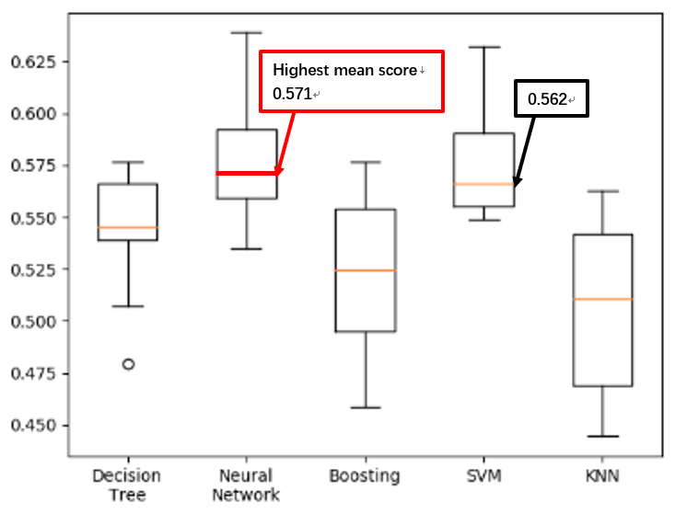
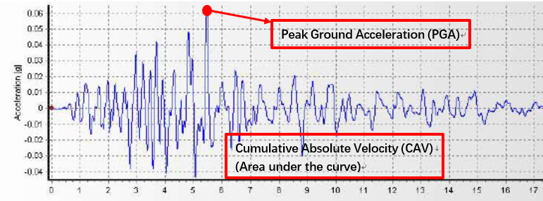

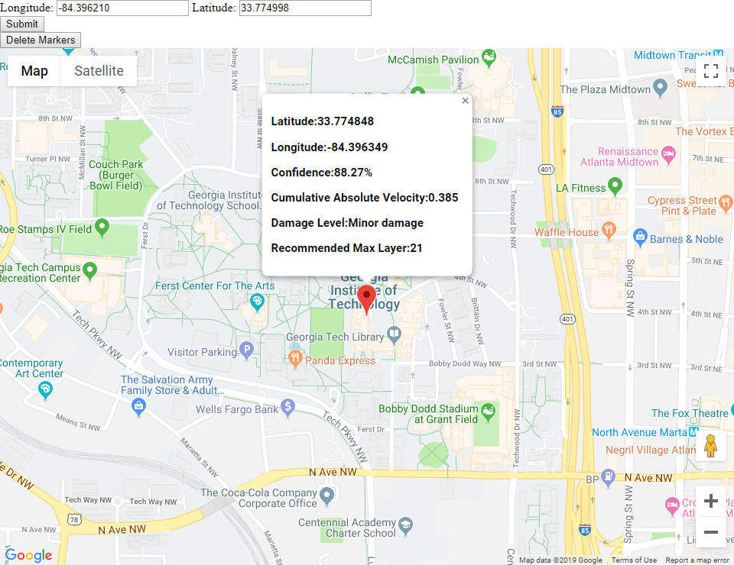
Earthquake Hazard Evaluation & Visualization
Cheng Zhang
Longchao Jia
Qiwei Mao
Tianhui Zhao
ABSTRACT
MODEL SELECTION & EVALUATION
The scope of this project is to build a model that would predict the seismic damage level of a certain building.
Model Input & Data Preprocess
Decision Tree
Neural Network
Ada-Boosting
Support Vector Machine (SVM)
K Nearest Neighbors (KNNs)
PC Regression & Partial Least Square
PROBLEM DESCRIPTION
The disaster caused by earthquake has left unforgettable memories to us. Recent breakthrough in machine learning algorithms and earthquake prediction models allow us to locate it and predict damage level of it.
The scope of this project is to build a model that would predict the seismic damage level of a certain building.
Figure 2. k-folds cross validation comparison with k = 10
METHOD and IDEAS
DATA VISUALIZATION
Five steps we took:
Database construction
Figure 1. A typical ground motion plot
Model Features Selection
Determining period using Lasso
Prediction Model Construction
Machine learning Regression Algorithms
Prediction Model Evaluation
K-fold cross-validation
Damage Level Prediction
Relate the predicted CAV value to the damage of a building
Data visualization
Output longitude, latitude, predicted earthquake intensity, confidence, recommended maximum layer of building
Input Geographical Location Information or Click on Map
Figure 3. Earthquake predicted information for GatechTech clough building
Output : Longitude, Latitude, Predicted Earthquake Intensity, Confidence, Recommend Maximum Layer of Building
FUTURE USAGE
Our project can be used by earthquake associations as the reference of revising seismic design code in order to ensure the earthquake resistant behavior of newly constructed buildings in a more economical way.
Moreover, the program can predict the damage of current buildings to make the disaster rescue scheme wisely.

