Slide 1
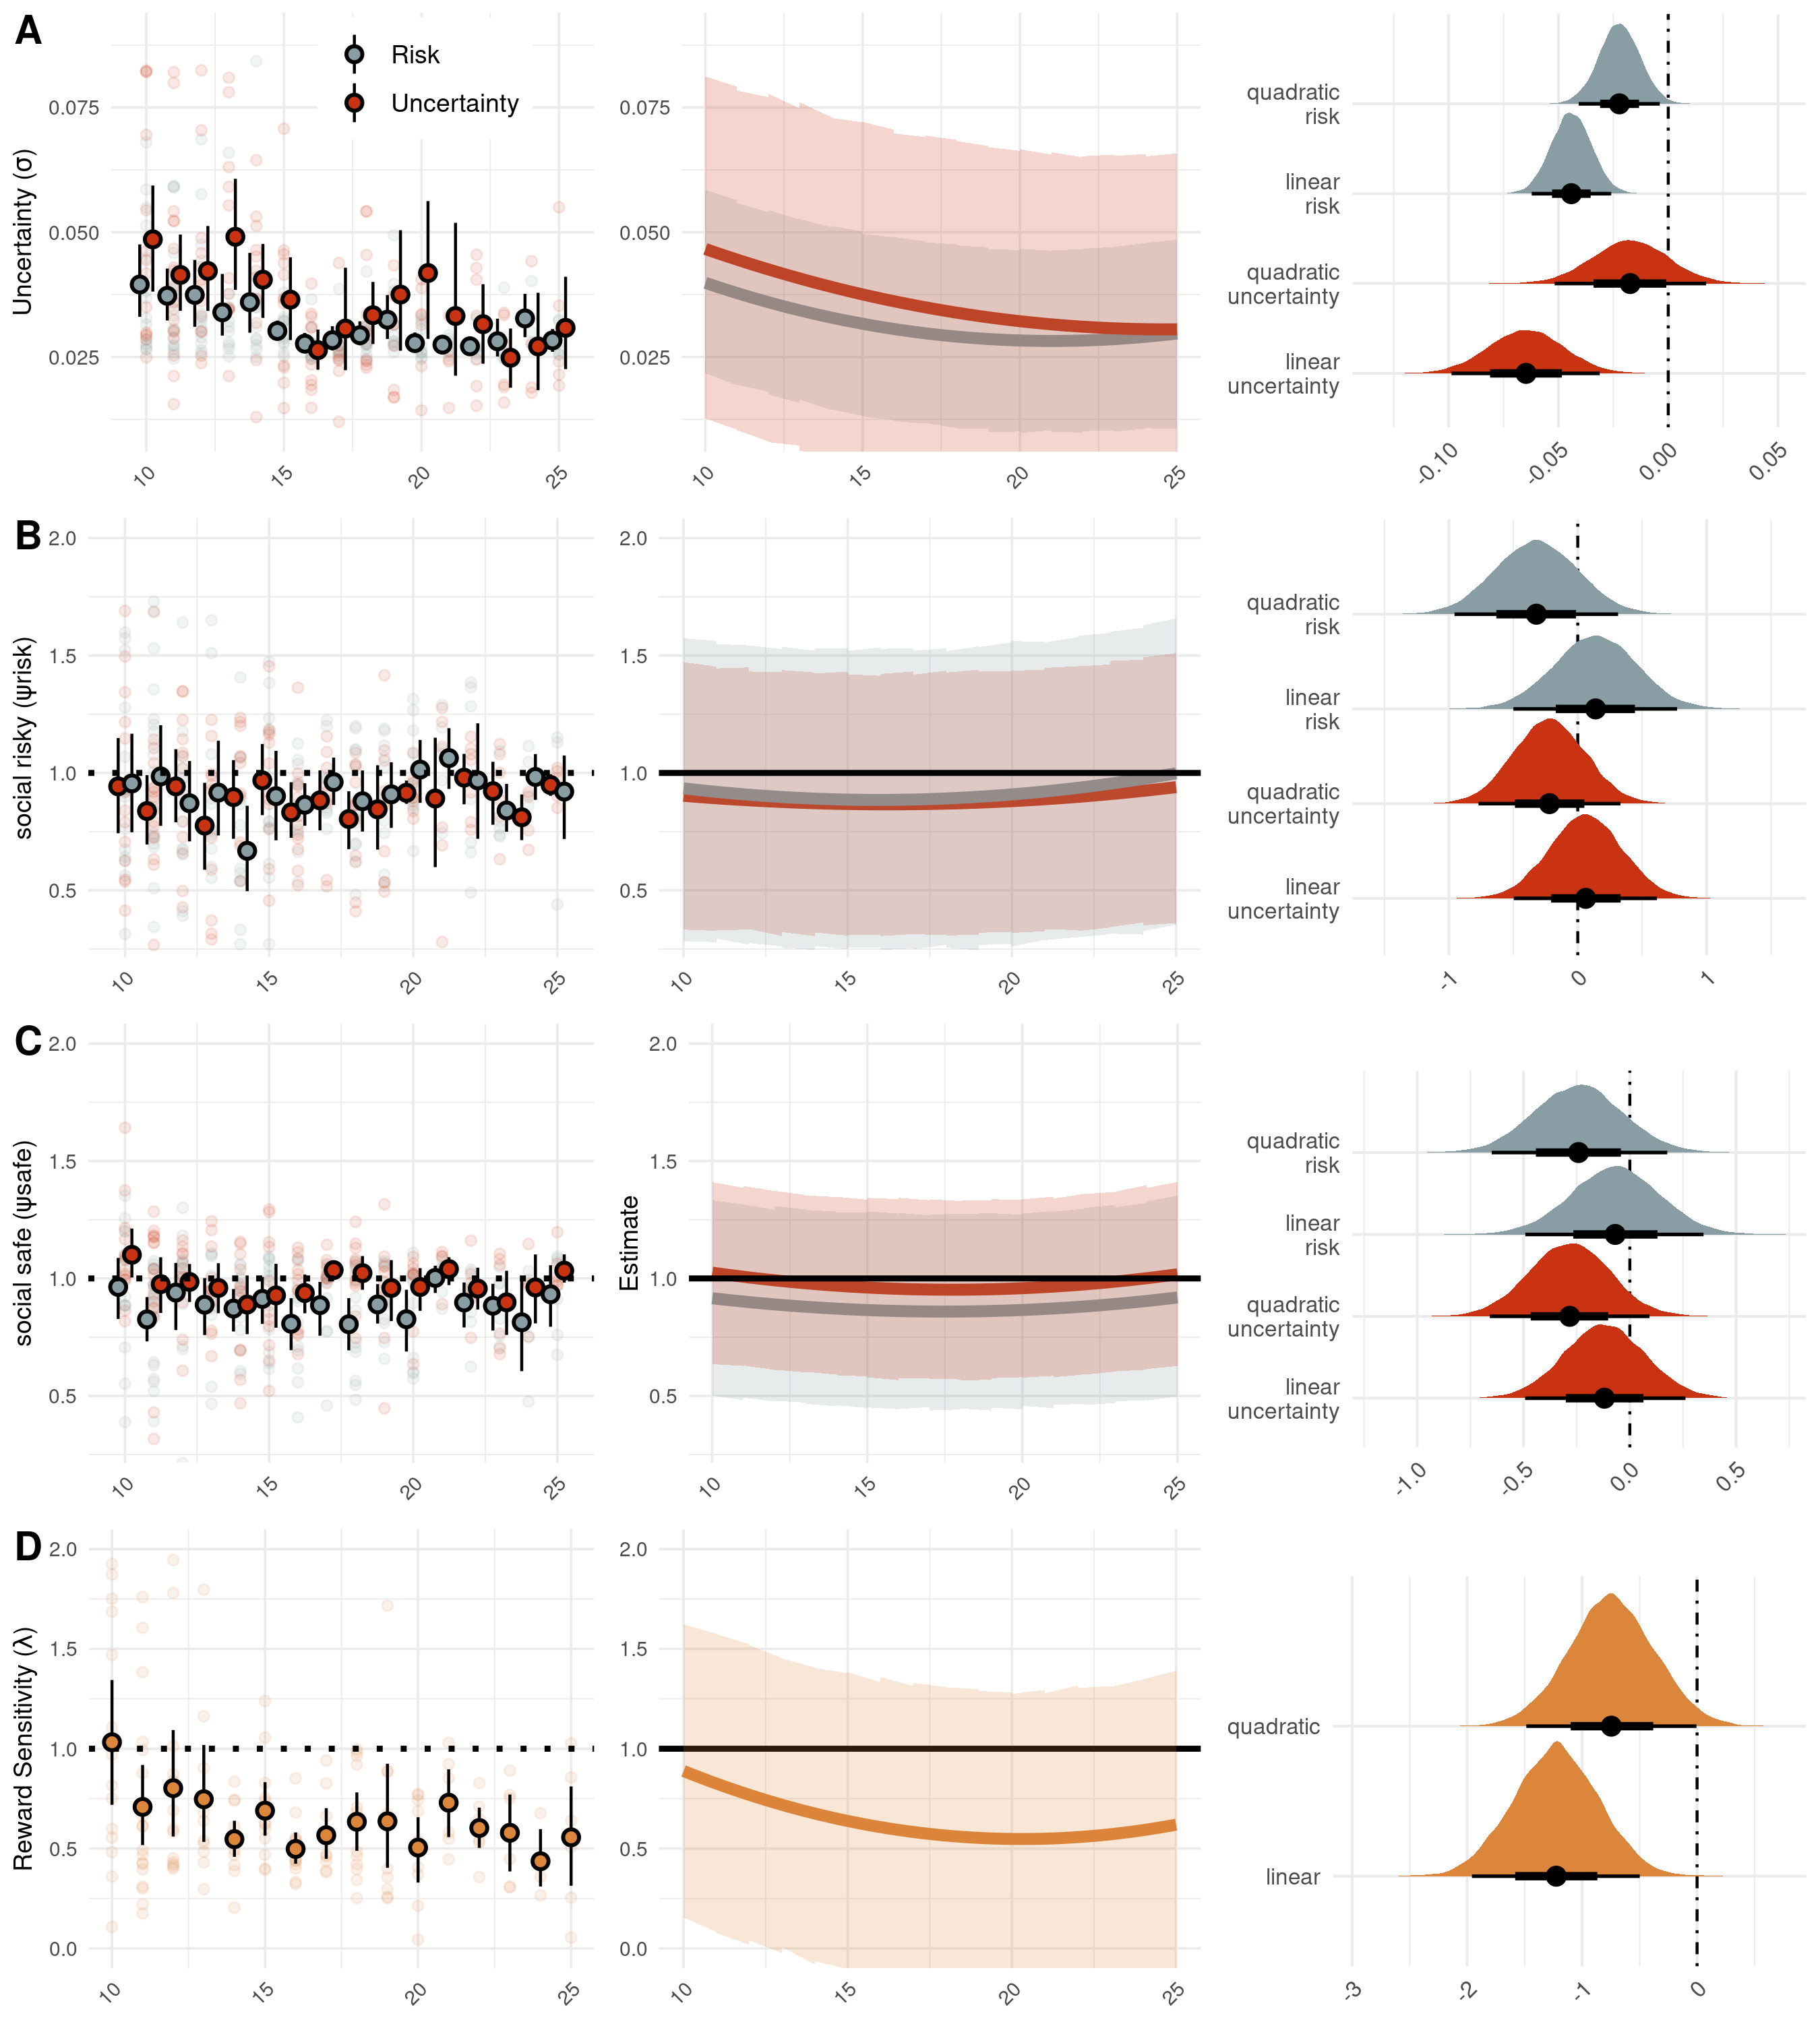
Parameter Estimate
Regression prediction
Effect of age:
Regression weights

