Slide 1
Welcome
Welcome to this gridsearch game.
On the following pages I will explain the game to you.
Please read the instructions carefully and ask any questions that you have about the game if anything is unclear.

Slide 2
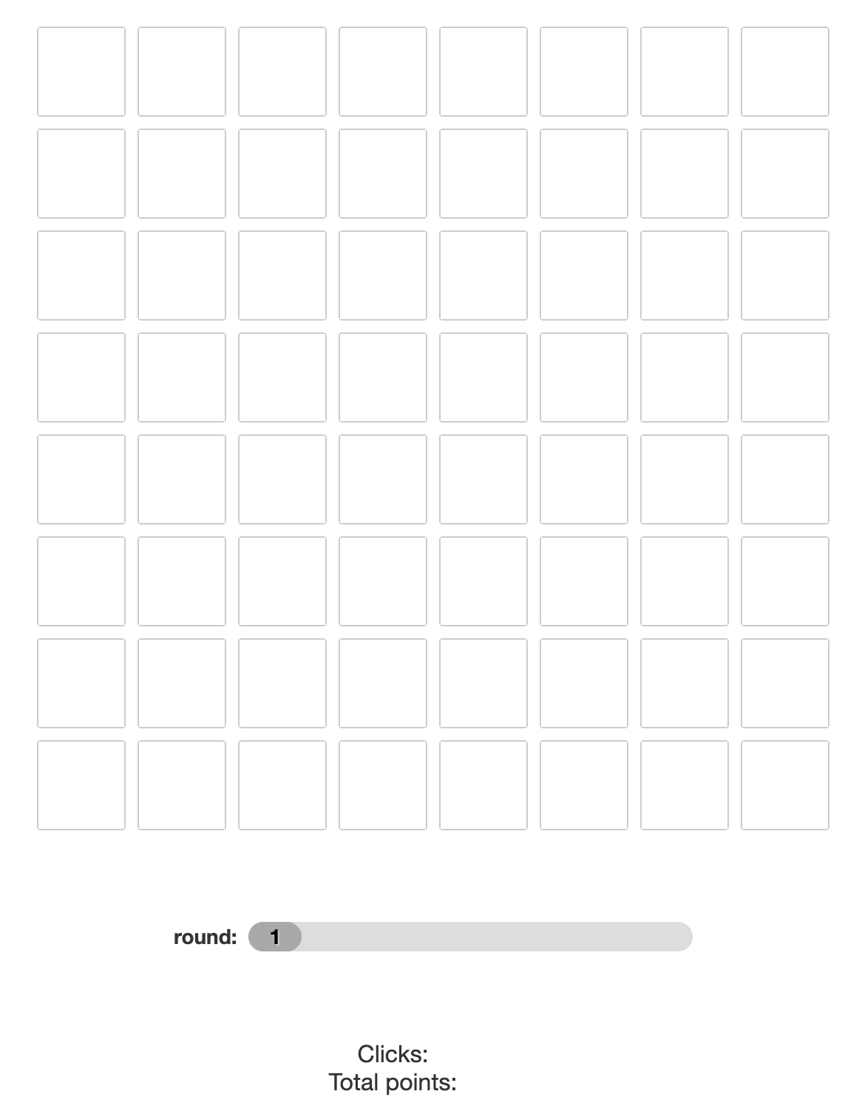
In the game, you need to collect as many Bonus points as you can.
For this, I am going to show you 12 grids like this, one after another.
Do your best, we will give 5€ extra to the player who earned most points in the game!

Slide 3
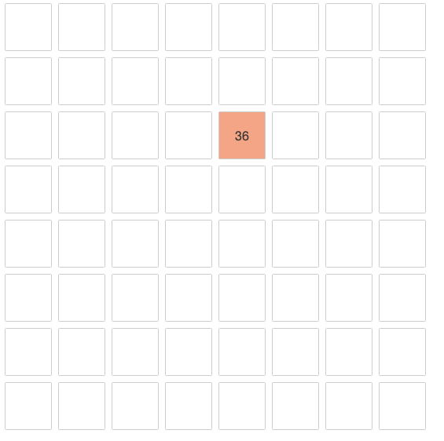
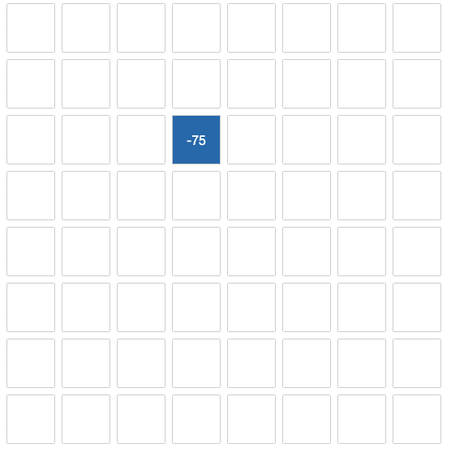
The grid consists of 64 tiles. By clicking on a tile, you can gain or loose bonus points. If you gain points, the color of the tile will turn orange or red, if you loose points it will turn blue.
The more points you gain or loose, the more intense will be the colour of the tile after you clicked on it.
In this example, someone clicked on a tile, and gained 36 points
In this example, someone clicked on a tile, and lost 75 points

Slide 4
Important!
If you have learned something about one particular tile, this does not tell you anything about the other tiles!
Good and bad tiles are distributed completely randomly across the grid.

Slide 5
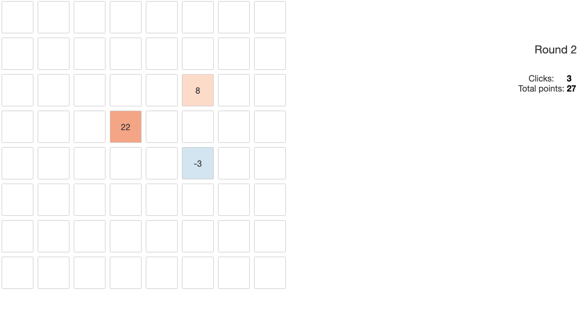
On the side, I am showing you how many of the 12 grids you already saw, how many klicks you already made and how many bonus points you already collected.
On each grid you can make 25 klicks!

Slide 6
Before every klick you have to choose: Do you want to klick on the same tile again or do you want to keep exploring and try to find another tile that is better?
This is not an easy decision. If you klick on a new tile you can not know how many points you will get from that tile and you might even loose points.
If you klick on a tile that you already klicked on, you can have an idea. But it is still not easy because some tiles that have been very good in one round can be very bad in the next.
Other tiles are more consistent.

Slide 7

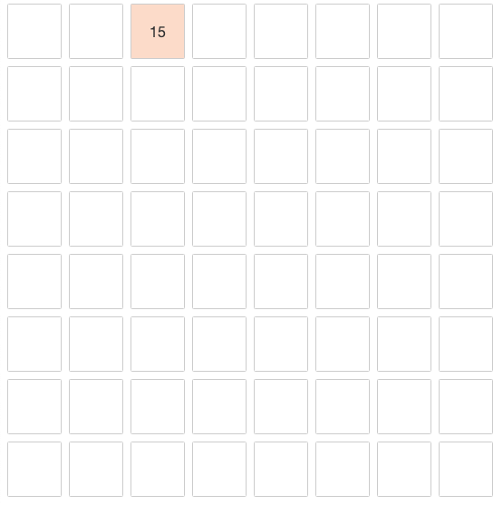
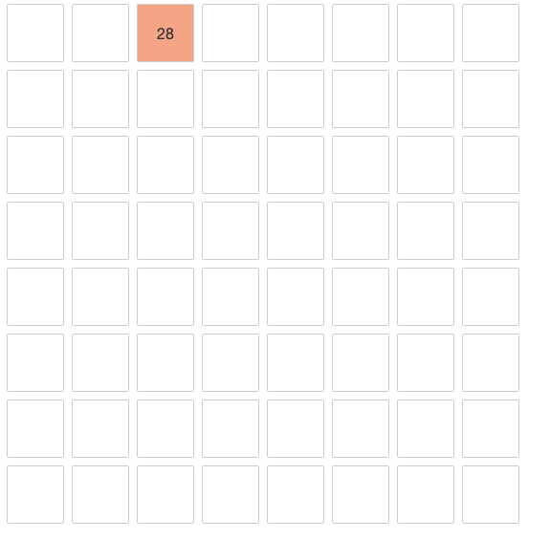
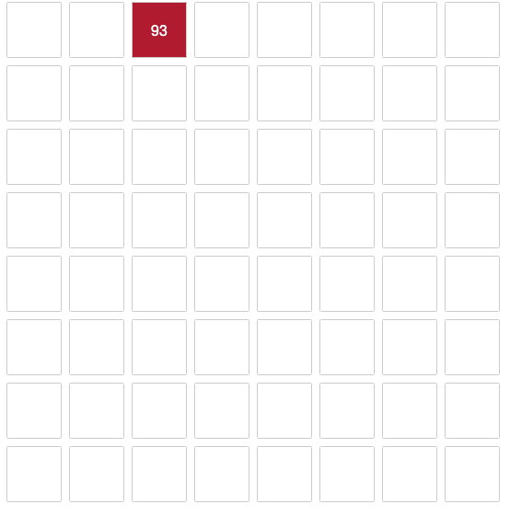
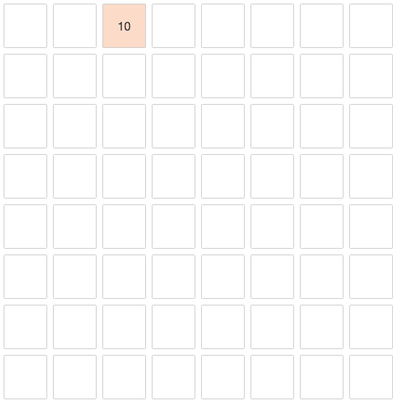
Here you can see the bonus obtained from repeatetly klicking on an inconsistent tile.
klick 1
klick 2
klick 3
klick 4

Slide 8
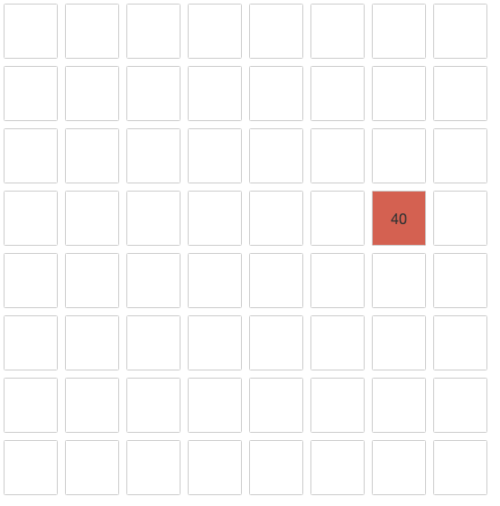



Here you can see the bonus obtained from repeatetly klicking on a consistent tile.
klick 1
klick 2
klick 3
klick 4

Slide 9
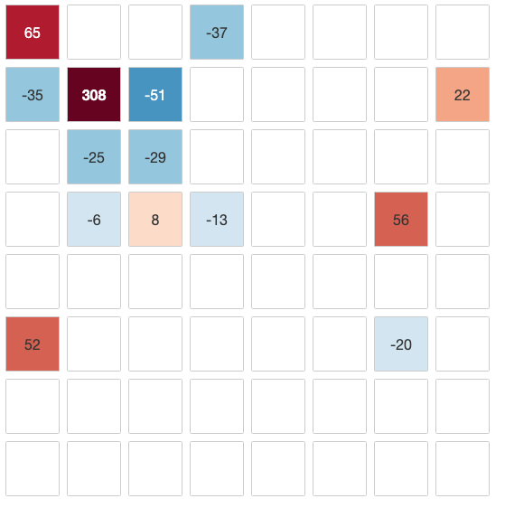
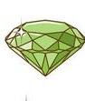

Now I am giving you a tip. I have been hiding a gem in some of the grids, but not in all of them. I am not telling you in which grids exaclty, but a gem it is worth looking for!
A gem is a tile, that is very consistent and offers many more bonus points than any other tile on the grid.
This is
a gem!
You do not get to search the whole grid for the gem. Remember, you only have 25 klicks,
it might be you never find the gem, eventhough it is hidden somewhere.

Slide 10
We also show you the decisions of someone who previously explored the same grid. There is a marker on the tile chosen by the previous player in the same round. We do not show you their bonus.
This tile was chosen by
A previous player.
On each round, that player turned around exactly as many tiles as you have!
It is up to you if you want to follow that player or not.

Slide 11
Questions?
If you have no questions left, then youre good to go. Good luck and have fun!

