Slide 1
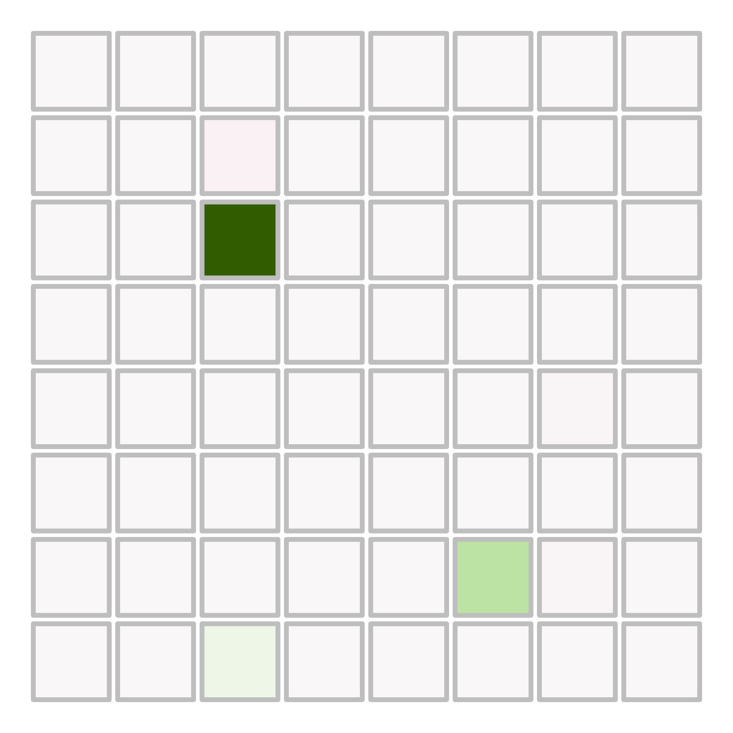

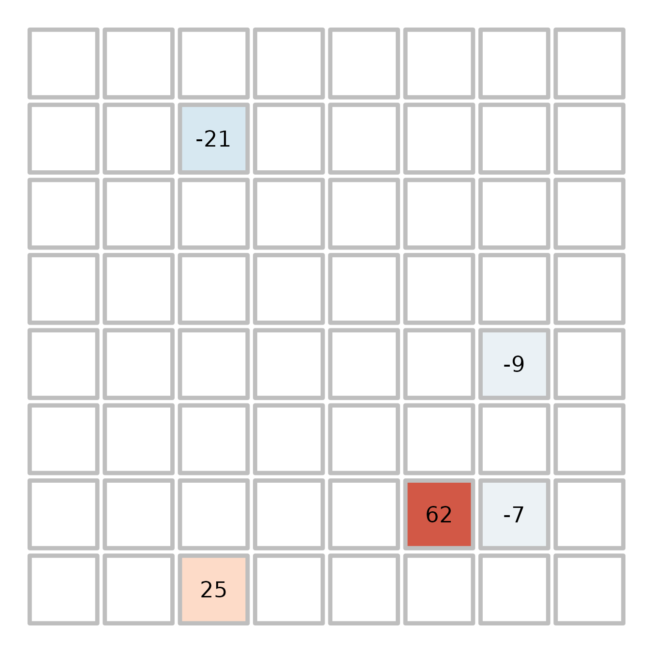
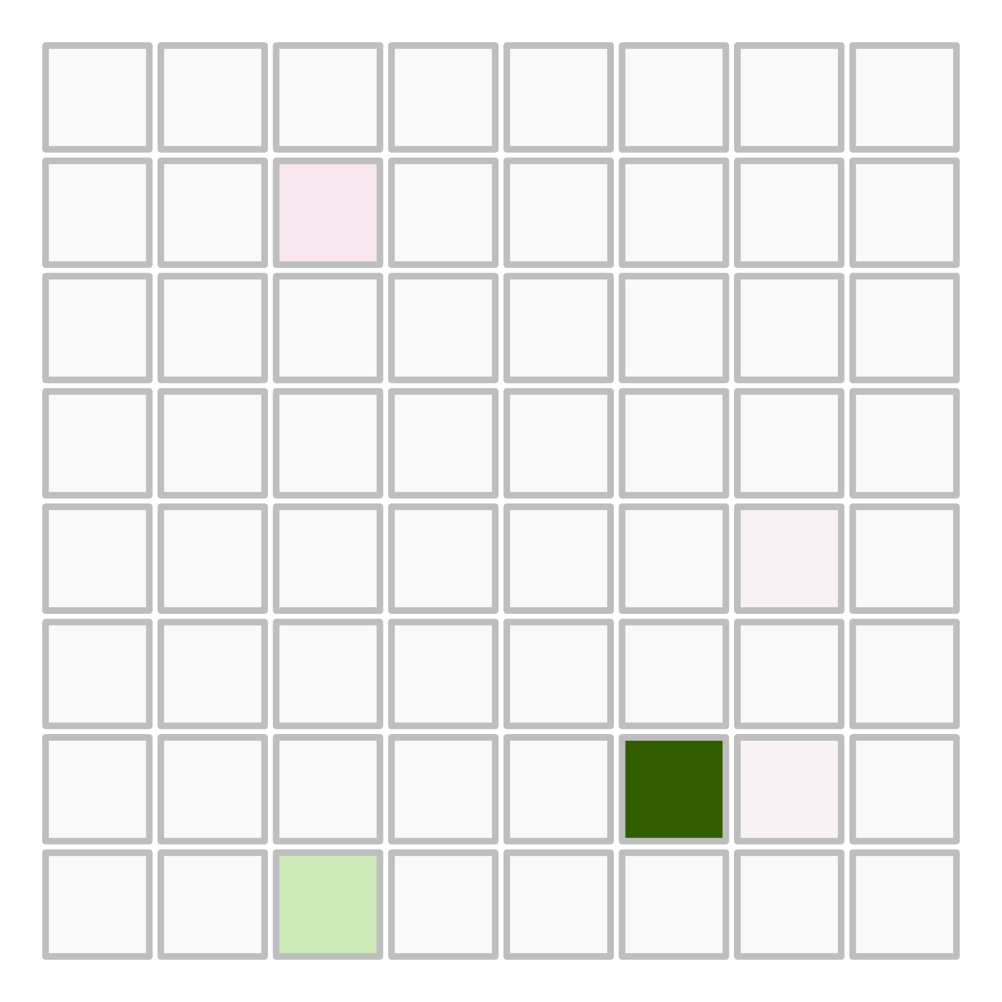


Social choice probabilities (p social)
Social info does increase probability
High quality demonstrator chose the same option each time;
Q social updated
Solo choice probabilities (p solo)
Solo values (Q solo)
t-1
t-2
softmax
t-3
t-3
t-2
t-1
Social info does not increase probability
Low quality demonstrator chose a different option each time;
Q social not updated

