Slide 1
Update

Slide 2
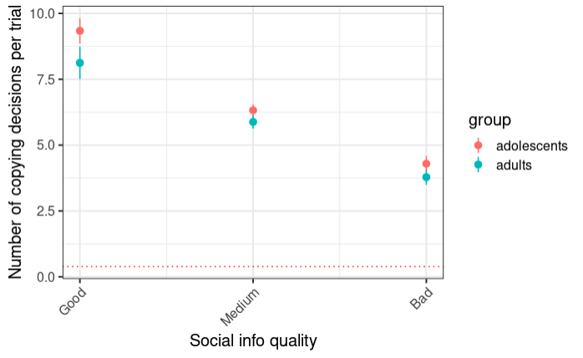
Behavior (what it comes down to, non?)

Slide 3
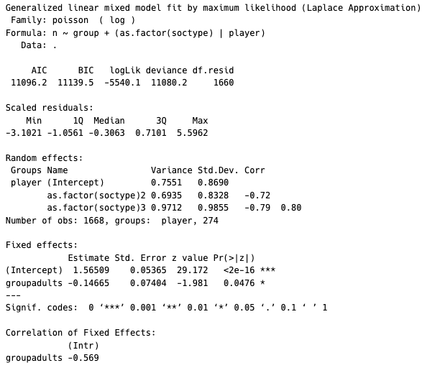
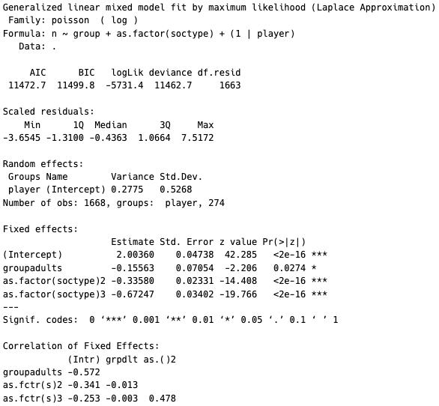
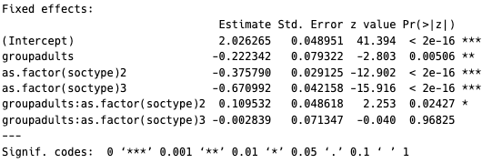
Age effect significant in Possion regression
With soctype as random effect
With soctype and fixed effect

Slide 4
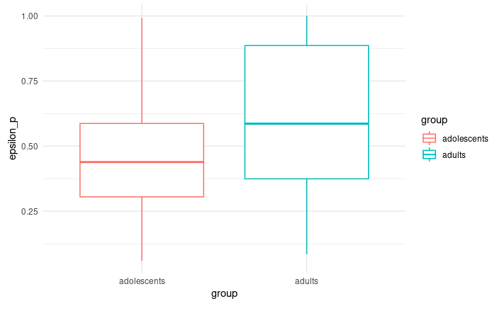
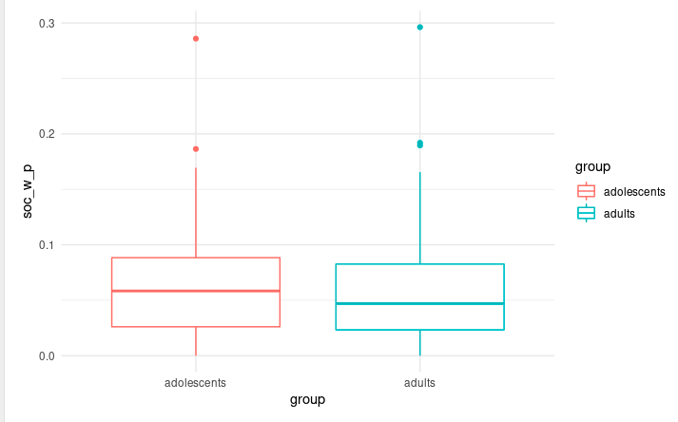
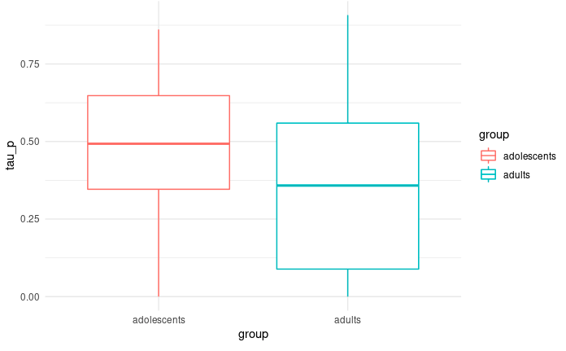
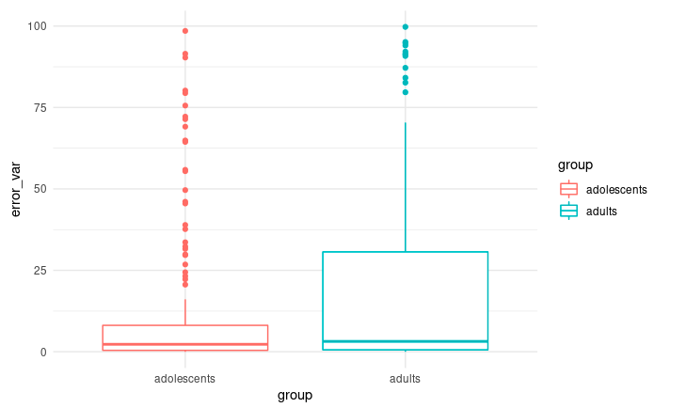
MLE Models: Probability model
Adolescents explore less when gem
Probability to follow slightly higher in adolescnets
Adolescents explore more before gem
Learning rate higher in adolescents

Slide 5
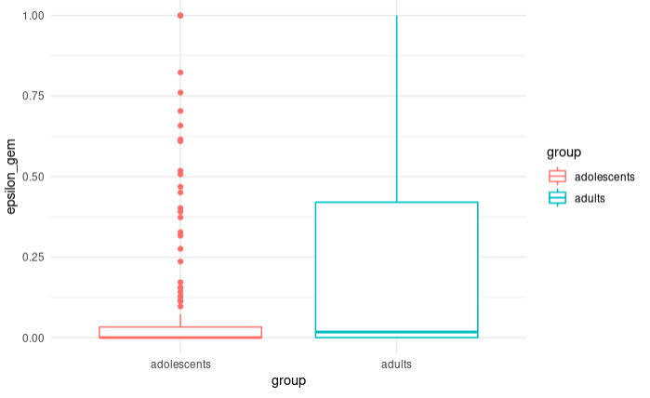
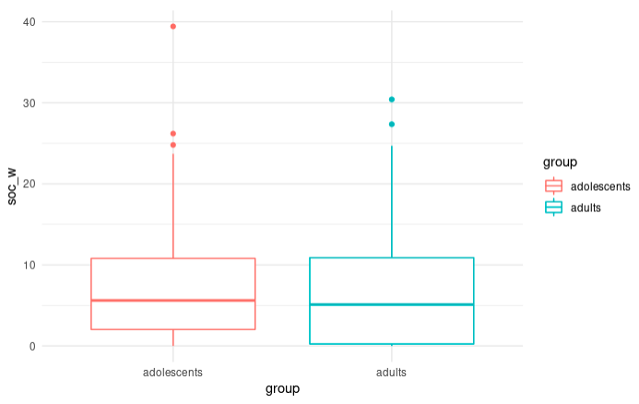
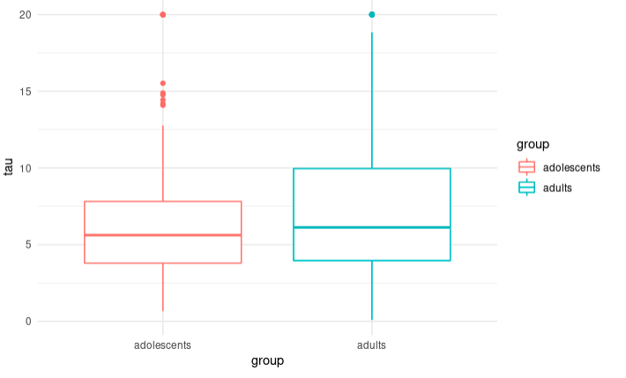
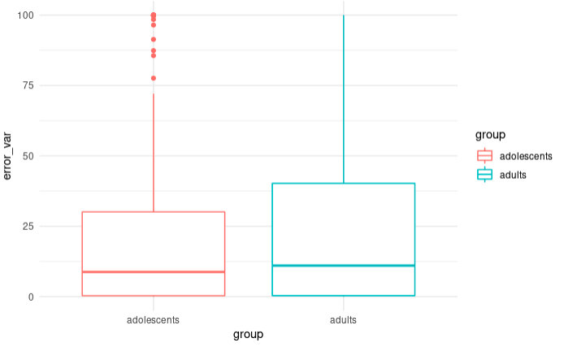
MLE Models: Social weight
Adolescents explore less when gem
“Social” utility higher in adolescents
Adolescents explore less before gem
Learning rate higher in adolescents

Slide 6
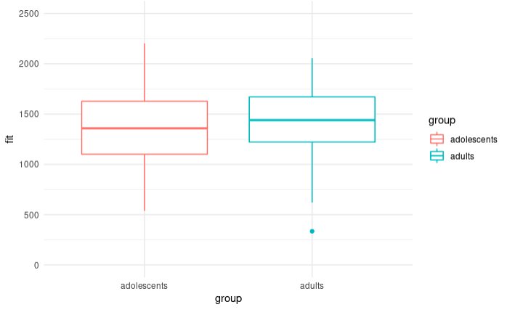
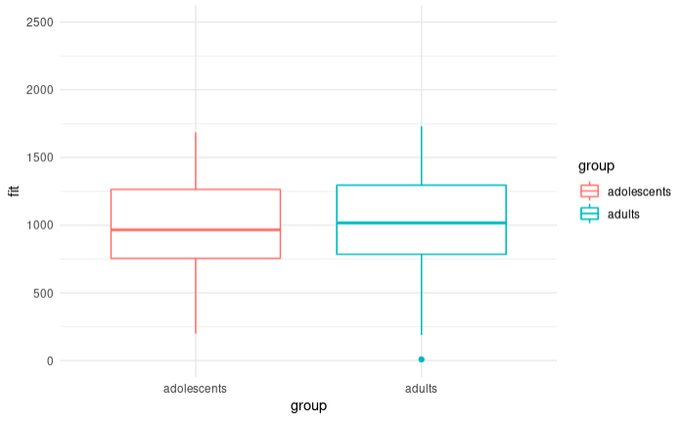
Weight model fits much better
Probability
Social weight

Slide 7
Problem:
Parameter ranges are huge
Softmax does not work when gem
Some people don’t copy
Solution:
Hbayes

Slide 8
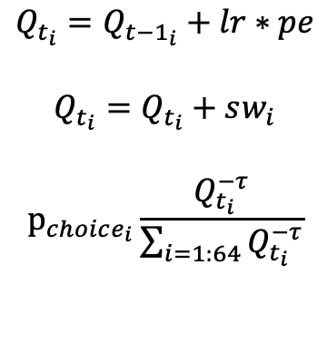
H Bayes Modelling: Rescorla Wagner
mu
sig
mu
sig
sig
mu
$$Q_{t_{i}}=Q_{t−1_{i}}+lr∗pe$$
$$Q_{t_{i}}=Q_{t_{i}}+sw_{i}$$
$$p_{choice_{i}}\frac{Q_{t_{i}}^{−τ}}{\sum_{i=1:64}{Q_{t_{i}}^{−τ}}}$$
lr
sw
tau
choice
trials
participants
agegroups

Slide 9
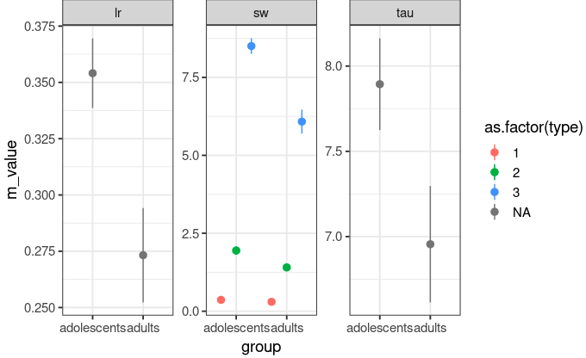
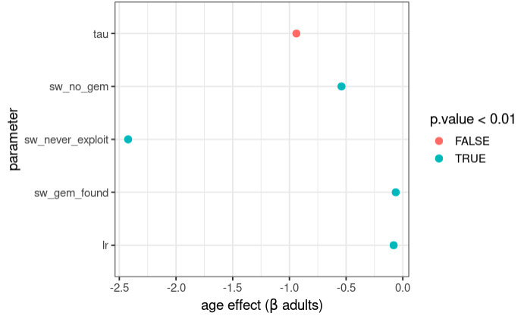
Parameter differences

Slide 10
We have: behavior; modelling
Todos write that shit up.?
Deadline: summer!

Slide 11
Modelling: 3 sws
mu
sig
mu
sig
sig
mu
$$Q_{t_{i}}=Q_{t−1_{i}}+lr∗pe$$
$$Q_{t_{i}}=Q_{t_{i}}+sw_{i}$$
$$p_{choice_{i}}\frac{Q_{t_{i}}^{−τ}}{\sum_{i=1:64}{Q_{t_{i}}^{−τ}}}$$
lr
sw
tau
choice
trials
participants
agegroups

