Slide 1
HANDS-ON SESSION
Building AI Agents with
LangChain & LangGraph
From a stateless prompt to a stateful, tool-using agent — built live.
Notes:
Today is hands-on and focused: just two tools, gone deep. LangChain gives us the building blocks; LangGraph turns them into a real agent. Most of our time is in the notebooks.

Slide 2
WHAT WE'LL DO
Two tools, built hands-on
01
LangChain basics
LCEL chains · tools · streaming
02
The bridge
why a chain isn't an agent — the manual tool loop
03
LangGraph fundamentals
state graphs · conditional edges
04
The agent loop
prebuilt ReAct agent · memory
05
Production feel
human-in-the-loop · LangGraph Studio
LangChain & LangGraph · Hands-on
2
Notes:
Five beats. Each one is a notebook section you run yourself. We'll pause on the bridge — that's the 'aha' that motivates LangGraph.

Slide 3
WHY A FRAMEWORK
A prompt is not an agent
An LLM is stateless and one-shot. Agents need the machinery around it.
Loops & state
Tools
Memory
Control
Reason → act → observe, repeatedly — with memory of the run
Reach beyond text: call functions, APIs, data
Remember earlier turns and facts across a conversation
Branch, retry, and pause for human approval
LangChain & LangGraph · Hands-on
3
Notes:
LangChain gives us tools and composition; LangGraph gives us loops, state, and control. That's the whole story of today.

Slide 4
LAYER 1
LangChain — the foundation
A model-agnostic interface, composable chains, and tool-calling.
1
LCEL Compose with the pipe: prompt | model | parser
LCEL
chain = prompt | llm | parser
chain.invoke({"topic": "agents"})
chain.stream({...}) # token by token
2
Tool calling The model requests a function — the agent primitive
3
Streaming & more invoke / stream / batch / async on any chain
The chain runs one direction — a DAG:
Prompt
Model
Parser
LangChain & LangGraph · Hands-on
4
Notes:
LangChain is the toolkit: one interface over any model, LCEL to compose, and tool-calling. Notebook 1 is all of this. But notice the shape — it flows one way. That's the limit we hit next.

Slide 5
THE KEY DISTINCTION
LangChain vs LangGraph
Same family, different job: linear chains vs. stateful graphs.
LangChain — a linear chain
LangGraph — a stateful graph
Prompt
LLM
Parser
Agent
Tools
↻
One pass, predictable. A DAG — no loops.
Reason → act → observe, loops until done. State persists.
LangChain
LangGraph
Architecture
Linear chains / DAGs
Graph with loops & state
State
Implicit, modular memory
Explicit, developer-controlled
Control flow
Step-by-step, predictable
Adaptive, branching, iterative
Best for
Prototypes, linear pipelines
Multi-step, stateful agents
Rule of thumb: LangChain for linear chains; LangGraph the moment you need loops, state, or branching.
LangChain & LangGraph · Hands-on
5
Notes:
The whole point: LangChain composes steps that run once. LangGraph makes the agent a graph — nodes loop back, state persists, you get branching and human-in-the-loop. You graduate to LangGraph the moment the work stops being a straight line.

Slide 6
LAYER 2
LangGraph — stateful agents
1
State graph — Nodes are functions over a shared state; edges say what runs next
THE AGENT LOOP
Conditional edges — A router picks the next node — branching & retries
Agent
Tools
2
ReAct agent — create_agent runs the reason→act→observe loop for you
↻ loops until done
3
Answer
4
Memory — A checkpointer + thread_id remembers the conversation
• state persists across steps (checkpointer)
Human-in-the-loop — interrupt_before pauses for approval on risky tools
• pause before Tools for human approval
5
• conditional edges branch the path
LangChain & LangGraph · Hands-on
6
Notes:
These five are exactly notebook 2's sections. The loop on the right is what create_agent automates — the manual tool loop from notebook 1, done for you, with state, branching, and an approval gate.

Slide 7
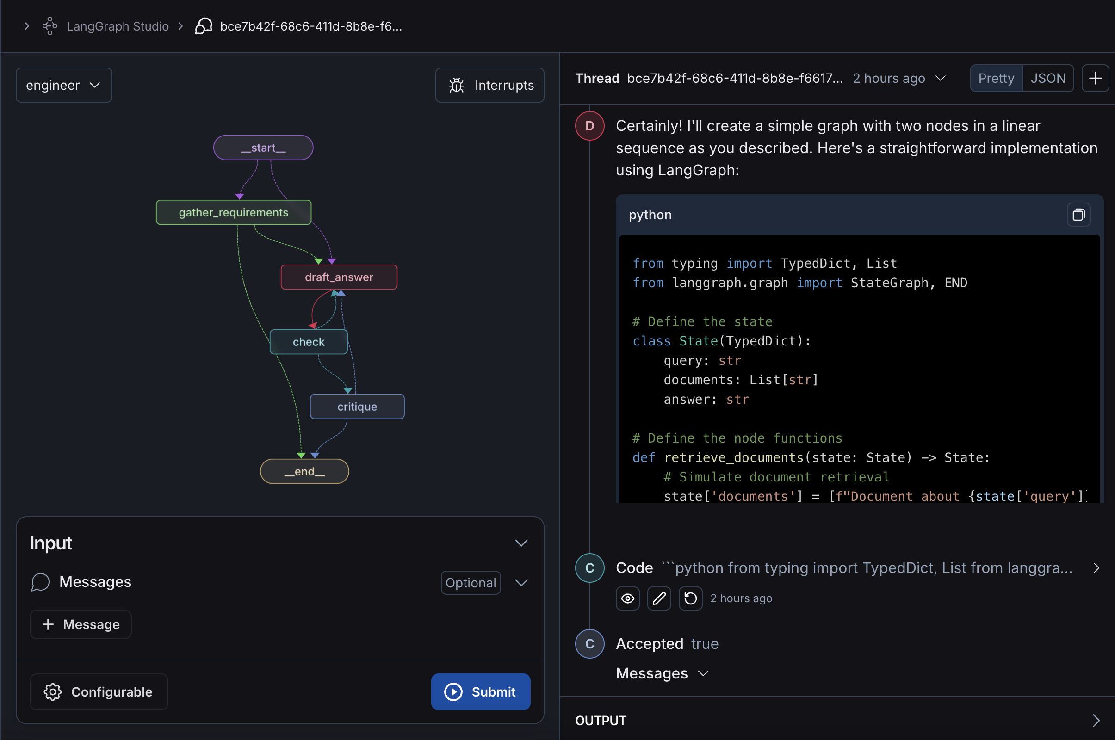
SEE IT RUN
LangGraph Studio
1
The graph, live
nodes, edges, and the loop — rendered from your code
2
Thread panel
messages, state, and the model's output side-by-side
3
Configurable · Interrupts
tweak config, add breakpoints (human-in-the-loop)
4
Submit → run
watch it execute, then fork & replay from any step
Screenshot: langgraph-engineer by Harrison Chase (LangChain) · open source
LangChain & LangGraph · Hands-on
7
Notes:
This is Studio on a real agent. Left: the graph rendered from code — start, gather_requirements, draft_answer looping with check, critique, end. Right: the thread with messages, state, and even generated code. Launch it with `langgraph dev`; submit an input, watch the path light up, open a node to inspect state, then fork and replay. Screenshot is from Harrison Chase's open-source langgraph-engineer.

Slide 8
YOUR TURN
What you'll run
NOTEBOOK 01
NOTEBOOK 02
LangChain
LangGraph
LCEL chain
state graph from scratch
tool calling + closing the loop
conditional edges
streaming
ReAct agent + memory
🧪 add a 2nd tool
🧪 human-in-the-loop
Plus: langgraph dev → open LangGraph Studio to watch the graph run, inspect state, fork & replay.
LangChain & LangGraph · Hands-on
8
Notes:
Two notebooks, run top to bottom, each ending in a build-it-yourself exercise. Then we open Studio to see a graph execute visually.

Slide 9
NOW — LIVE
Let's build it
Open JupyterLab → notebooks/01_langchain.ipynb
Run top to bottom · do the 🧪 Your turn cells
Notes:
Switch to JupyterLab. Run notebook 1, then notebook 2, pausing at each exercise. Studio at the end.

Slide 10
KEY TAKEAWAY
LangChain builds the pieces.
LangGraph makes them an agent.
Chains flow one way; agents loop, remember, branch, and pause for you.
You now have both — plus the notebooks to keep building.
Questions?
Notes:
Close on the one-liner: LangChain builds the pieces, LangGraph makes them an agent. Point them back at the two notebooks. Q&A.

