Slide 1

Imbokodo Bank
Purpose
Risk & Compliance Workbench
A practical walkthrough of the Analyst workflow: triage, investigation, evidence, data-quality recovery, analysis and reporting.
Analyst Standard
Operating Procedure
ANALYST ONLY
LOCAL VERIFICATION
This SOP documents the implemented local workflow. Cloud authentication and final AWS end-to-end validation remain separate deployment gates.
Project demonstration guide
Focus: Risk / Compliance Analyst
Know what happened. Act on what matters.
Prepared for project demonstration

Slide 2
Imbokodo Bank
How to use this SOP
ANALYST SOP
Risk & Compliance Workbench
Scope
Analyst control principles
This document demonstrates the Analyst role only.
Use the screenshots as the reference path during the presentation.
Follow the workflow from triage to evidence, action and reporting.
Do not demonstrate Administrator, Auditor or Maintainer functions unless specifically asked.
Evidence before action.
Recorded scores guide priority; they are not a probability of fraud.
Every investigation action should leave a trace.
Invalid data stays outside the trusted ledger until corrected.
Notifications point to work; the underlying record remains the source of truth.
Keep the live demo focused on one complete business journey.
Primary question: What happened? Why is it risky? What do I do next?
Internal project demonstration · Analyst workflow

Slide 3
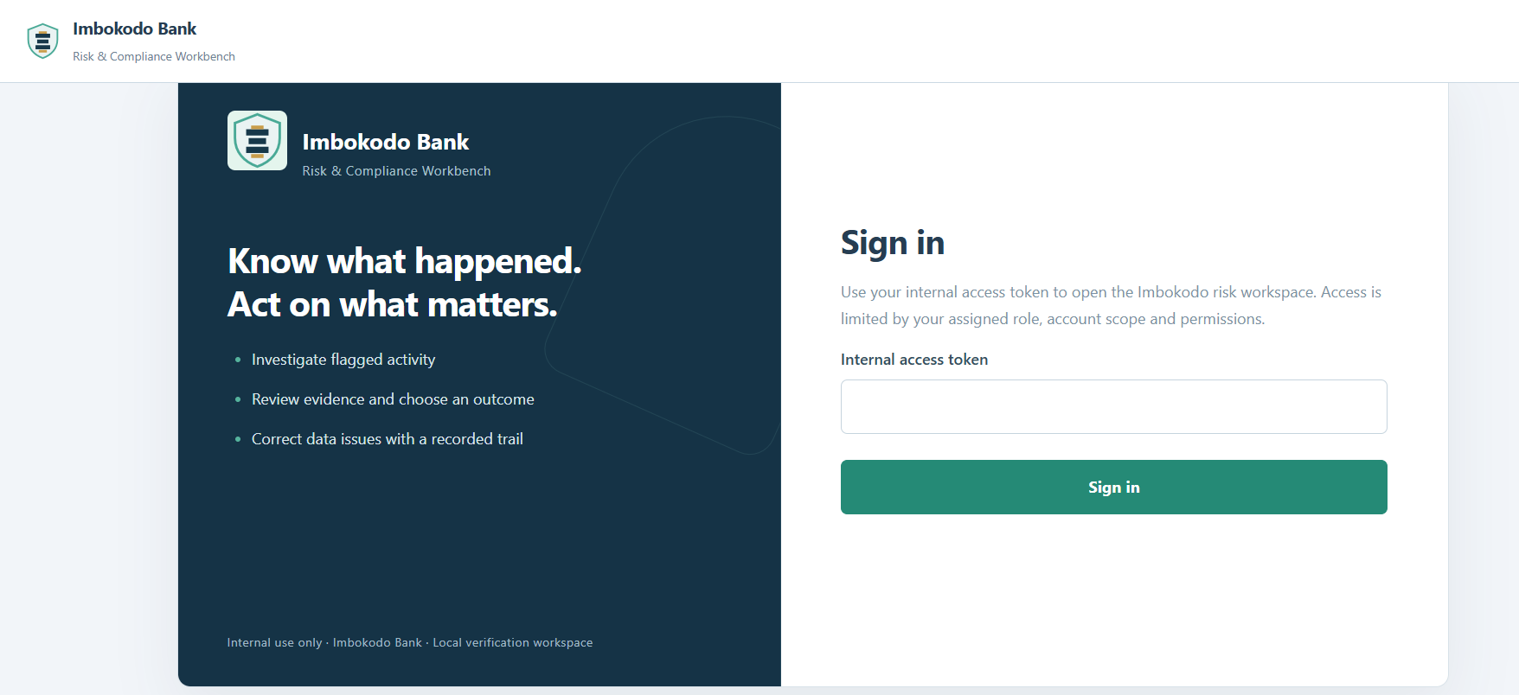
Imbokodo Bank
1. Sign in
ANALYST SOP
Risk & Compliance Workbench
Procedure
Open the Imbokodo Risk & Compliance Workbench.
Enter the assigned internal access token for the Analyst account.
Select Sign in.
Confirm the header shows the Analyst identity and role after authentication.
For the demo, use the Analyst identity only.
Figure 1 — Imbokodo Bank Risk & Compliance Workbench sign-in
Internal project demonstration · Analyst workflow

Slide 4
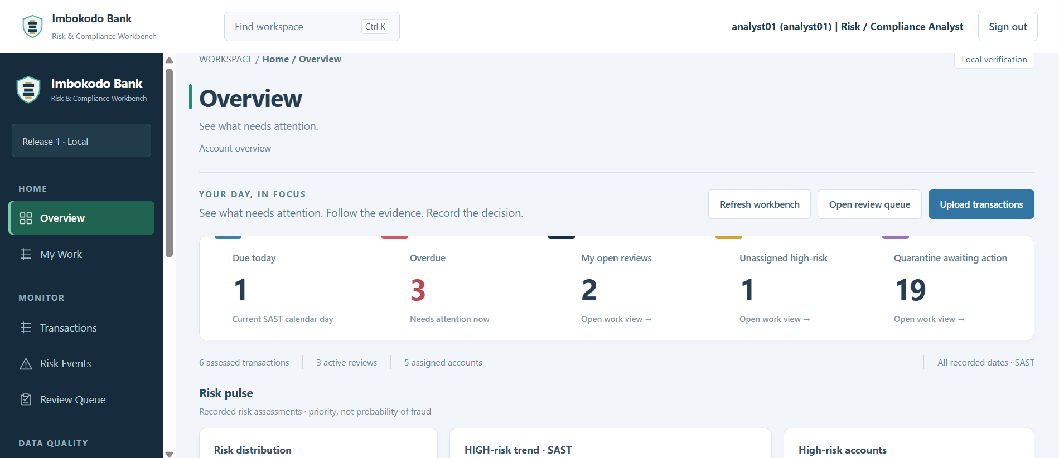
Imbokodo Bank
2. Start with Overview
ANALYST SOP
Risk & Compliance Workbench
What to check
Review Due Today and Overdue items first.
Check My Open Reviews to continue work already assigned to you.
Check Unassigned High Risk for urgent work that may need to be claimed.
Review quarantine workload if data-quality exceptions need attention.
Overview answers: “What needs my attention now?”
Figure 2 — Analyst Overview showing workload, priority items and risk activity
Internal project demonstration · Analyst workflow

Slide 5
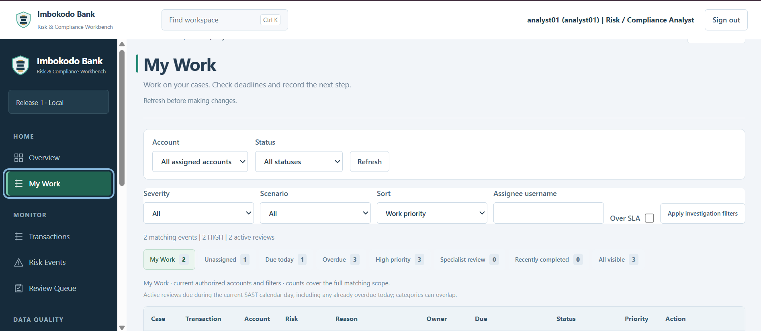
Imbokodo Bank
3. Work from My Work
ANALYST SOP
Risk & Compliance Workbench
Procedure
Use the work-view filters to narrow the queue.
Check Owner, Due, Priority and Status before opening a case.
Use Claim only for an eligible unassigned review.
Use Investigate or Continue to open the case workspace.
Treat overdue and high-priority work first.
Figure 3 — My Work queue showing ownership, risk reasons, priority and SLA status
Internal project demonstration · Analyst workflow

Slide 6
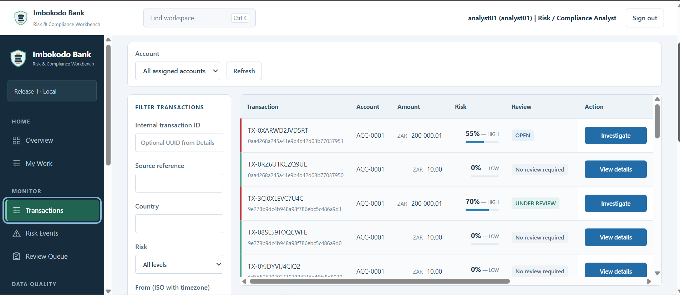
Imbokodo Bank
4. Review the transaction register
ANALYST SOP
Risk & Compliance Workbench
Procedure
Use filters to locate an account, risk level or review state.
Read LOW items as ledger-visible activity that normally needs no review.
Open HIGH or reviewable transactions using Investigate.
Do not interpret the risk percentage as a fraud probability.
The score is a configured risk priority score.
Figure 4 — Transactions register showing scores, review states and investigation actions
Internal project demonstration · Analyst workflow

Slide 7
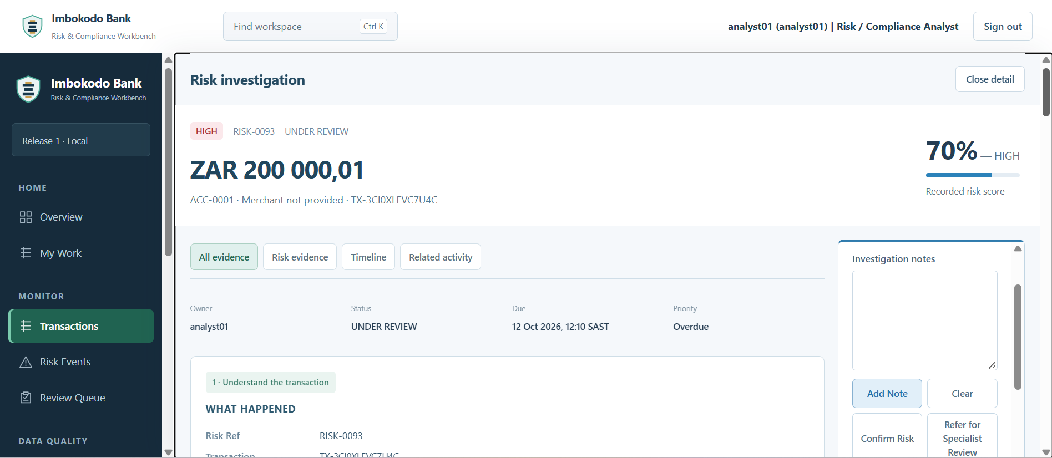
Imbokodo Bank
5. Open the Risk Investigation workspace
ANALYST SOP
Risk & Compliance Workbench
Procedure
Confirm transaction amount, account, risk reference and current status.
Check Owner, Due and Priority before taking action.
Start with All evidence, then use the focused evidence tabs as needed.
Use investigation notes to record reasoning before saving an action.
The Analyst makes the decision; the system supplies recorded evidence.
Figure 5 — Risk Investigation workspace showing case status, owner, SLA and Analyst actions
Internal project demonstration · Analyst workflow

Slide 8
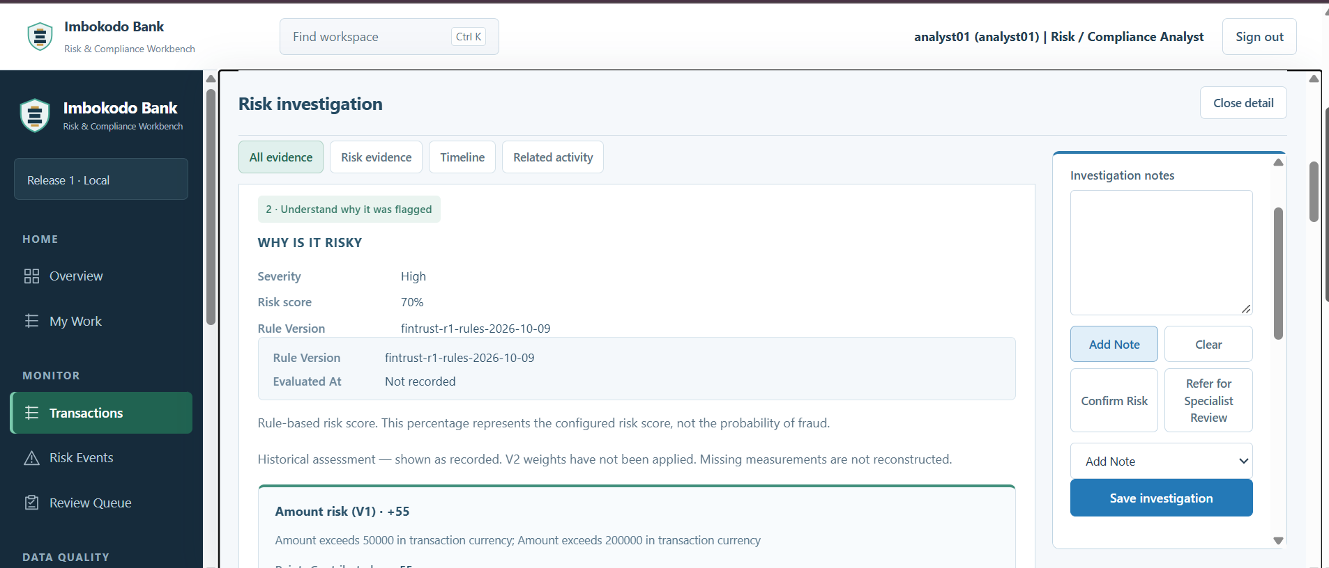
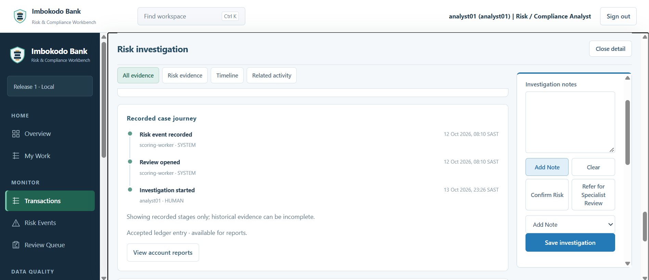
Imbokodo Bank
6. Understand why it was flagged
ANALYST SOP
Risk & Compliance Workbench
Figure 6 — Recorded risk evidence
Figure 7 — Recorded case journey
Check the rule version and reasons that produced the recorded score. Then use the case journey to distinguish system events from human investigation activity. Historical assessments remain as recorded; do not reconstruct missing evidence.
Internal project demonstration · Analyst workflow

Slide 9
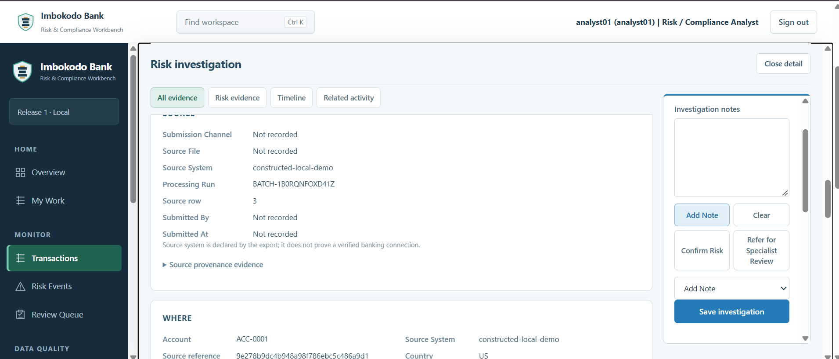
Imbokodo Bank
7. Check transaction provenance
ANALYST SOP
Risk & Compliance Workbench
Procedure
Review Source System, Processing Run and Source row.
Use Submission Channel, Source File, Submitted By and Submitted At when recorded.
Treat “Not recorded” as missing evidence — do not invent a value.
Use provenance to connect the investigation back to its processing history.
Provenance supports auditability and evidence tracing.
Figure 8 — Transaction source and processing provenance
Internal project demonstration · Analyst workflow

Slide 10
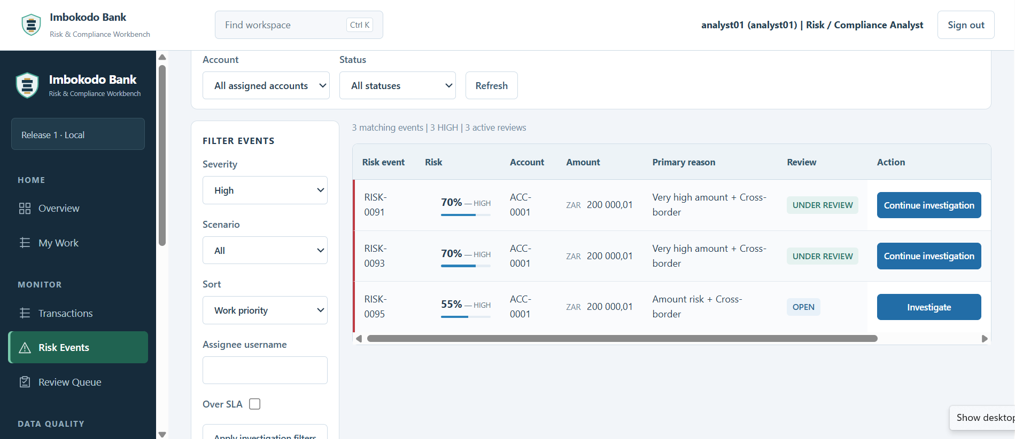
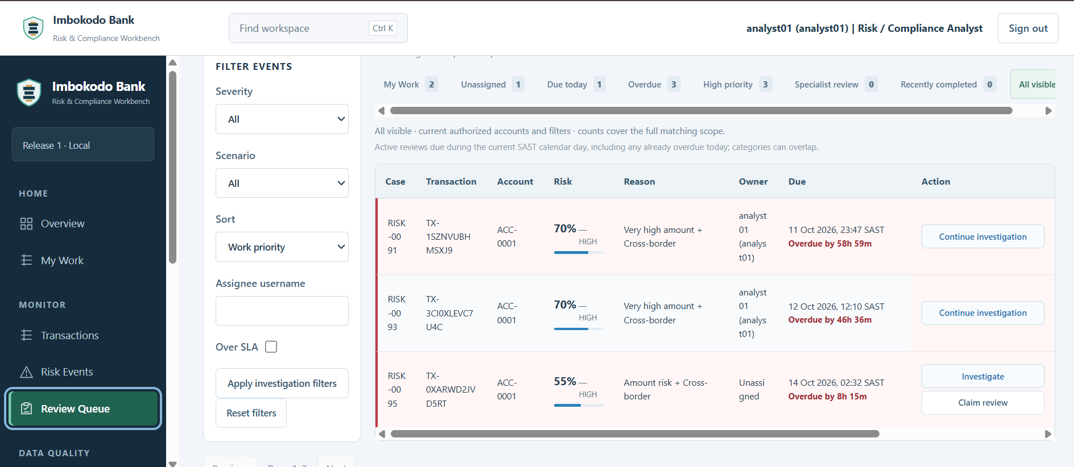
Imbokodo Bank
8. Triage Risk Events and Review Queue
ANALYST SOP
Risk & Compliance Workbench
Figure 9 — High-risk events and next action
Figure 10 — Review Queue with ownership and SLA
Risk Events shows why a transaction was flagged and what review state exists. Review Queue adds operational ownership, priority and SLA. Claim only work you are allowed to own; continue assigned investigations from the queue.
Internal project demonstration · Analyst workflow

Slide 11
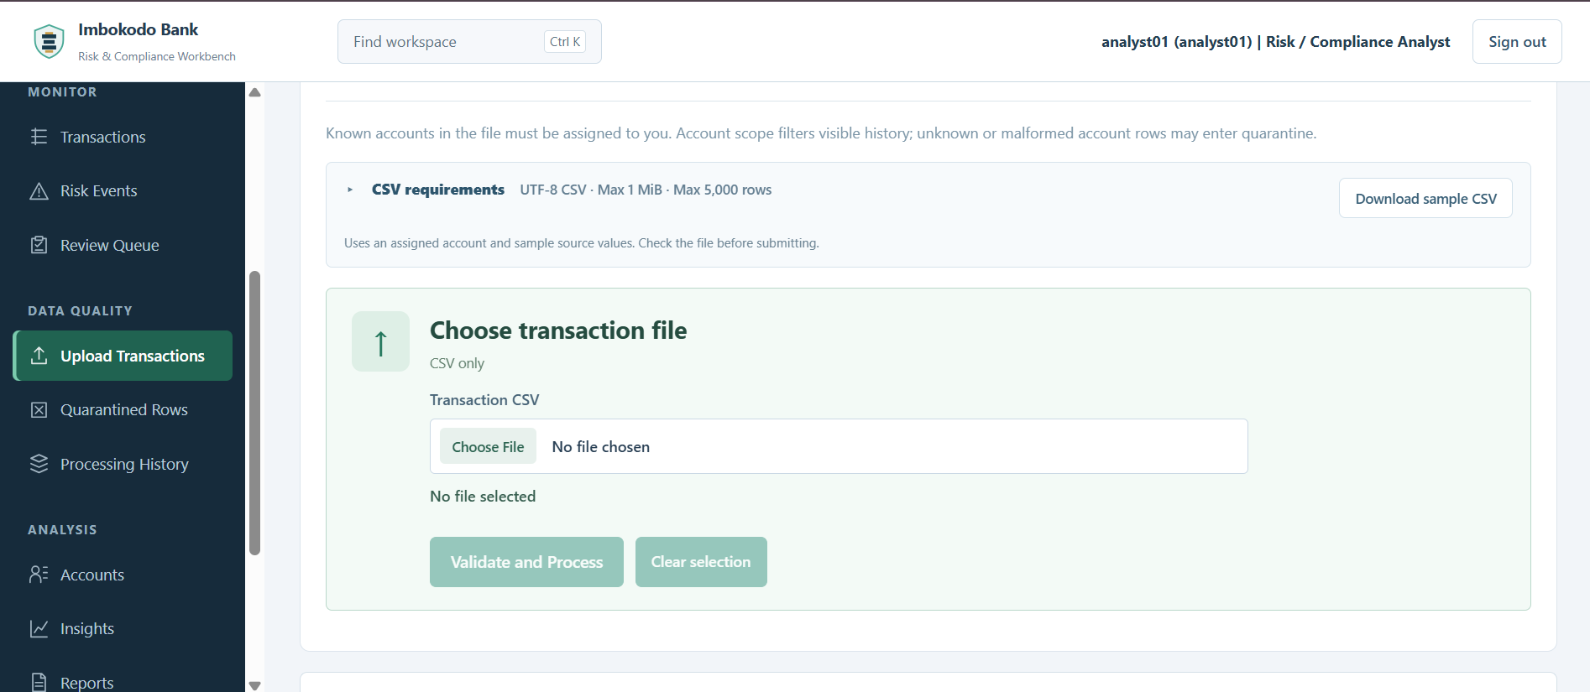
Imbokodo Bank
9. Upload transaction data
ANALYST SOP
Risk & Compliance Workbench
Procedure
Read the CSV requirements before selecting a file.
Use the sample CSV when the required structure is unclear.
Choose the transaction file.
Select Validate and Process.
Wait for the recorded processing outcome before navigating away.
Invalid rows are quarantined; they do not enter the trusted ledger.
Figure 11 — Upload Transactions workspace
Internal project demonstration · Analyst workflow

Slide 12
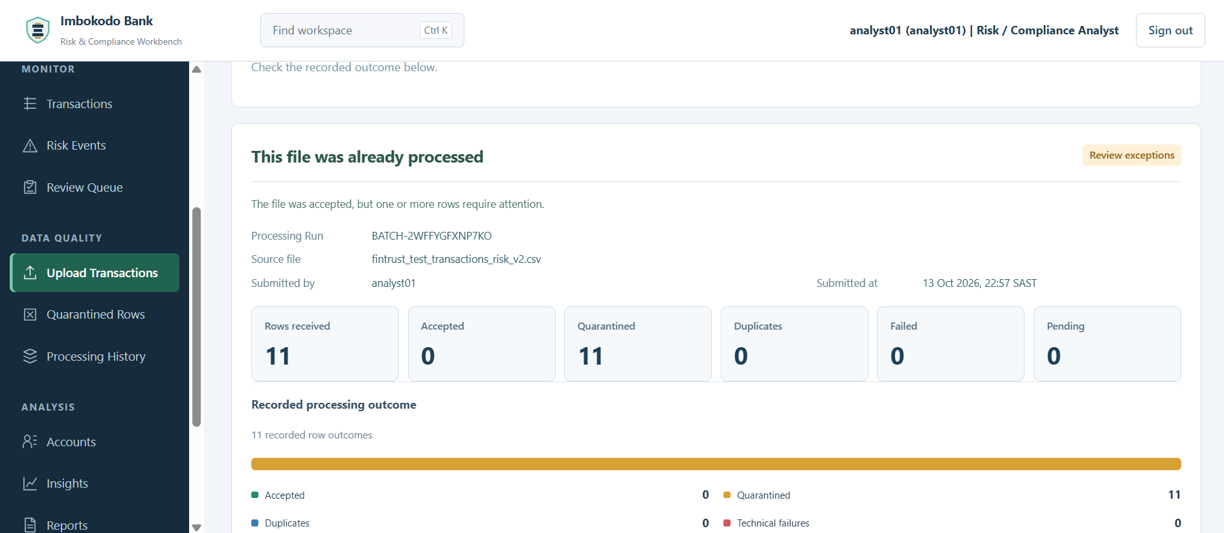
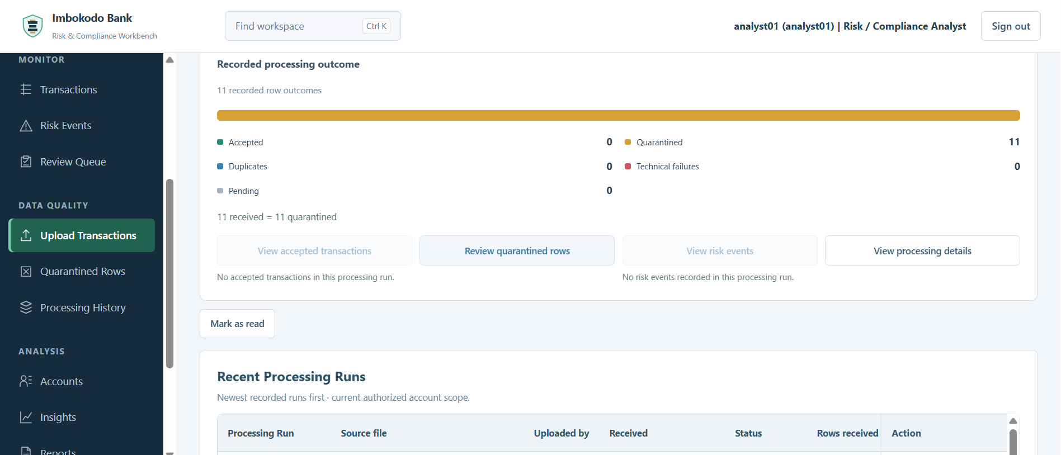
Imbokodo Bank
10. Read the processing outcome
ANALYST SOP
Risk & Compliance Workbench
Figure 12 — Recorded row outcomes and exception status
Figure 13 — Processing actions and recent runs
Reconcile the row totals before moving on. Use the enabled action that matches the outcome: review quarantined rows, inspect processing details, or open accepted/risk activity when available. A duplicate-file message means no additional transactions were created.
Internal project demonstration · Analyst workflow

Slide 13
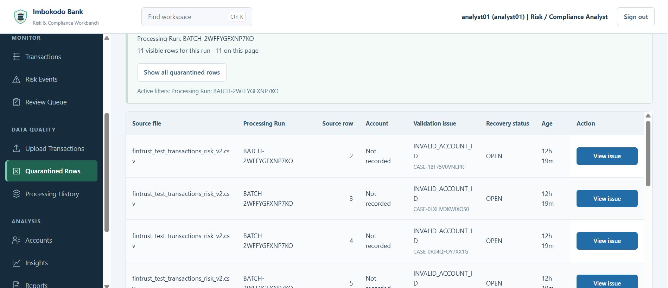
Imbokodo Bank
11. Review quarantined rows
ANALYST SOP
Risk & Compliance Workbench
Procedure
Keep the Processing Run filter when following a specific upload.
Review source file, source row and validation issue.
Open View issue for the row that needs recovery.
Do not manually move an invalid row into the trusted ledger.
The quarantine queue is evidence-preserving, not a discard bin.
Figure 14 — Quarantined rows filtered to a Processing Run
Internal project demonstration · Analyst workflow

Slide 14
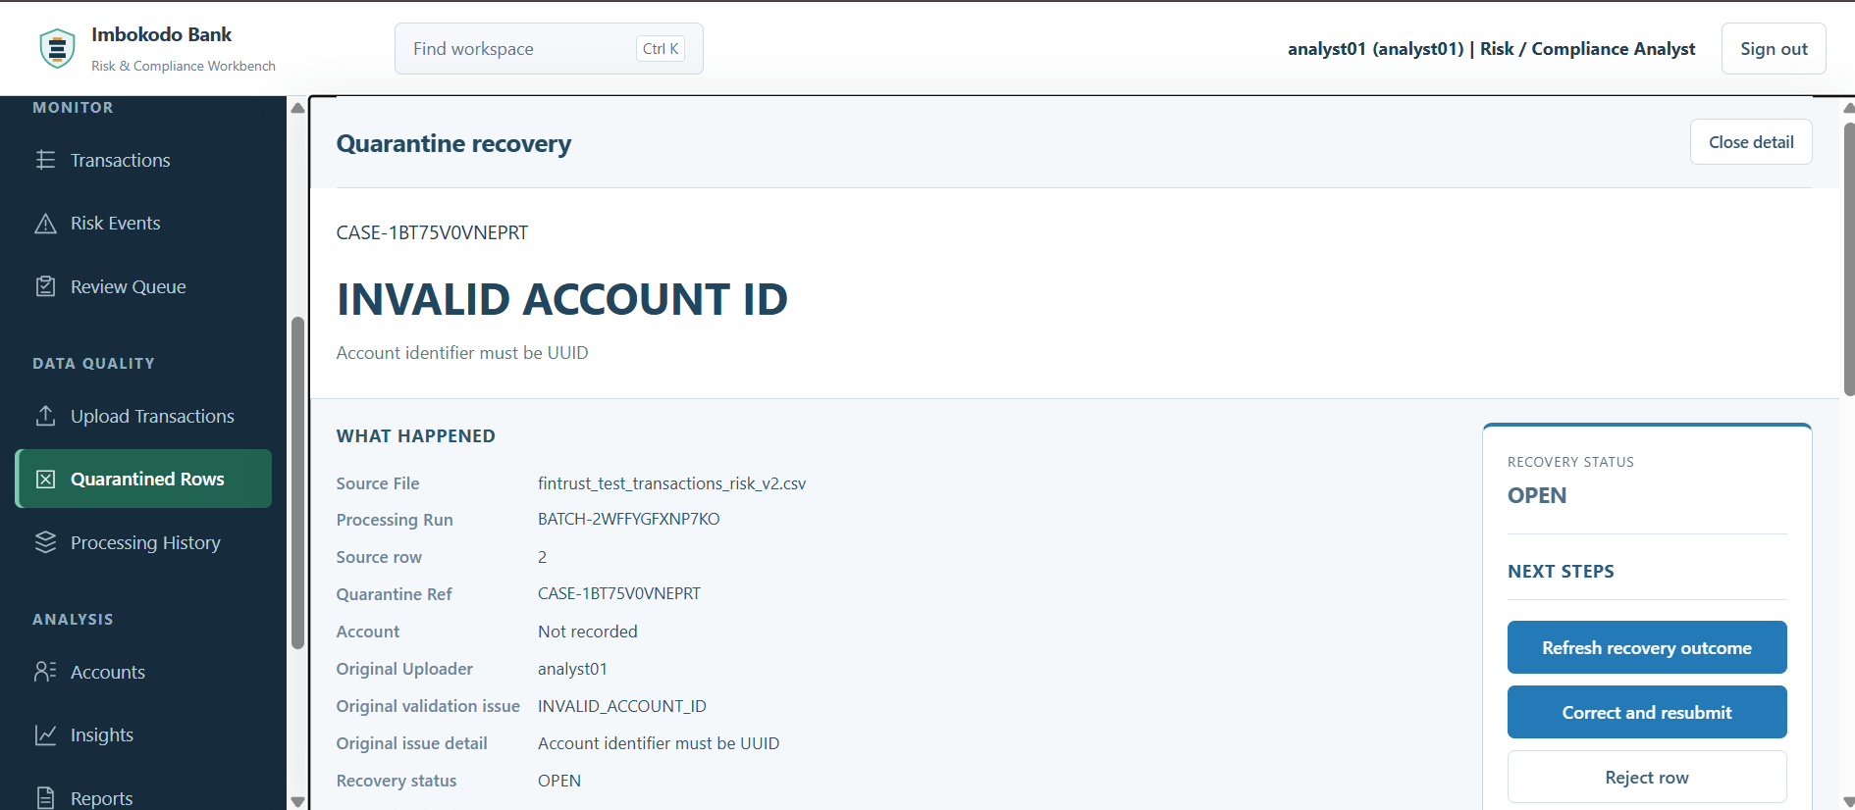
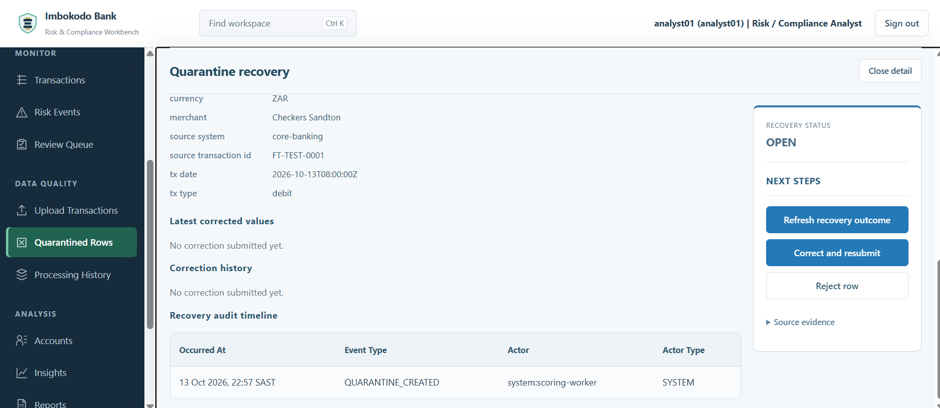
Imbokodo Bank
12. Recover a quarantined row
ANALYST SOP
Risk & Compliance Workbench
Figure 15 — Quarantine recovery and available actions
Figure 16 — Quarantine recovery audit timeline
Read the original issue and source context first. Correct and resubmit only when the source value can be safely corrected; Reject row when it should not proceed. The original values and recovery history remain recorded for audit.
Internal project demonstration · Analyst workflow

Slide 15
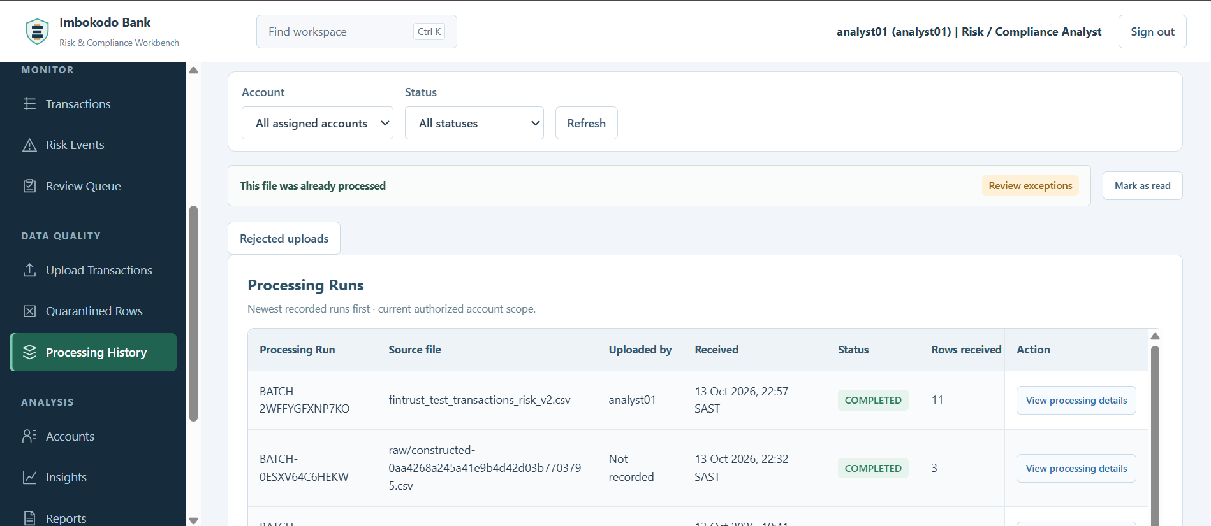
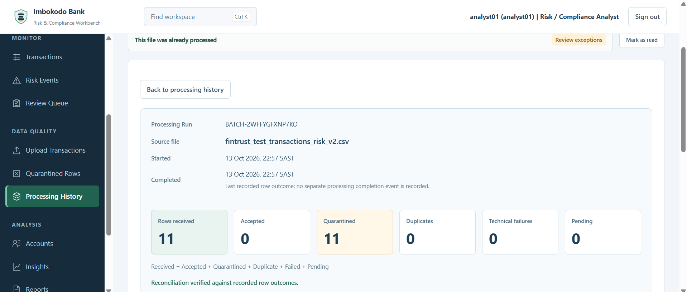
Imbokodo Bank
13. Verify Processing History
ANALYST SOP
Risk & Compliance Workbench
Figure 17 — Processing History
Figure 18 — Processing Details and reconciliation
Use Processing History to locate a run by source file, uploader or time. Open Processing Details to reconcile Received = Accepted + Quarantined + Duplicate + Failed + Pending and confirm the recorded row outcomes agree.
Internal project demonstration · Analyst workflow

Slide 16
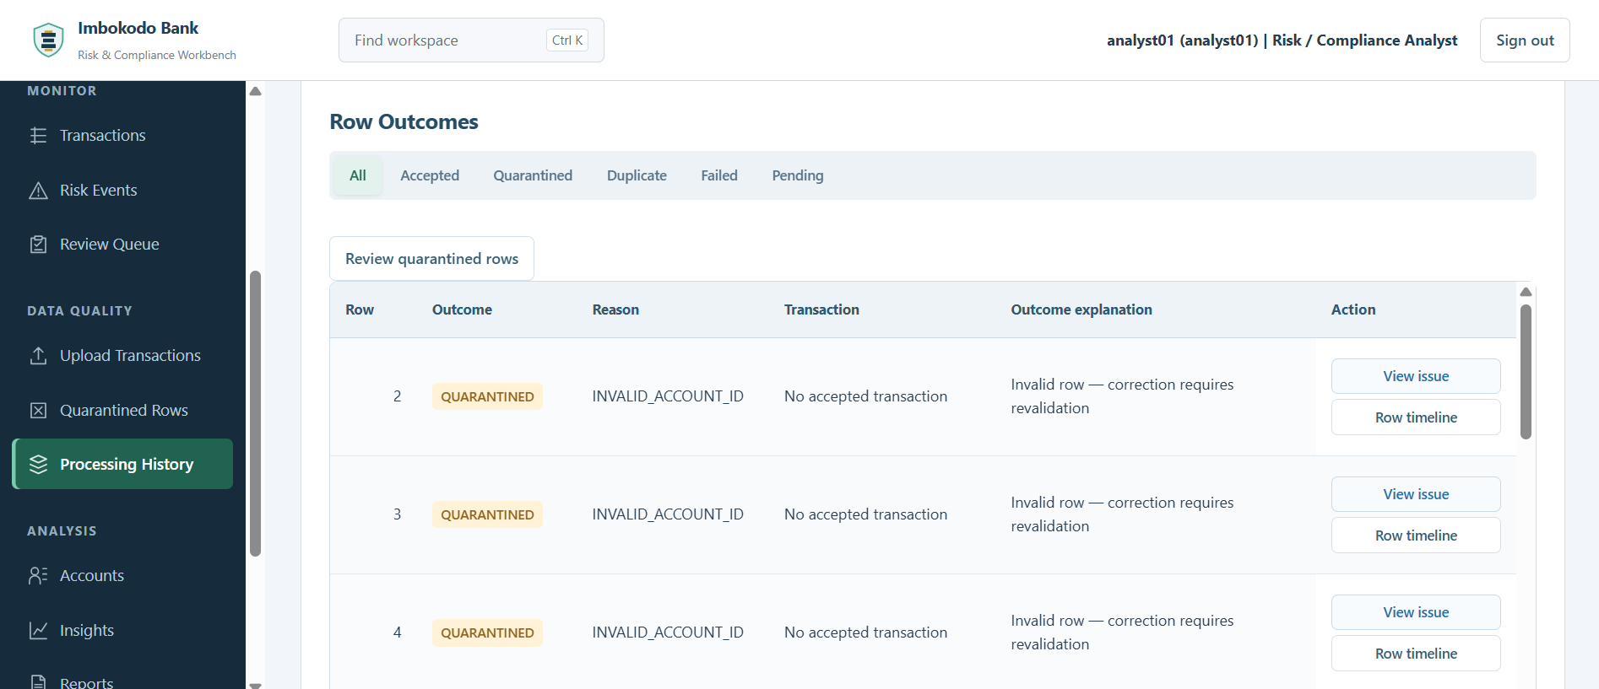
Imbokodo Bank
14. Inspect row outcomes
ANALYST SOP
Risk & Compliance Workbench
Procedure
Use the outcome tabs to isolate Accepted, Quarantined, Duplicate, Failed or Pending rows.
Open View issue when a quarantined row needs investigation.
Use Row timeline when the row lifecycle needs to be explained.
Keep processing outcomes tied to the recorded Processing Run.
This screen supports reconciliation and evidence review.
Figure 19 — Row Outcomes showing quarantine reasons and follow-up actions
Internal project demonstration · Analyst workflow

Slide 17
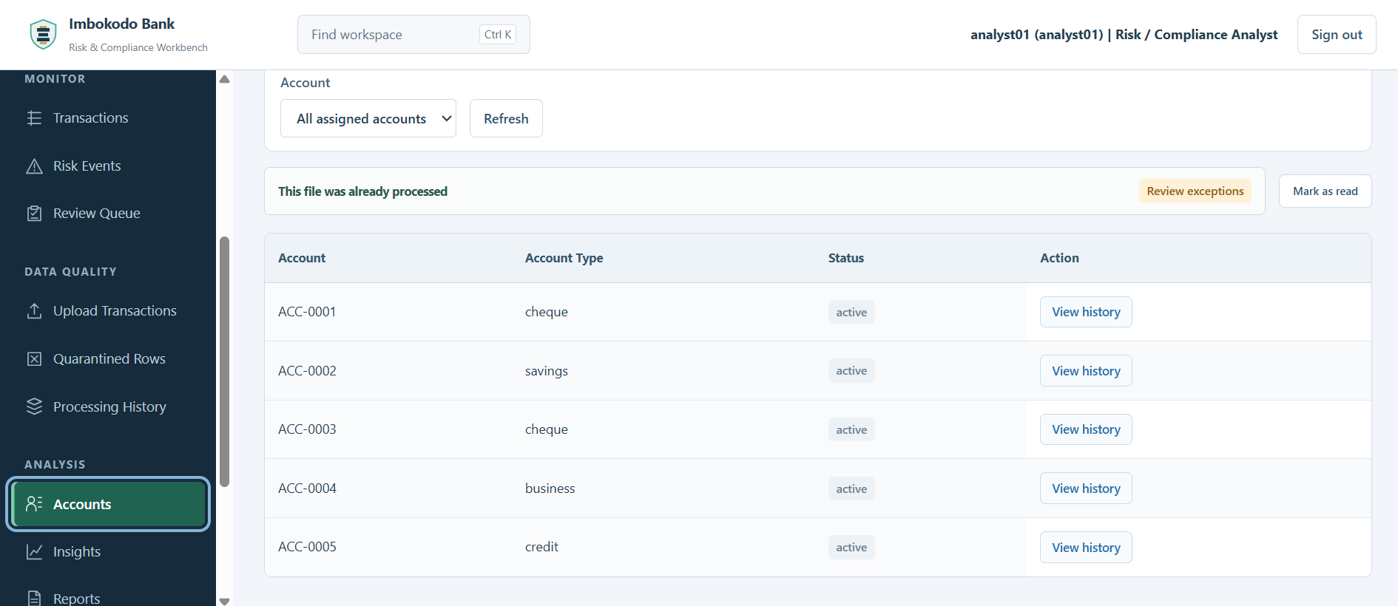
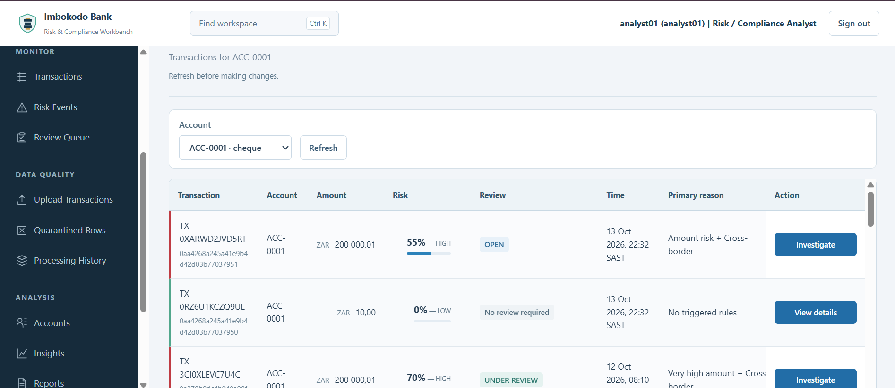
Imbokodo Bank
15. Review assigned accounts
ANALYST SOP
Risk & Compliance Workbench
Figure 20 — Assigned accounts
Figure 21 — Account History
Open only accounts available within the Analyst scope. Account History brings transaction activity, risk state and review state together so the Analyst can move from account context into the relevant investigation.
Internal project demonstration · Analyst workflow

Slide 18
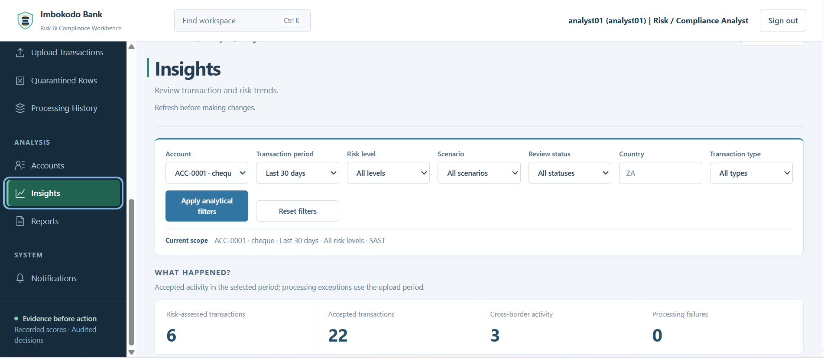
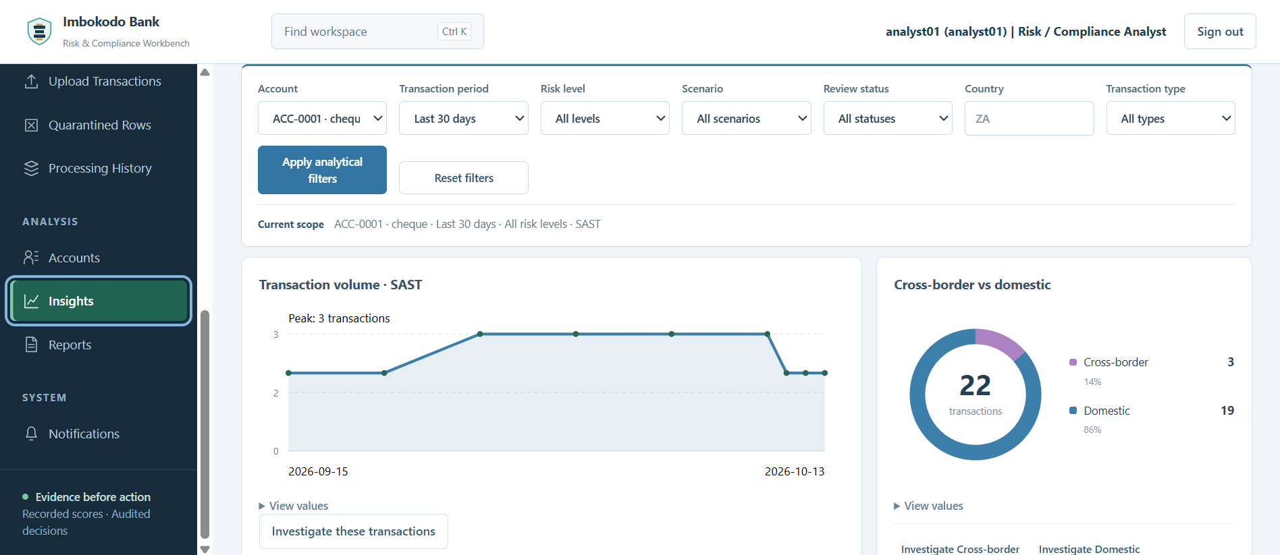
Imbokodo Bank
16. Analyse activity with Insights
ANALYST SOP
Risk & Compliance Workbench
Figure 22 — Custom analytical filters
Figure 23 — Transaction activity and cross-border analysis
Set the account and date scope first. Use the custom SAST date period when the default windows are not enough. Read the activity and cross-border views together, then use investigation links where the chart points to a transaction-level question.
Internal project demonstration · Analyst workflow

Slide 19
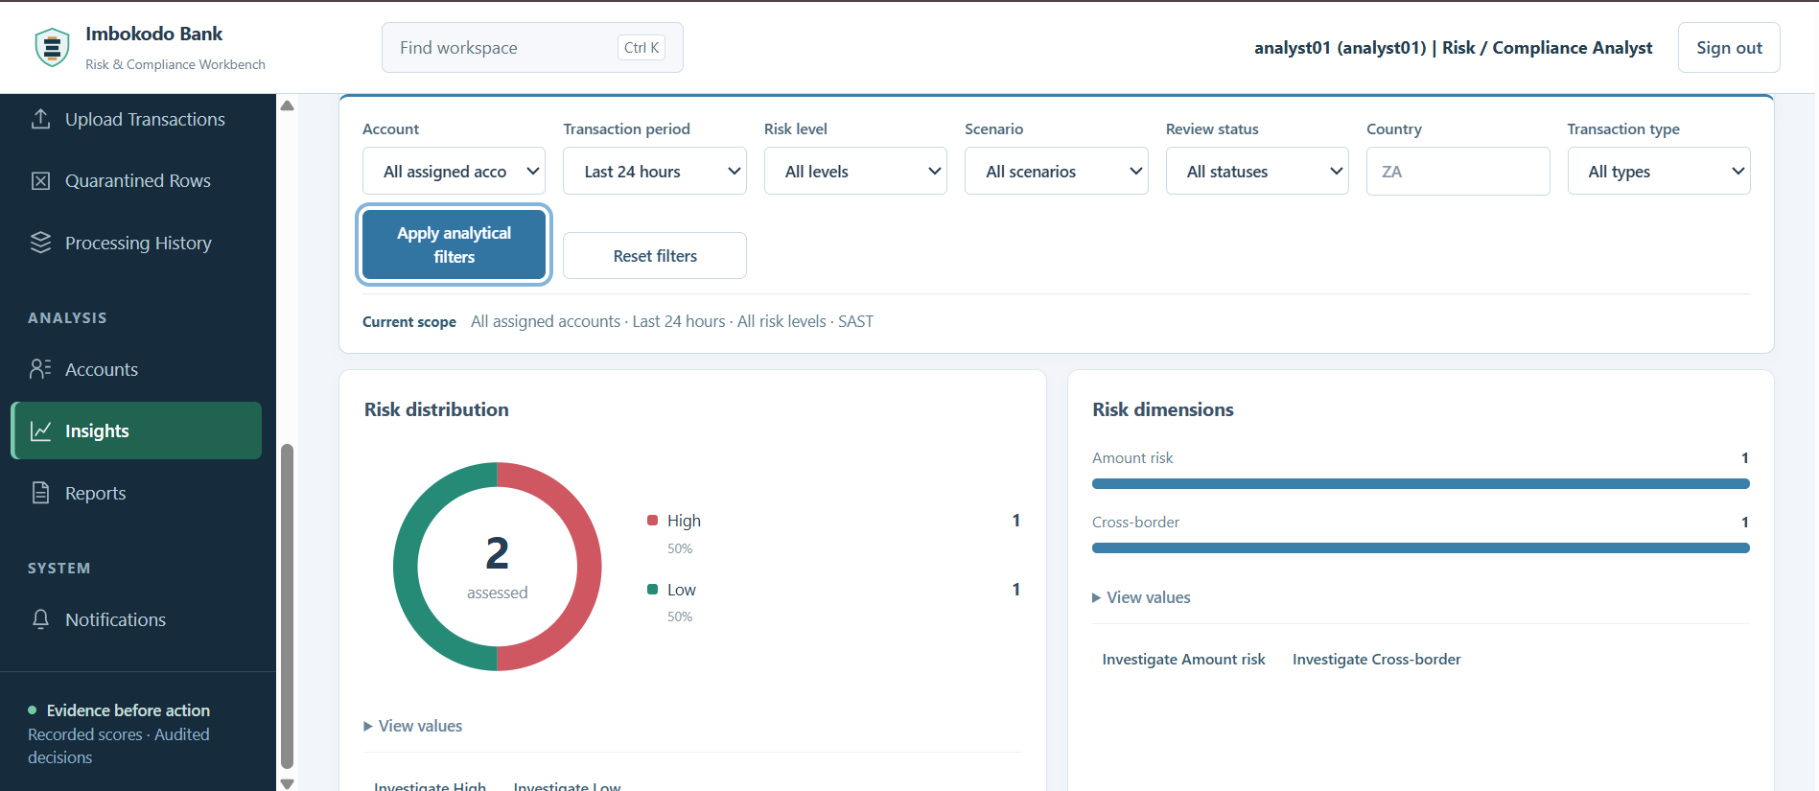
Imbokodo Bank
17. Use risk analysis as an investigation entry point
ANALYST SOP
Risk & Compliance Workbench
Procedure
Review the risk distribution for the selected scope.
Use recorded risk dimensions to understand what is driving the distribution.
Do not treat charts as final decisions.
Open the matching transactions when a pattern needs case-level investigation.
Insights helps find the question; the investigation workspace records the decision.
Figure 24 — Risk distribution and recorded risk dimensions
Internal project demonstration · Analyst workflow

Slide 20
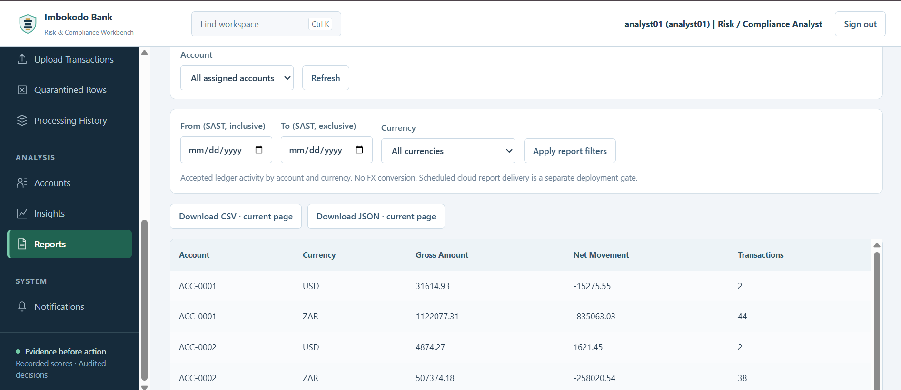
Imbokodo Bank
18. Produce Analyst reports
ANALYST SOP
Risk & Compliance Workbench
Procedure
Choose the account scope.
Set From and To using the SAST date controls.
Filter by currency when required.
Keep different currencies separate; the workbench does not perform FX conversion.
Export the current report as CSV or JSON when evidence must be shared or retained.
Reports summarize accepted ledger activity — not quarantined rows.
Figure 25 — Reports with account, SAST date and currency filters
Internal project demonstration · Analyst workflow

Slide 21
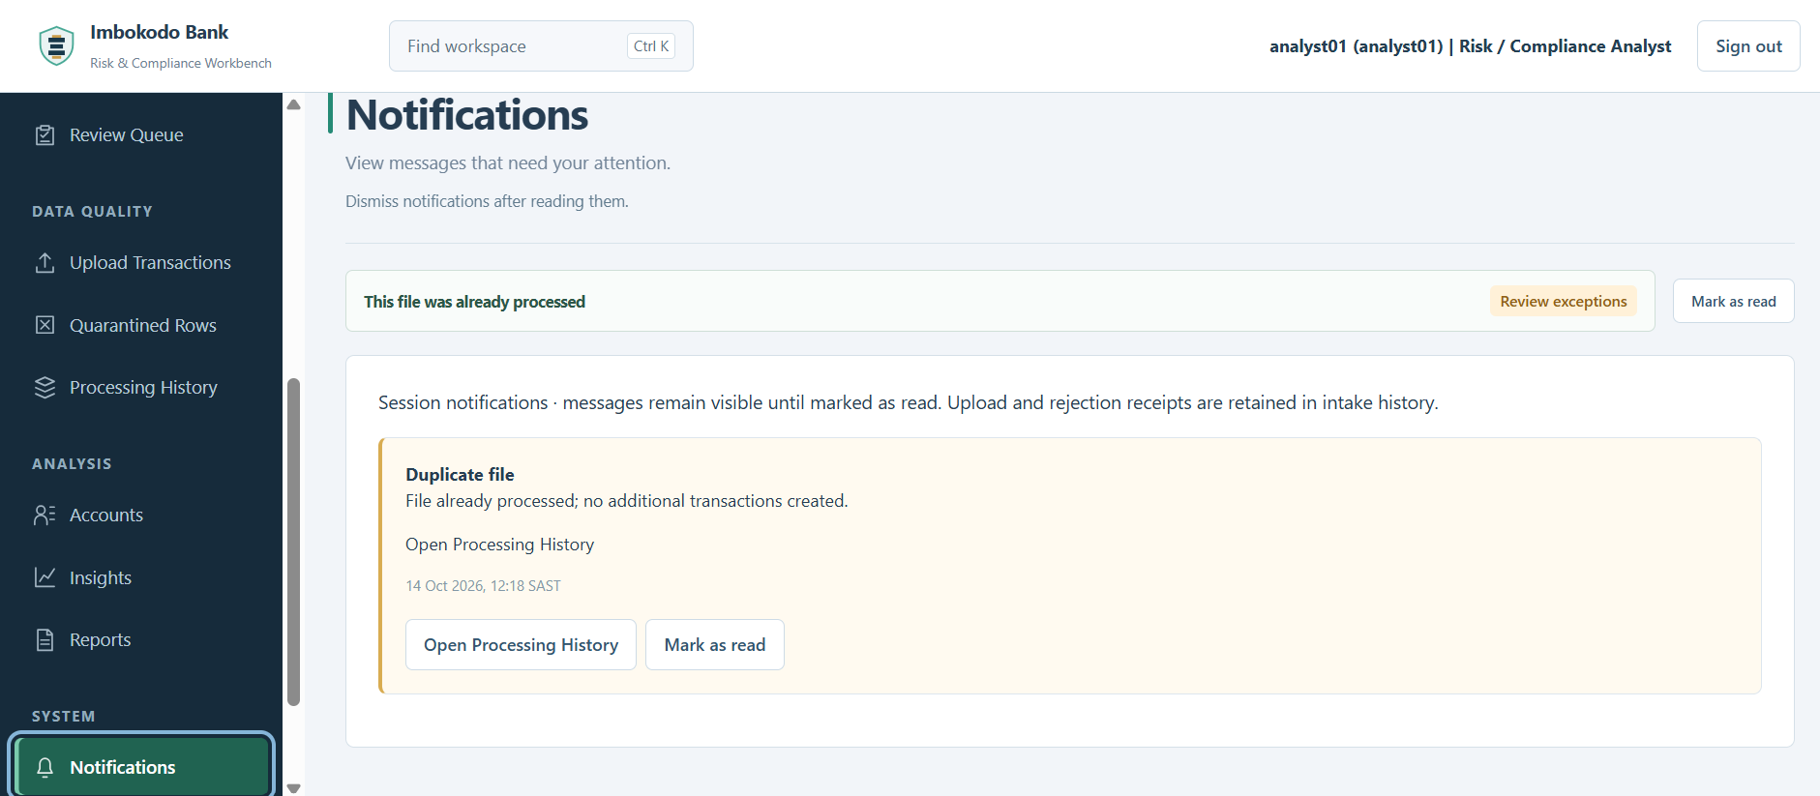
Imbokodo Bank
19. Review Notifications
ANALYST SOP
Risk & Compliance Workbench
Procedure
Read the notification message and timestamp.
Use the linked action to open the relevant operational record.
Mark the notification as read after it has been handled.
Remember that dismissing a notification does not delete the underlying processing or audit evidence.
Notifications point to work; Processing History remains the evidence source.
Figure 26 — Duplicate-file warning with linked follow-up action
Internal project demonstration · Analyst workflow

Slide 22
Imbokodo Bank
Analyst workflow summary
DEMO CLOSE
Risk & Compliance Workbench
1
TRIAGE
Overview → My Work → Review Queue
2
INVESTIGATE
Transaction → Evidence → Timeline → Provenance
3
DECIDE
Add note → Clear / Confirm Risk / Refer for Specialist Review
4
RECOVER DATA
Upload → Quarantine → Correct / Reject → Reconcile
5
ANALYSE
Accounts → Insights → Matching transactions
6
REPORT
Reports → Export → Notifications / Processing History
Trust the data. Understand the risk.
Prove the decision.
Internal project demonstration · Analyst role only

