Slide 1
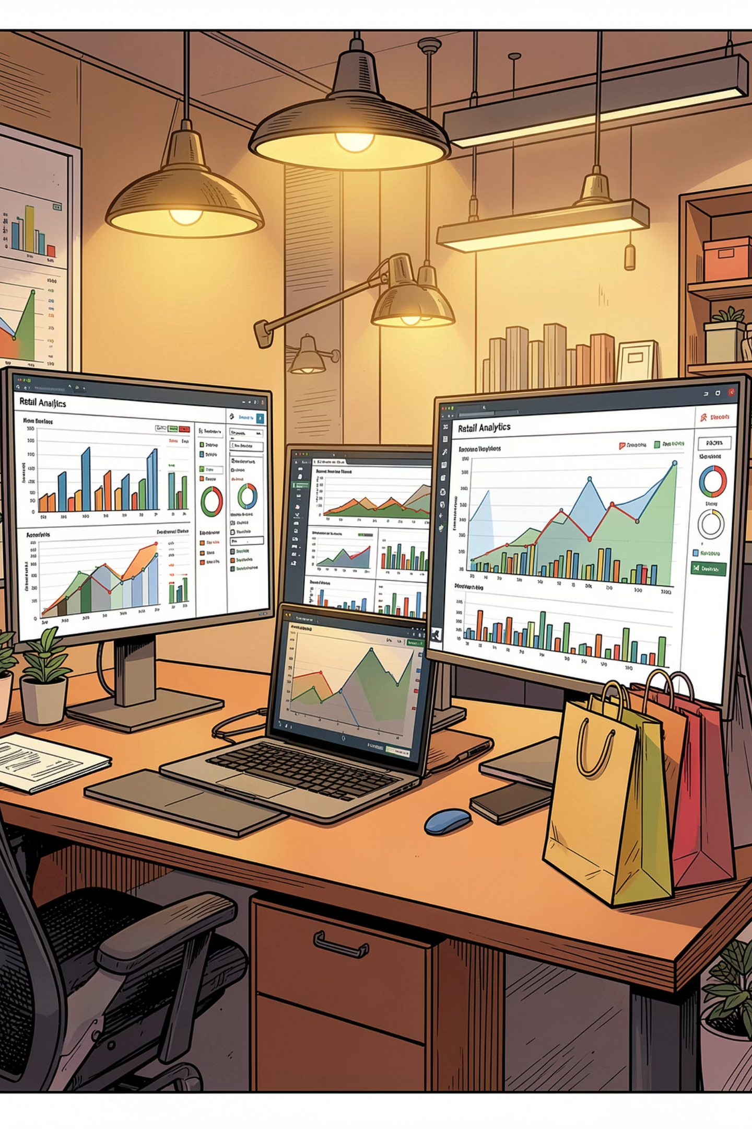
Customer Shopping Behavior Analysis
Analyzing 3,900 transactions across product categories to uncover spending patterns, customer segments, and subscription behavior for strategic decision-making.

Slide 2
DATASET OVERVIEW
The Data Behind the Insights
3,900
18
37
Total Purchases
Columns
Missing Values
Key Features Tracked
Customer demographics: Age, Gender, Location, Subscription Status
Purchase details: Item, Category, Amount, Season, Size, Color
Shopping behavior: Discount, Previous Purchases, Frequency, Rating, Shipping
Missing data in Review Rating was imputed using median ratings per product category.

Slide 3
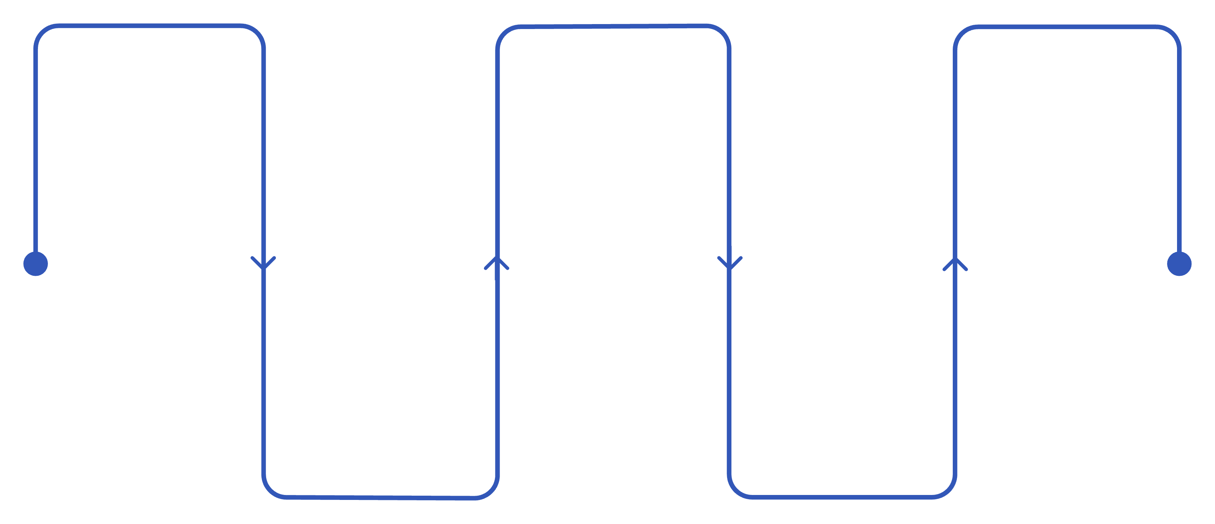
EDA · PYTHON
Data Preparation & Cleaning Pipeline
Load Data
Handle Missing
Load to DB
Read CSVs with pandas
Write cleaned table to PostgreSQL
Impute numeric medians
Explore
Feature Eng
Use .info() and .describe()
Create age groups and freq days
Columns standardized to snake case. Redundant promo_code_used column dropped after verifying overlap with discount_applied. Cleaned data loaded into PostgreSQL for SQL analysis.

Slide 4
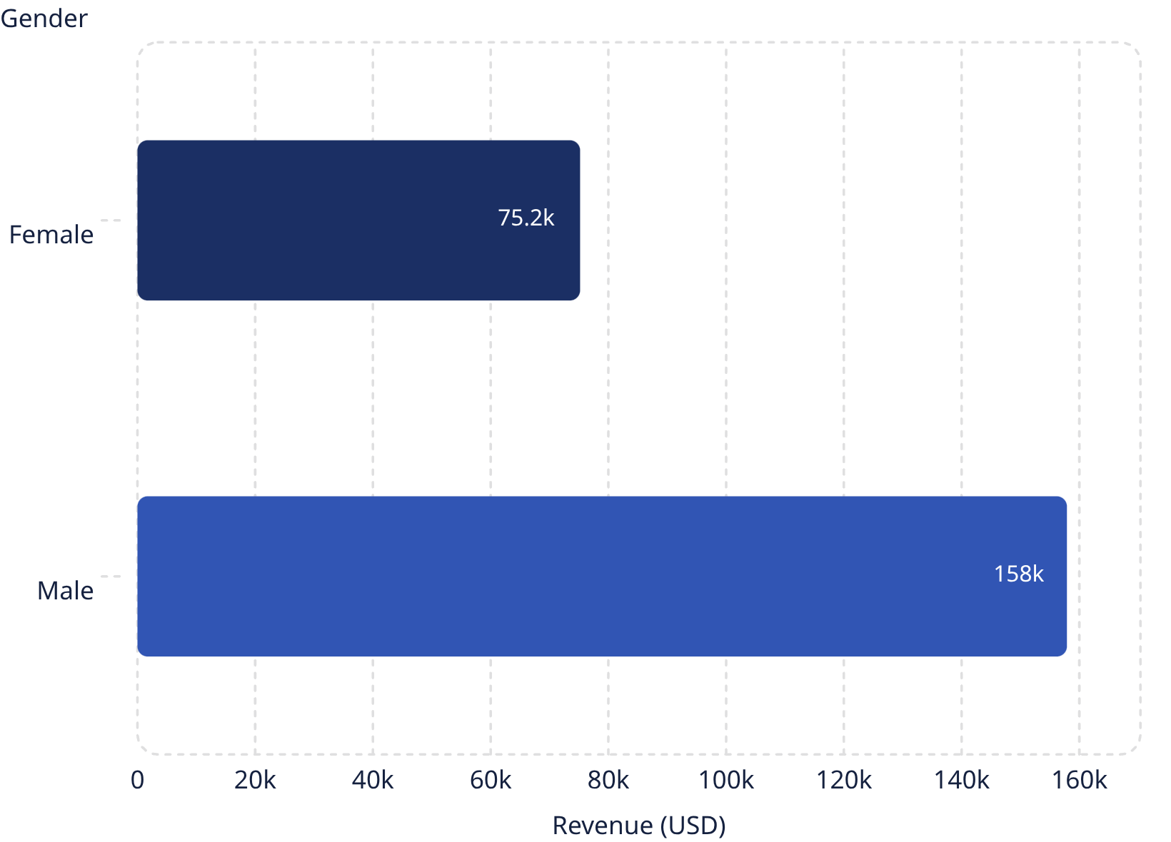
SQL ANALYSIS
Revenue by Gender
Male customers generated $157,890 in revenue — more than double the $75,191 from female customers.
This significant gap highlights a male-dominated customer base and points to gender-specific marketing opportunities.

Slide 5
SQL ANALYSIS
Top-Rated Products & Discount Dependence
Top 5 Products by Rating
Most Discount-Dependent Products
Product
Avg Rating
Product
Discount Rate
Gloves
3.86
Hat
50.00%
Sandals
3.84
Sneakers
49.66%
Boots
3.82
Coat
49.07%
Hat
3.80
Sweater
48.17%
Skirt
3.78
Pants
47.37%

Slide 6

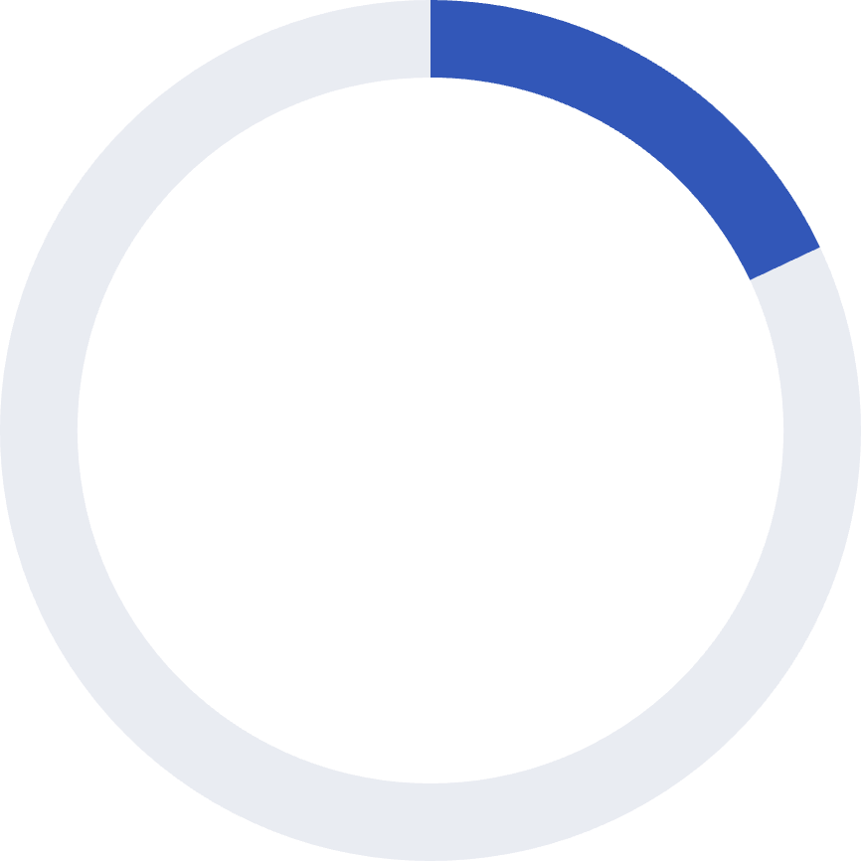

SQL ANALYSIS
Customer Segmentation
80%
18%
2%
Loyal
Returning
New
3,116 customers with extensive purchase history
701 customers making repeat purchases
83 first-time customers
The overwhelmingly loyal base is a strength, but the small new-customer segment signals a need for acquisition-focused strategies.

Slide 7
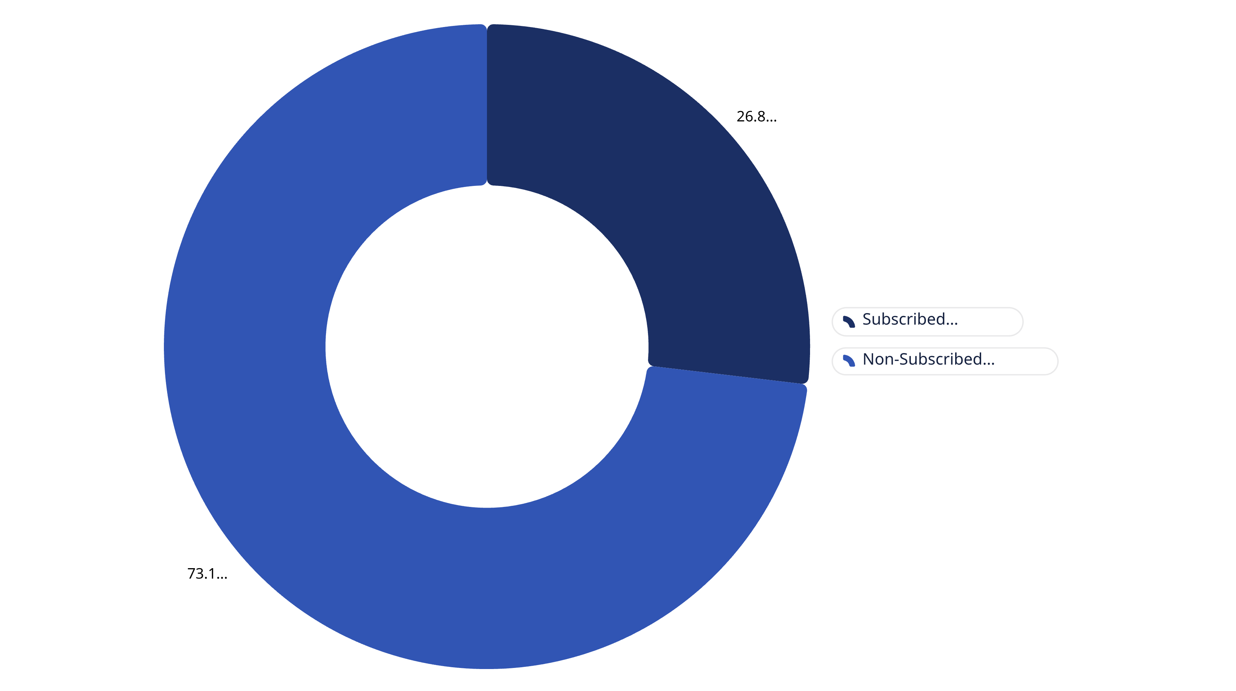
SQL ANALYSIS
Subscribers vs. Non-Subscribers
27%
73%
Subscribed
Non-Subscribed
1,053 customers · Avg spend $59.49
2,847 customers · Avg spend $59.87
Despite similar average spend, non-subscribers drive 73% of total revenue — a major untapped opportunity.

Slide 8
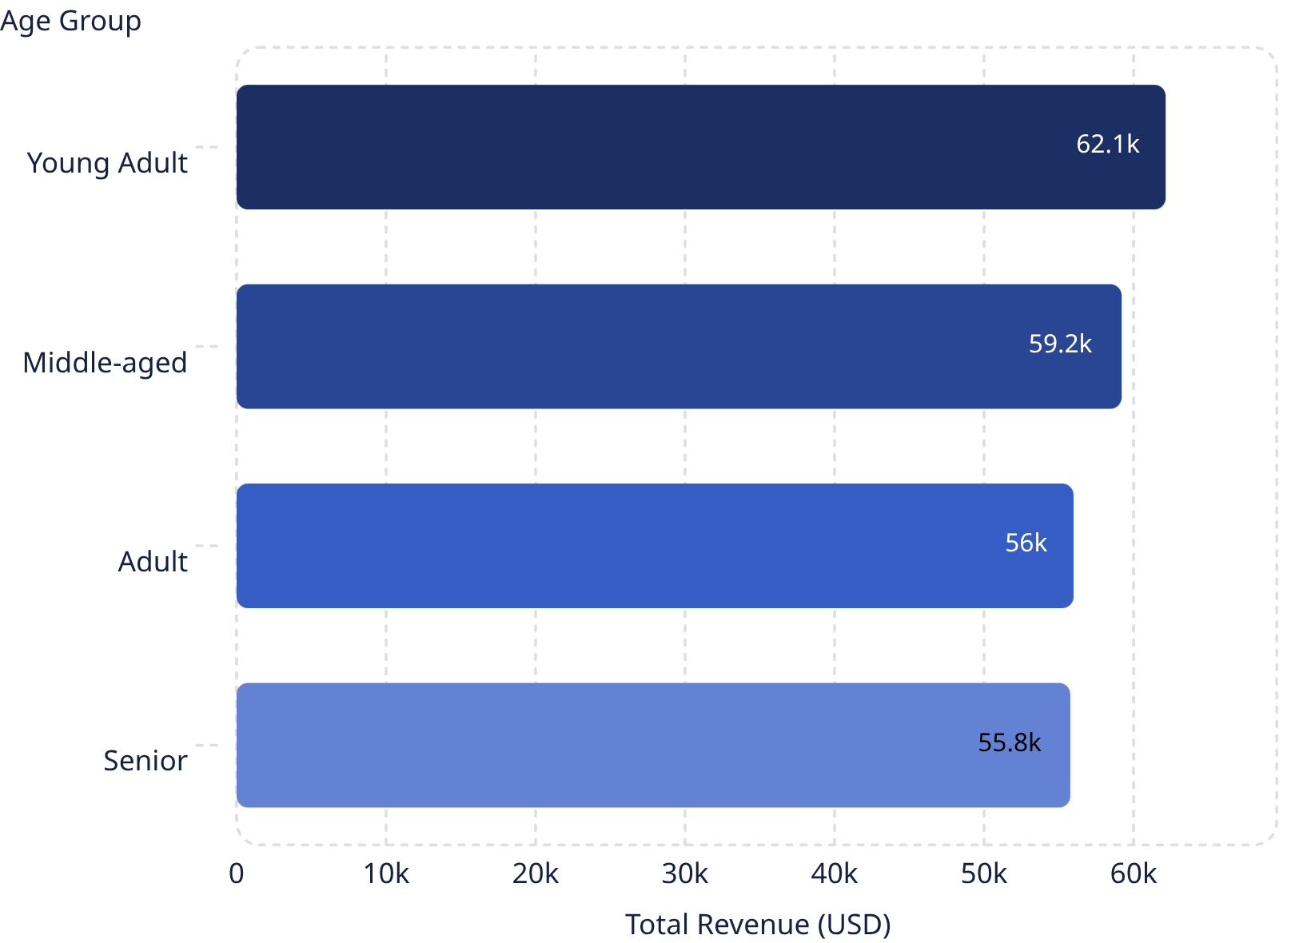
SQL ANALYSIS
Revenue by Age Group
Young Adults lead with $62,143 in revenue, followed closely by Middle-aged at $59,197.
Revenue is relatively evenly distributed, but younger segments show the strongest contribution — guiding where marketing dollars should focus.

Slide 9
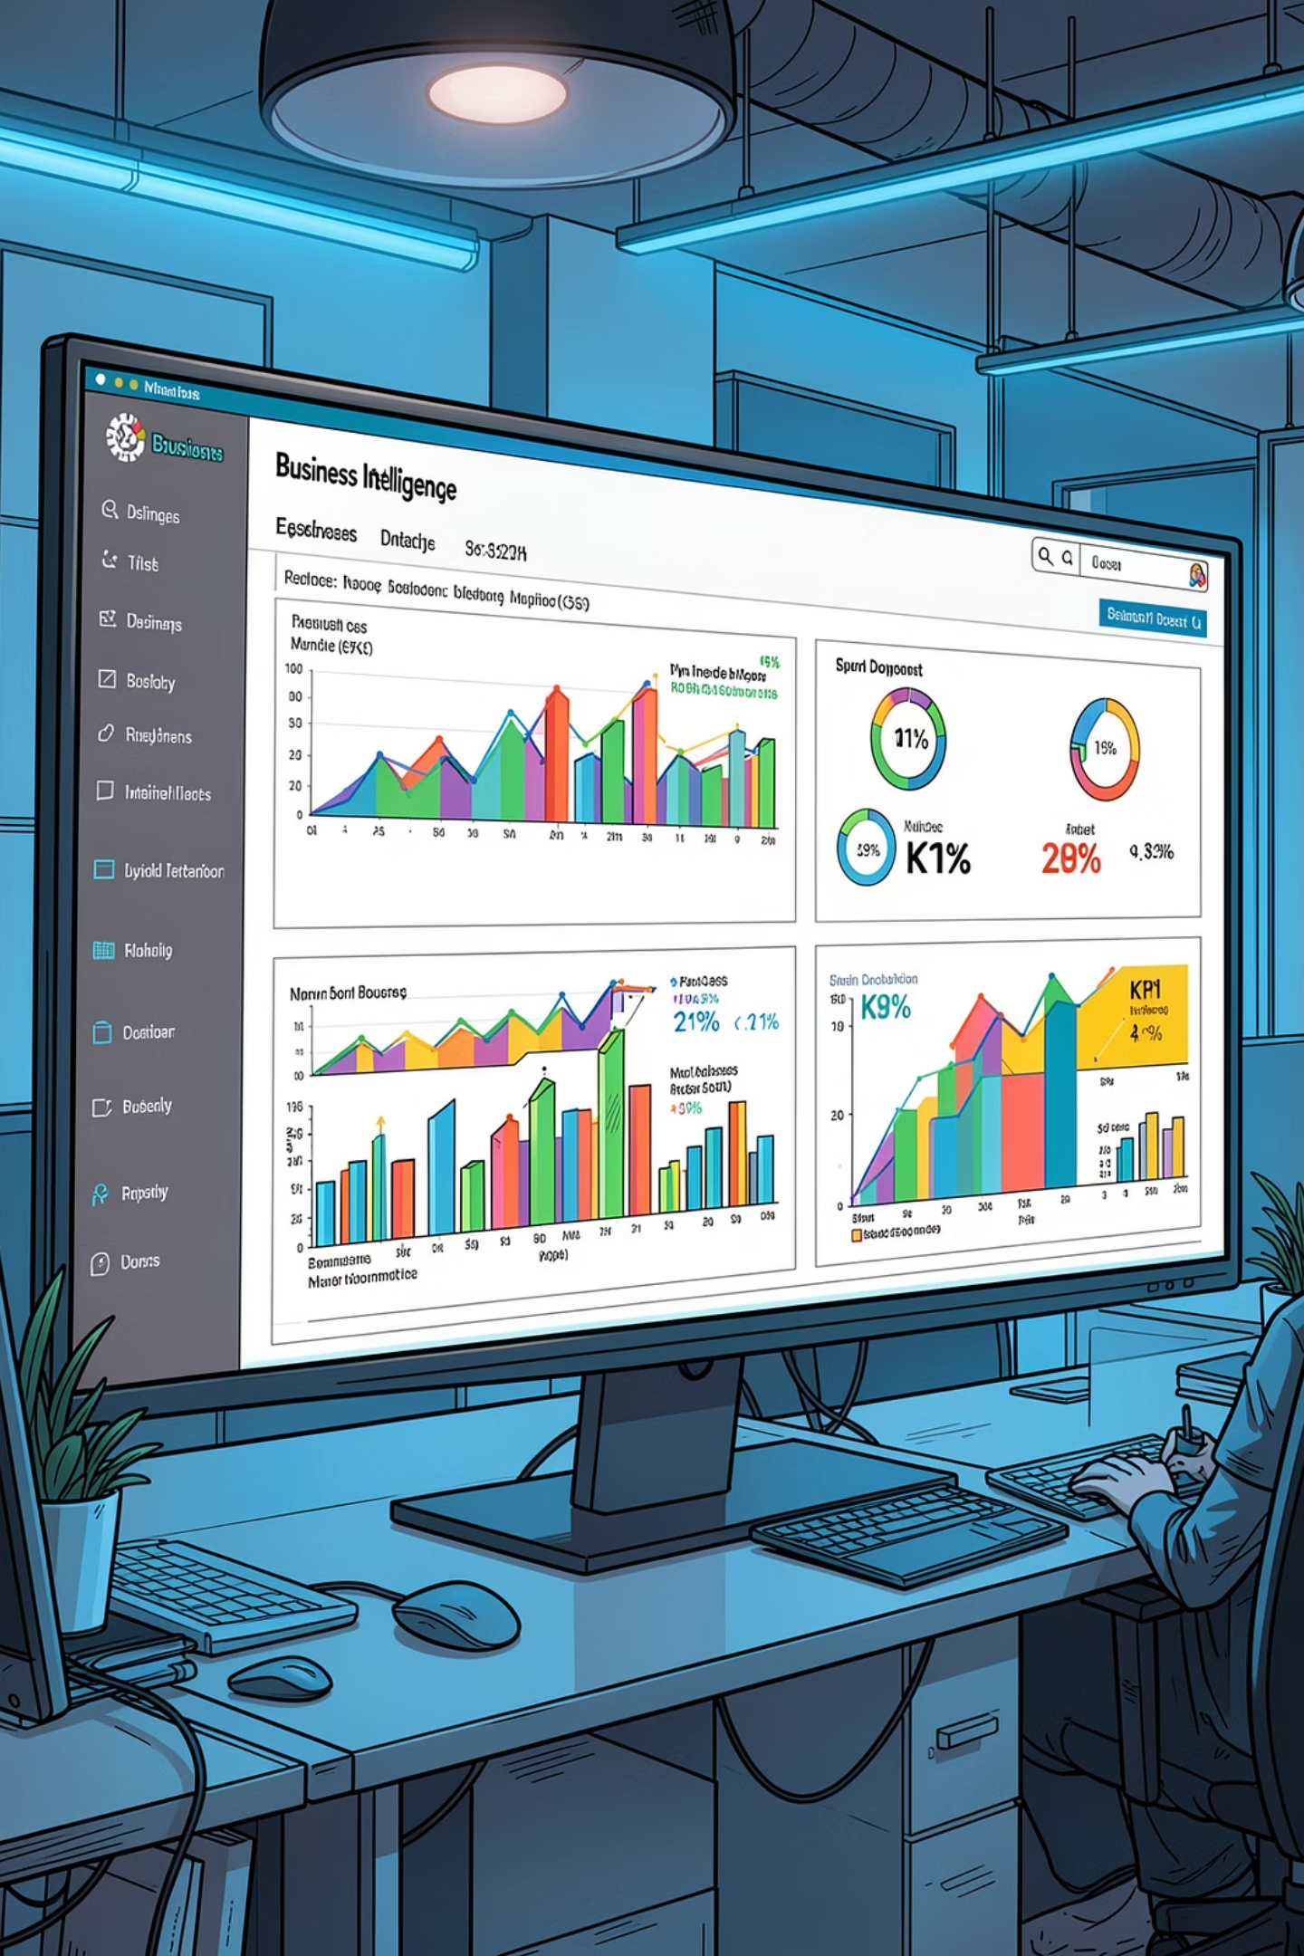
POWER BI
Interactive Dashboard
Key Metrics at a Glance
Interactive Filters
3.9K Number of Customers
$59.76 Average Purchase Amount
3.75 Average Review Rating
Subscription Status & Gender
Product Category (4 categories)
Shipping Type (6 options)
Revenue by category, age group, and sales volume visualized for real-time exploration.

Slide 10
RECOMMENDATIONS
Strategic Business Recommendations
1
2
3
Boost Subscriptions
Loyalty Programs
Review Discount Policy
Promote exclusive benefits to convert non-subscribers into loyal members.
Reward repeat buyers to move them into the Loyal segment.
Balance sales boosts with margin control on high-discount products.
4
5
Product Positioning
Targeted Marketing
Highlight top-rated and best-selling products in marketing campaigns.
Focus on high-revenue age groups and express-shipping users.

