Slide 1

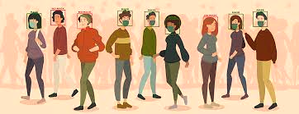
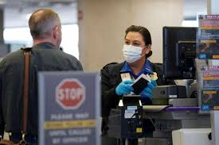
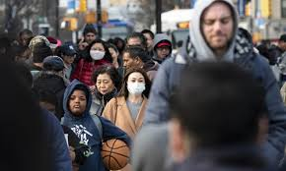
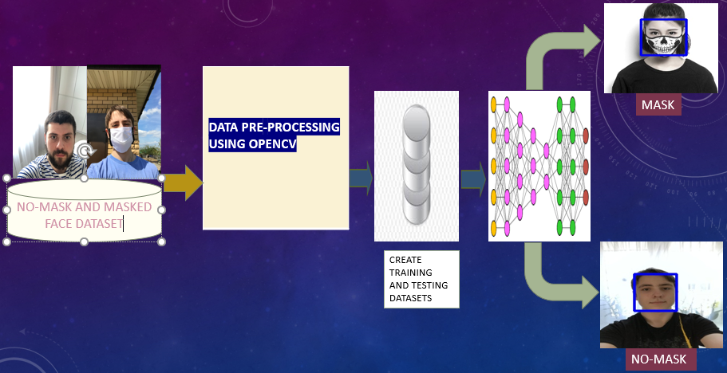
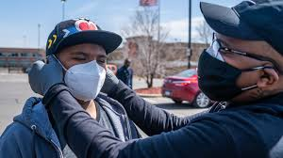
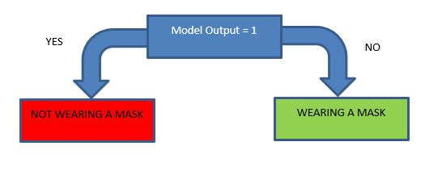
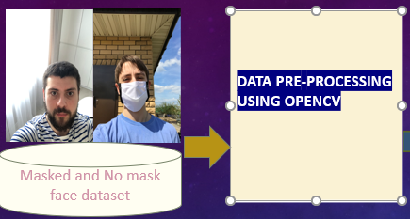
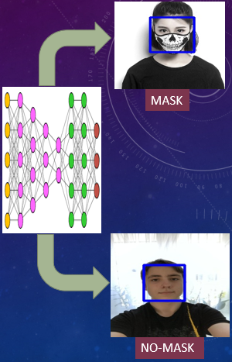

Face Mask Detector
AI SOLUTION
PROBLEM DEFINITION
The solution is a face mask detection model which can be implemented in public places such as malls, restaurants, schools, workplaces etc.
The aim of the solution is to manage and monitor the wearing of masks before entering a public establishment.
The solution will detect if a person is wearing a mask or not through a camera that can be placed next to the sanitizer station.
If a person is not wearing a mask an alert will be sent to the person through a buzzer and a counter value will be incremented to help measure the Covid 19 rules compliance.
Machine learning algorithms as well as deep learning will be implemented in the solution by using AI methods such a Computer vision, and Convolutional neural networks.
Data collection, model creation and training as well as testing using the python language and packages will be also included as part of the solution.
The wearing of masks in public has become very important in order to reduce the risk of contracting the corona virus.
Observations show that the number of people complying with the rule of wearing a mask in public places has dropped due to relaxation of the lockdown restrictions
There is often a need to have someone at the entrance of public establishments to monitor the wearing of mask which can be a risk to their health because of the possibility of being exposed to people who have the virus and not wearing masks
It is also easy for people to forget to wear their masks before entering public establishments.
Implementing this AI model in public establishment entrance points will eliminate the need to have humans monitoring the wearing of masks which will minimise the risk of contracting the virus.
MACHINE LEARNING APPROACH
DATA
The supervised machine learning algorithm will be used to implement this solution.
The classification method will be used to categorize the output of the model based on the captured face images.
Decision Tree classifier and logistic regression will be used within the convolutional neural network deep learning technique to classify the images based on the input data provided to the model.
Computer vision will be used to collect and pre-process image data for training and testing the model using the Intermediate-level vision.
Face detection will be performed using the openCV Haar cascade classifier.
The data required for the solution include camera images of people wearing and not wearing a mask.
This data can be obtained from the internet or through taking different pictures of people wearing and not wearing a mask using a webcam.
It is very important to also make sure that all the different types of mask are captured in the images for more accuracy.
As part of pre-processing and cleaning the input data, the images will have to be resized to a suitable value and converted to grayscale using the OpenCV package.
AI MODEL
The Convolutional neural network deep learning technique will be used to create the model with the help of the keras and sklearn libraries and packages.
The accuracy of the model will be evaluated by splitting the input data into a training data set and a testing data set.
Training data set will be used in the fit function to train the model and the testing data will be used in the predict function to determine the accuracy of the model.
The training and testing data will include images of people wearing and not wearing a mask.
Adding more layers of the Convolutional neural network will assist to improve the accuracy of the model. The following will also help to improve the accuracy:
optimizer = 'adam'
loss = 'binary_crossentropy'
metrics= ['accuracy']
performing image augmentations (rescaling the images)
increasing the number of epochs and validation steps
Providing more distinct input images to the training and testing data set
References
www.tutorialspoint.com
Globaltime.cn
straitstimes.org
mprnews,org
References
Medium.com
Pyimagesearch.com
Author: Zama Illona Phiri
Student Number: 218253303
: 218253303@edu.vut.ac.za

