Slide 1
Using Multiple Comparisons To Detect Meaningful Differences in Mean Salaries
Noah Diekemper
ST 765 // DAP 1
Monday, October 21, 2019

Slide 2
Intro
Kaggle, “Your Home For Data Science,” is a Google-owned website that offers datasets to download, a forum to post analyses, occasional competitions, &c.
In August 2017, they hosted a survey for people who work in or related to data science (many of these people were found through email lists or their social media channels); this generated 16,716 “usable” responses from 171 countries.

Slide 3
The Question
We ask whether some peripheral factors may meaningfully bear on salary. Instead of conventionally studied factors like age, years of experience, or country of operation, we look at Employer Industry, Job Satisfaction, and Employer Size.

Slide 4
The Data
The dataset contains 16,716 usable responses.
This is in the file multipleChoiceResponses.csv at https://www.kaggle.com/kaggle/kaggle-survey-2017#multipleChoiceResponses.csv
To be able to compare apples to apples and remove potentially confounding variables, we look only at rows where country is “United States” (the modal answer, commanding a quarter of all responses) and where gender selected is “male” (again, the modal answer, commanding 81% of all responses). For similar reasons we also only consider data where currency = ‘USD.’

Slide 5
Methodology: Imperfect Data
Since the variable in question is CompensationAmount, we eliminate the 14% of records where Employment Status is “Not Employed” (but we retain those that are just “retired” and “prefer not to say”).
We then replace all NAs and instances where CompensationAmount < 10 with the median of the rest, and also strike outliers (> $225,000).
This leaves us with 945 records.

Slide 6
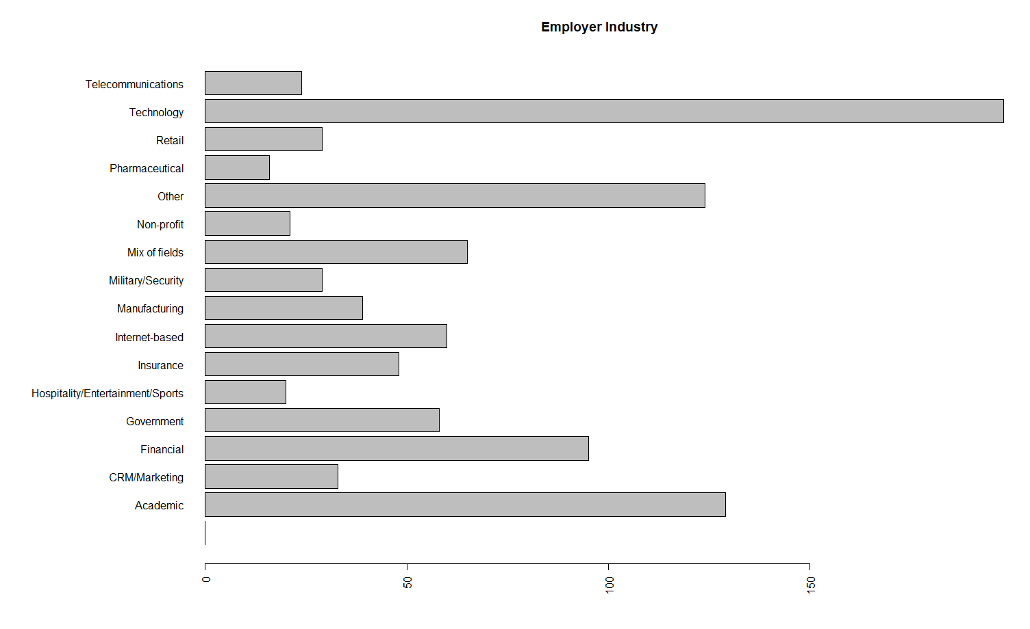
Variable 1: Employer Industry
This is what the breakdown of the data by Employer Industry looks like:

Slide 7
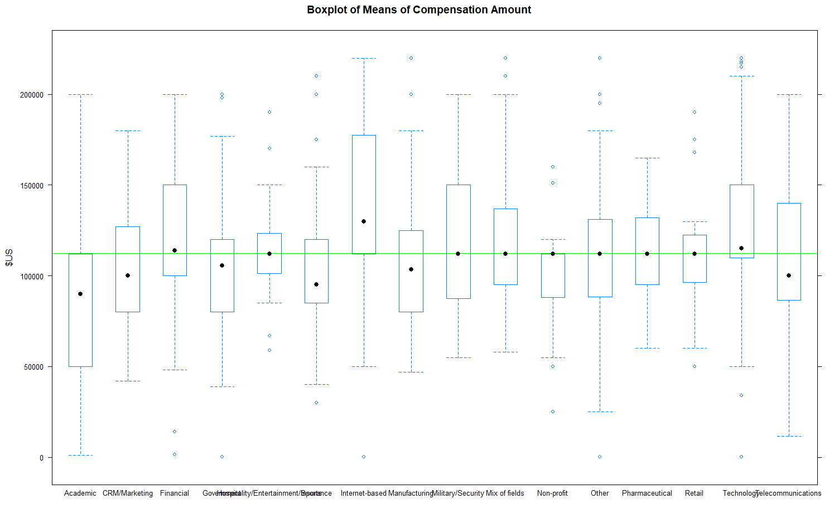
Visual Inspection: Boxplots of Means
Across the board, things look surprisingly consistent.

Slide 8
ANOVA suggests, though, that there is a difference:
> salmeans.aov <- aov(CompensationAmount~EmployerIndustry, data=filter3)
> anova(salmeans.aov)
Analysis of Variance Table
Response: CompensationAmount
Df Sum Sq Mean Sq F value Pr(>F)
EmployerIndustry 15 2.0989e+11 1.3992e+10 8.7987 < 2.2e-16 ***
Residuals 929 1.4774e+12 1.5903e+09
---
Signif. codes: 0 ‘***’ 0.001 ‘**’ 0.01 ‘*’ 0.05 ‘.’ 0.1 ‘ ’ 1

Slide 9
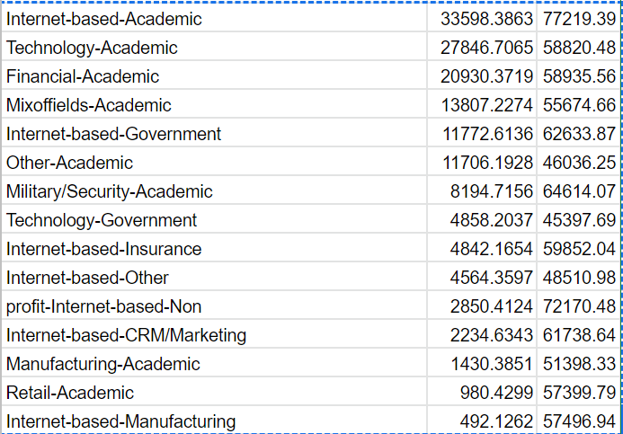
Multiple Comparison Suggests Some Pairs Matter
Of 120 possible pairings, multiple comparisons with Tukey suggests real differences exist between 15 of them, mostly with the “Academic” Industry and everything else.

Slide 10
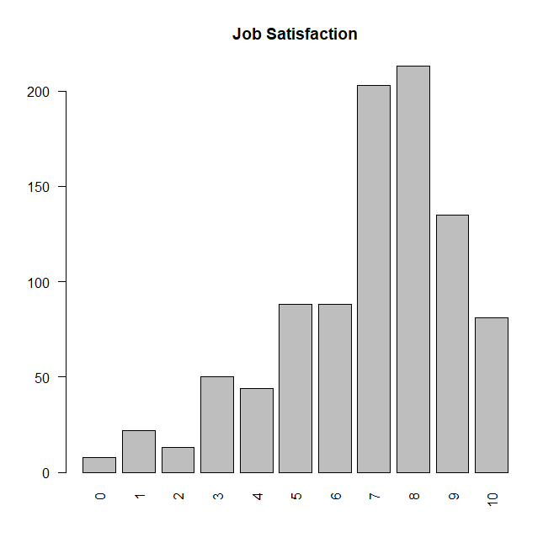
Variable 2: Job Satisfaction
We replace blank values
and “I prefer not to say” with 0.
1 means extremely dissatisfied;
10 means extremely satisfied.
To the right is a bar graph of frequencies.

Slide 11
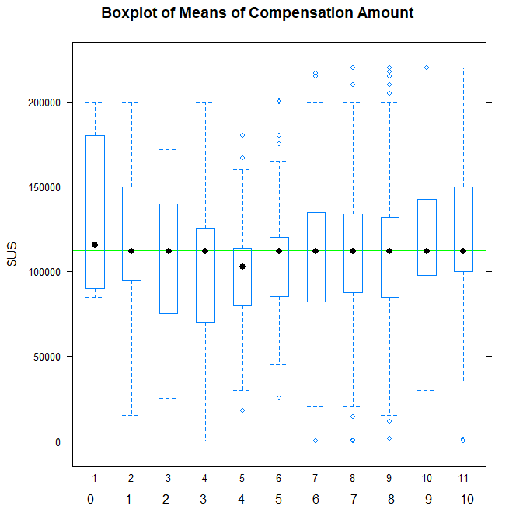
Visual Inspection: Boxplot of Means
There seems, again, to be a striking consistency across the board.

Slide 12
ANOVA suggests that job satisfaction is hardly significant
> satismeans.aov <- aov(CompensationAmount~JobSatisfaction, data=filter3)
> anova(satismeans.aov)
Analysis of Variance Table
Response: CompensationAmount
Df Sum Sq Mean Sq F value Pr(>F)
JobSatisfaction 10 3.5185e+10 3518509054 1.9892 0.03154 *
Residuals 934 1.6521e+12 1768824563
---
Signif. codes: 0 ‘***’ 0.001 ‘**’ 0.01 ‘*’ 0.05 ‘.’ 0.1 ‘ ’ 1

Slide 13
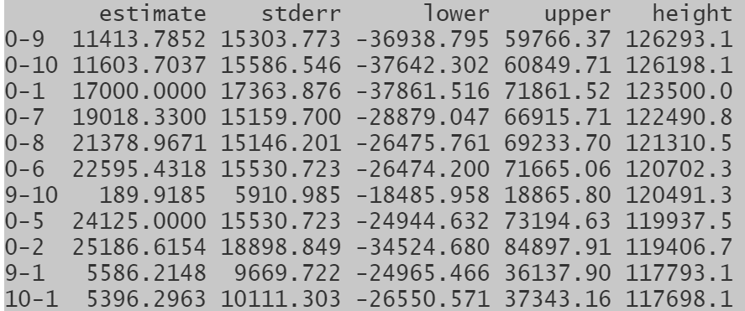
Multiple Comparisons Supports This
Multiple comparisons with Tukey fails to find even a single pairing that suggests a significant difference:

Slide 14
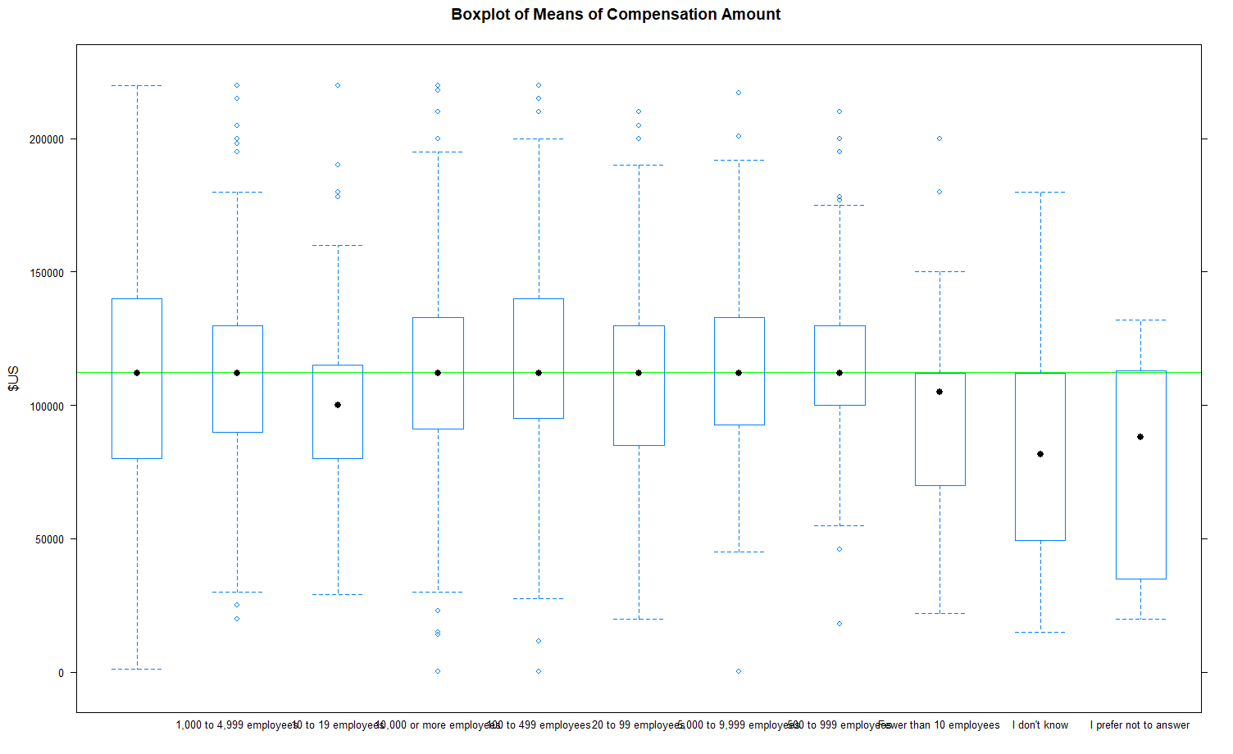
Variable 3: Employer Size
This sees similar across-the-board similarity except perhaps for the very small and “I don’t know”, “I prefer not to answer”:

Slide 15
ANOVA supports that finding
> sizemeans.aov <- aov(CompensationAmount~EmployerSize, data=filter3)
> anova(sizemeans.aov)
Analysis of Variance Table
Response: CompensationAmount
Df Sum Sq Mean Sq F value Pr(>F)
EmployerSize 10 4.7998e+10 4799815740 2.7348 0.002539 **
Residuals 934 1.6393e+12 1755106076
---
Signif. codes: 0 ‘***’ 0.001 ‘**’ 0.01 ‘*’ 0.05 ‘.’ 0.1 ‘ ’ 1

Slide 16
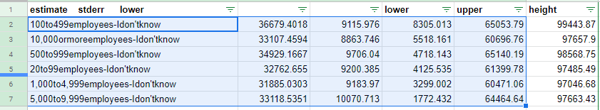
Multiple Comparisons Supports it as well
All pairings with significant differences involve the “I Don’t Know” category.

Slide 17
Conclusion
The primary finding from Industry analysis is that we can’t say industry is relevant to compensation, provided you’re not in academia. So perhaps you can take data science work to any industry in the US--health care, manufacturing, Internet work--free of salary concern.
(Unless there are more confounding causal factors, or everyone tried to do this and the market has a labor supply issue)
Multiple comparisons suggested no link between (self-reported) job satisfaction and compensation, suggesting that perhaps job satisfaction and money isn’t, generally speaking, a necessary trade-off.
The only pronounced link between company size and salary is whether or not the respondent knew, which predicted less compensation. So as far as that goes, perhaps not being clueless about broader corporate factors pays off.

