Slide 1
A Comprehensive Performance Analysis of Stream Processing with Kafka in Cloud Native Deployments for IoT Use-Cases
Chinmay Acharya:-16010122002
Manas Bhambhra:-16010122017
Parth Bhanushali:-16010122019

Slide 2
Introduction
The increasing number of Internet of Things (IoT) devices has led to an explosion of real-time data, requiring efficient and scalable processing frameworks. Traditional monolithic systems often struggle to meet the demands of low-latency analytics and elasticity.
Cloud-native platforms, built on containerized microservices and managed by orchestration tools like Kubernetes, provide the flexibility and resilience needed for modern data processing pipelines.
Apache Kafka, a distributed event streaming platform, along with Kafka Streams, enables real-time data transformation and analytics at scale. Their integration within cloud-native ecosystems makes them suitable for high-throughput, low-latency IoT workloads.
This study presents a performance analysis of Kafka and Kafka Streams deployed in Kubernetes environments, focusing on key metrics such as throughput, latency, CPU, and memory utilization.

Slide 3
Research Objectives
Evaluate the performance of Apache Kafka and Kafka Streams in processing real-time IoT data in cloud-native environments.
Measure key metrics: throughput, latency, CPU usage, and memory utilization under different workloads.
Analyze system behavior under stateless (filtering, anonymization) and stateful (aggregation) stream processing operations.
Assess the impact of TLS encryption and hardware configurations on overall system efficiency.
Implement and test a complete Kafka-based streaming pipeline to simulate real-world IoT scenarios.

Slide 4
IoT & Stream Processing
Role of Real-Time Analytics in IoT:
IoT systems generate continuous streams of data from sensors, devices, and edge nodes.
Real-time analytics enables immediate processing and response, crucial for time-sensitive decisions.
Delays in data processing can lead to system inefficiencies or even failures in critical applications.
Need for Reactive Systems:
Smart Cities: Traffic control, pollution monitoring, and public safety systems rely on real-time responses.
Healthcare: Patient monitoring devices demand low-latency analytics to detect emergencies like heart rate anomalies.

Slide 5
Kafka & Kafka Streams Overview
Apache Kafka:
Distributed, fault-tolerant, high-throughput messaging system.
Organizes data into topics, each divided into partitions and replicated across brokers.
Enables real-time data ingestion and distribution for scalable systems.
Kafka Streams:
Java-based stream processing library integrated with Kafka.
Processes data directly from Kafka topics using processing topologies (source, processor, sink nodes).

Slide 6
Kafka Features for IoT
High Throughput & Low Latency Kafka’s distributed architecture enables it to process millions of events per second with sub-second latency, ideal for real-time IoT scenarios.
Fault Tolerance Kafka replicates data across multiple brokers, ensuring resilience and high availability in case of node failures.
Stream-Table Duality Kafka Streams treats streams as changelogs and enables dynamic table views, allowing flexible real-time processing and enrichment.
Scalable & Distributed Kafka partitions topics across multiple brokers and processors, supporting horizontal scaling as the number of IoT devices grows.
Lightweight Deployment Kafka Streams applications are standard Java applications that can be containerized and deployed easily within cloud-native platforms like Kubernetes.

Slide 7
Cloud-Native Kafka Deployment
Containerization and Orchestration
Kafka and Kafka Streams applications are containerized using Docker.
Kubernetes is used to orchestrate deployments, ensuring scalability, self-healing, and rolling updates.
Strimzi Operator
Automates Kafka cluster provisioning and management in Kubernetes.
Handles broker configuration, topic creation, TLS encryption, and ZooKeeper coordination.
Kafka Streams Deployment
Kafka Streams processors are deployed as independent Java-based microservices.
Configurable thread count for parallel stream processing using partitioned topics.

Slide 8
Measurement Framework
Pipeline Components:
Kafka Producer (Java-based, JSON event publisher)
Kafka Cluster (multi-broker, TLS-enabled)
Kafka Streams Processor (stateless/stateful ops)
Optional Kafka Consumer (for output validation)
Deployment:
All services containerized using Docker
Orchestrated via Kubernetes with Strimzi Operator
Metrics Collected:
CPU & Memory usage (Kafka, Streams)
Processing Latency
Throughput (events/sec)
Monitoring Tools:
Prometheus, Grafana, Netdata
Environment:
ELKH Cloud (VMs and Bare-metal nodes)

Slide 9
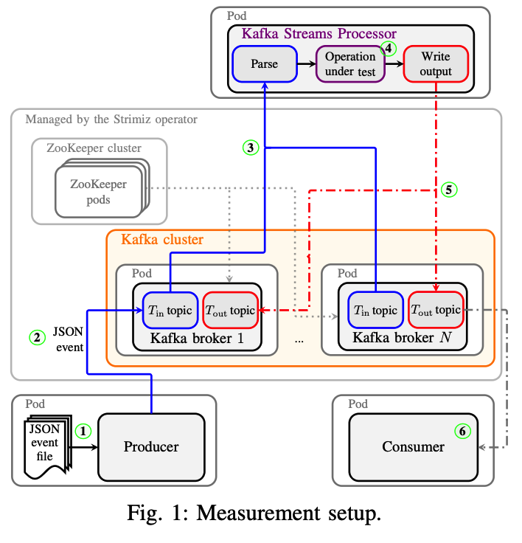
Measurement Framework

Slide 10
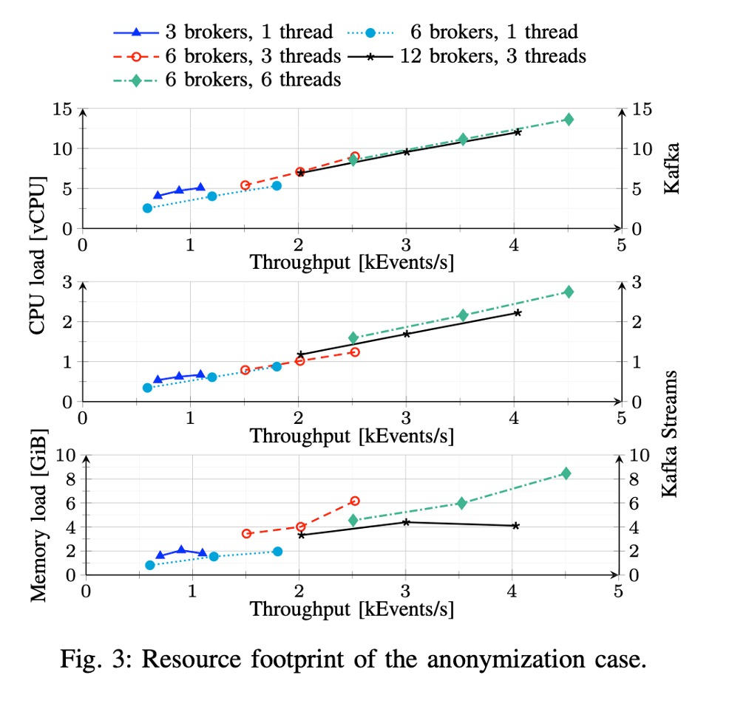
Performance Metrics
Throughput Events per second (EPS) processed successfully.
Latency Time from message production to final output.
CPU Usage Percentage of vCPU utilization per component (Kafka, Streams).
Memory Usage RAM consumed by Kafka brokers and processing nodes.
Scalability System behavior under increased load and thread counts.
Resource Efficiency Impact of stateless vs stateful processing on system resources.
TLS Overhead Additional CPU cost due to encrypted communication.

Slide 11
Stream Processing Scenarios
Scenario A: Filtering (Stateless)
Objective: Evaluate Kafka Streams’ performance during filtering of IoT events based on specific ID criteria.
Implementation:
Used filter() method in Kafka Streams API
Retained a configurable subset: 0.05%, 1%, and 10% of input stream
Output events written to a new Kafka topic
Performance Observations:
Throughput: No major drop between 0.05% and 1%; 10% caused ~5k events/sec reduction
Latency: Remained below 0.4 seconds in all test cases

Slide 12
Stream Processing Scenarios
Scenario B: Anonymization (Stateless)
Objective: Protect sensitive information in IoT event streams by masking selected data fields.
Implementation:
Kafka Streams map() method used to transform records.
Specific fields in JSON messages were anonymized using masked characters (e.g., replacing values with "X").
Less than 1% of total fields per event were modified.
Performance Observations:
Throughput: Capped around 4.5k events/sec due to reserialization overhead.
Latency: Maintained below 0.4 seconds across all configurations.

Slide 13
Stream Processing Scenarios
Scenario C: Aggregation (Stateful)
Overview Stateful processing was evaluated using Kafka Streams' windowed aggregations with a 1-second tumbling window. Three subcases were implemented to simulate common IoT analytics patterns.
Subcases
Basic Block Aggregation: Counted occurrences of 11 unique keys in the event stream. Output: Single key-value pair with 11 fields.
Grouped Block Aggregation: Counted events grouped by specific field values (e.g., event codes). Output: Multiple key-value pairs mapping event codes to counts.
Averaging Block Aggregation: Calculated average duration between start and end timestamps in events. Output: A single float representing the average time difference.
Performance Summary
Throughput: Peaked at ~1,000 events/sec — significantly lower than stateless scenarios.
Latency: Averaged around 0.6 seconds.

Slide 14
Performance Results and Observations
Baseline Performance (Kafka Only)
Objective: Evaluate Kafka's raw data ingestion capabilities without Kafka Streams to establish a baseline.
Setup:
12 Kafka brokers deployed in Kubernetes
Each broker allocated 2 vCPUs and 4GB RAM
TLS enabled, topics with replication factor of 3
Key Observations:
Maximum Throughput: ~32,000 events/sec
Memory Usage: Up to 90% of allocated memory per broker under load
Memory Retention Pattern: Memory usage remained high even after load reduction
Retention Time: No impact observed between 15-min and 1-hour configurations

Slide 15
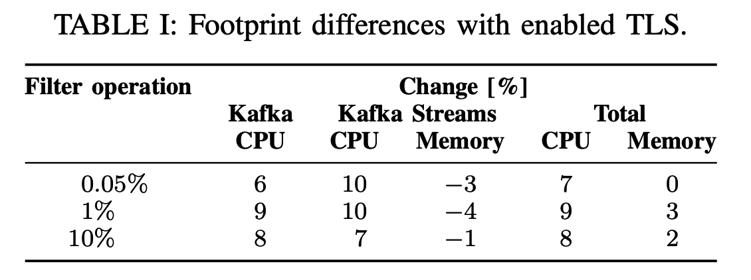
Performance Results and Observations
TLS Encryption Impact
Objective Evaluate the overhead introduced by enabling TLS encryption between the Kafka Producer, Kafka Cluster, and Kafka Streams Processor.
Findings
Throughput:
No observable drop in throughput after enabling TLS.
Data rates remained consistent across encrypted and unencrypted deployments.
Latency:
No significant increase in processing latency. Latency stayed under 0.4 seconds for stateless tasks and under 0.6 seconds for stateful tasks.
CPU Usage Increase:
Kafka- Increased by approximately 6–9%. Kafka Streams- Increased by approximately 7–10%

Slide 16
Deployment Environments
Test Platforms:
ELKH Cloud (OpenStack VMs):
Deployed on virtual machines using Kubernetes.
Configured with multiple brokers, pods, and containerized components.
Bare-Metal Server:
40-core CPU and 188 GB RAM.
Kubernetes deployed directly on hardware for minimal virtualization overhead
Throughput:
Bare-metal outperformed VMs significantly
VM-based Kafka ingestion was limited by inter-VM network performance (only ~30% of peak throughput)

Slide 17
Key Takeaways
Kafka and Kafka Streams provide scalable, low-latency stream processing suited for IoT use-cases in cloud-native environments.
Stateless operations (e.g., filtering, anonymization) achieve higher throughput and lower resource usage compared to stateful tasks.
Stateful operations (e.g., aggregation) consume significantly more memory and CPU, resulting in lower throughput and slightly higher latency.
TLS encryption introduces minimal overhead, increasing CPU usage slightly without affecting throughput or latency.
Deployment environment has a significant impact:
Bare-metal servers outperform cloud VMs due to better network throughput and more predictable resource allocation.
Kubernetes networking on VMs can become a bottleneck.
Monitoring and observability tools (Prometheus, Grafana, Netdata) are essential for tracking system behavior and supporting scaling decisions.

Slide 18
Conclusion
This study demonstrated the effectiveness of Apache Kafka and Kafka Streams for real-time stream processing in cloud-native IoT environments.
Stateless operations (filtering, anonymization) showed high throughput and low latency with efficient CPU and memory usage.
Stateful operations (aggregations) incurred higher resource usage and lower throughput, highlighting the trade-offs in complexity.
TLS encryption had minimal impact on latency but increased CPU usage slightly, proving its feasibility for secure deployments.
The deployment environment significantly influenced performance; bare-metal systems outperformed VM-based clusters, especially in terms of network throughput and resource utilization.
Overall, Kafka and Kafka Streams provide a scalable, resilient, and efficient foundation for IoT data processing in modern cloud-native architectures

Slide 19
Thank You

