Slide 1
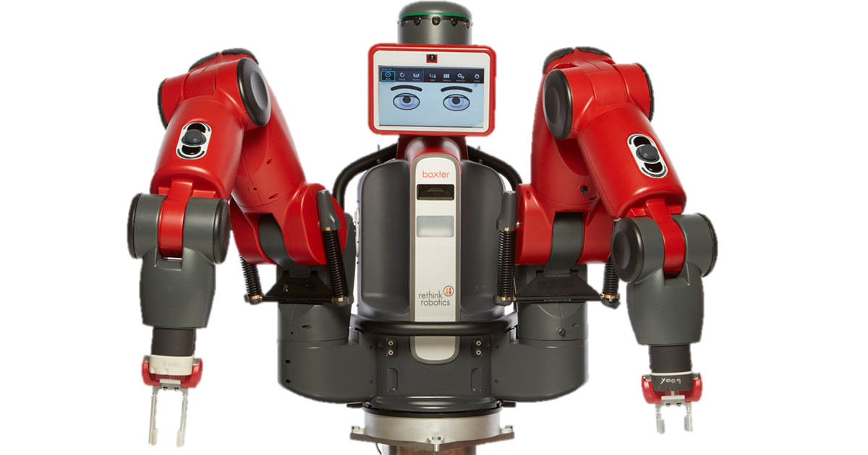
A
B
C
D

Slide 2
A
B
C
D

Slide 3
A
B
C
D

Slide 4
A
B
C
D

Slide 5
A
B
C
D

Slide 6
A
B
C
D

Slide 7
A
B
C
D

Slide 8
A
B
C
D

Slide 9
A
B
C
D

Slide 11
Instruction
Prepare
Execute
Rest
A
B
C
D
(Press Space Key)

