Slide 1
Teacher (generic)
KL
Domain emb (i)
Task emb (i)
Domain emb (i)
Task emb (i)
softmax
cross-domain
Res adapter (i)
LHUC (i)
Res adapter (i)
LHUC (i)
x(N)
Decoder (i)
x(N)
Encoder (i)
softmax
NLL
perplexity
x(K)
LM
bs
domain
reg
Wemb
Wemb
DC

Slide 2
Data augmentation
In-domain data selection:
Moore & Lewis score
LM
Decay feature algorithm.
Tf_idf.
Pseudo data:
Lexical Induction.
Back-translation.
Domain tag.

Slide 3
Training
Curriculum learning
Distributing sentence into shard according to its similarity score to interest domain.
Training with nearest shards first then further shards.
Meta-learning
Multi-objective optimization.

Slide 4
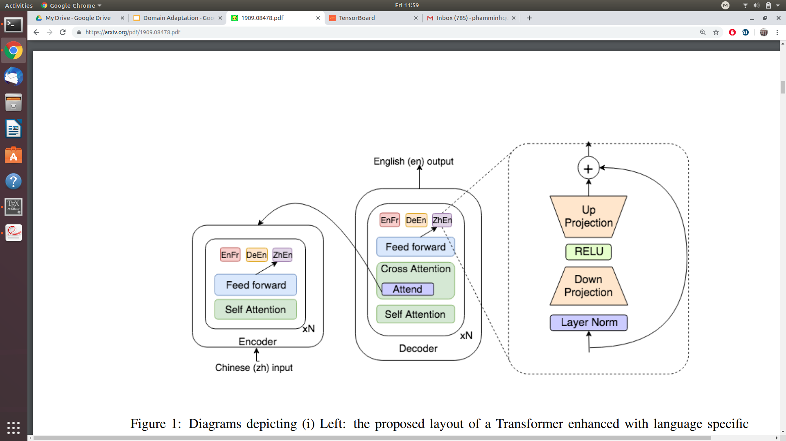
Residual Adapter

Slide 5
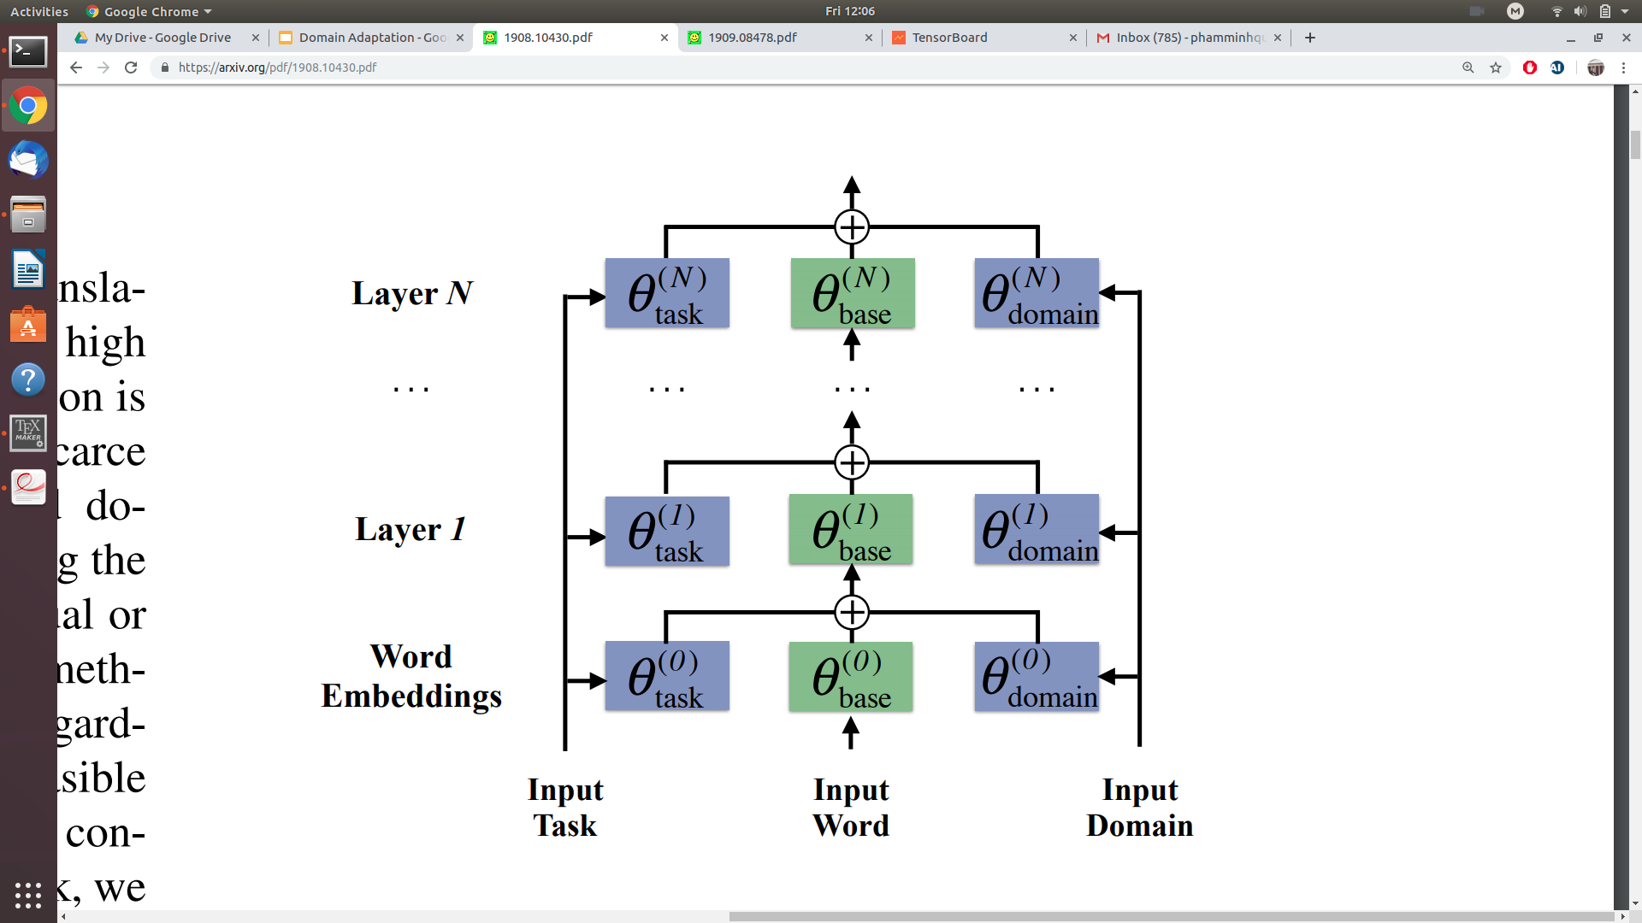
Domain, Task aware embedding

Slide 6
Experiments
English - French:
In domain: IT, Literature, Medical, News, Tourism, Europarl, DGT, UN, common crawl web, TED, Opensubtitle, Gnome, JRC, KDE4, OpenOffice, PHP, Ubuntu.
Out domain: WMT
English - German:
In domain: EMEA, TED, IWSLT, JRC-Acquis(law?), WIPO (World International Property Organization), IT, Koran, Subtitles.
Out domain: OpenSubtitles, WMT.
Chinese-English:
Task: BOLT, NIST
In domain: Webforum, news, Laws, Spoken, Thesis (UM-Corpus), and News (Linguistic Data Consortium), IWSLT
Outdomain: corpus of the task
Arabic-English:
Task: BOLT Phase 1 Dialectal-Arabic-to-English.
In domain: IWSLT TED Arabic-to-English;
Out domain: United Nations, Newswire, Web , Newsgroup, Broadcast, Lexicons, Iraqi, Levantine.
Russian, Korean-English:
In domain: WIPO
Out domain: Opensubtitles
Czech-English:
In domain: TED, law and EMEA
Out domain: WMT

