Slide 1
Design & Construction of the NUWAR Robot
Speaker: Josh Male
Supervisor: Dr Karol Miller

Slide 2
Parallel Robots
have more than one independent serial arm connecting the base and the end-effector
lightweight
high stiffness
high accuracy
good for slow heavy-load tasks or fast light-weight tasks (NUWAR falls into the latter category)

Slide 3
Motivation behind the Project
DELTA robot - 380m/s² and 10m/s (fastest known robot in the world)
Karol found (using a simple wire frame model in ADAMS) that rotating the motors could increase the workspace volume
Aim: to implement the DELTA robot with the ability to alter the motor angles - the NUWAR robot

Slide 4
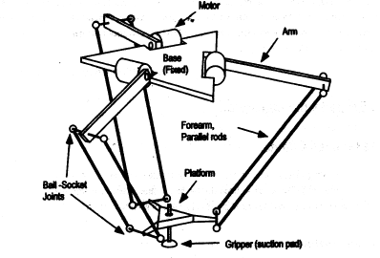
The DELTA Robot (invented by R. Clavel)

Slide 5
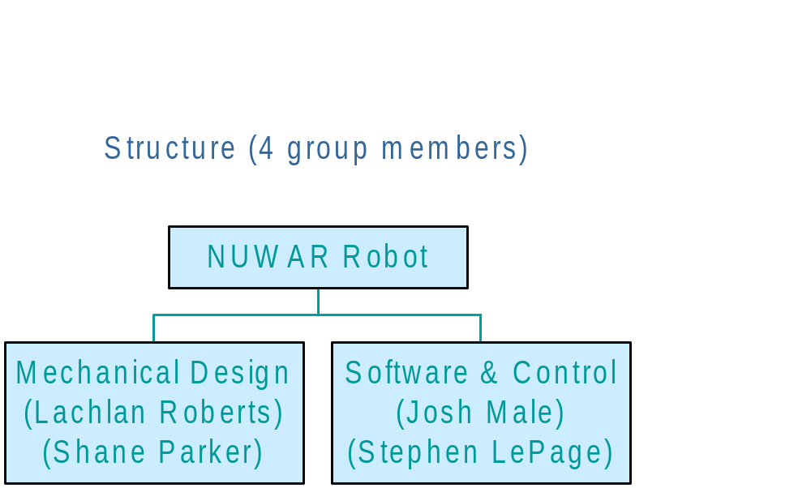
Roles in the Project

Slide 6
Software and Control Issues
Kinematics - Forward and Inverse (Josh Male)
Trajectory Generation (Stephen LePage)
Dynamics (Next Year)
Simulation (J. Male & S. LePage)
Control - personalised (Next Year)
Interfacing - hardware & software (J. Male & S. LePage)

Slide 7
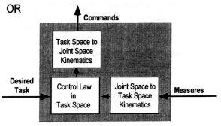
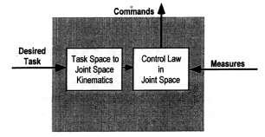
Importance of Kinematics
Relates actuated variables to the position and orientation of the end-effector

Slide 8
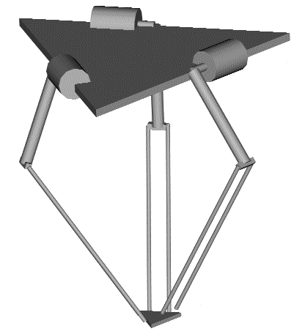
Base
Motors
Control Arms
Free Joints
Forearms
Traveling Plate
Free Joints

Slide 9
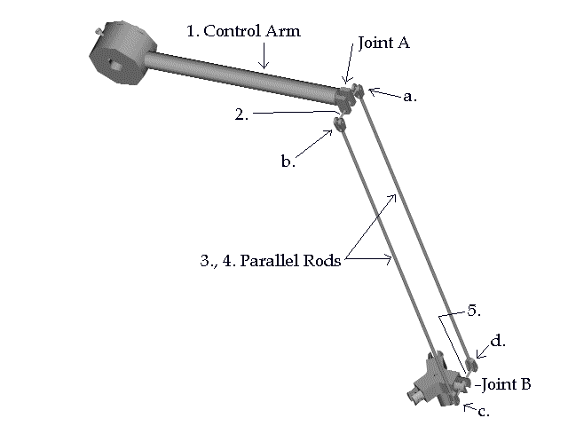
Arm Structure

Slide 10
Motor Pivots - α, β
Motors pivot in the α-direction at their own axes
pivot for β-direction is offset by ‘Rb’
motor axes are offset similarly and stay constant in position (they rotate through α and β)

Slide 11
Approaches to Kinematics
Denavit-Hartenburg parameterisation often used for serial manipulators
this can be extended for tree-robots
an equivalent tree-structure can be defined for a wide class of parallel robots
OR Geometric methods - provide a good physical interpretation of the kinematics.

Slide 12
Solutions for Forward Kinematics
Generic case - the forearm spheres intersect at two common points - two solutions
Singular solution - one sphere is tangential to the circle of intersection of the other two spheres
Infinite solutions - two spheres coincide
No solutions - the sphere to not intersect at a common point

Slide 13
Solutions for Inverse Kinematics - Single Arm
Generic case - two solutions
singular solution - eg. the forearm and the control arm become collinear or orthogonal - boundaries of the workspace
infinite solutions - possible forearm configuration for any control arm position
no solution - arm can’t reach the point.

Slide 14
Conclusions for Kinematics of the NUWAR robot
rotating the motors through α and β did not introduce any major complexities into the kinematic algorithms.
rotating the motors does have a significant effect on the workspace and the angles of the joints - hence limit checking is critical to prevent damage to the machine.

Slide 15
Acknowledgments
Dr Karol Miller
Stephen, Lachie and Shane for their help and assistance

Slide 16
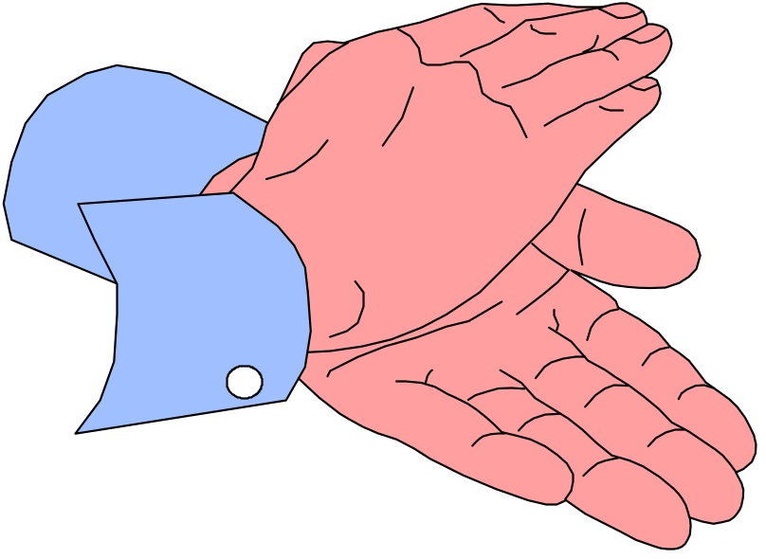
Questions and Comments?

