Slide 1
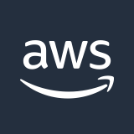
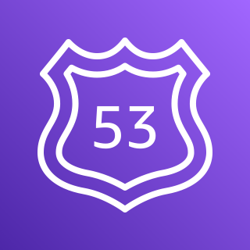

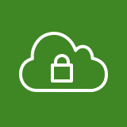





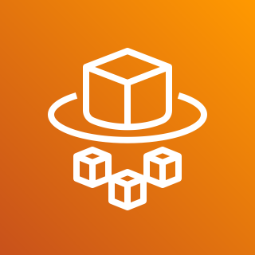
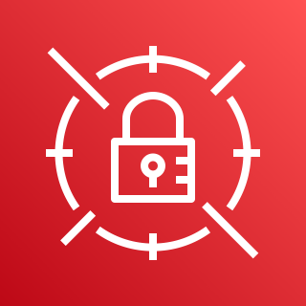
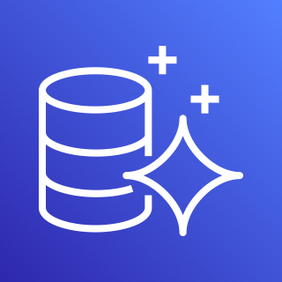
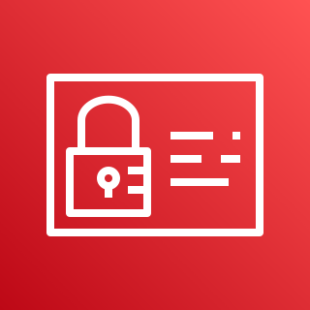
AWS Cloud
VPC
Internet gateway
Availability Zone
Availability Zone
Amazon Route 53
Public subnet
Public subnet
NAT gateway
AWS Certificate Manager (ACM)
Private subnet
Private subnet
Application Load Balancer
AWS Fargate
AWS Fargate
AWS Secrets Manager
Private subnet
Private subnet
Amazon Aurora Serverless (or Amazon RDS Cluster)
Amazon Aurora Serverless (or Amazon RDS Cluster)
AWS Identity and Access Management (IAM)

