Slide 1












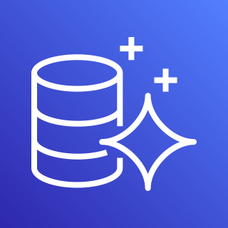
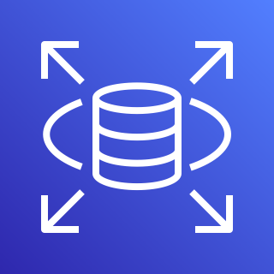
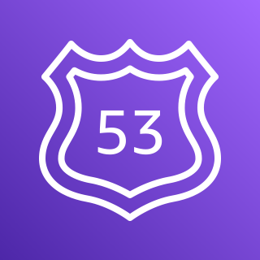
AWS Cloud
Availability Zone
Availability Zone
VPC
Internet gateway
Public subnet
Public subnet
IAM
NAT gateway
NAT gateway
Private subnet
Private subnet
Application Load Balancer
AWS Secrets Manager
Amazon ECS
AWS Fargate
Amazon ECS
AWS Fargate
Private subnet
Private subnet
ACM
Amazon Aurora
Amazon RDS
Amazon Aurora
Amazon RDS
Route 53

