Slide 1
Cloud Computing
Assignment 2
Container Practice
2017/04/14

Slide 2
Outline
OS-level Virtualization
Namespaces
Runc: A lightweight universal container runtime
Assignment Requirements

Slide 3
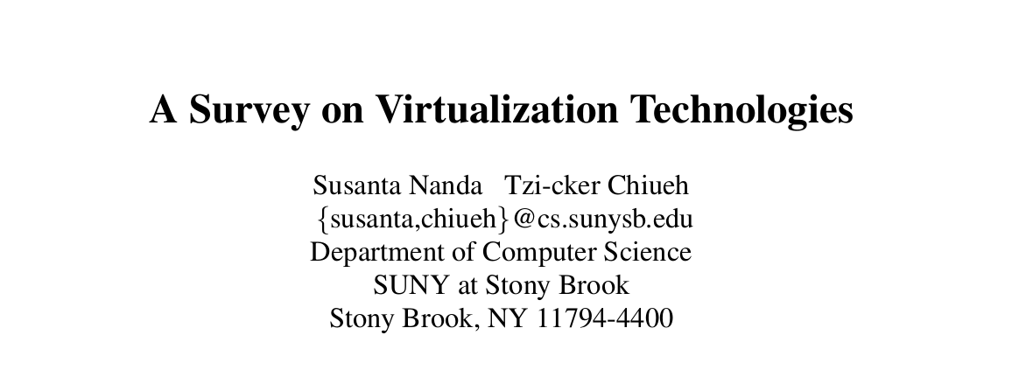

Slide 4
Quote 1
Virtuality differs from reality only in the formal world, while possessing a similar essence or effect. In the computer world, a virtual environment is perceived the same as that of a real environment by application programs and the rest of the world, though the underlying mechanisms are formally different.

Slide 5
Quote 2
Virtualization is a technology that combines or divides computing resources to present one or many operating environments using methodologies like hardware and software partitioning or aggregation, partial or complete machine simulation, emulation, time-sharing, and many others.

Slide 6
Virtualization
(the one you know)
VM 0
VM1
VM2
VMM
Hardware

Slide 7
Virtualization?
(the one you familiar with)
Process 0
Process 1
Process 2
OS
Hardware

Slide 8
OS-level Virtualization
(Containerization)
Container 0
Container 1
Container 2
container runtime
OS

Slide 9
OS-level Virtualization
In Unix: chroot
In *BSD: jails
  why do you“JB”your iphone?
In Linux: container
  Namespaces
  Cgroups
  Layered File System (optional)

Slide 10
Namespaces
UTS: Unix Time-sharing System
PID: Process Identifier
MNT: Mount
NET: Networking
IPC: Inter-Process Communication
USER
CGROUP

Slide 11
RunC: The Tutorial
https://katacoda.com/lalyos/scenarios/runc
We will provide you
  the rootfs directory (in step 2), and
  the config.json (in step 3)
for this assignment

Slide 12
NET
https://forums.docker.com/t/docker-and-iptables-configuration-startup/904
http://blog.scottlowe.org/2013/09/04/introducing-linux-network-namespaces/

Slide 13
Objective: Bridging Two Containers
Container A and B
A simple client runs on container A, in which user can types arbitary messages
An echo server runs on container B
A bridge program
Three programs in this assignment

Slide 14
The Bridge Program
Shares the X namespace with container A, and
Shares the Y namespace with container B
X and Y are different ones of the three namespaces: NET, MNT, IPC
  network interfaces of different subdomain
  different root directory
You may choose any of the combinations of X,Y

Slide 15
Environment
You may use the VM you created in the assignment 1, or
You may setup a Linux VM on your own machine, and setup runc on it
For Ubuntu users, apt-get install runc should work

Slide 16
Scoring
Connection between the programs (60%)
  X namespace connection (20%)
  Y namespace connection (20%)
  The echo service work (20%)
Report (40%)
Deadline: 5/19 (flexible)

Slide 17
Appendix -- network connection
Socket
Bind
Listen
Connect
Accept
Send, Recv

Slide 18
Appendix -- IPC (msg only) connection
Msgget
Msgsnd
Msgrcv
Msgctl

Slide 19
Appendix -- file system monitoring
inotify_init
inotify_add_watch

Slide 20
Appendix -- Client
Select or poll

