Slide 1
Compiler Principles
Sichuan University
luoyining@scu.edu.cn

Slide 2
第四章 语法分析—自上而下分析

Slide 3
Contents
►
4.1 语法分析器的功能
4.2 自上而下分析面临的问题
4.3 LL(1)分析法
4.4 递归下降分析程序构造
4.5 预测分析程序

Slide 4
语法分析的任务是分析一个文法的句子结构。
语法分析器的功能：按照文法的产生式(语言的语法规则)，识别输入符号串是否为一个句子(合式程序)。

Slide 5
Token
语法
分析树
源程序
词法
分析器
语法
分析器
编译程序
后续部分
符号表

Slide 6
main( )
main( int argc, char * argv[] )
{
…
source = fopen(pgm,"r");
…
listing = stdout; /* send listing to screen */
…
#if NO_PARSE
while (getToken()!=ENDFILE);
#else
syntaxTree = parse();
…
}

Slide 7
语法分析方法
自上而下/自顶向下分析法(Top-down)
从文法的开始符号出发，根据文法规则正向推导出给定句子的分析方法；
从根节点开始，往下构造分析树，直到创建每个叶节点的分析方法。
自下而上/自底向上分析法(Bottom-up)
从给定的输入串开始，根据文法规则逐步进行归约，直至归约到文法开始符号的分析方法；
从分析树的叶节点开始，步步向上归约，直至创建根结点的分析方法。

Slide 8
Contents
4.1 语法分析器的功能
4.2 自上而下分析面临的问题
4.3 LL(1)分析法
4.4 递归下降分析程序构造
4.5 预测分析程序
►

Slide 9
两种自上而下分析方法
带回溯（Backtracking）的方法
不带回溯的方法（预测分析）

Slide 10
带回溯的方法
这种分析过程本质上是一种穷举试探过程，是反复使用不同产生式谋求匹配输入串的过程。
试探发生回溯。
非确定的自顶向下分析法
S → aAb
A → de | d
adb
S
a
A
b
d
d
e

Slide 11
存在的问题
1. 回溯问题
分析过程中，当某个非终结符有多个产生式候选时，如果用某一个候选匹配成功，这种匹配可能是暂时的。出错时，不得不“回溯”。
2. 文法左递归问题
一个文法是含有左递归的，如果存在非终结符P
P ⇒⁺ Pα
含有左递归的文法将使自上而下分析陷入无限循环。

Slide 12
不带回溯的方法
attempts to predict the next construction in the input string using one or more look-ahead tokens.
确定的自顶向下分析法
Backtracking parsers are more powerful than predictive parsers but much slower, unsuitable for practical compilers.

Slide 13
Contents
4.1 语法分析器的功能
4.2 自上而下分析面临的问题
4.3 LL(1)分析法
4.4 递归下降分析程序构造
4.5 预测分析程序
►

Slide 14
4.4.1 递归下降分析的基本方法
4.4.2 消除左递归和消除回溯

Slide 15
exp → exp addop term | term
addop → + | -
term → term mulop factor | factor
mulop → *
factor → (exp) | number

Slide 16
Basic Method
The idea of Recursive-Descent Parsing
Viewing the grammar rule for a non-terminal A as a definition for a procedure to recognize an A.
The right-hand side of the grammar for A specifies the structure of the code for this procedure.
The sequence of terminals and nonterminals in a choice correspond to matches of input and calls to other procedures,
while choices correspond to alternatives (case or if statements) within the code.

Slide 17
Basic Method
Example A recursive-descent procedure that
recognizes a factor
factor → (exp) | number
procedure factor
begin
case token of
( :
match( ( );
exp;
match( ));
number :
match(number);
else error;
end case;
end factor ;
The token keeps the current next token in the input (one symbol of look-ahead).
The match procedure matches the current next token with its parameters, advances the input if it succeeds, and declares error if it does not.
procedure match(expectedToken);
begin
if token = expectedToken then
getToken;
else
error;
end if;
end match;

Slide 18
递归下降分析
遇到非终结符就调用，遇到终结符就匹配。
对应某个非终结符的典型过程的伪代码如下：
void A()
{
选择一个A产生式 A→X₁X₂…X_{k} ;
for ( i=1 to k)
{
if ( X_{i}是一个非终结符 )
调用过程X_{i}();
else if ( X_{i}是一个终结符 )
match();
else error;
}
}
通用的递归下降分析方法可能需要回溯。
— Alfred V. Aho, 《Compilers: Principles, Techniques, and Tools》

Slide 19
exp → exp addop term | term
addop → + | -
term → term mulop factor | factor
mulop → *
factor → (exp) | number
Left recursion
An immediate infinite recursive loop
Choice
Both exp and term (or term and factor) can begin with the same tokens (a number or left parenthesis).
确定的自顶向下分析法对语言的文法有一定的限制条件，那就是要求描述语言的文法是无左递归的和无回溯的。

Slide 20
构造确定的自上而下分析算法
消除左递归
消除回溯

Slide 21
4.4.1 递归下降分析的基本方法
4.4.2 消除左递归和消除回溯

Slide 22
Using EBNF
Extended Backus–Naur form，扩展的巴科斯范式
BNF notation is extended to include special notations for repetitive and optional constructs.

Slide 23
Repetition
Repetition is expressed by recursion in grammar rules.
A → A α | β (left recursive)
EBNF opts to use curly brackets {. . .} to express repetition
A → β {α}

Slide 24
Repetition
BNF
exp → exp addop term | term
EBNF
exp → term {addop term}
addop → + | -
procedure exp;
begin
term;
while token = + or token = - do
match(token);
term;
end while;
end exp;

Slide 25
Repetition
BNF
term → term mulop factor | factor
EBNF
term → factor {mulop factor}
mulop → *
procedure term;
begin
factor;
while token = * do
match(token);
factor;
end while;
end term;

Slide 26
Choice
Optional construct in EBNF are indicated by surrounding them with square brackets [...].
The grammar rule
if-stmt → if (exp) statement
| if (exp) statement else statement
would be written as follows in EBNF:
if-stmt → if (exp) statement [ else statement ]

Slide 27
Choice
if-stmt → if (exp) statement [else statement ]
procedure ifstmt;
begin
match( if );
match( ( );
exp;
match( ) );
statement;
if token = else then
match (else);
statement;
end if;
end ifstmt;
It is natural to write a parser that matches each else token as soon as it is encountered in the input.
This corresponds precisely to the most closely nested disambiguating rule.
（最近嵌套原则）

Slide 28
Using EBNF
In fact, EBNF notation is designed to mirror closely the actual code of a recursive-descent parser,
EBNF表示法是为更紧密地映射递归下降分析程序的真实代码而设计的。
so a grammar should always be translated into EBNF if recursive-descent is to be used.

Slide 29
Examples
exp → exp addop term | term
addop → + | -
term → term mulop factor | factor
mulop → *
factor → (exp) | number
exp → term { addop term }
addop → + | -
term → factor { mulop factor }
mulop → *
factor → (exp) | number

Slide 30
Syntax Diagrams（语法图）
Graphical representations for visually representing EBNF rules are called syntax diagrams.

Slide 31
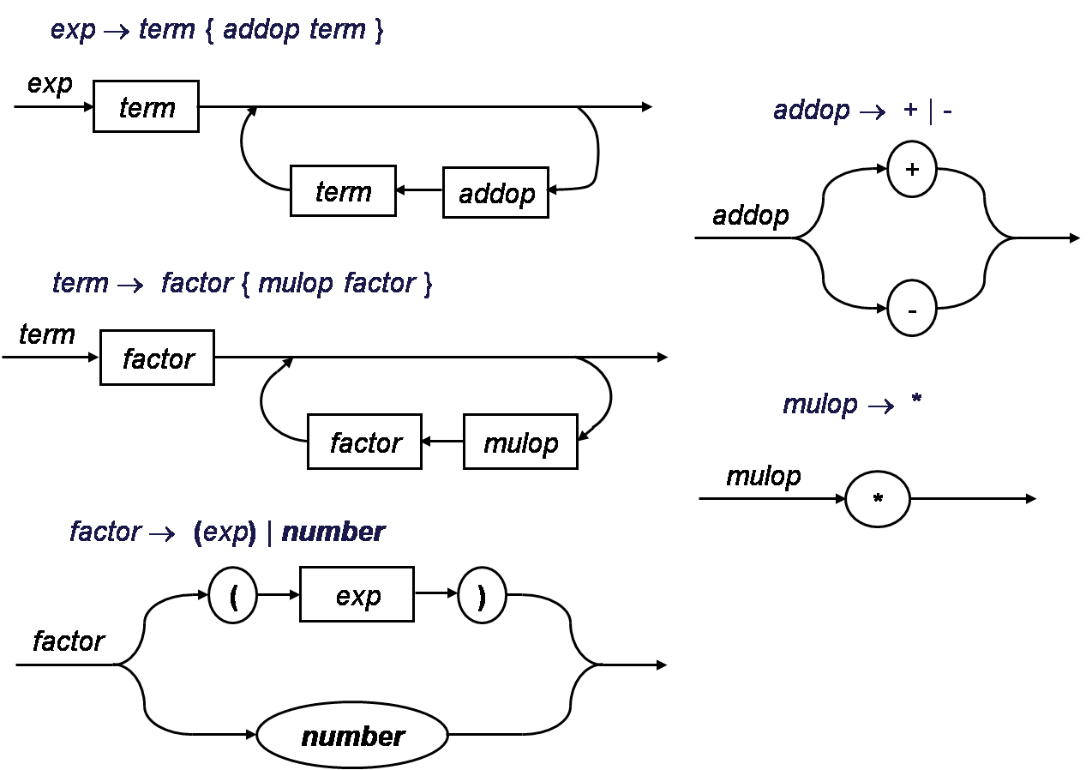
Examples

Slide 32
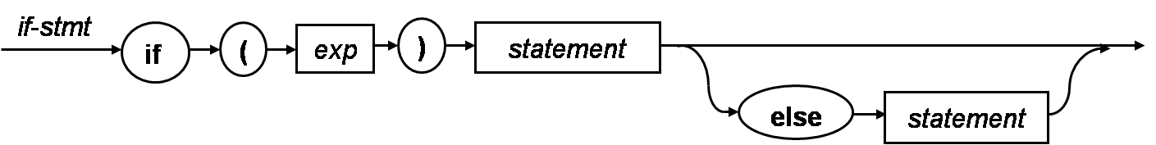
Examples
if-stmt → if (exp) statement [ else statement ]

Slide 33
Examples
E → T{+T}
T → F{*F}
F → i | (E)

Slide 34
A working simple calculator
Suppose to write a recursive-descent calculator for the simple integer arithmetic of the grammar.
Assume that the parsing procedures are functions that return an integer result.
exp → term { addop term }
addop → + | -
term → factor { mulop factor }
mulop → *
factor → (exp) | number

Slide 35
A working simple calculator
exp → term { addop term }
function exp: integer;
var temp: integer;
begin
temp:=term;
while token=+ or token = - do
case token of
+ : match(+);
temp:=temp+term;
- : match(-);
temp:=temp-term;
end case;
end while;
return temp;
end exp;
procedure exp;
begin
term;
while token = + or token = - do
match(token);
term;
end while;
end exp;
The code ensure that the operations are left associative by performing the operations as we cycle through the loop.

Slide 36
A working simple calculator in C code(1)
/* Simple integer arithmetic calculator according to the EBNF:
<exp> → <term> { <addop> <term> }
<addop> → + | -
<term> → <factor> { <mulop> <factor> }
<mulop> → *
<factor> → ( <exp> ) | Number
Inputs a line of text from stdin.
Outputs “error” or the result.
*/

Slide 37
A working simple calculator in C code(2)
#include <stdio.h>
#include <stdlib.h>
char token; /* global token variable */
/*function prototype for recursive calls*/
int exp(void);
int term(void);
int factor(void);
void error(void)
{
fprintf(stderr, “error\n”);
exit(1);
}

Slide 38
A working simple calculator in C code(3)
void match(char expectedToken)
{
if (token==expectedToken) token=getchar();
else error();
}
main()
{
int result;
token=getchar(); /*load token with first character for lookahead*/
result=exp();
if (token==’\n’) /*check for end of line*/
printf(“Result = %d\n”, result);
else error(); /*extraneous chars on line*/
return 0;
}

Slide 39
A working simple calculator in C code(4)
int exp(void)
{
int temp=term();
while ( (token==‘+’) || (token==‘-’) )
switch (token)
{
case ‘+’: match (‘+’);
temp+=term();
break;
case ‘-’: match (‘-’);
temp-=term();
break;
}
return temp;
}
<exp> → <term> { <addop> <term> }

Slide 40
A working simple calculator in C code(5)
int term(void)
{
int temp=factor();
while (token==‘*’)
{
match(‘*’);
temp*=factor();
}
return temp;
}
int factor(void)
{
int temp;
if (token==‘(’)
{
match (‘(’);
temp = exp();
match(‘)’);
}
else
if (isdigit(token))
{
ungetc(token,stdin);
scanf(“%d”,&temp);
token = getchar();
}
else error();
return temp;
}
<term> → <factor> { <mulop> <factor> }
<factor> → ( <exp> ) | Number

Slide 41
A working simple calculator
We have used above ideas to create a working simple calculator.
Instead of writing a full scanner, we have opted to use calls to getchar and scanf in place of a getToken procedure.

Slide 42
Right Associativity
exp → term addop exp | term
exp → { term addop } term
exp → term [ addop exp ]

Slide 43
Abstract Syntax Trees

Slide 44
Why Abstract Syntax Tree
The parse tree contains more information than is absolutely necessary for a compiler.

Slide 45
Expression
exp
exp → exp addop term | term
addop → + | -
term → term mulop factor | factor
mulop → *
factor → (exp) | number
exp
addop
term
exp
addop
term
─
factor
3+4*5-6
term
+
term
mulop
factor
number
6
factor
factor
number
5
*
number
3
number
4

Slide 46
Expression
E
E → E+T | E-T | T
T → T*F | T/F | F
F → (E) | i
T
T
*
F
i*(i+i)
F
(
E
)
i
E
+
T
T
F
F
i
i

Slide 47
抽象语法树
在语法树中去掉那些对翻译不必要的信息，从而获得更有效的源程序中间表示。经过这种变换后的语法树称为抽象语法树(Abstract Syntax Tree)。

Slide 48
Data Type Declaration
typedef enum {OpK,ConstK} ExpKind;
typedef enum {Plus,Minus,Times} OpKind;
typedef struct streenode
{
ExpKind kind;
OpKind op;
int val;
struct streenode *lchild,*rchild;
} STreeNode;
STreeNode *SyntaxTree;
exp → exp addop term | term
addop → + | -
term → term mulop factor | factor
mulop → *
factor → (exp) | number

Slide 49
Code
exp → term { addop term }
procedure exp;
begin
term;
while token = + or token = - do
match(token);
term;
end while;
end exp;
function exp: integer;
var temp: integer;
begin
temp:=term;
while token=+ or token = - do
case token of
+ : match(+);
temp:=temp+term;
- : match(-);
temp:=temp-term;
end case;
end while;
return temp;
end exp;

Slide 50
Code
function exp : syntaxTree;
var temp, newtemp: syntaxTree;
begin
temp:=term;
while token=+ or token=- do
newtemp:=makeOpNode(token);
match(token);
leftChild(newtemp):=temp;
rightChild(newtemp):=term;
temp=newtemp;
end while;
return temp;
end exp;

Slide 51
if-statements
The grammar for simplified if-statements
statement → if-stmt | other
if-stmt → if ( exp ) statement
| if ( exp ) statement else statement
exp → 0 | 1
The string if (0) other else other
statement
if-stmt
if
(
exp
)
statement
else
statement
0
other
other

Slide 52
if-statements
Using the grammar
statement → if-stmt | other
if-stmt → if ( exp ) statement else-part
else-part → else statement | ε
exp → 0 | 1
The same string if (0) other else other
statement
if-stmt
if
(
exp
)
statement
else-part
0
other
else
statement
other

Slide 53
if-statements
The grammar in the TINY
if-stmt→ if exp then stmt-sequence end
| if exp then stmt-sequence else stmt-sequence end

Slide 54
if-statements
An appropriate abstract syntax tree for if-statements would consist of three subordinate structures of the if-statement:
the test expression,
the then-part,
and the else-part (if present).
A abstract syntax tree for the string
if (0) other else other
if
0
other
other

Slide 55
Data Type Declaration
A set of C declarations would be:
typedef enum {ExpK, StmtK} NodeKind;
typedef enum {Zero, One} ExpKind;
typedef enum {IfK, OtherK} StmtKind;
typedef struct streenode
{
NodeKind kind;
ExpKind ekind;
StmtKind skind;
struct streenode *test,*thenpart,*elsepart;
} STreeNode;
STreeNode *SyntaxTree;

Slide 56
Code
function ifstatement: syntaxTree;
var temp:syntaxTree;
begin
match( if );
temp:= makeStmtNode(if);
match( ( );
testChild(temp):=exp;
match( ) );
thenChild(temp):=statement;
if token=else then
match(else);
elseChild(temp):=statement;
else
elseChild(temp):=nil;
end if;
end ifstatement;

Slide 57
A sequence of statements
The grammar of a sequence of statements separated by semicolons :
stmt-sequence → stmt ; stmt-sequence | stmt
stmt → s
The string s; s; s
stmt-sequence
;
stmt
;
stmt-sequence
s
;
s
stmt
;
stmt-sequence
s
s
s
stmt
s

Slide 58
Problem
The problem with this is that a seq node may have an arbitrary number of children, and this is difficult to provide for in a data type declaration.
seq
s
s
s

Slide 59
Solution
The solution is to use the standard leftmost-child right-sibling representation for a tree (presented in most data structures texts) to deal with arbitrary number of children.
The complication is that the links here are sibling links that must be distinguished from child links, and that require a new field in the syntax tree declaration.
s
s
s

Slide 60
Data Type Declaration
#define MAXCHILDREN 3
typedef struct treeNode
{
struct treeNode * child[MAXCHILDREN];
struct treeNode * sibling;
…
} TreeNode;

Slide 61
Syntax Tree Structure for the TINY Compiler

Slide 62
Structures in TINY
statements
if-statements
repeat-statements
assign-statements
read-statements
write-statements
expressions
operator-expressions
constant-expressions
identifier-expressions
A tree node will have a maximum of three child structures.
Statements will be sequenced via a sibling field instead of using a child field.

Slide 63
C Declarations for Syntax Tree Nodes
typedef enum {StmtK,ExpK} NodeKind;
typedef enum {IfK,RepeatK,AssignK,ReadK,WriteK} StmtKind;
typedef enum {OpK,ConstK,IdK} ExpKind;
#define MAXCHILDREN 3
typedef struct treeNode
{
struct treeNode * child[MAXCHILDREN];
struct treeNode * sibling;
int lineno;
NodeKind nodekind;
union { StmtKind stmt; ExpKind exp;} kind;
union { TokenType op;
int val;
char * name; } attr;
ExpType type; /* for type checking of exps */
} TreeNode;

Slide 64
Visual Description for Syntax Tree Structure
sequence of statements
…
Rectangular boxes indicate statement nodes.
Round or oval boxes indicate expression nodes.
Sibling pointers are drawn to the right of node boxes.
Child pointers are drawn below the boxes.
Triangles indicate additional, unspecified tree structures.
Dashed lines indicate structures that may or may not appear.

Slide 65
Visual Description for Syntax Tree Structure
if-statement
repeat-statement
if
test
then-part
else-part
repeat
body
test

Slide 66
Visual Description for Syntax Tree Structure
assign-statement, read and write statement
expressions
assign
(<name>)
read
(<name>)
write
expression
expression
const
(<value>)
ID
(<name>)
op
(<opkind>)
left operand
right operand

Slide 67
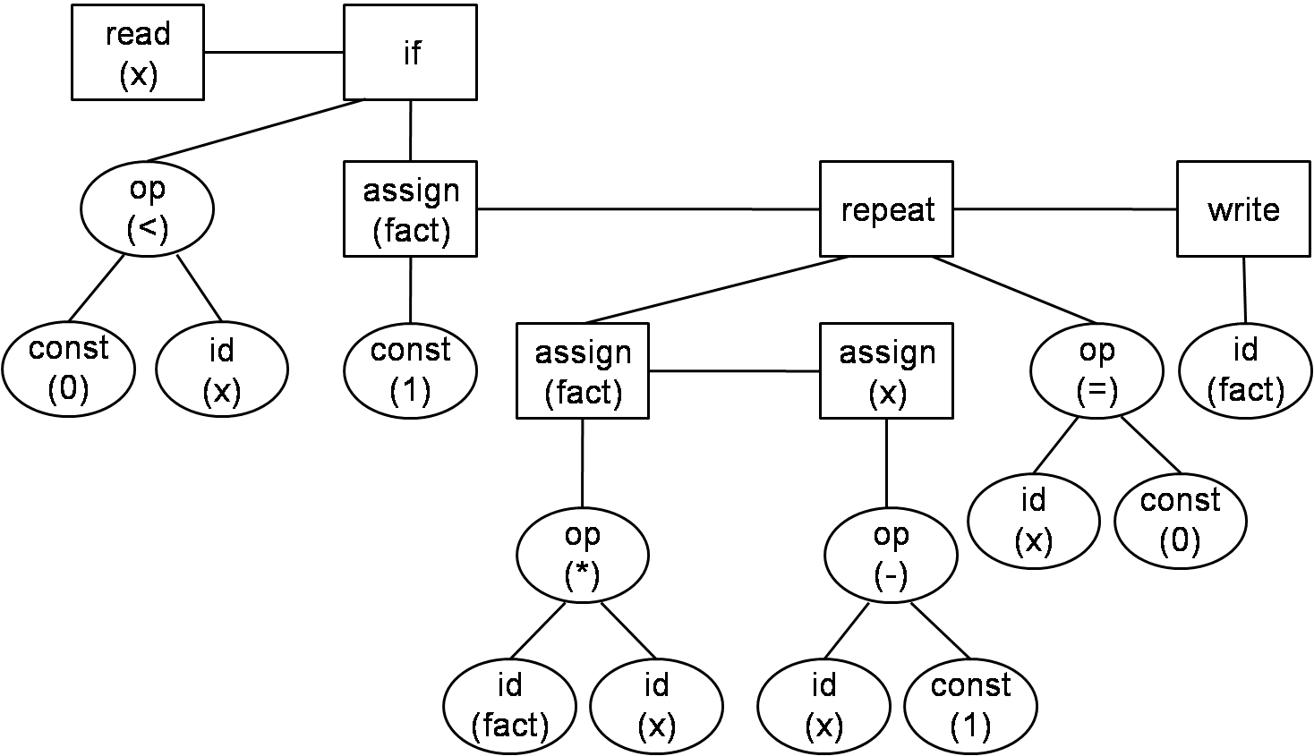
Syntax Tree for the Sample Program

Slide 68
A Recursive-Descent Parser for the TINY Language

Slide 69
Grammar of the TINY language in BNF
program → stmt-sequence
stmt-sequence → stmt-sequence; statement | statement
statement → if-stmt | repeat-stmt | assign-stmt | read-stmt | write-stmt
if-stmt→ if exp then stmt-sequence end
| if exp then stmt-sequence else stmt-sequence end
repeat-stmt → repeat stmt-sequence until exp
assign-stmt → identifier := exp
read-stmt → read identifier
write-stmt → write exp
exp → simple-exp comparison-op simple-exp | simple-exp
comparison-op → < | =
simple-exp → simple-exp addop term | term
addop → + | -
term → term mulop factor | factor
mulop → * | /
factor → (exp) |number |identifier

Slide 70
TINY PARSER CODES
The TINY parser consists of two code files:
parse.h and parse.c
The parse.h
consists of a single declaration
TreeNode * parse(void) ;
defining the main routine parse that returns a pointer to the syntax tree constructed by the parser.
The parse.c
consists of 11 mutually recursive procedure that correspond directly to the EBNF grammar.
The operators non-terminals are recognized as part of their associated expressions.

Slide 71
TINY PARSER CODES
The recursive parsing procedures make use of three utility procedures, which are gathered for simplicity into the file util.c, with interface util.h.
newStmtNode
take the type of statement as parameter;
allocate a new statement node of this kind;
return a pointer to the newly allocated node.
newExpNode
take the type of exp ad parameter;
allocate a new exp node of this kind;
return a pointer to the new allocated node.
Copystring
take a string as parameter;
allocate a sufficient space for a copy, and copy the string;
return a pointer to the newly allocated copy.

Slide 72
TINY PARSER CODES
A procedure PrintTree in util.c writes a linear version of the syntax tree to the listing, so that we may view the result of a parse.

Slide 73
Syntax Tree for the Sample Program
Read: x
If
Op: <
const: 0
Id: x
Assign to: fact
const: 1
Repeat
Assign to: fact
Op: * Id: fact Id: x
Assign to: x
Op: -
Id: x
const: 1
Op: =
Id: x
const: 0
Write
Id: fact

Slide 74
Syntax of C-

Slide 75
1. program → declaration-list
2. declaration-list → declaration-list declaration | declaration
3. declaration → var-declaration | fun-declaration
4. var-declaration → type-specifier ID ; | type-specifier ID [NUM];
5. type-specifier → int | void
6. fun-declaration → type-specifier ID (params) compound-stmt
7. params → param-list | void
8. param-list→ param-list , param | param
9. param → type-specifier ID | type-specifier ID [ ]
10. compound-stmt → { local-declarations statement-list }
11. local-declarations → local-declarations var-declaration | empty
12. statement-list → statement-list statement | empty
13. statement → expression-stmt | compound-stmt| selection-stmt
| iteration-stmt | return-stmt
14. expression-stmt → expression ; | ;

Slide 76
15. selection-stmt → if ( expression ) statement
| if ( expression ) statement else statement
16. iteration-stmt → while ( expression ) statement
17. return-stmt → return ; | return expression ;
18. expression → var = expression | simple-expression
19. var → ID | ID [ expression ]
20. simple-expression → additive-expression relop additive- expression | additive-expression
21. relop → <= | < | > | >= | == | !=
22. additive-expression → additive-expression addop term | term
23. addop → + | -
24. term → term mulop factor | factor
25. mulop → * | /
26. factor → ( expression ) | var | call | NUM
27. call → ID ( args )
28. args → arg-list | empty
29. arg-list → arg-list , expression | expression

Slide 77
Contents
4.1 语法分析器的功能
4.2 自上而下分析面临的问题
4.3 LL(1)分析法
4.4 递归下降分析程序构造
4.5 预测分析程序
►

Slide 78
4.3.1 左递归的消除
4.3.2 消除回溯，提取左因子
4.3.3 LL(1)分析条件

Slide 79
消除直接左递归
A → Aα | β
其中β不以A开头。
The grammar will generate the strings of the form βα^{n}.
把该文法等价地改写为如下的非直接左递归形式
A → βA’
A’ → αA’| ε
to generate β first
to generate the repetitions of α, using right recursion

Slide 80
Example
文法
E→E＋T | T
T→T * F | F
F→(E) | i
消除直接左递归：
E → TE′
E′ → +TE′ | ε
T → FT′
T′ → *FT′ | ε
F → (E) | i

Slide 81
消除直接左递归
一般而言，假定A的全部产生式是
A → Aα₁ | Aα₂ | … | Aα_{n} | β₁ | β₂ | … | β_{m}
其中，每个α都不等于ε，每个β都不以A开头
消除A的直接左递归就是把这些规则改写成：
A → β₁A’ | β₂A’ | … | β_{m}A’
A’ → α₁A’ | α₂A’ | … | α_{n}A’ | ε
Example
E → E＋T | E - T | T
消除直接左递归：
E → TE′
E′ → +TE′ | -TE′ | ε
左递归变右递归

Slide 82
间接左递归
文法G(S)
S→Qc|c
Q→Rb|b
R→Sa|a
该文法中虽然没有直接左递归，但S、Q、R都是左递归的。
S⇒Qc⇒Rbc⇒Sabc

Slide 83
消除左递归的算法
前提条件
文法不含回路（形如 P ⇒⁺ P的推导）且无ε产生式
算法
1. 把文法的所有非终结符按任一种顺序排列成P₁，P₂，…，P_{n}；
2. FOR i:=1 TO n DO
FOR j:=1 TO i-1 DO
把形如P_{i}→P_{j}γ的规则改写成
P_{i}→δ₁γ|δ₂γ|…|δ_{k}γ ; (其中P_{j}→δ₁|δ₂|…|δ_{k}是关于P_{j}的所有规则)
消除关于P_{i}规则的直接左递归性
3. 化简由2所得的文法。即去除那些从开始符号出发永远无法到达的非终结符的产生规则。
改写后的文法可能含有ε产生式。

Slide 84
4.3.1 左递归的消除
4.3.2 消除回溯，提取左因子
4.3.3 LL(1)分析条件

Slide 85
为了消除回溯必须保证：
对文法的任何非终结符，当要它去匹配输入串时，能够根据它所面临的输入符号准确地指派它的一个候选去执行任务，并且此候选的工作结果应是确信无疑的。
a….
S
A → α₁ | α₂ | … | α_{n}
...
A
...

Slide 86
First集合
令G是一个不含左递归的文法，对G的所有非终结符的每个候选α定义它的终结首符集FIRST(α)为
FIRST(α)={ a | α ⇒* a…, a∈V_{T}};
特别是，若α ⇒* ε，则规定ε∈FIRST(α)。
First(α)是指α能够推导出的所有符号串中位于串首的终结符号所组成的集合。
所以First集合也称为首符号集。

Slide 87
如果非终结符A的所有候选首符集两两不相交，即A的任何两个不同候选 α_{i}和 α_{j}
FIRST(α_{i})∩FIRST(α_{j})＝φ
当要求A匹配输入串时，A就能根据它所面临的第一个输入符号a，准确地指派某一个候选去执行任务。这个候选就是那个终结首符集包含a的α。
Example
factor → (exp) | number
if-stmt → if (exp) statement
| if (exp) statement else statement

Slide 88
提取左因子
A → αβ | αγ
文法改写为
A → αA’
A’ → β | γ
Example
if-stmt → if (exp) statement
| if (exp) statement else statement
提取左因子之后的文法:
if-stmt → if (exp) statement else-part
else-part → else statement | ε

Slide 89
提取左因子
一般形式
A → αβ₁ | αβ₂ | … | αβ_{n}
A → αA’
A’ → β₁ | β₂ | … | β_{n}
经过反复提取左因子，就能够把每个非终结符(包括新引进者)的所有候选首符集变成为两两不相交。
缺点
大量引进新的非终结符和ε产生式。

Slide 90
Algorithm for Left Factoring a Grammar
while there are changes to the grammar do
for each non-terminal A do
let α be a prefix of maximal length that is shared
by two or more production choices for A
if α≠ε then
let A →α₁|α₂|…|α_{n} be all the production choices for A
and suppose that α₁, α₂,…, α_{k} share α, so that
A → αβ₁|αβ₂|…|αβ_{k}|α_{k+1}|…|α_{n}, the β_{j}’s share
no common prefix, and α_{k+1},…, α_{n} do not share α
replace the rule A → α₁|α₂|…|α_{n} by the rules
A → αA’ | α_{k+1} | … | α_{n}
A’→ β₁ | β₂ | … | β_{k}
反复提取左因子

Slide 91
Example
考虑文法
statement → assign-stmt | call-stmt | other
assign-stmt → ID := exp
call-stmt → ID (exp-list)
statement → ID := exp | ID (exp-list) | other
statement → ID statement’ | other
statement’ → := exp | (exp-list)
Note how this obscures the semantics of call and assignment by separating the identifier from the actual call or assign action.

Slide 92
4.3.1 左递归的消除
4.3.2 消除回溯，提取左因子
4.3.3 LL(1)分析条件

Slide 93
构造确定的自上而下分析算法
消除左递归
消除回溯
改写后的文法
不含左递归
每个非终结符的所有候选式的First集合两两不相交
当一个文法符合上述条件时，是否就一定能进行有效的自上而下分析？
如果文法中包含ε产生式
P → ε

Slide 94
Example
文法
E → TE′
E′ → +TE′ | ε
T → FT′
T′ → *FT′ | ε
F → (E) | i
输入串 i+i

Slide 95
当非终结符Ａ面临输入符号ａ，
A → α₁ | α₂ | … | α_{n}
a ∉First(α_{i})
ε ∈First(α_{i})
Ａ是否可以自动匹配 ε？
分析
只有当ａ是在文法的某个句型中允许出现在Ａ后的终结符时，才能允许Ａ自动匹配；
否则，ａ在这里的出现是一种语法错误。

Slide 96
Follow集合
假定S是文法G的开始符号，对于G的任何非终结符A，定义
FOLLOW(A)={ a | S ⇒* …Aa…, a∈V_{T}};
特别是，若S ⇒* …A，则规定#∈FOLLOW(A)。
FOLLOW(A)是文法G的所有句型中紧随在A之后出现的终结符或#。

Slide 97
LL(1)文法
构造不带回溯的自上而下分析的文法的条件
1. 文法不含左递归，
2. 对于文法中每一个非终结符A的各个产生式的候选首符集两两不相交。即，若
A→α ₁|α ₂|…|α _{n}
则 FIRST(α_{i})∩FIRST(α_{j})＝φ (i≠j)
3. 对文法中的每个非终结符A，若它存在某个候选首符集包含ε，则
FIRST(α _{i})∩FOLLOW(A)=φ i=1,2,...,n
如果一个文法G满足以上条件，则称该文法G为LL(1)文法。

Slide 98
LL(1)
第一个L表示从左到右扫描输入串，
第二个L表示最左推导，
1表示分析时每步只需要向前查看一个符号。
LL(k)分析
若在分析过程中，每步向前扫描k个符号来确定选用的产生式，则称该方法为LL(k)分析。

Slide 99
LL(1)分析
对于一个LL(1)文法，可以对其输入串进行有效的无回溯的自上而下分析。
假设要用非终结符A进行匹配，面临的输入符号为a，A的所有产生式为
A→α ₁|α ₂|…|α _{n}
1. 若a∈FIRST(α _{i})，则选择α_{i}进行匹配；
2. 若a不属于任何一个候选首符集，则：
若ε∈FIRST(α_{i})且 a∈FOLLOW(A)， 则让A与ε自动匹配。
否则，a的出现是一种语法错误。

Slide 100
Contents
4.1 语法分析器的功能
4.2 自上而下分析面临的问题
4.3 LL(1)分析法
4.4 递归下降分析程序构造
4.5 预测分析程序
►

Slide 101
消除左递归
BNF
exp → exp addop term | term
EBNF
exp → term {addop term}
procedure exp;
begin
term;
while token = + or token = - do
match(token);
term;
end while;
end exp;

Slide 102
消除左递归
exp → exp addop term | term
exp → term exp’
exp’→ addop term exp’ | ε
procedure exp
begin
term;
exp’;
end exp;
procedure exp’
begin
case token of
+: match(+);
term;
exp’;
-: match(-);
term;
exp’;
end case;
end exp’;

Slide 103
Contents
4.1 语法分析器的功能
4.2 自上而下分析面临的问题
4.3 LL(1)分析法
4.4 递归下降分析程序构造
4.5 预测分析程序
►

Slide 104
递归下降分析法仅适用于支持递归调用的语言实现。
LL(1) Parsing uses an explicit stack rather than recursive calls to perform a parse.

Slide 105
4.5.1 预测分析程序工作过程
4.5.2 预测分析表的构造

Slide 106
预测分析器模型
栈是语法分析的一种基本数据结构，用于存放分析过程中的文法符号。
用“#”作为栈底符号；同时，也用这个符号作为输入串的结束符。
预测分析表是一个M[A,a]形式的矩阵，其中，A∈V_{N}，a∈V_{T}U{#}。

Slide 107
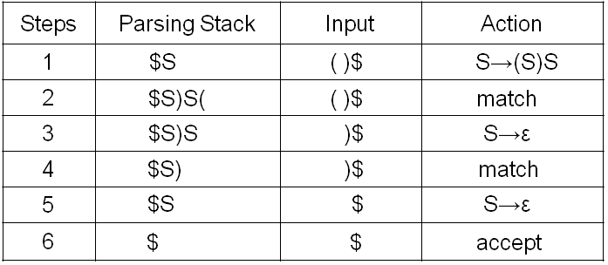
Example
Generate
Match
 | ( | ) | #
S | S→(S)S | S→ε | S→ε
[S→(S)S]
[S→ε]
[S→ε]
S ⇒ (S)S
⇒ ( )S
⇒ ( )
Which corresponds precisely to the steps in a leftmost derivation of string ( ).

Slide 108
分析过程
符号栈 | 输入串 | 动作
#S | Inputstring# | 匹配/生成 (match/generate)
… | … | 匹配/生成 (match/generate)
# | # | 接受(accept)

Slide 109
分析动作
总控程序根据当前栈顶符号X和当前输入符号a，执行下列三种动作之一:
1. 若X=a=‘＃’，则分析成功，停止分析。accept
2. 若X=a≠‘＃’，则X出栈，a指向下一个输入符号。match
3. 若X是一个非终结符，则查看分析表M。
若M[X,a]中存放着关于X的一个产生式，则X出栈，把产生式的右部符号串按反序一一进栈(若右部符号为ε，则无符号进栈)。 generate
若M[X,a]为空或存放着“出错标志”，则调用出错诊察程序ERROR。 error
若X是一个终结符且X≠a，出错（不匹配） error

Slide 110
A Parsing Algorithm Using LL(1) Parsing Table
(* assumes # marks the bottom of the stack and the end of the input *)
push the start symbol onto the top the parsing stack;
while the top of the parsing stack ≠ # do
if the top of the parsing stack is terminal a and the next input token = a
then (* match *)
pop the parsing stack;
advance the input;
else if the top of the parsing stack is non-terminal A
and the next input token is terminal a
and parsing table entry M[A,a] contains production A→X₁X₂…X_{n}
then (* generate *)
pop the parsing stack;
for i:=n downto 1 do
push X_{i} onto the parsing stack;
else error;
if the top of the parsing stack = # and the next input token = #
then accept
else error;

Slide 111
Example
已知文法G(E)如下，输入串为i₁*i₂+i₃，利用分析表进行预测分析。
E → TE′
E′ → +TE′ | ε
T → FT′
T′ → *FT′ | ε
F → (E) | i
 | i | + | * | ( | ) | #
E | E→TE′ |  |  | E→TE′
E′ |  | E′→+TE′ |  |  | E′→ε | E′→ε
T | T→FT′ |  |  | T→FT′
T′ |  | T′→ε | T′→*FT′ |  | T′→ε | T′→ε
F | F→i |  |  | F→ (E)

Slide 112
步骤 符号栈 输入串 动作
1 #E i₁*i₂+i₃# E→TE′
2 #E′T i₁*i₂+i₃# T→FT′
3 #E′T′F i₁*i₂+i₃# F→i
4 #E′T′i i₁*i₂+i₃# 匹配
5 #E′T′ *i₂+i₃# T′→*FT′
6 #E′T′F* *i₂+i₃# 匹配
7 #E′T′F i₂+i₃# F→i
8 #E′T′i i₂+i₃# 匹配
9 #E′T′ +i₃# T′→ε
10 #E′ +i₃# E′→+TE′
11 #E′T+ +i₃# 匹配
12 #E′T i₃# T→FT′
13 #E′T′F i₃# F→i
14 #E′T′i i₃# 匹配
15 #E′T′ # T′→ε
16 #E′ # E′→ε
17 # # 接受

Slide 113
4.5.1 预测分析程序工作过程
4.5.2 预测分析表的构造

Slide 114
预测分析表的构造
1. 构造FIRST集合
2. 构造FOLLOW集合
3. 构造预测分析表

Slide 115
构造文法符号的FIRST集合
对每一文法符号X∈V_{T}∪V_{N} ，构造FIRST(X)。
连续使用以下规则，直至FIRST集合不再增加元素：
1. 若X∈V_{T}，则FIRST(X)＝{X}。
2. 若X∈V_{N}，且有产生式X→a…，则把a加入到FIRST(X)中；若X→ε是一条产生式，则把ε加到FIRST(X)中。
3. 若X→Y…是一个产生式且Y∈V_{N}，则把FIRST(Y)中的所有非ε-元素都加到FIRST(X)中；
若X→Y₁Y₂…Y_{k}是一个产生式，Y₁，…，Y_{i-1}都是非终结符，而且对于任何j，1≤j≤i-1，FIRST(Y_{j})都含有ε(即Y₁…Y_{i-1} ⇒* ε)， 则把FIRST(Y_{i})中的所有非ε-元素都加到FIRST(X)中；
特别是，若所有的FIRST(Y_{j})均含有ε，j＝1, 2, …, k，则把ε加到FIRST(X)中。

Slide 116
Example
已知文法G(S)如下，计算该文法中各个符号的First集合。
S → aAb
A → cd | c

Slide 117
Example
已知文法G(S)如下，计算该文法中非终结符的First集合。
S → Aa
A → a | ε

Slide 118
Example
已知文法G(S)如下，计算First(S) 。
S → ABCd
A → a | ε
B → bSe | fA | ε
C → cB | gC | ε

Slide 119
Example
已知文法G(E)如下，计算该文法中非终结符的First集合。
E→TE′
E′→+TE′ | ε
T→FT′
T′→*FT′ | ε
F→(E) | i

Slide 120
Algorithm for Computing First (A)
Algorithm for computing First(A) for all non-terminal A
for all non-terminal A do First(A):={ };
while there are changes to any First(A) do
for each production choice A→X₁X₂…X_{n} do
k := 1; Continue := true;
while Continue=true and k<=n do
add First(X_{k})-{ε} to First(A);
if ε is not in First(X_{k}) then Continue:=false;
k := k + 1;
if Continue=true then add ε to First(A);

Slide 121
Algorithm for Computing First (A)
Simplified algorithm in the absence of ε-production.
for all non-terminal A do First(A):={ };
while there are changes to any First(A) do
for each production choice A→X₁X₂…X_{n} do
Add First(X₁) to First(A);

Slide 122
Example
The computation process
Grammar rule | Pass1 | Pass2
F → i | FIRST(F) = { i }
F → (E) | FIRST(F) = { i, ( }
T′ → ε | FIRST(T’) = { ε }
T′ → *FT′ | FIRST(T’) = { ε, * }
T → FT′ | FIRST(T) = { i, ( }
E′ → ε | FIRST(E’) = { ε }
E′ → +TE′ | FIRST(E’) = { ε, + }
E → TE′ | FIRST(E) = { i, ( }
E→TE′
E′→+TE′ | ε
T→FT′
T′→*FT′ | ε
F→(E) | i

Slide 123
Example
Another computation process
Grammar rule | Pass1 | Pass2 | Pass3 | Pass4
E → TE′
E′ → +TE′
E′ → ε
T → FT′
T′ → *FT′
T′ → ε
F → (E)
F → i

Slide 124
构造符号串的FIRST集合
对文法G的任何符号串α=X₁X₂…X_{n} ，构造集合FIRST(α)。
1. FIRST(α)＝FIRST(X₁)\{ε}；
2. 若对任何1≤j≤i-1，ε∈FIRST(X_{j})，则把FIRST(X_{i})\{ε}添加到FIRST(α)中；
特别是，若所有的FIRST(X_{j})均含有ε，1≤j≤n，则把ε添加到FIRST(α)中。显然，若α＝ε，则FIRST(α)＝{ε}。

Slide 125
预测分析表的构造
1. 构造FIRST集合
2. 构造FOLLOW集合
3. 构造预测分析表

Slide 126
构造非终结符的FOLLOW集合
对于文法G的每个非终结符A，构造FOLLOW(A)。
连续使用以下规则，直至每个FOLLOW集合不再增加新的元素：
1. 对于文法的开始符号S，#∈FOLLOW(S)；
2. 若A→αBβ是一个产生式，则把FIRST(β)\{ε}添加到FOLLOW(B)中；
3. 若A→αB是一个产生式，或A→αBβ是一个产生式且 β ⇒* ε (即ε∈FIRST(β))，则把FOLLOW(A)添加到FOLLOW(B)中。

Slide 127
Note
The ε is never an element of a Follow set.
Follow sets are defined only for non-terminal.
Follow sets work “on the right” in production while First sets work “on the left” in the production.

Slide 128
Example
已知文法G(E)如下，计算该文法中非终结符的Follow集合。
E → TE′
E′ → +TE′ | ε
T → FT′
T′ → *FT′ | ε
F → (E) | i
FIRST(E) ={ (, i }
FIRST(E′)={ +, ε }
FIRST(T) ={ (, i }
FIRST(T′)={ *, ε }
FIRST(F) ={ (, i }

Slide 129
Example
E → TE′
E′ → +TE′ | ε
T → FT′
T′ → *FT′ | ε
F → (E) | i
E → TE′
E′ → +TE′
E′ → ε
T → FT′
T′ → *FT′
T′ → ε
F → (E)
F → i

Slide 130
Example
Rule | Pass 1 | Pass 2 | Pass3
E → TE′ | FOLLOW(E) = { # } FOLLOW(T) = { +, # } FOLLOW(E’) = { # } | FOLLOW(E) = { #, ) } FOLLOW(T) = { +, #, ) } FOLLOW(E’) = { #, ) }
E′ → +TE′
T → FT′ | FOLLOW(F) = { *, +, # } FOLLOW(T’) = { +, # } | FOLLOW(F) = { *, +, #, ) } FOLLOW(T’) = { +, #, ) }
T′ → *FT′
F → (E) | FOLLOW(E) = { #, ) }
The First sets
FIRST(E) ={ (, i }
FIRST(E′)={ +, ε }
FIRST(T) ={ (, i }
FIRST(T′)={ *, ε }
FIRST(F) ={ (, i }
The Follow sets
FOLLOW(E) = { #, ) }
FOLLOW(E′) = { #, ) }
FOLLOW(T) = { +, #, ) }
FOLLOW(T′) = { +, #, ) }
FOLLOW(F) = { *, +, #, ) }

Slide 131
Algorithm for Computing Follow(A)
Algorithm for the computation of Follow sets
Follow(start-symbol):={#};
for all non-terminals A ≠ start-symbol do Follow(A):={ };
while there are changes to any Follow sets do
for each production A→X₁X₂…X_{n} do
for each X_{i} that is a non-terminal do
add First(X_{i+1}X_{i+2}…X_{n}) – {ε} to Follow(X_{i})
if ε is in First(X_{i+1}X_{i+2}…X_{n}) then
add Follow(A) to Follow(X_{i})

Slide 132
Error Handing in Top-Down Parsers
E → T { + T }
procedure E;
begin
T;
while token=+ do
match(token);
T;
end while;
end E;

Slide 133
预测分析表的构造
1. 构造FIRST集合
2. 构造FOLLOW集合
3. 构造预测分析表

Slide 134
分析表构造算法
1. 对文法G的每个产生式A→α，执行第(2)步和第(3)步；
2. 对每个终结符号a∈First(α)，把A→α添加到M[A,a]中；
3. 若ε∈First(α)，则对任何b∈Follow(A)，把A→α添加到M[A,b]中；
4. 把所有无定义的M[A,a]标上错误标志。

Slide 135
Example
E → TE′
E′ → +TE′ | ε
T → FT′
T′ → *FT′ | ε
F → (E) | i
FIRST(E) ={ (, i }
FIRST(E′)={ +, ε }
FIRST(T) ={ (, i }
FIRST(T′)={ *, ε }
FIRST(F) ={ (, i }
FOLLOW(E) = { #, ) }
FOLLOW(E′) = { #, ) }
FOLLOW(T) = { +, #, ) }
FOLLOW(T′) = { +, #, ) }
FOLLOW(F) = { *, +, #, ) }
 | i | + | * | ( | ) | #
E | E→TE′ |  |  | E→TE′
E′ |  | E′→+TE′ |  |  | E′→ε | E′→ε
T | T→FT′ |  |  | T→FT′
T′ |  | T′→ε | T′→*FT′ |  | T′→ε | T′→ε
F | F→i |  |  | F→ (E)

Slide 136
Note
如果G是左递归或二义的，则M至少含有一个多重定义入口。因此，消除左递归和提取左因子将有助于获得无多重定义的分析表M。
可以证明，一个文法G的预测分析表M不含多重定义入口，当且仅当该文法为LL(1)的。

Slide 137
Example
E → E+T | T
T → T*F | F
F → (E) | i
 | i | + | * | ( | ) | #
E | E → E+T E → T |  |  | E → E+T E → T
T
F

Slide 138
Example
文法G(S):
S → iCtS | iCtSeS | a
C → b
提取左因子
S → iCtSS’ | a
S’ → eS | ε
C → b
 | a | b | e | i | t | #
S | S→a |  |  | S→iCtSS’
S’ |  |  | S′→eS S′→ε |  |  | S′→ε
C |  | C→b

Slide 139
End of Chapter Four
THANKS

