Slide 1

Project/Team ID – 4CY17 Team Name- Cyber Punk
Project Title- Cloud Based To-do Application
Project Domain- Cloud Computing
Project Guide- Mr. Gaurav Sharma
Team Members- Nonit Bajaj, Kushagra Vaishnav

Slide 2
LITERATURE REVIEW: COMPARISON TABLE
Criteria | AWS (Lambda, API Gateway, DynamoDB, Cognito) | Firebase (Cloud Functions, Firestore, Auth) | Azure (Functions, Cosmos DB, AD B2C) | Traditional Server-based Model
Architecture | Fully serverless, event-driven | Fully serverless, real-time database | Fully serverless, scalable | Monolithic or microservice
Scalability | Auto-scalable, handles spikes | Auto-scalable, good for real-time apps | Auto-scalable, built-in load balancing | Requires manual scaling
Database | DynamoDB (NoSQL) | Firestore (NoSQL, real-time) | Cosmos DB (NoSQL/Multi-model) | MySQL, MongoDB, etc.
Authentication | AWS Cognito | Firebase Authentication | Azure AD B2C | Custom JWT or OAuth setup
Deployment | AWS Amplify / S3 + CloudFront | Firebase Hosting | Azure App Service | Dedicated VM or hosting service
Real-time Sync | Complex setup needed | Built-in real-time updates | Requires SignalR or extra setup | Not inherently supported
Learning Curve | Moderate to High | Beginner friendly | Moderate to High | Depends on stack complexity
Cost Efficiency | Pay-per-use; Free Tier available | Very cost-effective for small apps | Pay-per-use, free trial | Fixed server costs
Ecosystem Support | Strong AWS ecosystem | Strong for mobile/web apps | Good for enterprise apps | Depends on hosting & services
Security | Highly secure, IAM policies | Secure but fewer enterprise-level controls | Enterprise-grade security | Developer-dependent
Offline Support | Limited (needs workarounds) | Built-in offline support (Firestore caching) | Limited | Complex to implement
Use Case Fit | Scalable production-grade apps | Mobile/web real-time apps, MVPs | Large enterprise applications | Traditional web apps
AWS Serverless Stack:
Best for production-grade, scalable apps with enterprise security needs.
More control but requires handling individual services and permissions.
Firebase:
Easier for beginners, faster MVP development.
Built-in real-time sync and offline support are strong points for task apps.
Limited fine-grained control compared to AWS.
Azure:
Good for enterprise-scale apps with Microsoft ecosystem integration.
Not as beginner-friendly for small projects.
Traditional Server-Based Models:
Good control but not scalable or cost-efficient for modern cloud-based apps.
Requires constant maintenance, monitoring, and scaling effort.

Slide 3
Cloud-Based To-Do list Application
DETAILED EXPLANATION OF THE PROPOSED SOLUTION:
HOW IT ADDRESSES THE PROBLEM:
The proposed solution is a cloud-based to-do list app with a serverless backend.
Key Components:
Frontend: Built with React.js (or Next.js/Vue.js) to provide a clean, responsive UI for task management. Users can add, update, delete, and mark tasks complete.
Backend: AWS Lambda or Firebase Functions handle task logic with auto-scaling and no server maintenance. API calls manage tasks.
Authentication: Uses AWS Cognito or Firebase Authentication for secure sign-up/login.
Database: DynamoDB or Firestore stores task data securely in the cloud.
Deployment: Hosted on platforms like AWS Amplify, Vercel, or Netlify.
Benefits:
Scalable with serverless architecture.
Cost-effective: Pay only for usage.
Cross-platform: Sync tasks on mobile and desktop.
Secure: Cloud-based storage with built-in security.
In essence, the app provides a simple, efficient, and cost-effective solution for task management with minimal infrastructure.
The app addresses the problem by providing a centralized, cloud-based task manager that is accessible across devices. It helps users stay organized with features like task creation, priority setting, and syncing. With a serverless backend, there's no server management needed, and it scales automatically. Cloud security ensures data safety, and real-time access eliminates the risk of losing or forgetting tasks. It’s a simple, secure, and efficient solution for personal or team task management.
INNOVATION AND UNIQUENESS OF THE SOLUTION:
The solution is unique due to its serverless architecture, offering scalability, cost-efficiency, and no server management. It provides real-time sync across devices and secure authentication with minimal setup. The design is simple yet powerful, supporting both individual use and team collaboration. It combines advanced features with effortless maintenance, making it innovative and accessible.

Slide 4
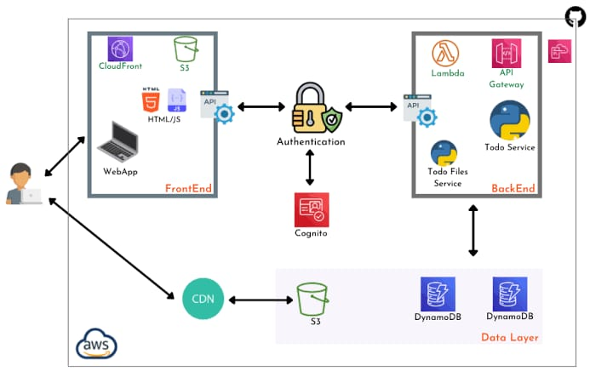
TECHNICAL APPROACH
FLOW DIAGRAM

Slide 5
FEASIBILITY AND VIABILITY
A) Technical Feasibility
Highly Feasible
Technology Availability: Cloud platforms (AWS, Firebase, Azure) provide ready-made services like Lambda, API Gateway, DynamoDB/Firestore, and authentication modules.
Developer Skills: Project requires knowledge of web development (React/Next.js) and basic cloud/serverless functions—widely available skillsets.
Scalability: Serverless architecture easily supports scaling without infrastructure concerns.
Deployment: Can be hosted on platforms like Vercel, Netlify, or AWS Amplify with minimal effort.
Challenges:
Handling complex user-specific features like reminders/notifications may add complexity.
Security configurations (CORS, authentication) need careful implementation.
A) Economic Viability
High Viability for MVP
Low Initial Cost: Serverless architecture (pay-per-use) minimizes upfront and operational costs.
Free Tiers: AWS, Firebase, Azure provide free tiers that cover early development and small user bases.
Monetization Potential: Freemium models, ads, or premium features (sharing, AI features) can make the app self-sustaining or profitable.
B) Market Viability
Good
Productivity tools are always in demand, especially with remote work and study trends.
Can target students, professionals, freelancers, and small businesses.
Differentiation is possible with features like personalization, cloud sync, or AI suggestions.
B) Operational Feasibility
Feasible
Simple CRUD operation logic makes development, maintenance, and operation easy.
Serverless backend reduces ongoing server maintenance.
Can be managed by a small team or even a solo developer for an MVP (Minimum Viable Product).
C) Social & Environmental Viability
Positive
Encourages digital productivity, organization, and eco-friendly behavior by reducing paper usage.
Promotes digital literacy and exposure to cloud-based tools.
C) Legal & Compliance Feasibility
Moderately Feasible
If user data is stored, ensure compliance with privacy laws like GDPR or local regulations.
Using cloud services makes compliance easier due to built-in data security and privacy features.

Slide 6
2. Economic Benefits Cost-Effective Solution: Serverless architecture reduces infrastructure costs since you pay only for what you use—suitable for startups and small businesses. Business Efficiency: Enables small teams or freelancers to manage tasks without investing in expensive project management software. Scalability: Can serve a growing user base without major overhead, supporting future monetization models (freemium, subscription).
POTENTIAL IMPACT ON THE TARGET AUDIENCE:
BENEFITS OF THE SOLUTION (SOCIAL, ECONOMIC, ENVIRONMENTAL, ETC.):
1. Increased Productivity and Task Management
Helps users organize tasks effectively and prioritize work.
Reduces mental clutter by offering a digital workspace accessible anywhere.
2. Accessibility and Convenience
Since it’s cloud-based, users can access their to-do list from any device (mobile, tablet, desktop).
No dependency on a specific device—data is stored securely in the cloud.
3. Enhanced User Experience (UX)
A simple, intuitive, and clean UI attracts casual users and professionals alike.
Features like real-time syncing, task reminders, and progress visualization can improve user engagement.
4. Security and Data Reliability
Serverless architecture and cloud storage ensure high reliability, reduced downtime, and secured user data.
Users feel confident storing their personal tasks and work plans.
5. Scalability for Different User Segments
Can serve individuals, students, and even small teams for basic project management.
Future enhancements like collaboration and sharing can expand the audience.
6. Learning and Adoption of Cloud Technology
Introducing users to the advantages of serverless technology, showing how fast and responsive cloud apps can be.
Educates small business users about secure and scalable digital task management solutions.
1. Social Benefits
Improved Time Management: Helps users (students, professionals, homemakers) stay organized, reducing stress and improving mental well-being.
Promotes Productivity Culture: Encourages goal setting, accountability, and consistent habit-building among users.
Collaboration Potential: Future features could promote teamwork, planning, and better communication for groups or small organizations.
3. Environmental Benefits
Reduced Resource Consumption: Serverless and cloud-based models optimize resource usage, reducing energy wastage compared to traditional server setups.
Paperless Productivity: Encourages users to move away from paper planners or notebooks, reducing paper waste.
Shared Cloud Infrastructure: Promotes green computing by relying on large cloud providers who invest in energy-efficient, carbon-neutral data centers.

Slide 7
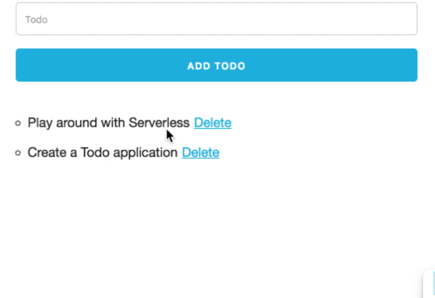
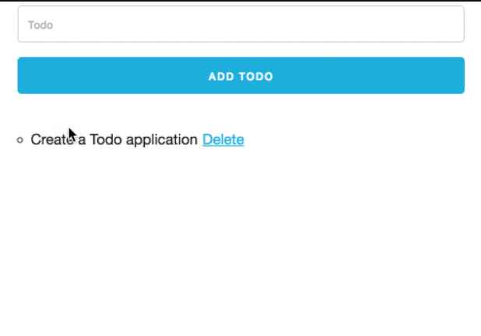
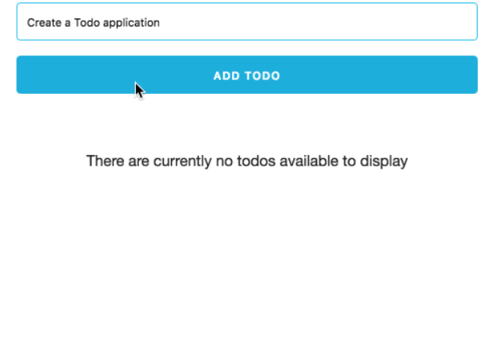
DEMO OF THE PROJECT

Slide 8
RESEARCH AND REFERENCES
Serverless Concepts
AWS Lambda Getting Started
What is Serverless? - AWS
Serverless Stack (SST) Guide
Frontend
React + AWS Amplify (Official Guide)
Next.js + Serverless API Routes
Authentication
Amazon Cognito Developer Guide
Firebase Authentication
Deployment
AWS Amplify Hosting
Vercel for React/Next.js
Sample GitHub Repositories (Reference Projects)
AWS Serverless TODO App
https://github.com/aws-samples/aws-serverless-workshops/tree/master/Todo
React + Amplify To-Do Example
https://github.com/aws-amplify/amplify-js/tree/main/packages/react-example/todo
Firebase To-Do Example
https://github.com/firebase/functions-samples/tree/main/quickstarts/functions-todo

