Slide 1
DOM Introduction using JavaScript in Microsoft Visual Studio
許乙清
husic@nfu.edu.tw

Slide 2
DOM Introduction
DOM
Javascript examples

Slide 3
DOM Introduction
DOM (Document Object Model)
The DOM is a platform and language independent interface that will allow programs and scripts to dynamically access and update the content, structure and style of documents, such as HTML, XHTML, XML documents.

Slide 4
Status of the DOM
DOM Level1
  W3C recommendation, 1 Oct. 1998.
DOM Level2
  W3C recommendation, 13 Nov. 2000.
DOM Level3
  W3C candidate recommendation, 7 Nov. 2003
There are many parts in the DOM (e.g. DOM Level2 contains DOM Level2 Core, DOM Level2 Event, etc.).
Generally speaking, we use the term “DOM” for “DOM Core” if no specific indication.

Slide 5
DOM Introduction
DOM
  defines a standard way for accessing and manipulating XML documents.
  presents an XML document as a tree-structure.
  DOM example and API (method) can refer to the below URL
  http://www.w3schools.com/dom/dom_intro.asp
  http://www.w3school.com.cn/xmldom/index.asp [簡體中文]

Slide 6
Program
XML
document
Web Client side program (e.g.: JavaScript, VBScript, …)
Web Server side program (e.g.: JSP, ASP, PHP, Python)
Console program (e.g.: C++, Java, C#, VB.Net, …)
DOM
Output
每個語言所提供的DOM API語法是類似的

Slide 7
The DOM Interface
The DOM has many interfaces to handle various node objects.
Every interface has its “Attributes” and “Methods”.
  Compare with Object Oriented Programming (OOP).
DOM | OOP
Interface | Object Class
Attribute | Property
Method | Method

Slide 8
Most Frequently Used Interface, Node
Attributes
  childNodes
    Return the child nodes in a NodeList
  nodeName
    Return the name of the node
  nodeValue
    Return the value of the node
  firstChild, lastChild, previousSibling, nextSibling, etc.
Methods
  getElementsByTagName, insertBefore, replaceChild, removeChild, appendChild, etc.

Slide 9
XML document (book1.xml)
<?xml version="1.0" encoding="utf-8"?>
<bookstore>
<book category="cooking">
<title lang="en">Everyday Italian</title>
<author>Giada De Laurentiis</author>
<year>2005</year>
<price>30.00</price>
</book>
</bookstore>

Slide 10
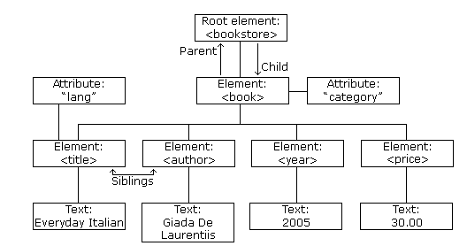
DOM tree

Slide 11
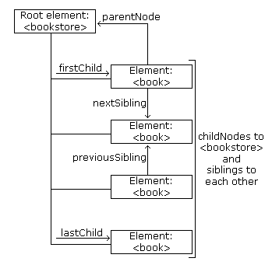
Node relation

Slide 12
XMLHttpRequest
XMLHttpRequest讓你可以取得其他網站的資料(如HTML, XHTML,或XML)，並加以管理，在自己建立的網站中，混入來自多個其他網站的內容。
XMLHttpRequest 物件發送請求和處理回應之前，必須先用 JavaScript 建立一個XMLHttpRequest 物件。由於XMLHttpRequest 不是一個W3C 標準，所以可以採用多種方法使用JavaScript 來建立 XMLHttp-Request 的實例。
使用fetch 物件技術來讀取XML檔案。

Slide 13
XML document (book1.xml)
http://140.130.34.14/dom/javascript/book1.xml
<?xml version="1.0" encoding="utf-8"?>
<bookstore>
<book category="cooking">
<title lang="en">Everyday Italian</title>
<author>Giada De Laurentiis</author>
<year>2005</year>
<price>30.00</price>
</book>
</bookstore>

Slide 14
dom-1.html
<!DOCTYPE html>
<html>
<head>
<title>dom-1.html</title>
</head>
<body>
<script type="text/javascript">
fetch('book1.xml')
.then(response => response.text())
.then(str => (new window.DOMParser()).parseFromString(str, "text/xml"))
.then(xmlDom => {
let title = xmlDom.getElementsByTagName("title")[0].textContent;
let author = xmlDom.getElementsByTagName("author")[0].textContent;
let year = xmlDom.getElementsByTagName("year")[0].textContent;
document.write(title + "<br />");
document.write(author + "<br />");
document.write(year);
})
.catch(error => console.error('Error loading XML:', error));
</script>
</body></html>

Slide 15
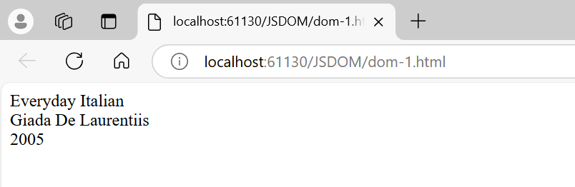

Slide 16
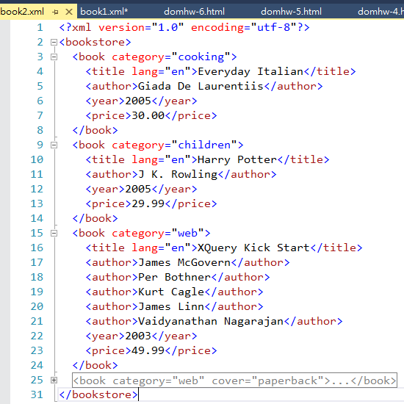
XML document (book2.xml)
http://140.130.34.14/dom/javascript/book2.xml

Slide 17
dom-2.html
javascript只能讀local的XML檔
<!DOCTYPE html>
<html>
<head>
<title>dom-2.html</title>
</head>
<body>
<script type="text/javascript">
fetch('book2.xml')
.then(response => response.text())
.then(str => (new window.DOMParser()).parseFromString(str, "text/xml"))
.then(xmlDom => {
let titleNode = xmlDom.getElementsByTagName("title");
for (let i = 0; i < titleNode.length; i++) {
document.write(titleNode[i].textContent + " <br />");
}
})
.catch(error => console.error('Error loading XML:', error));
</script>
</body></html>

Slide 18
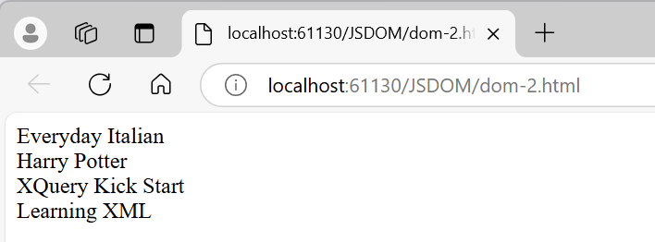

Slide 19
XML document (book3.xml)
<?xml version="1.0" encoding="utf-8"?>
<bookstore>
<book category="cooking">
<title lang="zh-tw">中國一定強</title>
<author>Giada De Laurentiis</author>
<year>2005</year>
<price>30.00</price>
</book>
</bookstore>

Slide 20
dom-3.html
<!DOCTYPE html>
<html>
<head>
<title>dom-1.html</title>
</head>
<body>
<script type="text/javascript">
fetch('book3.xml')
.then(response => response.text())
.then(str => (new window.DOMParser()).parseFromString(str, "text/xml"))
.then(xmlDom => {
document.write("<h2>資料顯示</h2><hr />");
let title = xmlDom.getElementsByTagName("title")[0].textContent;
let author = xmlDom.getElementsByTagName("author")[0].textContent;
let year = xmlDom.getElementsByTagName("year")[0].textContent;
document.write(title + "<br />");
document.write(author + "<br />");
document.write(year);
document.write("<hr />課程:Web技術與應用");
})
.catch(error => console.error('Error loading XML:', error));
</script>
</body></html>

Slide 21
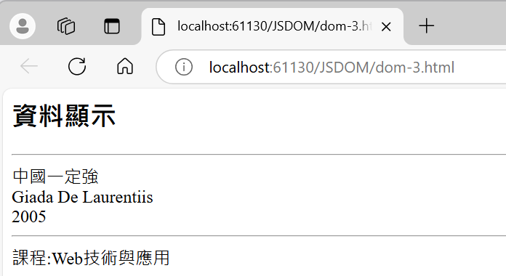

Slide 22
Node Type & Node Value
Node Type | Type value
Element | 1
Attribute | 2
Text | 3
Comment | 8
Document | 9

Slide 23
Traversing Nodes (dom-4.html)
<html>
<head>
<title>dom-4.html</title>
</head>
<body>
<script type="text/javascript">
fetch('book2.xml')
.then(response => response.text())
.then(str => (new window.DOMParser()).parseFromString(str, "text/xml"))
.then(xmlDom => {
let books = xmlDom.documentElement.childNodes;
for (let i = 0; i < books.length; i++) {
if (books[i].nodeType == 1) {//Process only element nodes (type 1)
document.write(books[i].tagName);
document.write("<br />");
}
}
})
.catch(error => console.error('Error loading XML:', error));
</script>
</body></html>

Slide 24
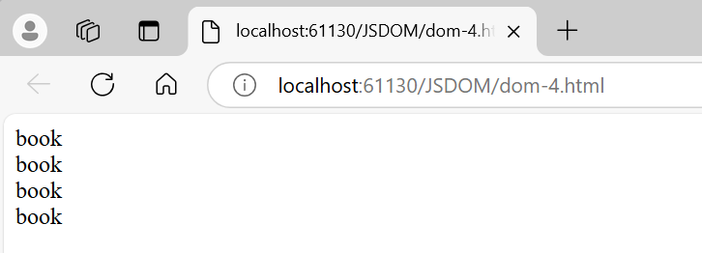

Slide 25
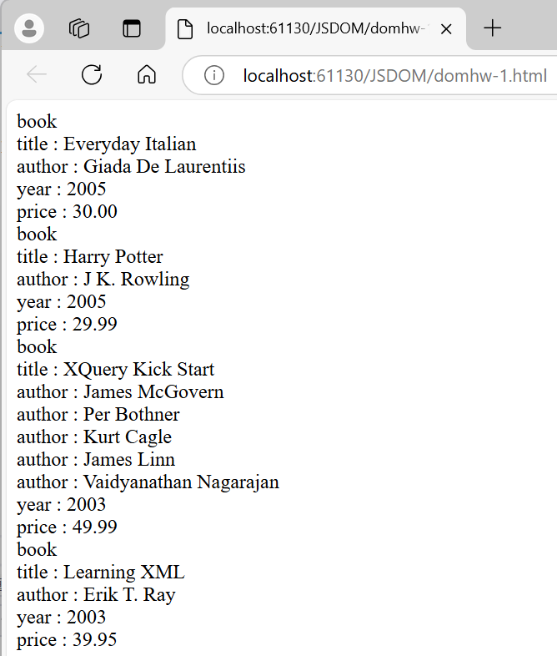
作業 domhw-1.html
(修改dom-4.html)

Slide 26
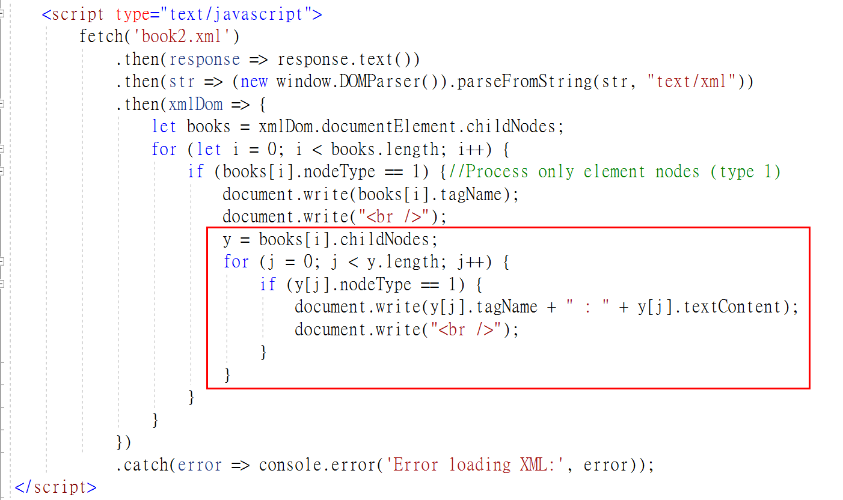
作業 domhw-1.html
(修改dom-4.html)

Slide 27
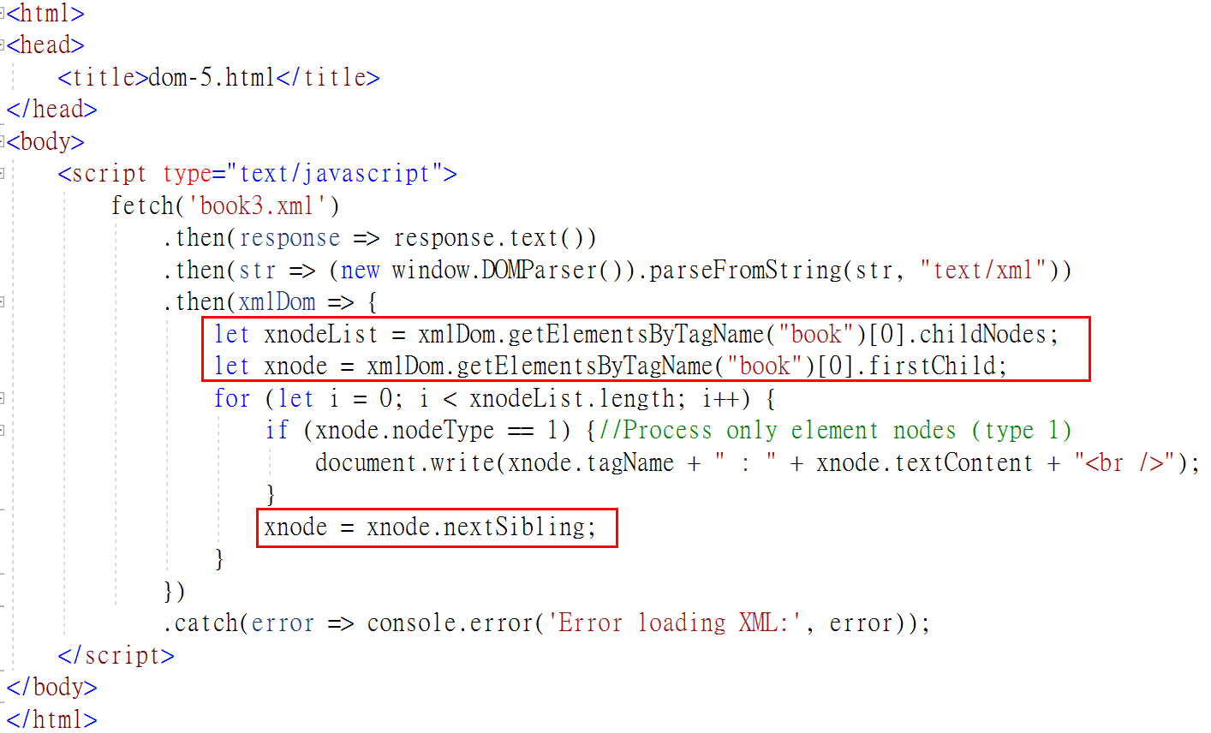
firstChild, nextSibling (dom-5.html)

Slide 28
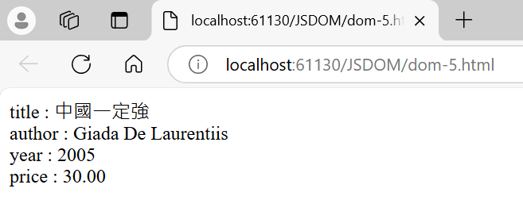

Slide 29
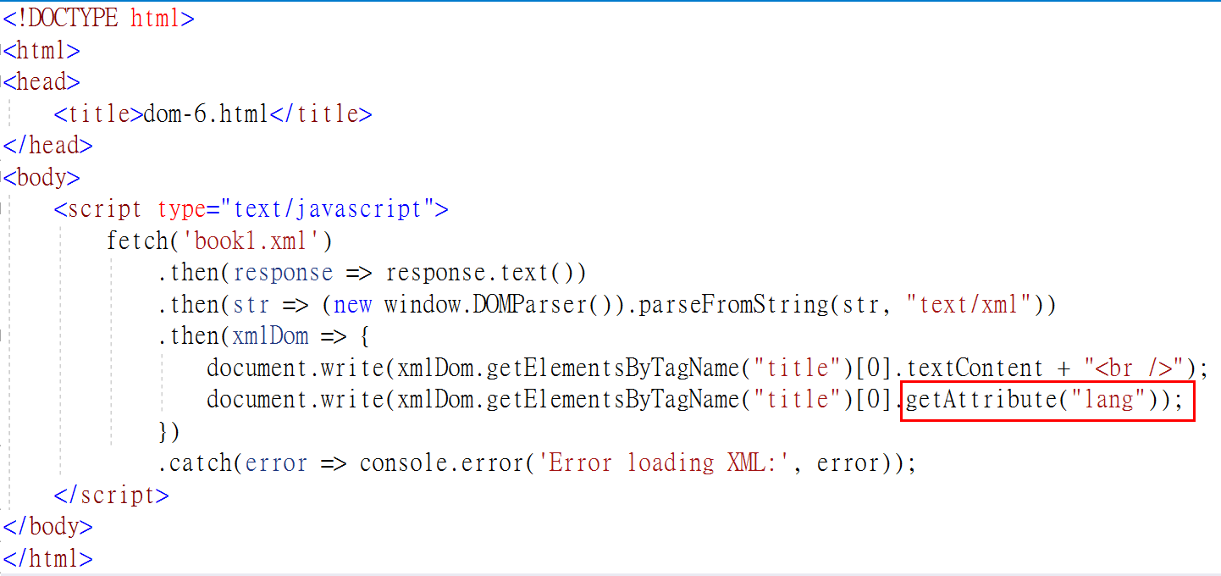
getAttribute (dom-6.html)

Slide 30
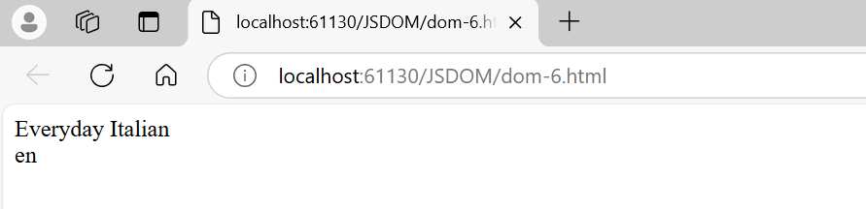

Slide 31
get a child of root (dom-7.html)
<script type="text/javascript">
fetch('book3.xml')
.then(response => response.text())
.then(str => (new window.DOMParser()).parseFromString(str, "text/xml"))
.then(xmlDom => {
document.write("<table border=1><tr><th>節點</th><td>內容</td></tr >");
let xnodeList = xmlDom.getElementsByTagName("book")[0].childNodes;
let xnode = xmlDom.getElementsByTagName("book")[0].firstChild;
for (let i = 0; i < xnodeList.length; i++) {
if (xnode.nodeType == 1) {//Process only element nodes (type 1)
document.write("<tr><th>" + xnodeList[i].tagName + "</th>");
document.write("<td>" + xnodeList[i].textContent + "</td></tr>");
}
xnode = xnode.nextSibling;
}
})
.catch(error => console.error('Error loading XML:', error));
</script>

Slide 32
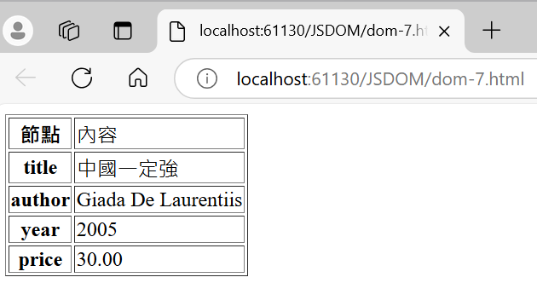

Slide 33
其他範例
dom-8.html …. 讀取 book4.xml
http://140.130.34.14/dom/javascript/book4.xml (每本書只有一位作者)
http://140.130.34.14/dom/javascript/book5.xml (每本書允許多位作者)
更多範例 http://www.w3school.com.cn/xmldom/index.asp

Slide 34
dom-8.html
<script type="text/javascript">
fetch('book4.xml')
.then(response => response.text())
.then(str => (new window.DOMParser()).parseFromString(str, "text/xml"))
.then(xmlDom => {
//顯示根元素名稱(booklist)
document.write(xmlDom.documentElement.tagName);
//顯示根元素內所有子元素的內容
document.write("(" + xmlDom.documentElement.textContent + ")<br />");
//取出根元素中所有children
fnodeList = xmlDom.documentElement.childNodes;
// 顯示所有子節點
for (let i = 0; i < fnodeList.length; i++) {
if (fnodeList[i].nodeType == 1) {//Process only element nodes (type 1)
//顯示第i個子元素名稱
document.write("&nbsp;&nbsp;+-- " + i + ":" + fnodeList[i].tagName);
//顯示第i個子元素內所有子元素的內容
document.write("(" + fnodeList[i].textContent + ") <br />");

Slide 35
dom-8.html
if (fnodeList[i].hasChildNodes()) {
//取出第i個子元素中所有children
snodeList = fnodeList[i].childNodes
// 顯示所有子節點
for (let j = 0; j < snodeList.length; j++) {
if (snodeList[j].nodeType == 1) {//Process only element nodes (type 1)
//顯示第i個子元素中第j個子子元素名稱
document.write("&nbsp;&nbsp;&nbsp;&nbsp;&nbsp;+-- " + snodeList[j].tagName)
//顯示第i個子元素中第j個子子元素內所有子元素的內容
document.write("(" + snodeList[j].textContent + ")<br />")
}
}
}

Slide 36
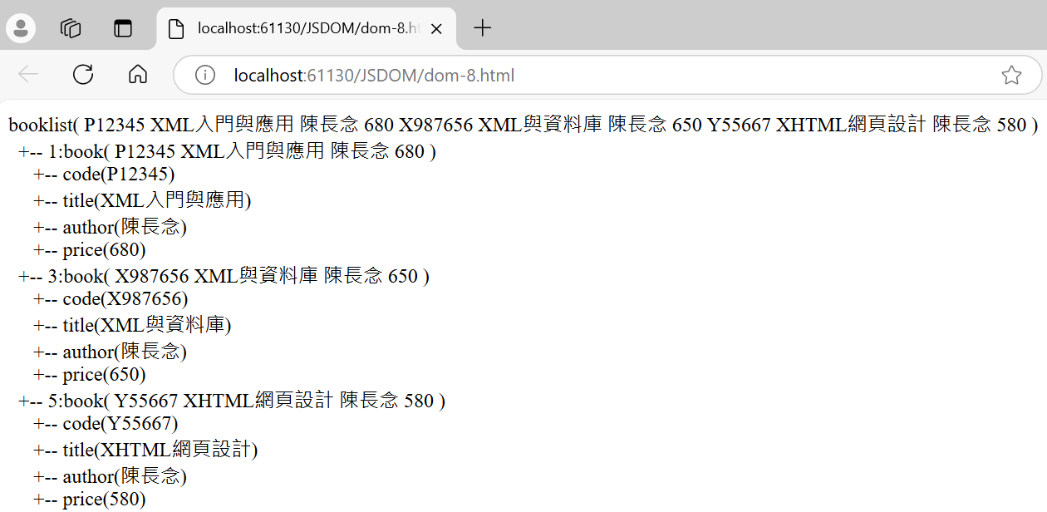
dom-8.html

Slide 37
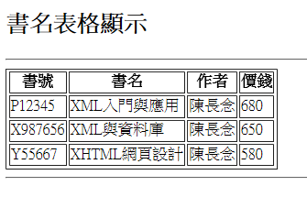
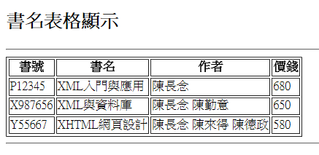
作業 domhw-2.html
讀取book4.xml
讀取book5.xml

Slide 38
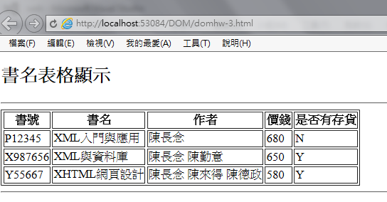
作業 domhw-3.html
讀取book5.xml , 讀取<book>內的sales屬性

Slide 39
Open Data
政府資料開放平台
https://data.gov.tw/
空氣品質指標(AQI)(xml, json, hour)
https://data.gov.tw/dataset/40448
修改dom-8.html 呼叫上面的 空氣品質指標 XML檔

Slide 40
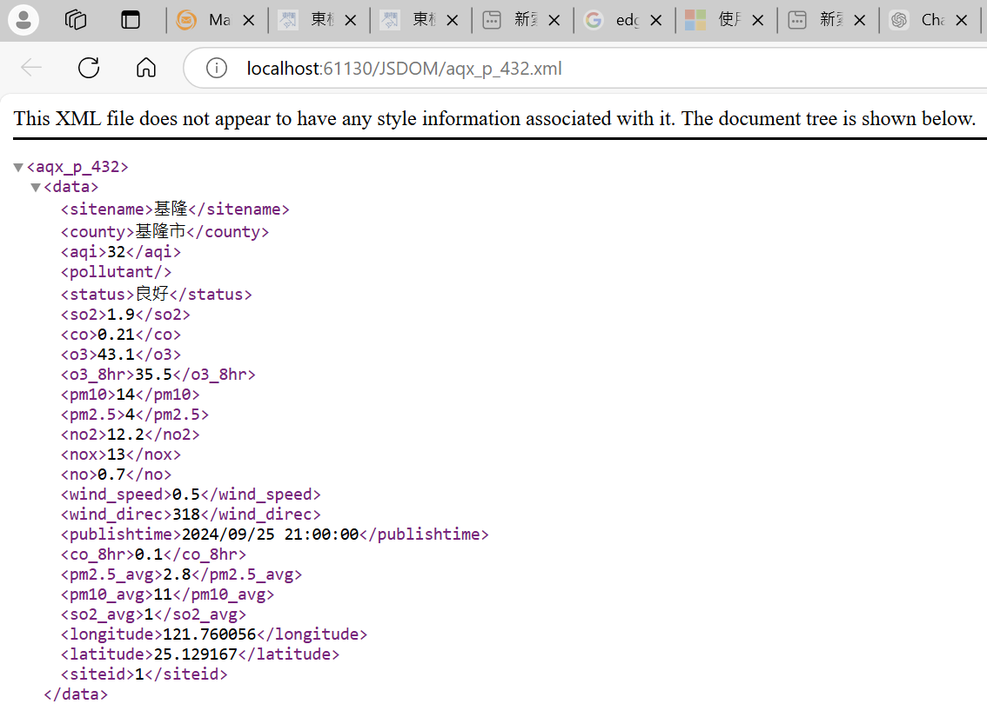
空氣品質即時污染指標(xml, json, hour), 下載後存檔為aqx_p_432.xml

Slide 41
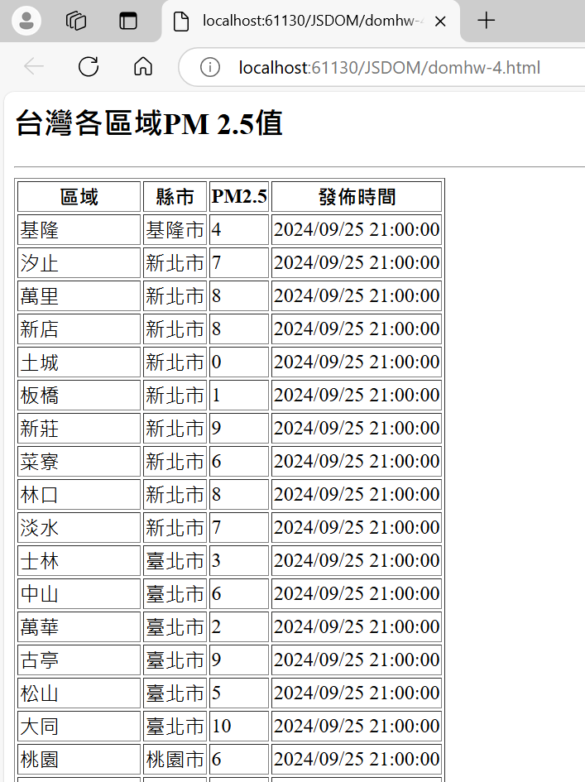
作業 domhw-4.html

Slide 42
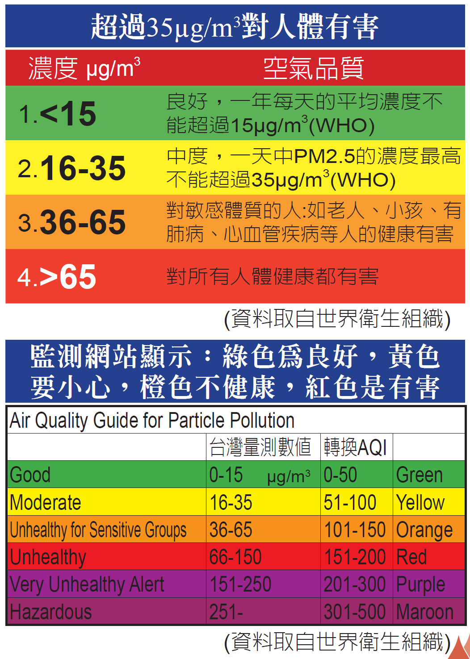

Slide 43
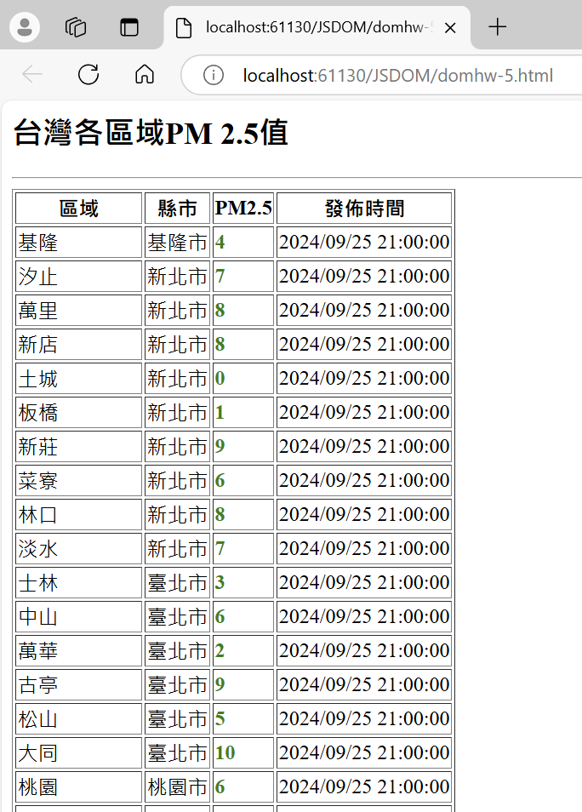
作業 domhw-5.html

