Slide 1
FIRST FINANCE
One interface for AI models
Switch between local and hosted models without rewriting finance logic.
SESSION 01 · 09:30–10:00 · 10 MIN CONCEPTS + 20 MIN NOTEBOOK
First Finance - Arnaud Demes
Notes:
State the outcome: one measured application boundary supports local Ollama and hosted OpenAI models.
[Sources]
- https://developers.openai.com/api/docs/models
- https://docs.ollama.com/api
[/Sources]

Slide 2
WHY A GATEWAY
A gateway isolates every provider change
OLLAMA
Choose a model
→
ONE INTERFACE
→
local · private
provider · model · endpoint
invoke(messages)
OPENAI
hosted · metered
SAME RESPONSE FIELDS
provider · model · response · latency · tokens
Switch providers in configuration; the notebook keeps one stable call.
First Finance - Arnaud Demes
ARCHITECTURE
02
Notes:
Walk left to right. Configuration selects the provider adapter; application code consumes one normalized response record.
[Sources]
- https://developers.openai.com/api/docs/models
- https://docs.ollama.com/api
[/Sources]

Slide 3
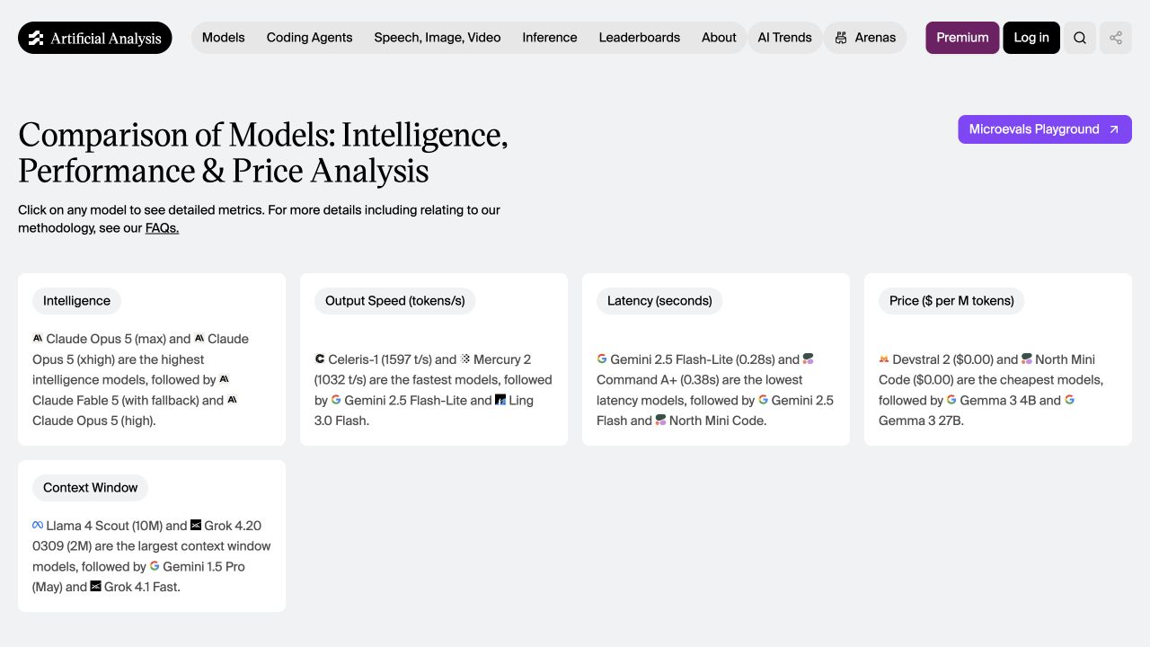
CHOOSING A MODEL
Choose models on quality, speed, latency and cost
Compare 4 signals
quality · output speed · latency · price
Use one gateway
Run every candidate through the same application interface.
Public benchmarks create the shortlist; your task picks the winner.
Source: Artificial Analysis model comparison · accessed 25 Aug 2026
First Finance - Arnaud Demes
BENCHMARK
03
Notes:
[Sources]
- https://artificialanalysis.ai/models (accessed 2026-08-25)
- https://developers.openai.com/api/docs/models/gpt-5.6-luna (accessed 2026-08-25)
[/Sources]
Public benchmarks are a selection aid, not a substitute for task-specific evaluation.

Slide 4
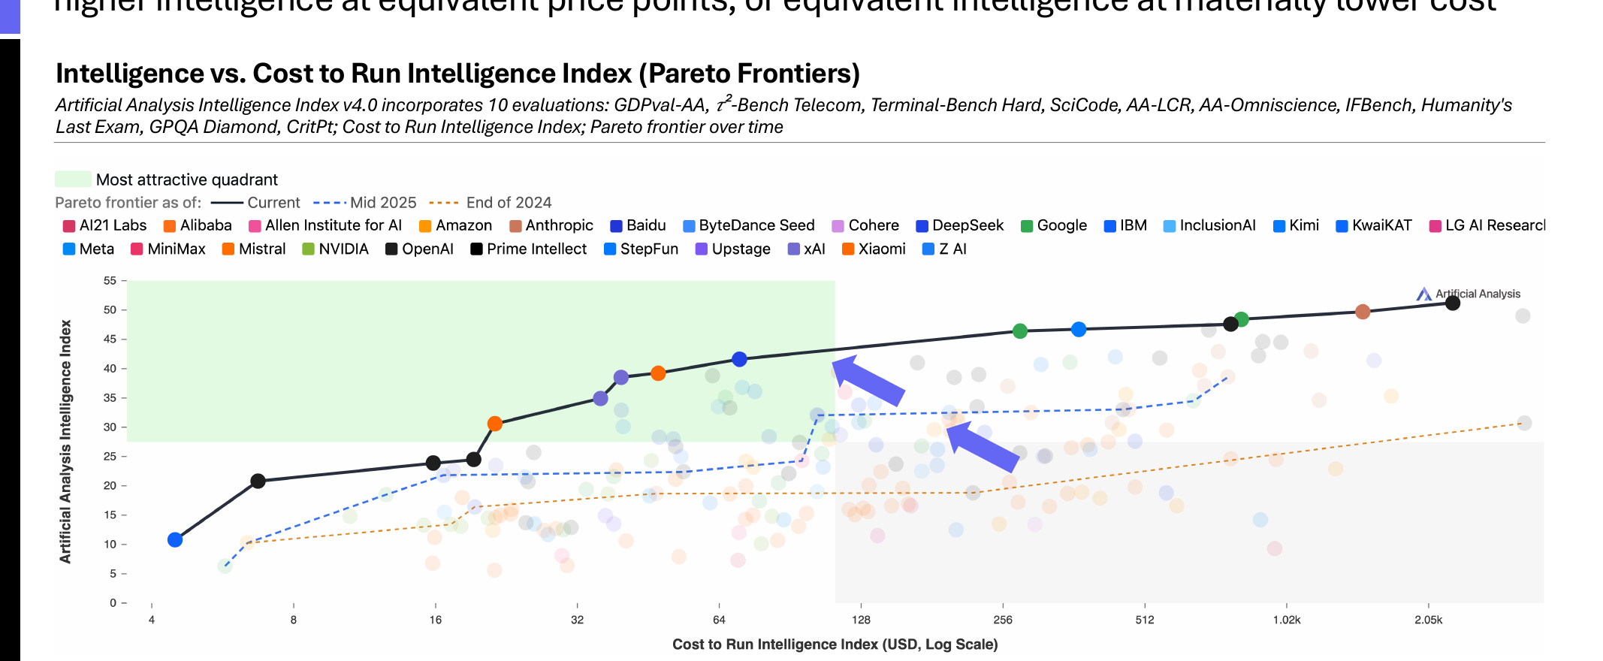
COST TREND
Better AI models are becoming cheaper
The same spend buys more intelligence—and the frontier keeps moving.
Source: Artificial Analysis State of AI · 2025 Year-End · p.16
First Finance - Arnaud Demes
MARKET EVIDENCE
04
Notes:
[Sources]
- https://artificialanalysis.ai/downloads/state-of-ai/2025/2025-Year-End-Artificial-Analysis-State-of-AI-Highlights-Report.pdf (page 16, accessed 2026-08-25)
[/Sources]
The chart is Artificial Analysis's Intelligence vs. Cost to Run Intelligence Index (Pareto Frontiers). Use it to explain why a gateway should make model choice configurable and measurable. Public benchmarks define a shortlist; quality, latency, and cost still need validation on the learner's own task.

Slide 5
MESSAGE ROLES
Separate stable rules from each user request
STABLE RULES
messages = [
Role · boundaries · evidence rules
("system", stable_instructions),
("human", question_and_evidence),
THIS REQUEST
]
Question · company · period · evidence
Clear roles make every call easier to test, version and trace.
First Finance - Arnaud Demes
MESSAGES
05
Notes:
Separate stable system instructions from the current question and evidence. These roles remain inspectable and versionable.
[Sources]
- https://developers.openai.com/api/docs/guides/prompt-engineering
[/Sources]

Slide 6
LIVE LUNA RESULT
The live Luna call was fast—and fully grounded
199 TOKENS
gpt-5.6-luna
→
3,892 ms
→
32 input · 167 output
OpenAI · course gateway
first-answer latency
3,729 ms
grounded-answer latency
GROUNDING
4/4 evidence checks passed
Observed 25 Aug 2026 · one run, not a general speed benchmark.
First Finance - Arnaud Demes
LIVE RUN
06
Notes:
[Sources]
- https://developers.openai.com/api/docs/models/gpt-5.6-luna (accessed 2026-08-25)
[/Sources]
Observed course run from notebooks/01_model_gateway.ipynb on 2026-08-25. First call: 3,892 ms, 32 input tokens, 167 output tokens. Grounded call: 3,729 ms. These values are a run receipt, not a benchmark claim.

Slide 7
WHAT BREAKS
A vague question produces unusable finance analysis
“What is happening with AI demand?”
01
02
03
04
05
Company
Period
Source
Evidence rule
Output contract
No model can reliably supply requirements the application never defined.
First Finance - Arnaud Demes
FAILURE
07
Notes:
Let the technically successful call fail as analysis. Ask students to name the five missing contract elements before revealing them.
[Sources]
- https://developers.openai.com/api/docs/guides/prompt-engineering
[/Sources]

Slide 8
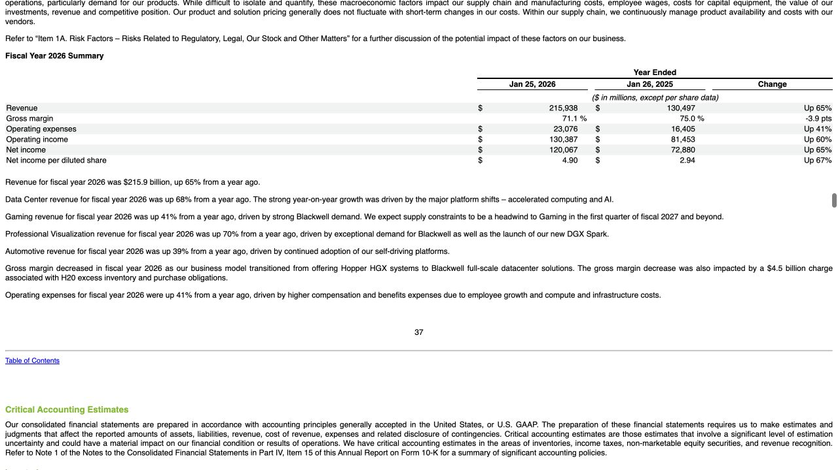
LESSON EVIDENCE
This lesson uses a small, visible SEC evidence set
$215.9bn
Revenue · +65% year on year [F1]
$193.7bn
Data Center · +68% year on year [F2]
$16.0bn Gaming · +41% [F3]
We curate four facts here; students learn document loading in Lesson 03.
H20-related charge: $4.5bn [F4]
First Finance - Arnaud Demes
EVIDENCE
08
Notes:
[Sources]
- https://www.sec.gov/Archives/edgar/data/1045810/000104581026000021/nvda-20260125.htm (accessed 2026-08-25)
[/Sources]
The notebook uses a manually curated evidence card derived from this filing. It does not download or parse the filing. Lesson 03 introduces document loading; later retrieval lessons automate evidence selection.

Slide 9
PASS CONDITIONS
The notebook passes only when the answer is grounded
01
Company and reporting period
PASS
LIVE RESULT
02
Two+ metrics; no new numbers
PASS
gpt-5.6-luna
03
At least two evidence citations
PASS
4/4 grounding
no invented numbers
04
One explicit limitation
PASS
Today: evidence checks. Later: document retrieval and stronger evaluation.
First Finance - Arnaud Demes
NOTEBOOK
09
Notes:
The four checks are intentionally simple and inspectable: company/period, at least two metrics with no new numbers, at least two citations, and one explicit limitation. This is a Lesson 1 learning contract, not a production evaluation suite.

Slide 10
FIRST FINANCE
Quick quiz
Choose one answer for each question.
1. Which component hides provider-specific details?
A Prompt | B Model gateway | C Vector database
2. What does streaming mainly change?
A Delivery | B Grounding | C Factual quality
3. What should the gateway record when token metadata is missing?
A Zero | B None | C An estimate
LESSON 01 · 3 QUESTIONS · 3 MINUTES
First Finance - Arnaud Demes
Notes:
Instructor purpose: Check the three core decisions before the lesson closes.
Planned timing: 3 minutes.
Facilitation: ask for one letter per question.
[Sources]
- chapters/01-model-gateway.md
[/Sources]

Slide 11
FIRST FINANCE
Answers
Check the idea, not only the letter.
1. B. Model gateway
It keeps provider changes behind one stable application interface.
2. A. Delivery
Streaming changes when output appears, not whether the answer is grounded.
3. B. None
Missing metadata stays unknown instead of becoming an invented number.
LESSON 01 · CORRECTION
First Finance - Arnaud Demes
Notes:
Instructor purpose: Correct the quiz and restate the practical rule behind each answer.
Planned timing: 3 minutes.
Facilitation: ask learners to explain each rule in their own words.
[Sources]
- chapters/01-model-gateway.md
[/Sources]

