Slide 1
FIRST FINANCE
Prompt to Product Contract
Use examples to teach judgment, schemas to enforce shape, and finance rules to protect meaning.
SESSION 02 · 10:00–10:30 · 12 MIN CONCEPTS + 18 MIN NOTEBOOK
First Finance - Arnaud Demes
Notes:
Open with the central problem: fluent language is not yet dependable application data. This lesson builds three controls in sequence—examples for judgment, schemas for shape, and finance validation for meaning.
[Sources]
- https://developers.openai.com/api/docs/guides/prompt-engineering
- https://developers.openai.com/api/docs/guides/structured-outputs
[/Sources]

Slide 2
CORE PROBLEM
Software cannot depend on free-form answers
FLEXIBLE TEXT
STABLE DATA
Flexible prose changes wording and structure from run to run.
Stable fields let code parse, validate and route the result.
[FREE FORM] fluent · variable · hard to test
[CONTRACT] typed · predictable · observable
A structured response creates an application boundary—not a truth guarantee.
First Finance - Arnaud Demes
WHY
02
Notes:
Contrast the two systems. The model is optimized to generate language; the application needs stable fields, types, and explicit failure states. Structured output solves the interface problem, while later checks solve the finance problem.
[Sources]
- https://developers.openai.com/api/docs/guides/structured-outputs
[/Sources]

Slide 3
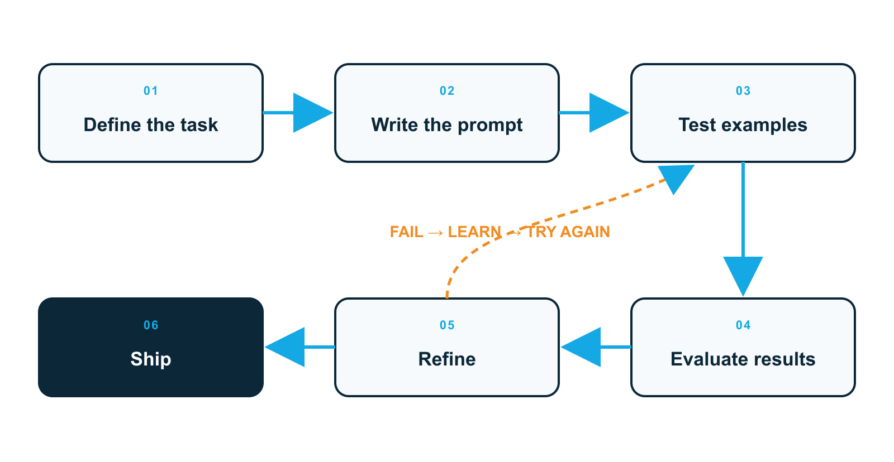
DESIGN LOOP
Prompt engineering is a test-and-refine loop
WHY IT MATTERS
A prompt is a hypothesis about how the model will behave.
SHIP CONDITION
Promote only after examples pass repeatable checks.
First Finance - Arnaud Demes
ADAPTED · GOOGLE
03
Notes:
Use the workflow to make the discipline visible: define the task, write a prompt, test it, evaluate outputs, refine, and ship only after the behavior is repeatable. The loop matters because prompt quality is empirical, not self-evident. Diagram adapted from Google's published prompt design workflow for this finance lesson.
[Sources]
- https://docs.cloud.google.com/gemini-enterprise-agent-platform/models/prompts/prompt-design-strategies
[/Sources]

Slide 4
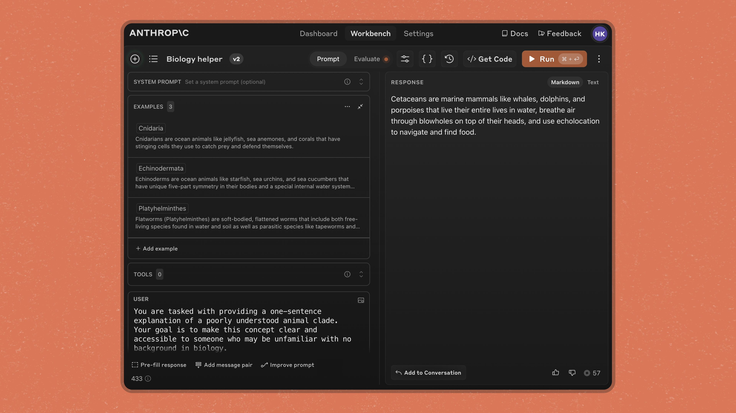
FEW-SHOT LEARNING
Examples teach patterns instructions leave implicit
EXAMPLES TEACH
Tone · structure · evidence use · uncertainty
WHY IT MATTERS
Rules alone leave judgment underspecified.
First Finance - Arnaud Demes
ANTHROPIC · EXAMPLES
04
Notes:
Point to the EXAMPLES 3 label in Anthropic Workbench. Examples are not decoration: they demonstrate the mapping from an input situation to the desired response pattern. For finance, examples can distinguish reported fact, interpretation, and an honest caveat.
[Sources]
- https://claude.com/blog/prompt-improver
- https://platform.claude.com/docs/en/build-with-claude/prompt-engineering/claude-prompting-best-practices
- https://developers.openai.com/api/docs/guides/prompt-engineering
[/Sources]

Slide 5
PROMPT EVIDENCE
More examples reveal more of the desired pattern
01
Zero-shot
RULES
USE
02
One-shot
PATTERN
3–5 examples
03
Few-shot
EDGES
FACT · INFERENCE · CAVEAT
04
Finance example set
JUDGMENT
Use few-shot examples when the task contains judgment, ambiguity, or edge cases.
First Finance - Arnaud Demes
SHOTS
05
Notes:
Zero-shot gives only instructions. One-shot demonstrates one mapping. Few-shot reveals repeated patterns and boundary cases. Anthropic recommends relevant, diverse examples and generally suggests three to five; OpenAI likewise describes few-shot prompting as learning from input/output examples.
[Sources]
- https://developers.openai.com/api/docs/guides/prompt-engineering
- https://platform.claude.com/docs/en/build-with-claude/prompt-engineering/claude-prompting-best-practices
[/Sources]

Slide 6
TWO CONTROLS
Examples steer judgment; schemas enforce shape
EXAMPLES
SCHEMA
Teach what a good fact, inference, or caveat looks like.
Constrain fields, types, enums and required values.
[BEHAVIOR] tone · reasoning · edge cases
[SHAPE] parseable · typed · complete
Use both: one shapes behavior; the other makes the response dependable software input.
First Finance - Arnaud Demes
CONTROLS
06
Notes:
Make the distinction explicit. Examples provide behavioral evidence; the schema provides a machine-checkable interface. Neither replaces the other, and neither establishes factual truth by itself.
[Sources]
- https://developers.openai.com/api/docs/guides/prompt-engineering
- https://developers.openai.com/api/docs/guides/structured-outputs
- https://platform.claude.com/docs/en/build-with-claude/structured-outputs
[/Sources]

Slide 7
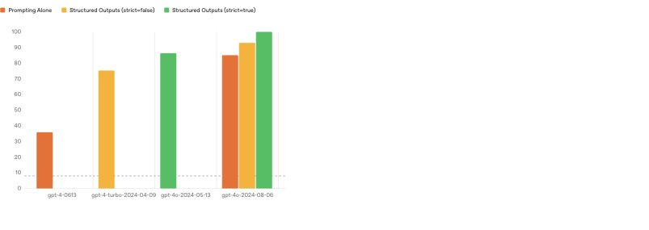
OPENAI EVIDENCE
Strict schemas eliminate format failures in this eval
PUBLISHED RESULT
100% schema match for gpt-4o-2024-08-06
IMPORTANT LIMIT
Schema adherence does not prove the finance.
First Finance - Arnaud Demes
OPENAI · EVAL
07
Notes:
The chart reports OpenAI's 2024 complex JSON-schema evaluation. The gpt-4o-2024-08-06 model with strict Structured Outputs reached 100% schema matching in that published eval. Treat this as evidence for format reliability in the tested setting—not as a universal correctness or truth guarantee.
[Sources]
- https://openai.com/index/introducing-structured-outputs-in-the-api/
- https://developers.openai.com/api/docs/guides/structured-outputs
[/Sources]

Slide 8
FINANCE LIMIT
Schema-valid can still be financially wrong
Candidate: “Data Center growth was entirely recurring.”
01
02
03
04
05
JSON ✓
Fields ✓
Enums ✓
No extras ✓
Evidence ✕
Reject: the filing does not support the word “entirely.”
First Finance - Arnaud Demes
VALIDATION
08
Notes:
The object can be valid JSON and satisfy every schema constraint while the claim remains unsupported. The finance layer must check whether the source excerpt supports the wording, including absolute terms such as “entirely.”
[Sources]
- https://developers.openai.com/api/docs/guides/structured-outputs
- https://www.sec.gov/Archives/edgar/data/1045810/000104581026000021/nvda-20260125.htm
[/Sources]

Slide 9
RELIABILITY PIPELINE
Reliable finance outputs need two gates
01
SEC evidence
GROUND
THEN
02
Instructions + examples
STEER
Finance rules
03
LLM response
GENERATE
EVIDENCE · MEANING · COMPLETENESS
04
Schema gate
SHAPE
Gate 1 makes the object parseable; Gate 2 checks evidence, meaning and completeness.
First Finance - Arnaud Demes
PIPELINE
09
Notes:
Read this as the lesson backbone. Source evidence and examples shape the generation. The schema gate checks the object's structure. Finance rules then check evidence support, semantic meaning, and required coverage before the application accepts the brief.
[Sources]
- https://developers.openai.com/api/docs/guides/prompt-engineering
- https://developers.openai.com/api/docs/guides/structured-outputs
- https://www.sec.gov/Archives/edgar/data/1045810/000104581026000021/nvda-20260125.htm
[/Sources]

Slide 10
PRACTICAL EXERCISE
The notebook tests each control separately
01
Load visible SEC evidence
SOURCE
NOW RUN
02
Compare zero- and few-shot
BEHAVIOR
Notebook 02
03
Generate a typed brief
SCHEMA
15 cells 20 minutes
04
Reject unsupported meaning
6 / 6
Three small calls: two prompt comparisons, then one schema-bound result.
First Finance - Arnaud Demes
NOTEBOOK
10
Notes:
The notebook is deliberately compact. Students make two small unstructured calls to compare zero-shot and genuine few-shot behavior, then one schema-bound call. The final validation exercise proves that valid shape can still fail finance semantics.
[Sources]
- https://developers.openai.com/api/docs/guides/prompt-engineering
- https://developers.openai.com/api/docs/guides/structured-outputs
- https://www.sec.gov/Archives/edgar/data/1045810/000104581026000021/nvda-20260125.htm
[/Sources]

Slide 11
FIRST FINANCE
Quick quiz
Choose the control that solves each problem.
1. What does few-shot prompting teach?
A Exact facts | B Desired patterns | C Source access
2. What does a strict schema guarantee?
A Shape | B Truth | C SEC accuracy
3. Why add finance validation after the schema?
A Meaning can still be wrong | B To add words | C To select a provider
LESSON 02 · 3 QUESTIONS · 3 MINUTES
First Finance - Arnaud Demes
Notes:
Ask for one letter per question, then ask one learner to explain the difference between behavior, shape, and meaning.
[Sources]
- https://developers.openai.com/api/docs/guides/prompt-engineering
- https://developers.openai.com/api/docs/guides/structured-outputs
[/Sources]

Slide 12
FIRST FINANCE
Answers
Three controls solve three different problems.
1. B. Desired patterns
Examples demonstrate the behavior that instructions leave implicit.
2. A. Shape
A strict schema constrains the object; it does not prove the claims.
3. A. Meaning can still be wrong
Finance checks still verify evidence, meaning and completeness.
LESSON 02 · CORRECTION
First Finance - Arnaud Demes
Notes:
Close with the mnemonic: examples for behavior, schemas for shape, finance validation for meaning. Ask learners to name which control they would add when an output is fluent but inconsistent, parseable but unsupported, or missing a required field.
[Sources]
- https://developers.openai.com/api/docs/guides/prompt-engineering
- https://developers.openai.com/api/docs/guides/structured-outputs
[/Sources]

