Slide 1
FIRST FINANCE
One Document or Retrieval?
Choose CAG or RAG before generation
SESSION 03 · 10:45–11:30 · 18 MIN CONCEPTS + 25 MIN NOTEBOOK
First Finance - Arnaud Demes
Notes:
Open with the decision, not the acronyms: should the application send a complete bounded source, or retrieve only the evidence needed? The lesson answers that question before teaching retrieval mechanics.
[Sources]
- https://www.sec.gov/Archives/edgar/data/1045810/000104581026000021/nvda-20260125.htm
- https://developers.openai.com/api/docs/guides/prompt-caching
[/Sources]

Slide 2
CORE DISTINCTION
Prompting controls behaviour; context controls evidence
Prompt
Context
Instructions · examples · output contract
Documents · tools · memory · retrieved evidence
[CONTROLS] what the model should do
[CONTROLS] what the model can use
A better prompt cannot supply missing evidence; more evidence cannot repair a vague contract.
First Finance - Arnaud Demes
BOUNDARY
02
Notes:
Separate two engineering responsibilities. Prompt engineering specifies behaviour and output. Context engineering determines the evidence, tools, and state available to the call. They work together but solve different failures.
[Sources]
- https://developers.openai.com/api/docs/guides/prompt-engineering
- https://developers.openai.com/api/docs/guides/prompt-caching
[/Sources]

Slide 3
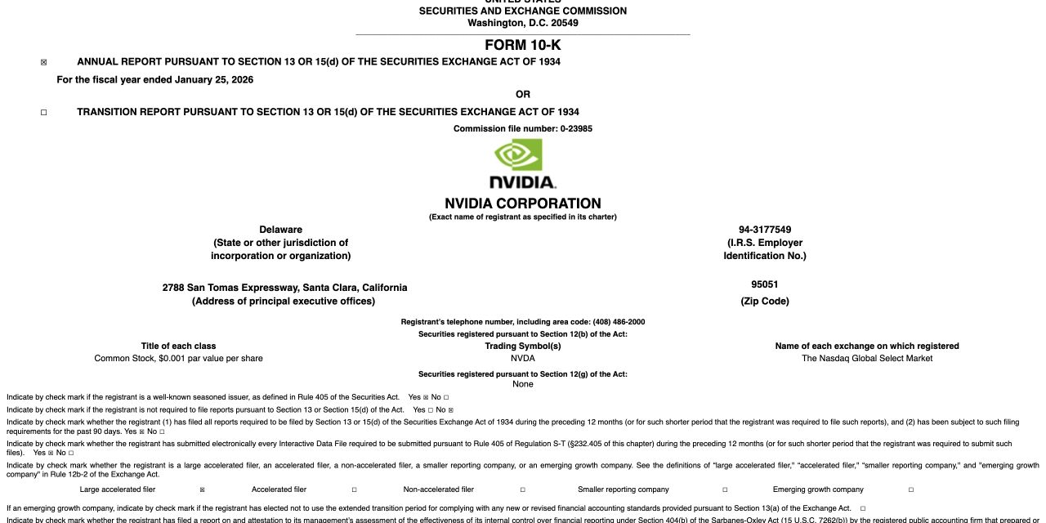
OFFICIAL SOURCE
The source is one 1.98 MB filing—not a pasted fact card
SEC PROVENANCE
FY2026 Form 10-K Accession 0001045810-26-000021
TWO ARTIFACTS
Complete filing for corpus decisions Bounded pack for repeated questions
First Finance - Arnaud Demes
SOURCE
03
Notes:
The repository now preserves the official primary filing. The SEC index records accession 0001045810-26-000021, filing date February 25, 2026, report period January 25, 2026, and primary document size 1,967,816 bytes. The browser-rendered saved document is verified in the course manifest.
[Sources]
- https://www.sec.gov/Archives/edgar/data/1045810/000104581026000021/0001045810-26-000021-index.htm
- https://www.sec.gov/Archives/edgar/data/1045810/000104581026000021/nvda-20260125.htm
[/Sources]

Slide 4
CONTEXT BUDGET
The context window is a budget—not a document bin
01
Reserve answer capacity
OUTPUT
TEACHING WINDOW
02
Add instructions + question
ADD
8,192 tokens
03
Estimate evidence tokens
MEASURE
pack fits filing does not
04
Choose route before generation
ROUTE
Four characters per token is a teaching estimate—not a provider tokenizer.
First Finance - Arnaud Demes
BUDGET
04
Notes:
Budget every component: instructions, evidence, question, and an answer reserve. The course uses a transparent four-characters-per-token estimate so students can see the application rule; production systems should use the selected model's tokenizer and verified limits.
[Sources]
- chapters/03-cag-financial-document.md
- https://developers.openai.com/api/docs/guides/prompt-caching
[/Sources]

Slide 5
PROMPT CACHING
CAG reuses a stable prefix; it does not cache answers
STABLE PREFIX
Request A:
Instructions + source remain exact
policy → source → question A
Request B:
CHANGING SUFFIX
policy → source → question B
Append each new question last
Confirm reuse with cached-token telemetry; latency alone is not proof.
First Finance - Arnaud Demes
CACHE
05
Notes:
OpenAI prompt caching reuses eligible exact prefixes automatically. Put stable content first and dynamic content last. For GPT-5.6 and later, the guide states a 1,024-token minimum cacheable prompt length. A cache stores reusable processing state—not answers—and cached-token telemetry is the evidence of reuse.
[Sources]
- https://developers.openai.com/api/docs/guides/prompt-caching
[/Sources]

Slide 6
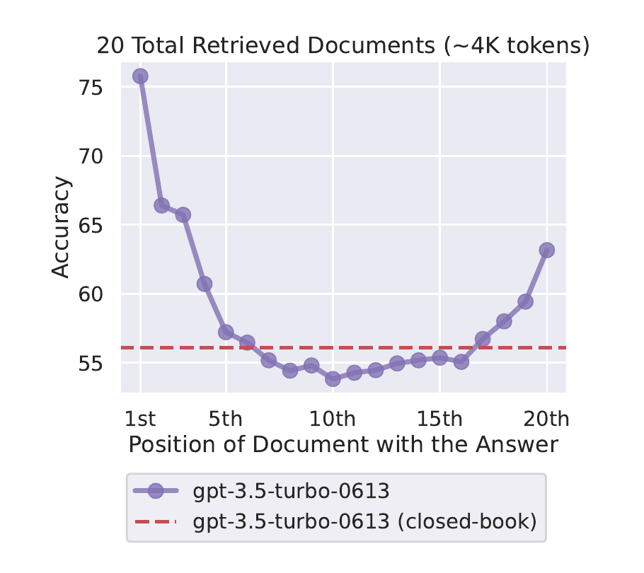
LONG CONTEXT
Fits in the window does not mean every fact gets used
PUBLISHED RESULT
Accuracy changed with the position of the answer-bearing document.
DESIGN IMPLICATION
Evaluate representative questions—not only token fit.
First Finance - Arnaud Demes
ATTENTION
06
Notes:
Liu et al. varied the position of the answer-bearing document among 20 retrieved documents. In the published example shown, accuracy was strongest near the beginning and improved again near the end, with weaker results through much of the middle. The implication is not that every model has the same curve; it is that fit and use must be evaluated separately.
[Sources]
- https://arxiv.org/abs/2307.03172
[/Sources]

Slide 7
ARCHITECTURE CHOICE
Use CAG for complete evidence; RAG for selected evidence
Direct CAG
Retrieval + RAG
Bounded · stable · useful as a whole
Large · changing · selectively relevant
[USE] repeated questions over the same source
[USE] search first · preserve source identity
The route belongs to the application—not to the acronym.
First Finance - Arnaud Demes
CHOICE
07
Notes:
CAG works best when a complete bounded source is useful across repeated questions. RAG earns its infrastructure when the corpus is too large, changes frequently, or each question needs only a selective evidence set. Both still require grounding checks.
[Sources]
- https://developers.openai.com/api/docs/guides/prompt-caching
[/Sources]

Slide 8
ROUTING CONTRACT
Make the route before generation
01
Does the complete artifact fit safely?
FIT
TYPED STATE
02
Is the whole artifact useful?
VALUE
Context Decision
03
Will it remain stable across questions?
STABLE
route · tokens reason
04
Return route + reason
RECORD
Fit is necessary for CAG; usefulness and operations decide whether it is sufficient.
First Finance - Arnaud Demes
DECIDE
08
Notes:
The decision is application state, not an intuition hidden in notebook code. Record the document estimate, prompt overhead, available capacity, route, and reason before generation. Later lessons can log the same typed object as trace data.
[Sources]
- https://developers.openai.com/api/docs/guides/prompt-caching
[/Sources]

Slide 9
NVIDIA CASE
The same filing routes two ways
Context pack
Full filing
~1,598 estimated tokens
~495,672 estimated tokens
[CAG] complete pack · repeated questions
[RAG] select evidence · keep provenance
Same issuer. Same filing. Different application artifact.
First Finance - Arnaud Demes
CASE
09
Notes:
These are deterministic course estimates using four characters per token: approximately 1,598 tokens for the bounded official context pack and 495,672 for the saved complete filing. In the 8,192-token teaching window, the pack routes to CAG and the complete filing routes to RAG.
[Sources]
- https://www.sec.gov/Archives/edgar/data/1045810/000104581026000021/nvda-20260125.htm
[/Sources]

Slide 10
PRACTICAL LAB
The notebook proves the boundary with the real filing
01
Verify SEC file + manifest
CHECK
NOW RUN
02
Build bounded official pack
PACK
Notebook 03
03
Ask two stable-prefix questions
CALL
15 cells 25 minutes
04
Route the complete filing to RAG
DECIDE
Four executable figures; same notebook code with Ollama or OpenAI.
First Finance - Arnaud Demes
NOTEBOOK
10
Notes:
The compact notebook now has 15 cells. Students verify the official file, build the source-derived pack, visualize the budget, ask two repeated-prefix questions, inspect cache telemetry when available, and route the complete filing to RAG. No synthetic appendix is required.
[Sources]
- https://www.sec.gov/Archives/edgar/data/1045810/000104581026000021/nvda-20260125.htm
- https://developers.openai.com/api/docs/guides/prompt-caching
[/Sources]

Slide 11
FIRST FINANCE
Quick quiz
Choose one answer for each question.
1. Which artifact routes to CAG in this lab?
A Bounded official pack | B Complete filing | C Neither
2. What proves prompt-cache reuse?
A Lower latency | B Cached-token telemetry | C A fluent answer
3. When does RAG earn its complexity?
A Always | B When evidence must be selected | C When answers are short
LESSON 03 · 3 QUESTIONS · 3 MINUTES
First Finance - Arnaud Demes
Notes:
Ask learners to answer before showing the correction. The questions test the three architecture boundaries: artifact choice, cache evidence, and retrieval need.
[Sources]
- chapters/03-cag-financial-document.md
- https://developers.openai.com/api/docs/guides/prompt-caching
[/Sources]

Slide 12
FIRST FINANCE
Answers
Check the idea, not only the letter.
1. A. Bounded official pack
Its complete evidence is useful and fits the teaching budget.
2. B. Cached-token telemetry
Latency varies; the provider's cached-token field records reuse.
3. B. When evidence must be selected
Retrieval earns its complexity when full context is too large or selectively useful.
LESSON 03 · CORRECTION
First Finance - Arnaud Demes
Notes:
Close by resolving the opening question. For this application, the source-derived bounded pack uses CAG and the complete filing uses RAG. The decision is recorded before generation, and neither route removes the need for grounding.
[Sources]
- chapters/03-cag-financial-document.md
- https://developers.openai.com/api/docs/guides/prompt-caching
- https://www.sec.gov/Archives/edgar/data/1045810/000104581026000021/nvda-20260125.htm
[/Sources]

